Slide 1
Chest X ray in TB

Slide 2
Aims of TB CXR interpretation
To differentiate CXR not suggestive of TB; CXR suggestive of TB; CXR suggestive of TB with possible differential diagnosis
To prescribe CXR within diagnosis algorithm considering clinical and bacteriology (smear, Xpert, LPA, culture, DST)

Slide 3
Why CXR?
CXR is cost-effective with use of digital Xray and can be free of charge for presumed TB patients
CXR interpretation can be centrally/externally controlled with computerized digital Xray improving reliability
CXR can filter presumed TB patients eligible for Xpert
CXR reading has been neglected for a long time and health workers have forgotten how to read it

Slide 4
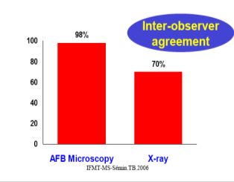
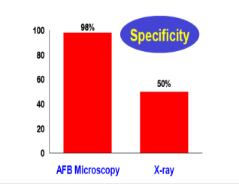
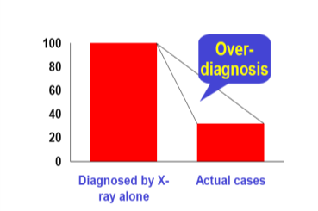
CXR challenges
CXR difficult reading;
low specificity;
3) risk of overdiagnosis
Rule 1: Physicians need to be trained on CXR interpretation
Rule 2: No diagnosis of TB with CXR alone
Notes:
4

Slide 5
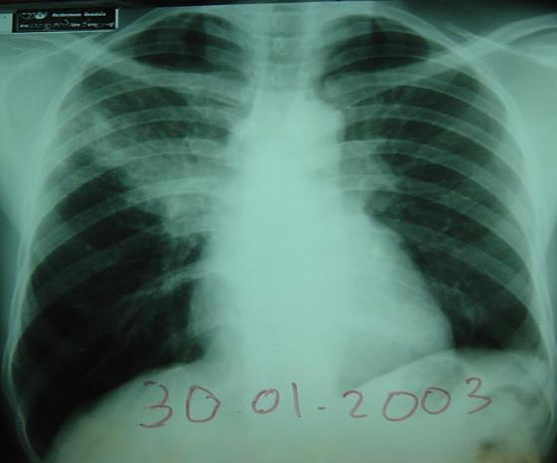
Observation
CENAT Phnom Penh
M 42y old smoker,
hemoptysis
RSL Opacity
AFB neg
“Dg of TB M(-)by tb expert”
TB treatment for
8 monthes with no improvment
It is a bronchial cancer
Rule 3 : No TB diagnosis in case of heavy smoker without bronchoscopy
Notes:
5

Slide 6
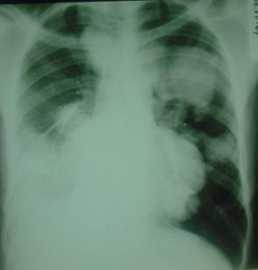
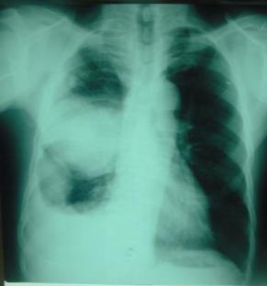
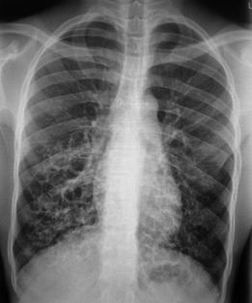
Mistakes
“ Métastasis
Bronchial cancer
bronchiectasis
bronchiectasis
60 y old smoker, hemoptisy
30 y old. Past history of
amputation
Man hemoptisy, repeted pulmonary infections
Notes:
6

Slide 7
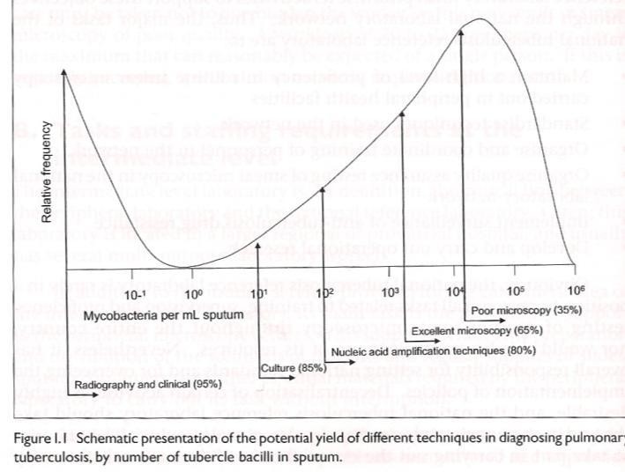

CXR opportunities: 1) high sensitivity, 2) high cost effectiveness, 3) complement Xpert
From “Priorities for TB Bacteriology Services in LICs“, 2007 IUATLD
Poor Sm exam
Quality Sm exam
CXR and clinics
95%
Xpert 80%
Culture 85%
Notes:
7

Slide 8
Physician must use all the tools he had for TB diagnosis
Past history and notion of possible contagion
Clinical signs
Skin test for children only
Chest X ray
Anatomopathology
Biological examination
Bacteriological examination
Ex pleural effusion : is pleural biopsy available ?
anatomopathologist available ?
Notes:
8
The patient’s history, clinical signs and symptoms, results of tst and chest-X-ray, as well as the non specific biologial findings and the histopathology analysis findings are very important to diagnose tuberculosis, but the specific diagnosis is based on the detection of the bacterium M. tuberculosis.

Slide 9
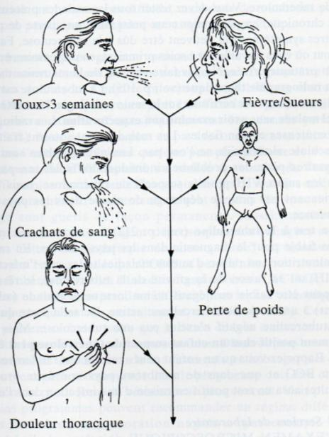
Classical clinical signs,
But non specific
Cough> 2-3 weeks
Fever and sweet
Hemoptysis = strongly indicative of TB
But other possible etiologies:
Bronchial cancer
Bronchiectasis inactive sequella
Pneumonia - Aspergilloma
Pulmonary embolism
Mitral stenosis, acute pulmonary edema….
hemoptisy
Weigh loss
Sputum analysis for AFB X 2
Notes:
9

Slide 10
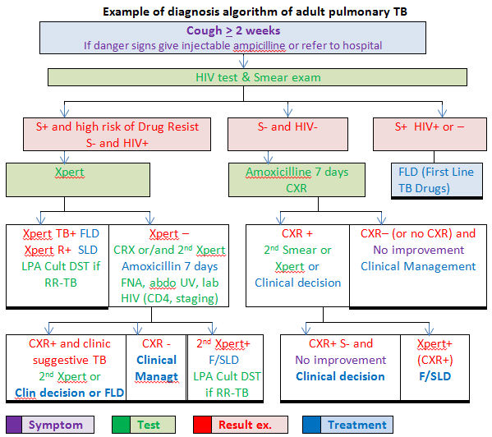

Slide 11
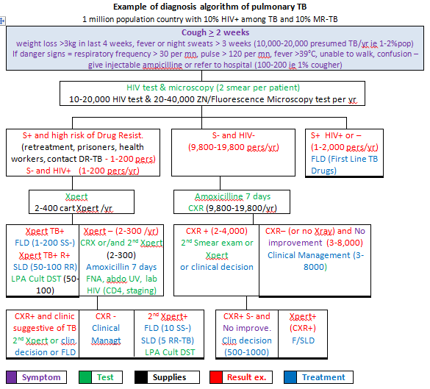

Slide 12
When prescribing Chest X ray
1. for adult presumed TB patients
Smear + : TB treatment whithout CXR
Smear negative & HIV+ : CXR (+ Xpert if abnormal CXR)
Smear negative & HIV - & acute respiratory symptoms/disease : CXR (+ Xpert if abnormal CXR)
Smear negative & HIV - & symptoms after non specific antibiotic : CXR (+ Xpert if abnormal CXR)

Slide 13
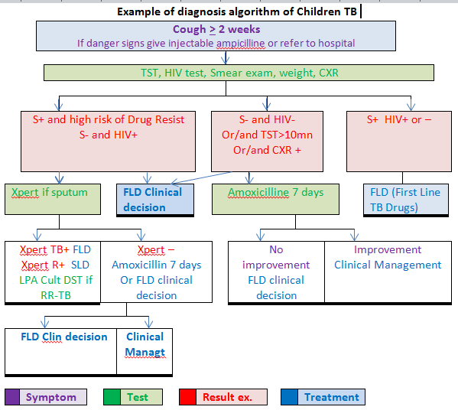

Slide 14
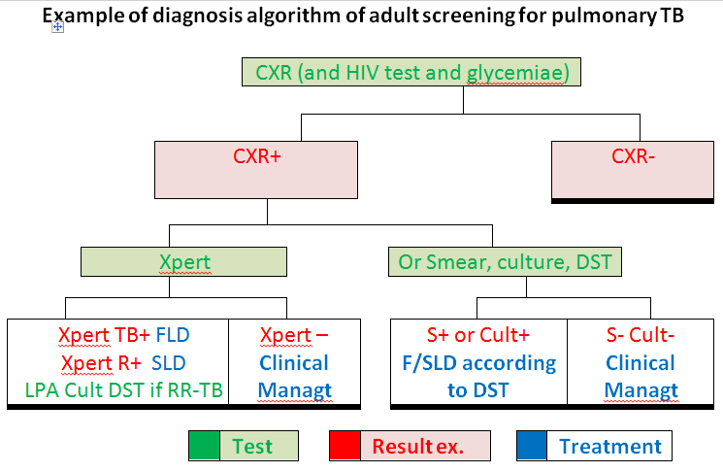

Slide 15
2. For children presumed TB patients
Symptomatics, TST >10mn, eventually household contact of TB : CXR
3. For risk group population (ie TB incidence > than general population)
CXR as first screening exam for all population once to twice per year (+ Smear if abnormal CXR + Xpert or culture)

Slide 16
Chest X ray does not make alone TB diagnosis
because pictures are rarely specific:
Suggestive TB pictures: Nodules, macronodules, cavited nodules, infiltrates and cavities.
Not suggestive pictures of TB: ex:not cavited round opacity >3cm
CXR very useful for diagnosis of TB S - especially
in case of AIDS but differential diagnosis are numerous
CXR is not recommended at the end of TB treatment. But it
can be very useful for sequellea assessment
.
Notes:
16
The patient’s history, clinical signs and symptoms, results of tst and chest-X-ray, as well as the non specific biologial findings and the histopathology analysis findings are very important to diagnose tuberculosis, but the specific diagnosis is based on the detection of the bacterium M. tuberculosis.

Slide 17
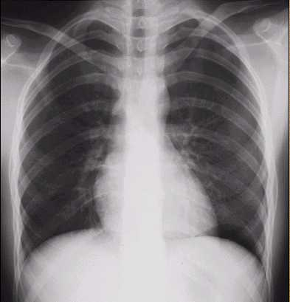
CXR (N)

Slide 18
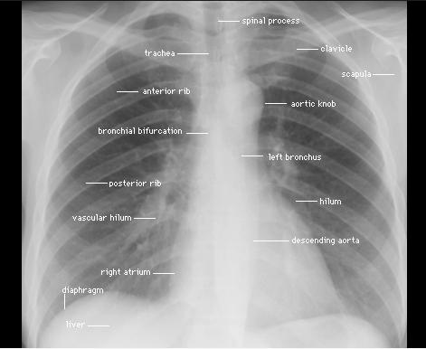
CXR (N)

Slide 19
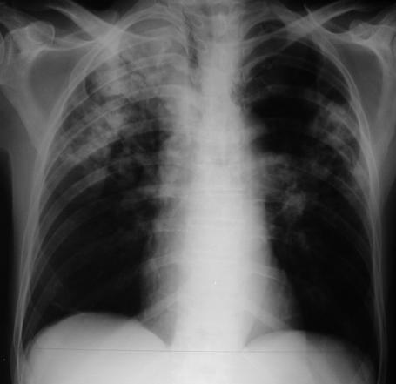
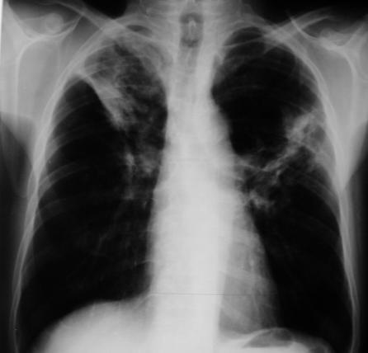
TB
AFB +
Healed TB after treatment
AFB neg. Do not confuse with TBM-
Notes:
19

Slide 20
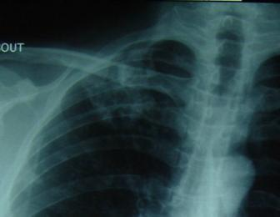
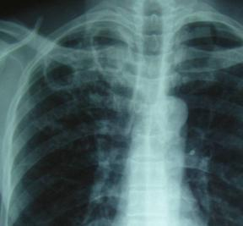
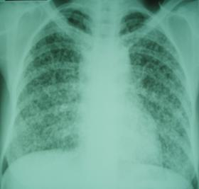
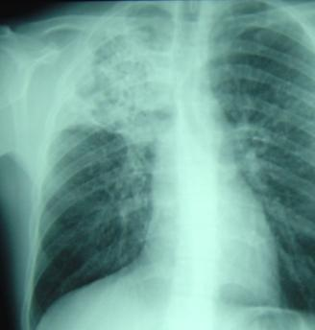
Infiltrate
AFB+/-
Cavities
AFB +
Milliary
AFB -
TB pneumonia
AFB+ +
TB adenopathies
AFB -
TB Pericarditis
AFB -
Notes:
20

Slide 21

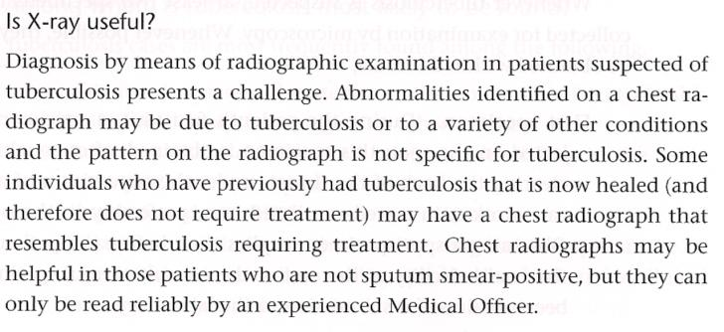
Sequella
problem

Slide 22
Active versus inactive lesions
Chest plain films have limited value for this purpose, since they can only establish that the lesion is stable, and stable lesions can contain active bacilli.
CT can add valuable information for the detection of activity
Branching opacities, cavitations or consolidation are clear signs of active tuberculosis

Slide 23
Primary tuberculosis (PT)
• lymphadenopathy, which is observed in almost all patients. Generally
unilateral, with the hilar and paratracheal regions most often affected and
less frequently the subcarinal nodes.
• Parenchymal consolidation is a common associated feature, but
lymphadenopathy is often the only radiological finding
CT is more sensitive than plain films for the detection of lung lesions and enlarged lymph
nodes.
• Tuberculous pleurisy is more common in primary than post primary disease.

Slide 24
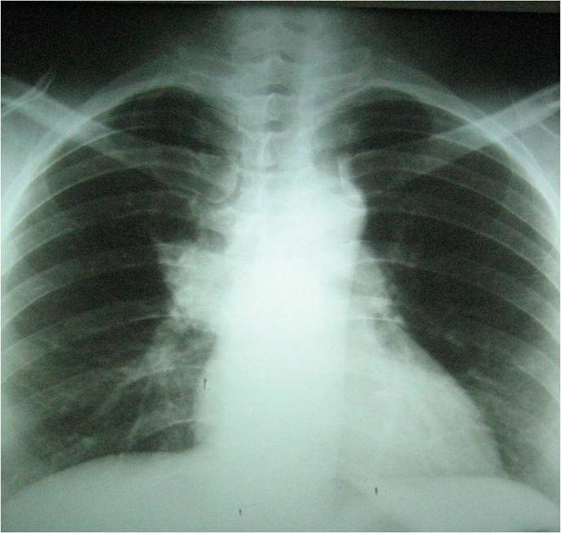
CXR: large right hilium

Slide 25
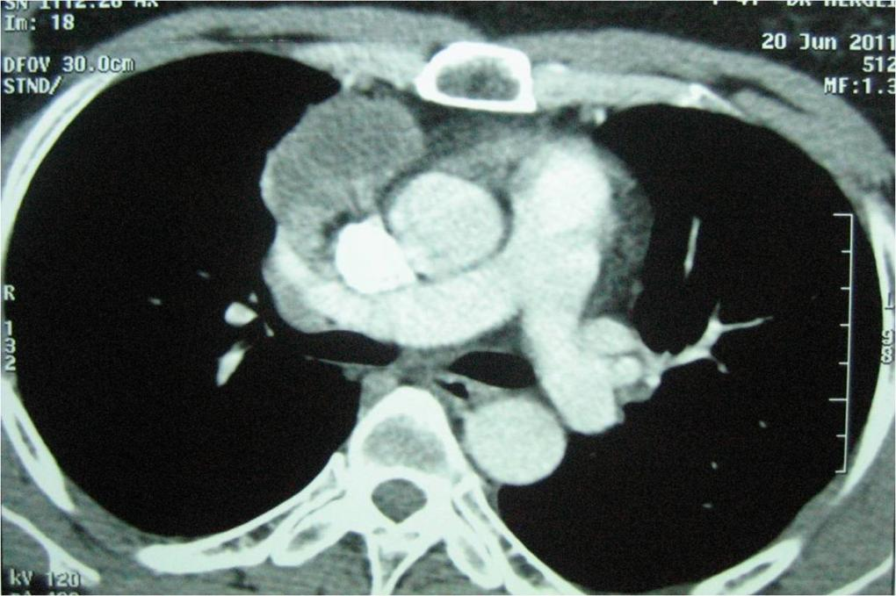
Same patient. Computed tomography of the chest, mediastinal window: right hilar lymph node with a necrotic content

Slide 26
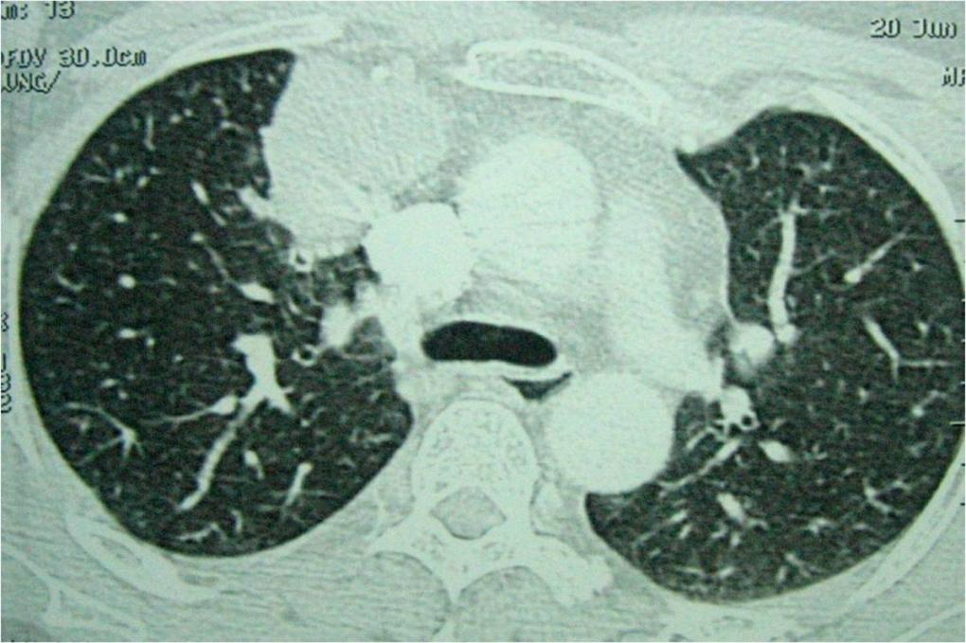
Same patient.Computed tomography of the chest, parenchymal window. No parenchymal lesion associated

Slide 27
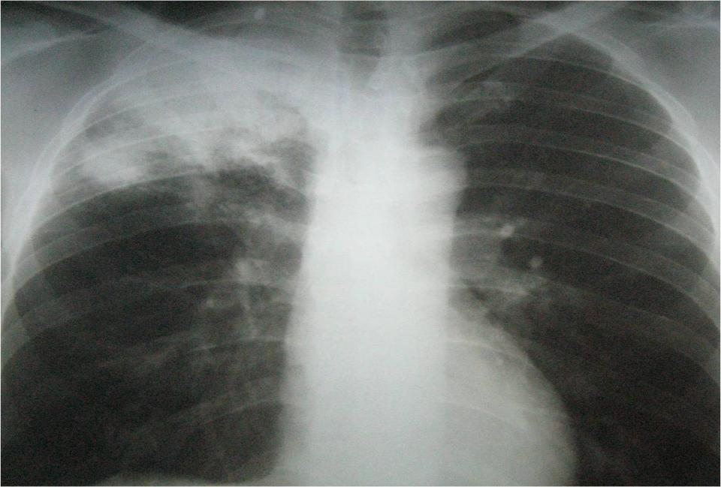
Chest radiography: air space consolidation of the appical right lobe, location highly suggestive of tuberculosis.

Slide 28
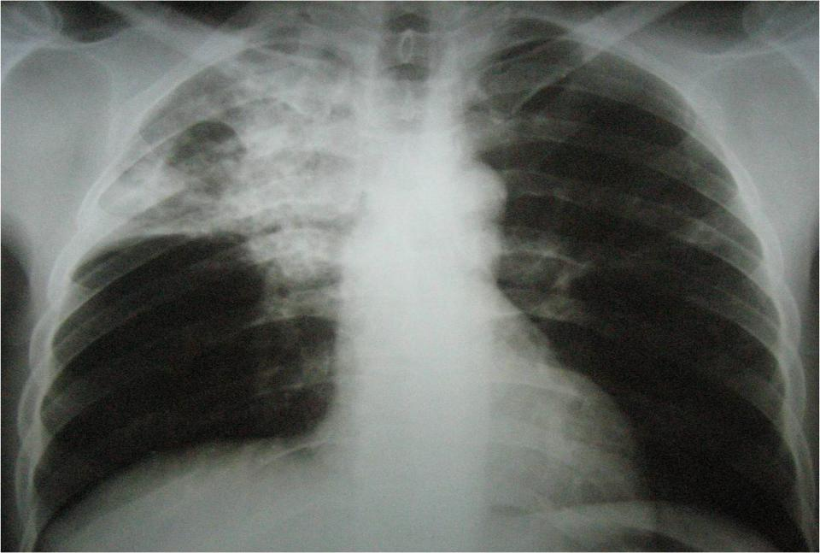
CXR shows cavitation within an air space consolidation of the right upper lobe.

Slide 29
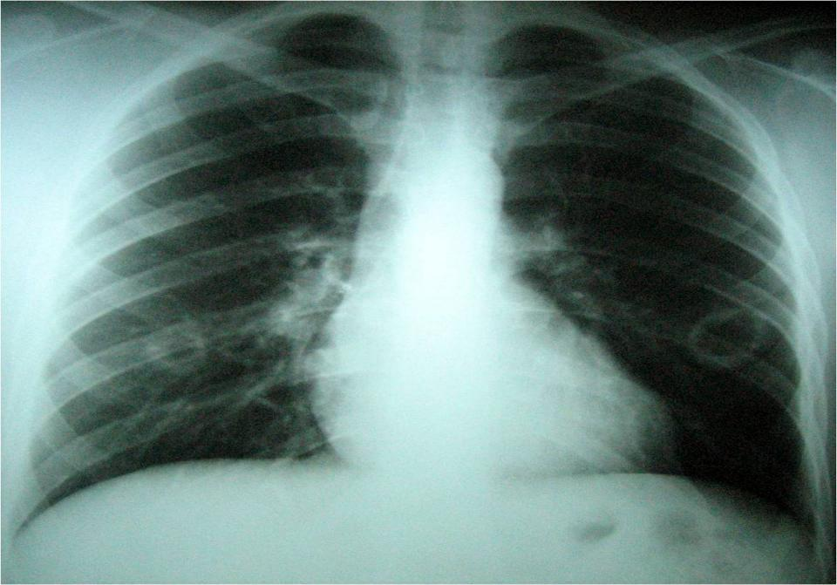
CXR shows bilateral cavitation.

Slide 30
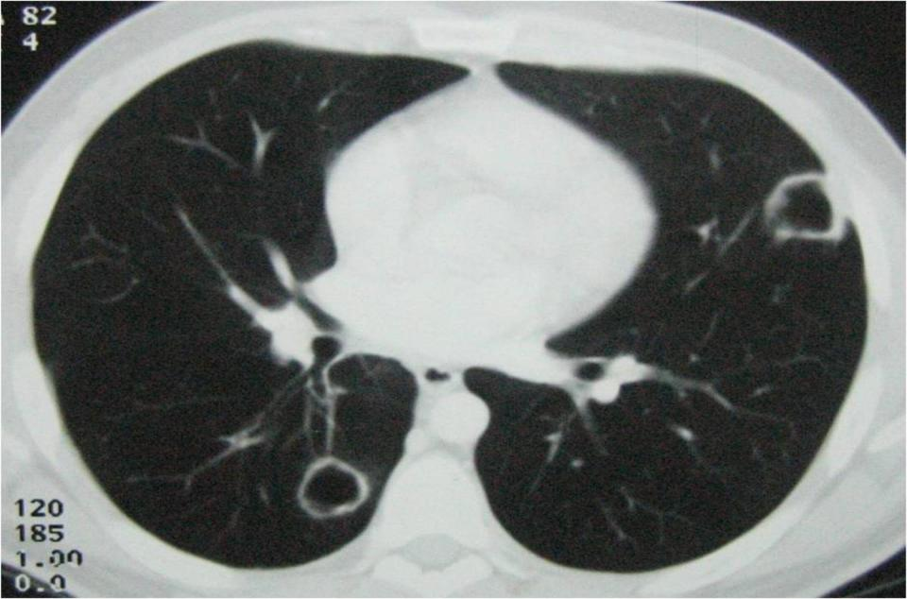
CT of the chest of the same patient. Bilateral cavitations are better established.

Slide 31
Postprimary tuberculosis (PPT) / relapse
- Reactivation of a previous tuberculous lesion: chronic granulomatous infection
- Histology: caseation necrosis
- Radiologically:
• Consolidation: patchy, poorly defined segmental.
- Mainly apical and posterior segments of the upper lobes
- less frequently in the superior segment of the lower lobe (typical distribution: high
concentration of oxygen in the upper lung areas, increased virulence of the bacilli, and
- less effective lymphatic drainage of these segments as compared to other areas of the
lung)
• Cavitation: characteristic of PPT.
Appears in around half of patients. They may be single or multiple
Usually have thick walls with irregular margins
Air-fluid level: possible.
• Nodular opacities: associated with the cavitations or alone
- "tree-in-bud"pattern: consisting of multiple branching linear structures (bronchogenic
dissemination of the disease). Tree-in-bud opacities are also seen in other infections, but when visualized in combination with cavitations or nodular opacities in the upper and posterior lung segments and in the appropriate clinical setting, a specific diagnosis of pulmonary tuberculosis can be established.
- hilar and mediastinal lymphadenopathy is uncommon.

Slide 32
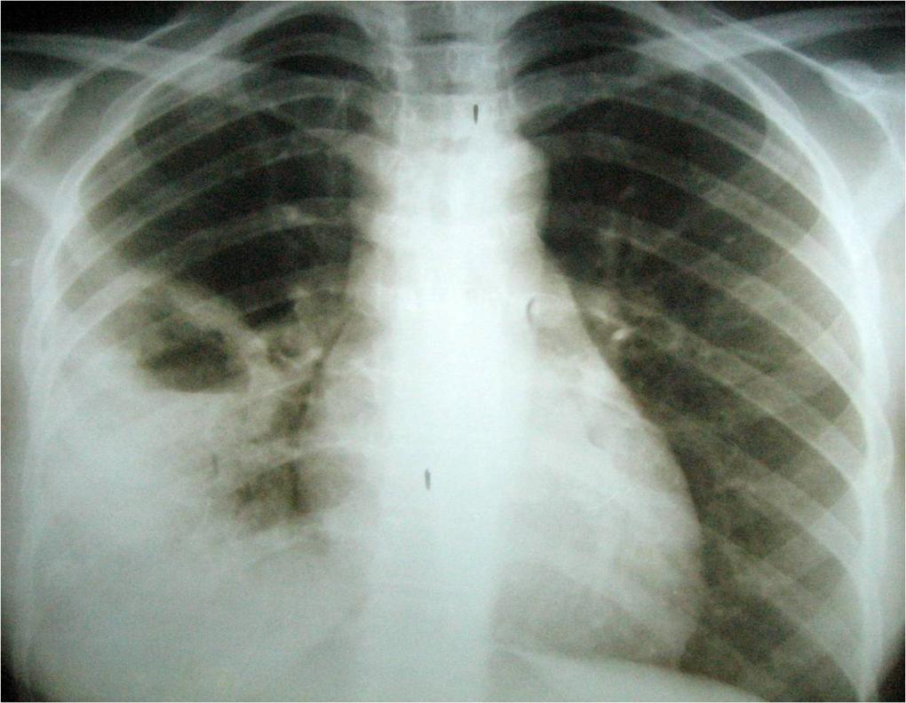

Slide 33
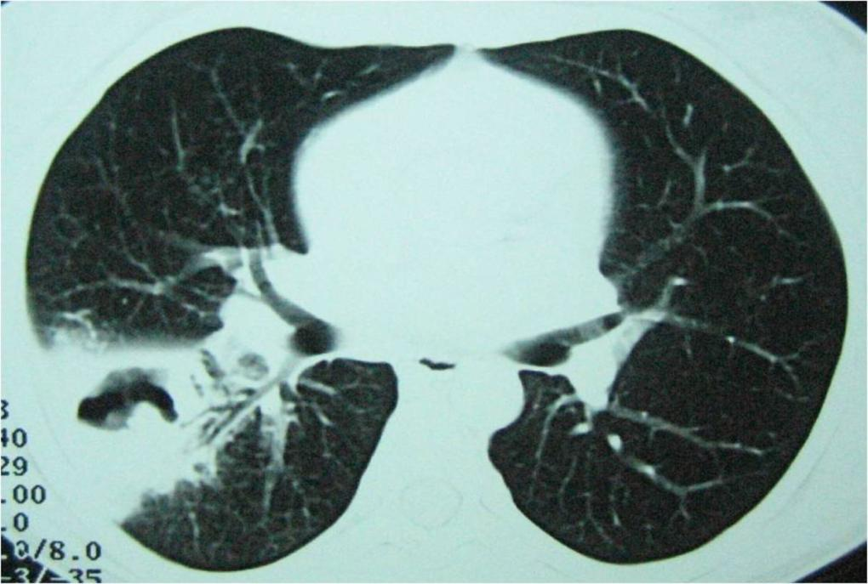
HRCT of the same patient: cavitation in the right Fowler segment with thick, irregular wall. Bronchial sign is also visible.

Slide 34
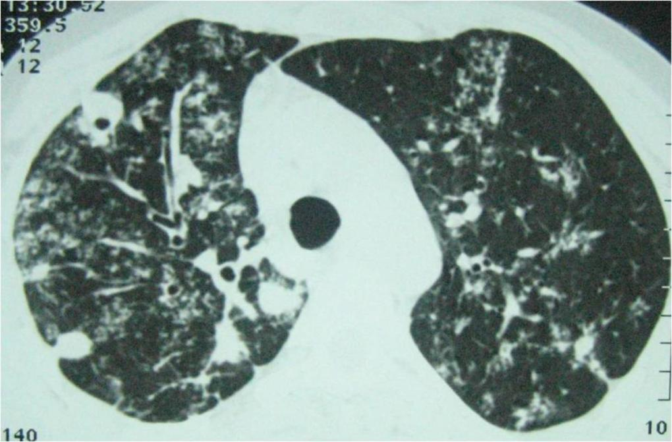
Postprimary tuberculosis. HRCT: characteristic pattern of tree in bud opacities and lung cavity.

Slide 35
Miliary disease
- Widespread dissemination of tuberculosis by hematogenous spread.
- Can occur in both primary and postprimary tuberculosis.
Commonly seen in the elderly and immunocompromised patients.
- Multiple diffuse nodules, 1- 3mm in size
- Chest plain films provide diagnostic features in most cases, but late in the evolution.
- CT: accurate early diagnosis: randomly distributed micronodular pattern.
- This type of random distribution is also observed in hematogenous.
Differentiel diagnosis: metastatique miliary, but the nodules are
larger.

Slide 36
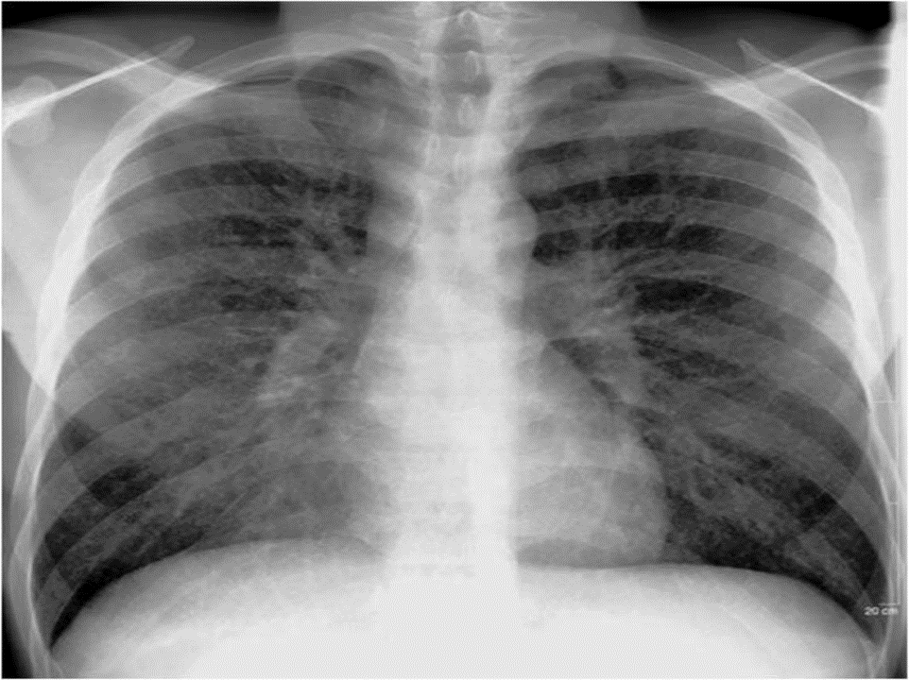

Slide 37
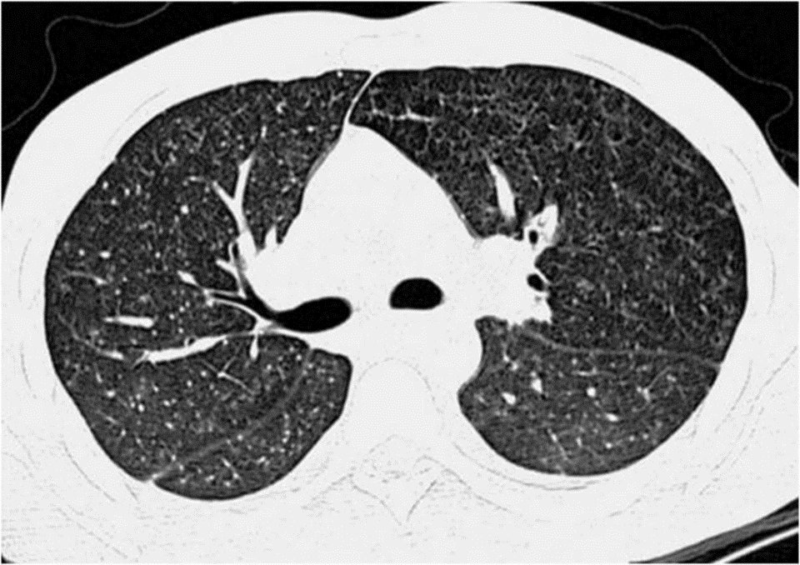
Miliary TB. HRCT: multiple nodules

