Slide 1
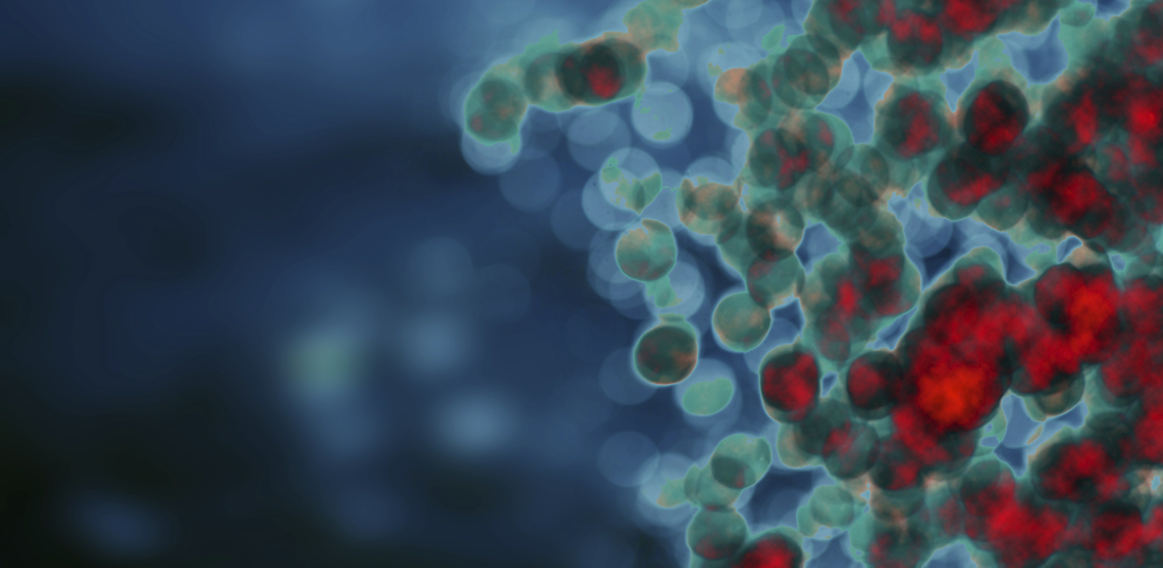
LYMPHOMA. MYELOFIBROSIS

Slide 2
LYMPHOMA
Lymphoma is a cancer of white blood cells that arises in the lymphatic system.
Types of Lymphoma:
Hodgkin's lymphoma frequently develops from B-cells, but may also develop from T-cells.
The majority of lymphoma cases are non-Hodgkin lymphoma

Slide 3
LYMPHOMA. Epidemiology
2^{d -} 3rd most common cancer
Annual incidence of 13.2 per million children
Major types include Hodgkin's and Non-Hodgkin's lymphoma (NHL):
  60% are NHL
  40% Hodgkin’s Lymphoma:

Slide 4
WHO/REAL Classification of Lymphoid Neoplasms
B-Cell Neoplasms
Precursor B-cell neoplasm
Precursor B-lymphoblastic leukemia/lymphoma
(precursor B-acute lymphoblastic leukemia)
Mature (peripheral) B-neoplasms
B-cell chronic lymphocytic leukemia / small lymphocytic lymphoma
B-cell prolymphocytic leukemia
Lymphoplasmacytic lymphoma‡
Splenic marginal zone B-cell lymphoma
(+ villous lymphocytes)*
Hairy cell leukemia
Plasma cell myeloma/plasmacytoma
Extranodal marginal zone B-cell lymphoma of MALT type
Nodal marginal zone B-cell lymphoma
(+ monocytoid B cells)*
Follicular lymphoma
Mantle cell lymphoma
Diffuse large B-cell lymphoma
Mediastinal large B-cell lymphoma
Primary effusion lymphoma†
Burkitt’s lymphoma/Burkitt cell leukemia§
T and NK-Cell Neoplasms
Precursor T-cell neoplasm
Precursor T-lymphoblastic leukemia/lymphoma
(precursor T-acute lymphoblastic leukemia
‡ Formerly known as lymphoplasmacytoid lymphoma or immunocytoma
^{II} Entities formally grouped under the heading large granular lymphocyte
leukemia of T- and NK-cell types
* Provisional entities in the REAL classification
Mature (peripheral) T neoplasms
T-cell chronic lymphocytic leukemia / small
lymphocytic lymphoma
T-cell prolymphocytic leukemia
T-cell granular lymphocytic leukemia^{II}
Aggressive NK leukemia
Adult T-cell lymphoma/leukemia (HTLV-1+)
Extranodal NK/T-cell lymphoma, nasal type#
Enteropathy-like T-cell lymphoma**
Hepatosplenic γδ T-cell lymphoma*
Subcutaneous panniculitis-like T-cell lymphoma*
Mycosis fungoides/Sézary syndrome
Anaplastic large cell lymphoma, T/null cell,
primary cutaneous type
Peripheral T-cell lymphoma, not otherwise characterized
Angioimmunoblastic T-cell lymphoma
Anaplastic large cell lymphoma, T/null cell,
primary systemic type
Hodgkin’s Lymphoma (Hodgkin’s Disease)
Nodular lymphocyte predominance Hodgkin’s lymphoma
Classic Hodgkin’s lymphoma
Nodular sclerosis Hodgkin’s lymphoma (grades 1 and 2)
Lymphocyte-rich classic Hodgkin’s lymphoma
Mixed cellularity Hodgkin’s lymphoma
Lymphocyte depletion Hodgkin’s lymphoma
† Not described in REAL classification
§ Includes the so-called Burkitt-like lymphomas
** Formerly known as intestinal T-cell lymphoma
# Formerly know as angiocentric lymphoma

Slide 5
LYMPHOMA
Risk Factors:
Non-Hodgkin lymphoma is more common in developed regions of the world and in men.
Infection with the Epstein Barr virus and other such viruses increases the risk of developing lymphoma.
Symptoms:
Swollen lymph nodes, unexplained weight loss, fever, extreme night sweats, and severe "itchiness".
Symptoms vary with the location in which the cancer arises.
Detection and Diagnosis
Lymphatic tumors may be detected by a USD, CT scan, an MRI, or a PET scan;
Biopsy and pathology;
BCL-6, p53, and HDM2 are all genes involved in the development of lymphoma;
immunophenotyping, molecular, cytogenetics, and other techniques are used for diagnosis.

Slide 6
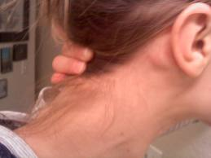
Enlarged Cervical lymphnodes

Slide 7
Growgh
Indolent – these lymphomas grow slowly. The majority of NHLs are considered indolent. Indolent lymphomas are generally considered incurable with chemotherapy and/or radiation therapy.
Aggressive – these lymphomas have a rapid growth pattern. This is the second most common form of NHL and are curable with chemotherapy.
Very Aggressive – these lymphomas grow very rapidly. They account for a small proportion of NHLs and can be treated with chemotherapy. Unless treated rapidly, these lymphomas can be life threatening.

Slide 8
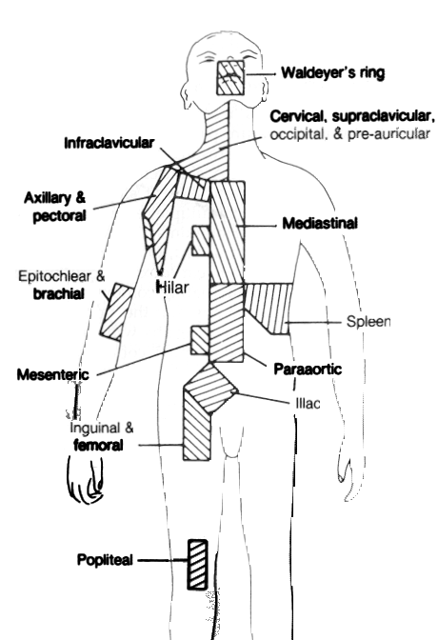
Anatomic definition of lymph node regions used for staging purposes

Slide 9
Approach to Lymphadenopathy
Palpable LAD in children – “the rule”
LAD in adults
  < 1cm considered “normal” (< 2cm in groin)
LAD is normal response to foreign antigens
  May include infections, allergens, autoimmune targets
Pathologic LAD due to proliferation or infiltration

Slide 10
Normal B cell Development
Pre B cell
IgM
B cell
Follicles
Bone
Marrow
Travel
Lymph Node

Slide 11
B cell finds “meaning”
“meaning”
B cell activation
Germinal Center
Formation

Slide 12
Germinal Center Activity
Proliferation
Signals
“Never die”
Signals
Mutation
Signals
Survival
Signals
Germinal Center

Slide 13
Plasma Cells travel back to bone marrow
Memory B cell
“Activated B cell”
Plasmacytoid Cell
IgM

Slide 14
Causes of lymphadenopathy (LAD)
Infections
  Bacterial – pyogenic, cat-scratch, syphilis, tularemia, plague
  Mycobacterial – tuberculosis, leprosy, MAI
  Fungal – histoplasmosis, coccidioidiomycosis
  Chlamydial – lymphogranuloma venereum
  Parasitic – toxo, trypanosomiasis, filariasis
  Viral – EBV, CMV, rubella, HIV, hepatitis C
Inflammatory disorders
  Autoimmune - Rheumatoid arthritis, SLE
  Drugs – serum sickness, phenytoin
  Castleman’s disease
  Histiocytic diseases (SHML, LH)
  Kawasaki syndrome
  Kimura’s disease
  Sarcoidosis
Storage diseases
  Gaucher’s, Neimann-Pick disease
  Amyloidosis
Endocrinopathies
  Hyperthyroidism, adrenal insufficiency
Cancer
  “Immune system” cancers
  Metastatic carcinoma

Slide 15
The Most Frequent Causes
Unexplained (?)
Infection
Immune system disorders
Immune system malignancies (Lymphoma)
Metastatic carcinoma
Other

Slide 16
Approach to patient with LAD
Does the patient have a known illness that causes LAD? Treat and monitor
Is there infection? Treat and monitor.
Is the LAD large (> 3cm) or have unusual characteristic (i.e. hard)? Biopsy.
If none are true, monitor 2 to 6 weeks, if persistent or large, biopsy.

Slide 17
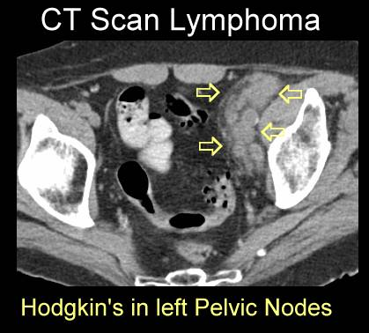

Slide 18
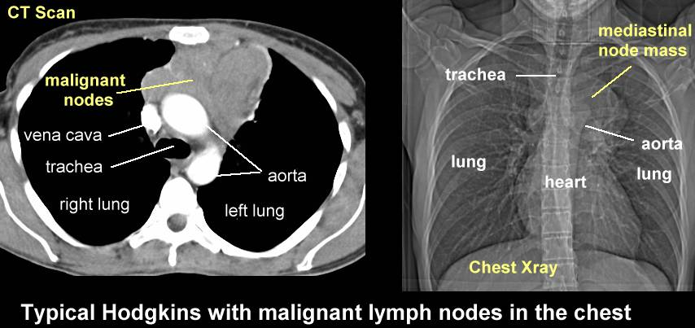

Slide 19
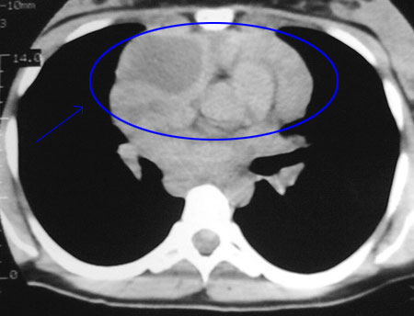
CHEST CT

Slide 20
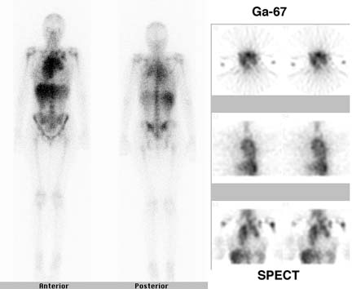
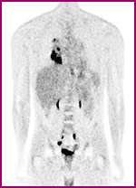
Nuc Med & PET scans

Slide 21
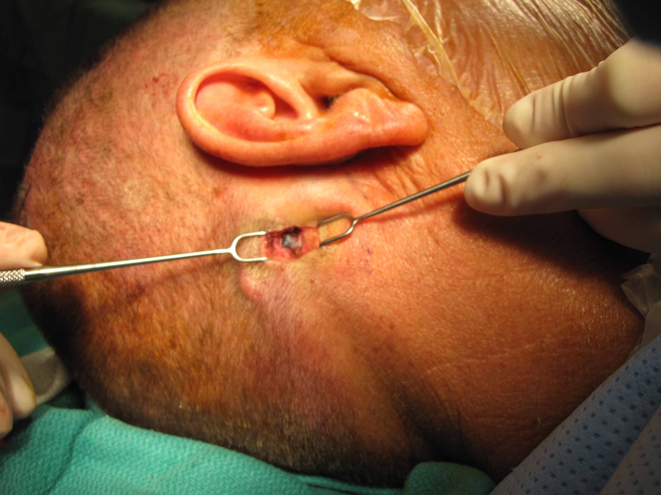
Lymphnode Excisional or Incisional Biopsy

Slide 22
LYMPHOMA
Treatment:
Specific treatment plans for lymphoma depend on the type and stage of disease.
Non-Hodgkin's lymphoma can be treated with surgery, radiation therapy, chemotherapy, stem cell transplantation, or targeted treatments.
Hodgkin's disease is treated with chemotherapy, radiation and bone marrow transplantation

Slide 23
HODGKIN’S LYMPHOMA. Epidemiology
5 % of all ped. cancer.
Incidence by age is bimodal
  In industrialized countries, peak- late 20’s and after 50’s
  In developing countries, early peak is before adolescence
Epidemiologic studies demonstrate 3 forms:
  Childhood form (<14 years)
  Young adult form (15-34)
  Older form (55-74).
More common in patients with congenital and acquired immune system abnormalities
  Ataxia telangiectasia
  AIDS

Slide 24
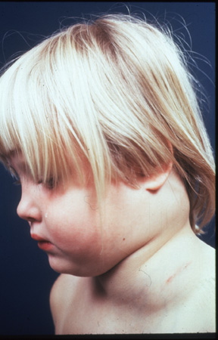
HODGKIN’S LYMPHOMA.
Risk factors
Studies have suggested several infectious agents:
  EBV
  Human Herpes Virus 6
  CMV
High EBV titers and the presence of EBV genomes in Reed-Sternberg cells
Surface markers suggest T-cell or B-cell lineage;
Higher concordance in monozygotic twins.

Slide 25
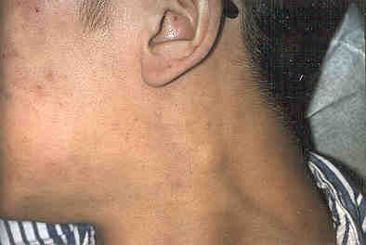
HODGKIN’S LYMPHOMA.
Clinical Presentation
The most common presentation in children is asymptomatic cervical lymphadenopathy
  Painless, firm,not inflammatory
Extension from one lymph node group to another
Fever > 38ºC on 3 consecutive days
Drenching night sweats
Unexplained 10% wt loss
2/3 of patients have mediastinal adenopathy at presentation
  Cough or SOB if significant compression
Infrequently presents as axillary or inguinal adenopathy

Slide 26
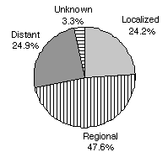
HODGKIN’S LYMPHOMA.
Extranodal Metastasis
Hodgkin’s spreads through the lymphatic system
Most frequent sites of extranodal involvement in decreasing order of frequency
  bone marrow, bone,liver, lung, pericardium or pleura
Paraneoplastic syndromes
  More likely seen in relapsing patients with widespread disease and NHL
  Hematologic, skin, nervous system, kidneys

Slide 27
HODGKIN’S LYMPHOMA.
Diagnostic workup
Labs:
  CBC with diff
  ESR
  LFTs, Renal function
  Alkaline phosphatase; ferritin, copper elevated
  Immune response decreased,
  Cytokines Il 1, 6, TNF- B, Il 2 elevated
Cervical area US/CT/MRI
Thoracic imaging
  Chest Xray, CT scan of chest (ant/middle mediastinum)
    best visualization of lung parenchyma, pleura
Abdominal imaging
  US/CT/MRI
  Lymphangiogram
    Most reliable method of detecting retroperitoneal lymph nodes
    Rarely done in children
Gallium Scan/ PET scan
  Search the body for other involvement
Bone marrow biopsy
  Recommended for stage IIB or higher
  Bone marrow involvement at presentation is rare
Bone scan
  Recommended for patients with bone pain, elevated alk phos, or extranodal disease
Tissue is needed for definitive histologic diagnosis
  Sample the node that is most accessible
PE with careful attention and measurement of lymph nodes

Slide 28
CHEST CT

Slide 29
Nuc Med & PET scans

Slide 30
Hodgkin Biology
Reed-Sternberg CellS is a “crippled” germinal center B cell
  does not have normal B cell surface antigens
  micromanipulation of single RS followed by PCR demonstrates clonally rearranged, but non functional immunoglobulin genes
    somatic mutations result in stop codon (no sIg)
    no apoptotic death malignant transformation
  unclear how this occurs ? EBV
  unclear how cells end up with RS phenotype

Slide 31
HODGKIN’S LYMPHOMA. Reed-Sternberg CellS

Slide 32
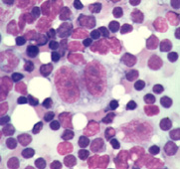
Reed-Sternberg Cells

Slide 33
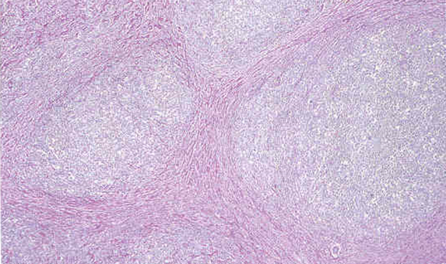
Nodular Sclerosing
Hodgkin Lymphoma

Slide 34
HODGKIN’S LYMPHOMA.
Histologic Subtypes
Rye Classification (classical Hodgkin Disease)
  Nodular Sclerosing
Most common (50-75% of all cases of HD, about 40% of younger patients and 70% of adolescents with HD)
Thickened lymph node capsule, organized collagenous bands forming circumscribed nodules
Often involves lower cervical, supraclavicular, and mediastinal nodes
  Immunophenotyping: Rees-Sternberg cells CD30 and CD15 positive
  Mixed Cellularity
15-30% of all cases of HD
Common in younger children (<10 years)
Most frequent subtype in HIV patients
Many Reed-Sternberg cells
LN has inflammatory background with lymphocytes, plasma cells, eosinophils, histiocytes, and malignant reticular cells
Frequently presents with advanced disease and extranodal extension at diagnosis
  Lymphocyte depletion
    Least common, Least favorable;
Rare in children
May actually be diffuse large cell lymphoma
Many bizarre, malignant reticular cells
Many RS cells
Few lymphocytes
Diffuse fibrosis and necrosis
Often presents with widespread disease with bone and bone marrow involvement
  Lymphocyte Predominance : Most favorable
B-cell lineage
Accounts for 10-15% of children with HD
More common in younger patients
Often presents as localized disease
More common in males (2:1)
LN structure partially or completely destroyed
Often misdiagnosed as reactive hyperplasia (benign appearing lymphocytes)
Reed-Sternberg cells are rare
Immunophenotyping: Rees-Sternberg cells have B cell markers
CD 20 and surface Immunoglobulin

Slide 35
Staging: Ann Arbor Classification
B symptoms:
  Fever of 38 for 3 consecutive days
  Drenching night sweats
  Unexplained loss of 10% or more of body weight in the 6 months preceding diagnosis
A
  Absence of above symptoms

Slide 36
Modified Ann Arbor Staging
“E” designation for extranodal disease
B symptoms
    recurrent drenching night sweats during previous month
    unexplained, persistent, or recurrent fever with temps above 38 C during the previous month
    unexplained weight loss of more than 10% of the body weight during the previous 6 months
Criteria for bulk
  10 cm nodal mass
  mediastinal mass > 1/3 thorax diameter

Slide 37
Staging: Ann Arbor Classification
Stage I
  Involvement of a single lymph node region (I) or of a single extralymphatic organ or site (IE)
Stage II
  Involvement of two or more regions on the same side of the diaphragm (II) or localized involvement of an extralymphatic organ or site and one or more node regions on the same side of the diaphragm (IIE)
Stage III
  Involvement of lymph node regions on both sides of the diaphragm (III), which may be accompanied by involvement of the spleen (IIIS) or by localized involvement of an extralymphatic organ (IIIE) or both (IIISE)
Stage IV
  Diffuse or disseminated involvement of one or more extralymphatic organs or tissues with or without lymph node involvement

Slide 38
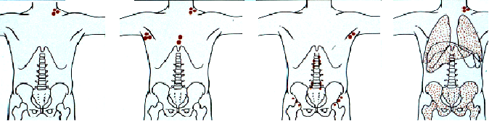
Ann Arbor Staging System for Hodgkin's Disease and Non-Hodgkin's Lymphoma
Stage I Stage II Stage III Stage IV
Notes:
Historically, this staging methodology was designed for Hodgkin’s disease but has been adapted to NHL. Staging defines the extent of a cancer along three axes: tumor (T); node (N); and metastasis (M). The rationale behind a staging system is to accomplish the following:
Plan treatment strategies
Help evaluate the treatment results
Standardize information to facilitate exchanges between health-care professionals and treatment centers
Formulate a more accurate prognosis
Promote the continuity of cancer investigation
The Ann Arbor Staging System is the most commonly used in NHL. It is divided into four stages (I to IV), according to nodal and extralymphatic involvement, and subclassified into A and B categories.
A designates the absence of the so-called B symptoms.
B signals their presence.
The B symptoms are as follows:
Unexplained loss of more than 10% of body weight in the 6 months before diagnosis
Unexplained fever with temperatures above 38º Celsius
Drenching night sweats
Skarin AT, ed. Dana-Farber Cancer Institute Atlas of Diagnostic Oncology. Philadelphia:
Lippincott; New York: Gower Medical Pub; 1991.
Available at http://www.acs.ohio-state.edu/units/cancer/handbook/staging.pdf. Accessed 6/25/02.

Slide 39
Treatment
Balance ensuring the best opportunity for long-term, disease free survival and the lowest risk of severe treatment toxicity
Chemotherapy + involved field radiation therapy
  Multiagent chemo: ABVE-PC, ABVD,OPPA/COPP
    Adria, Bleo, Vinc, Etoposide, PDN, Ctx
No. of courses of chemo according to stage→
  2-4 →early stage, 4-6 →advanced stage disease
Early relapse: Bone marrow/SC transplant

Slide 40
Poor Prognosis
Poor prognostic factors:
  Patients who fail to achieve complete remission
  Patients who have a brief remission
    12 months or less
  Patients who develop multiple relapses

Slide 41
Late Complications of Therapy
Secondary malignancies
  Leukemia/non-Hodgkin’s lymphoma
  Solid tumors (usually occur within field of previous radiation)
Gonadal toxicity
Hypothyroidism
Cardiotoxicity
  cardiomyopathy or constrictive pericardial dz
Lung toxicity
  radiation pneumonitis and fibrosis

Slide 42
Non Hodgkin’s Lymphoma
Hodgkins
  Indolent
  Cervical, mediastinal, supraclavicular LAD
  B sx common
Non-Hodgkins
  Rapid (tumor lysis)
  Abdominal, mediastinal masses and LAD
  Abdominal pain common
  Intussusception

Slide 43
High Risk for NHL
Familial cases
  Rare reports
Inherited immunodeficiencies
  Wisckott-Aldrich, X-linked immunoproliferative, ataxia telangiectasia
Acquired immunodeficiencies
  HIV, organ transplant, post-BMT
EBV
  malaria
Chemicals
  Pesticides and solvents

Slide 44
NHL in general
Rapidly growing
  Potential doubling time of 16 hours
High metastatic potential
  2/3 have widespread disease at the time of diagnosis
  Bone marrow and CNS most common

Slide 45
Frequency of NHL Subtypes in Adults
Mantle cell (6%)
Peripheral T-cell (6%)
Indolent (35%)
Other subtypes with a
frequency ≤2% (9%)
Composite
lymphomas (13%)
Diffuse large
B-cell (31%)
Armitage et al. J Clin Oncol. 1998;16:2780–2795.
Notes:
Key Point: The REAL/WHO classification system makes it possible to define clinically distinct types of NHL.^{1,2}
This is a clinical evaluation of the REAL classifications in 1403 cases of NHL at 9 study sites worldwide.²
For most subtypes, diagnostic accuracy and reproducibility were ≥85%.²
The most common NHL subtypes²
Indolent lymphomas 35%
Follicular lymphoma 22%
Small lymphocytic lymphoma 6%
Marginal zone B-cell MALT 5%
Marginal zone B-cell nodal 1%
Lymphoplasmacytic 1%
Mantle cell lymphoma 6%
Peripheral T-cell lymphoma 6%
Diffuse large B-cell lymphoma 31%
Composite lymphomas 13%
The Non-Hodgkin’s Lymphoma Classification Project. A clinical evaluation of the International Lymphoma Study Group classification of non-Hodgkin’s lymphoma. Blood. 1997;89:3909–3918.
Armitage JO, Weisenburger DD, for the Non-Hodgkin’s Lymphoma Classification Project. New approach to classifying non-Hodgkin’s lymphomas: clinical features of the major histologic subtypes. J Clin Oncol. 1998;16:2780–2795.

Slide 46
NHL breakdown

Slide 47
Cell origins
Small non-cleaved
  B cell exclusively
Lymphoblastic
  T cell predominantly
Large cell
  B or T cell (most B)
Burkitt’s
ALL
Lymphoma vs Leukemia
25% BM involvement
Leukemia
Arbitrary cut-off

Slide 48
NHL: Classification - 1
Key Points
  cell size: small cell vs. large cell
  nodal architecture: follicular vs. diffuse
Principle
  More aggressive: diffuse, large cell
  More indolent: follicular, small cell

Slide 49
NHL: Classification - 2
Terminology (refers to natural history)
  low grade = indolent
  intermediate grade = aggressive
  high grade = aggressive
Principle
  indolent: slow growing, incurable
  aggressive: rapidly growing, curable

Slide 50
Presentations
Belly
Small noncleaved (B cell)
  Abdominal tumor (80%)—ileocecal region
    R iliac fossa mass, mistaken for appy
    Intussusception occasionally
  Metastases common
    Bone, testis, breast, salivary glands, thyroid
Lymphoblastic (T cell)
  Mediastinal mass (50-70%)
    Pleural effusions
    LAD, supradiaphragmatic (50-80%)
Large cell
  T cell: anterior mediastinal mass
  B cell: abdominal mass
Thorax

Slide 51
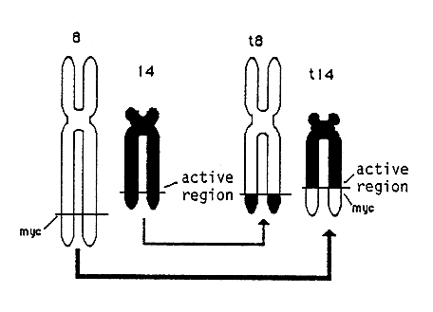
Burkitt’s lymphoma. C-myc oncogene
All B cell lymphomas have a translocation of the c-myc oncogene
  Although the exact site differs between different types

Slide 52
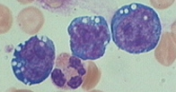
Burkitt’s histopath
Small and uniform in shape and size
Nucleus with chromatin
Hi ratio of nuclear:cytoplasm
Basophilic cytoplasm
Lipid vacuoles
2-5 nucleoli

Slide 53
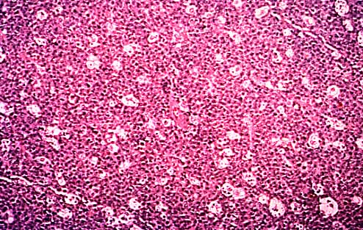
Burkitt’s lymphoma ‘starry sky’
On low power, macrophages appear as stars against the dark background

Slide 54
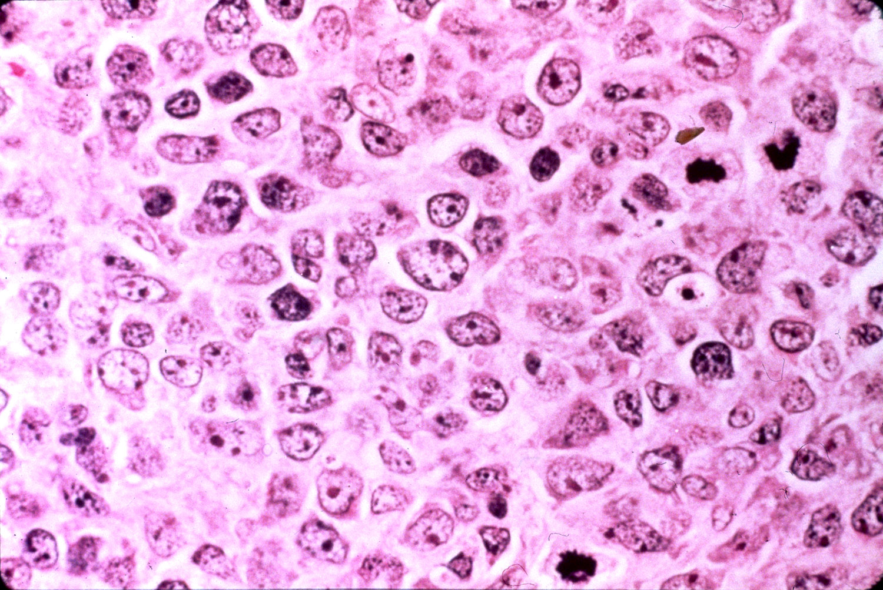
Burkitt’s lymphoma ‘starry sky’

Slide 55
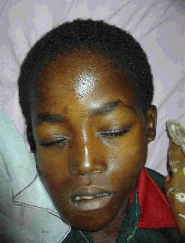
Endemic vs. Sporadic
Endemic
  African variety
    Maxilla and mandible
    Associated with EBV
Sporadic
  Seen all over
    Abdominal organs
    20% EBV association

Slide 56
The EBV connection
Review of immunology
  B cells are infected with EBV
  T cells (cytotoxic) are involved in the response to EBV infection
Theory
  Malaria, and other major infections, causes immunosuppression
  Host is unable to generate an adequate T cell response, to keep infection in check
  The B cells then proliferate→ lymphoma

Slide 57
W/U of NHL
PE
CBC
Chem
  Electrolytes
  Liver, renal panels
  LDH, uric acid
Imaging
  CT chest and abd
  Gallium scan
    FDG PET scan
Bone marrow
CSF exam
Metastatic w/u
Marker of tumor burden, important determinant of outcome
Measure for tumor lysis

Slide 58
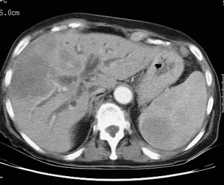
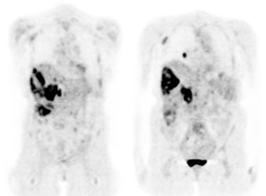
CT scan vs. PET scan

Slide 59
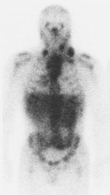
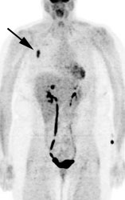
Gallium vs. FDG-PET
FDG is tagged glucose

Slide 60
Therapy - 1
Chemo only
  Surgery only for abdominal emergency
  Radiation for SVC obstruction, or paraspinal compression
B cell
  High dose intensive therapy
T cell
  Similar to ALL therapy

Slide 61
Therapy - 2
Most aggressive lymphomas
  CHOP – cyclophosphamide, vincristine, doxorubicin, and prednisone
Most indolent lymphomas
  Many need no treatment – only for symptoms
  Oral alkylators, CVP, CHOP, fludarabine, rituximab
  Relapse – many patients will benefit from high dose chemotherapy (transplant)

Slide 62
Rituximab
Approved Indication for the treatment of patients with relapsed or refractory low-grade or follicular, CD20 positive B-cell non-Hodgkin’s lymphoma”
IgG1 kappa chimeric murine/human monoclonal antibody against CD20
Application in B-cell malignancy and autoimmunity

Slide 63
Making Chimeric Antibody
Murine Anti-CD20 Ig gene
Human IgG1 gene
Clone Variable Region gene
Clone Constant Region gene
Mouse
Human
Chimeric Gene
Cellular Producer

Slide 64
Mechanisms of Activity for IgG1 Antibodies
Dendritic Cell
Complement
NK Cell

Slide 65
Complications
Tumor related
  SVC syndrome
  Spinal cord compression
  Pleural and pericardial effusions
  Pulmonary embolism
  Obstructive uropathy
  Pharyngeal/ airway obs
Metabolic
  Tumor lysis
  SIADH (syndrome of inappropriate secretion of antidiuretic hormone )
  Hypo/Hyperglycemia
GI
  Bleeding, fistulae, obstruction
Cytokine mediated
  Cachexia, fever malaise
Hematologic
  BM infiltration
  Pancytopenia

Slide 66
Tumor Lysis!!!
Evaluate
  Phosphorus
  Uric acid
  Calcium
  Potassium
Life threatening emergency
  Hydrate
  Alkalinize

Slide 67
CONCLUSION
Hodgkins vs. Non-Hodgkins
Reed Sternberg cells
  Hodgkin
Starry Sky
  NHL
Painless cervical adenopathy presentation
  Hodgkin’s
Associated with immune dysfunction
  BOTH
Indolent
  Hodgkins
B symptoms
  Hodgkins
Abdominal mass presentation
  NHL
60% of lymphomas
  NHL
EBV association
  BOTH

Slide 68
Myeloproliferative Neoplasms (MPN). MYELOFIBROSIS

Slide 69
Hypocellular AML & hypocellular MDS

Slide 70

MPN are clonal disorders of the hematopoietic stem cell
Essential Thrombocythemia (ET)
Polycythemia Vera
(PV)
Myelofibrosis (MF)
Red Cells
Platelets
Marrow Fibrosis
Hematopoietic stem cell (HSC)
JAK2^{V617F} mutation
CALR mutation

Slide 71
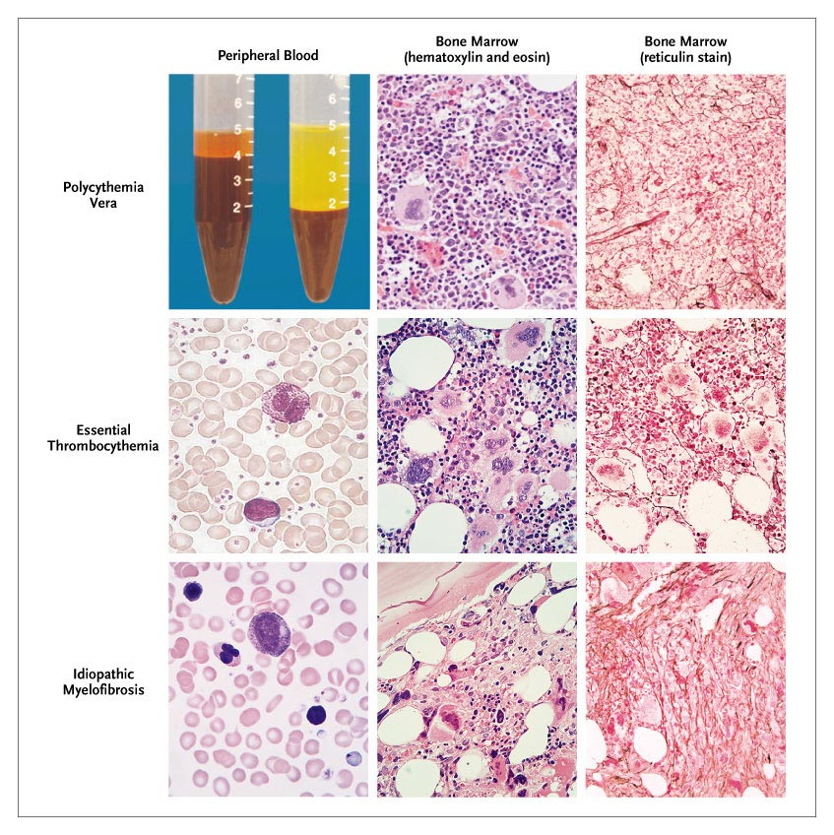
MPN are clonal disorders of the hematopoietic stem cell
Polycythemia Vera
(PV)
Red Cells
Hematopoietic stem cell (HSC)
JAK2^{V617F} mutation

Slide 72
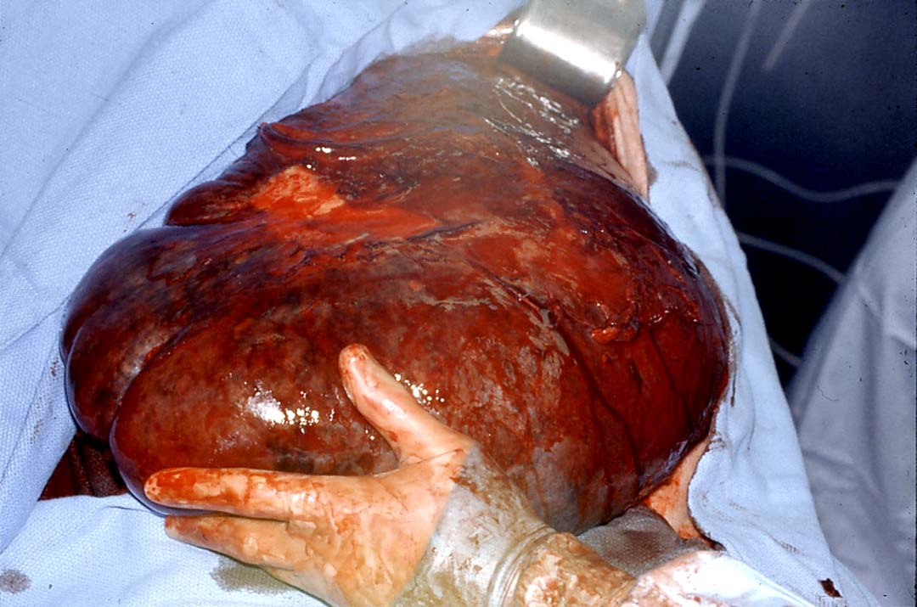
MPN are clonal disorders of the hematopoietic stem cell
Myelofibrosis (MF)
Marrow Fibrosis
Hematopoietic stem cell (HSC)
JAK2^{V617F} mutation

Slide 73
MYELOFIBROSIS
AKA: agnogenic myeloid metaplasia with myelofibrosis
Clonal stem cell disorder affecting megakaryocytes predominantly
All myeloproliferative disorders can result in a phase which can be difficult to distinguish from primary MF
Myeloid metaplasia refers to earlier proliferative phase where extramedullary hematopoiesis predominates.

Slide 74
MYELOFIBROSIS
Myelofibrosis is a chronic myeloproliferative disease with clonal hematopoesis and secondary(non-clonal) hyperproliferation of fibroblasts (stimulated by PDGF, EGF, TGF-β released from myeloid cells, mainly from neoplastic megakaryocytes) with increased collagen synthesis. It produces bone marrow fibrosis and to extramedullary hematopoesis in the spleen or in multiple organs
Other terms
  agnogenic myeloid metaplasia
  primary myelofibrosis,
  osteomyelofibrosis,
  idiopathic myelofibrosis,
  myelofibrosis with myeloid metaplasia

Slide 75
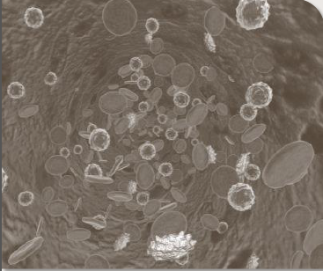
Myelofibrosis with Myeloid Metaplasia
JAK2 mutation in 60% of patients
Myelofibrosis is a clonal hematologic malignancy with reactive marrow fibrosis
Primary myelofibrosis, or PMF, entered the scientific discourse in 1879 with varied nomenclature
–Agnogenic myeloid metaplasia
–Myeloid metaplasia with myelofibrosis
–Chronic idiopathic myelofibrosis
Patients with an antecedent diagnosis of PV or ET are diagnosed with PPV-MF or PET-MF

Slide 76

MYELOFIBROSIS
Insidious onset in older people
  asymptomatic (15% - 30%)
  severe fatigue
Splenomegaly - massive
Hepatomegaly
Hypermetabolic symptoms
  Loss of weight, fever and night sweats
Bleeding problems
Bone pain
Gout
Can transform to acute leukaemia in 10-20% of cases

Slide 77
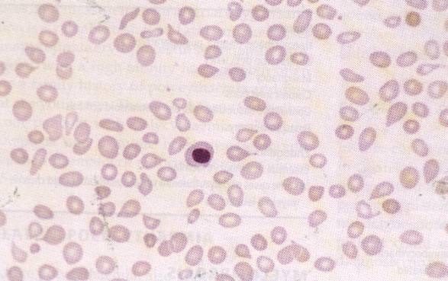
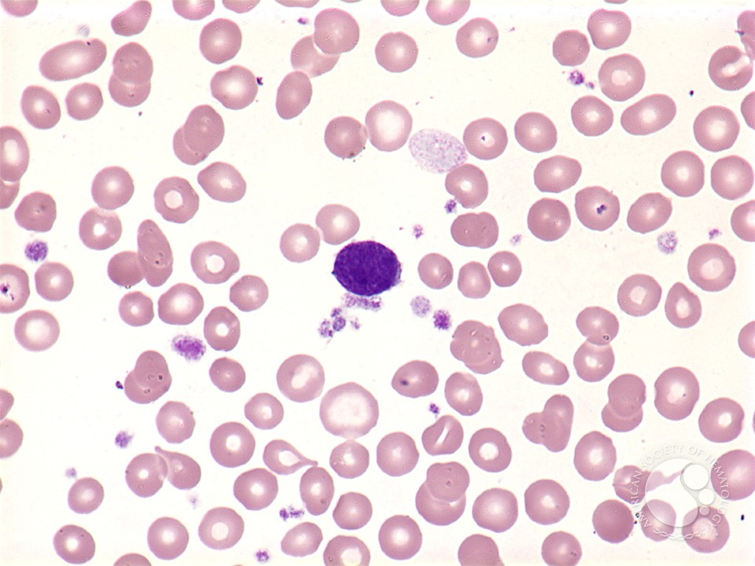
MYELOFIBROSIS
Anaemia
High WBC at presentation
Later leucopenia and thrombocytopenia
Leucoerythroblastic blood film
Tear drops red cells
Bone marrow aspiration- Failed due to fibrosis
Trephine biopsy- fibrotic hypercellular marrow
Increase in NAP score
JAK2⁺ (V617F) in approximately 50% of cases
“Naked" megakaryocytic nucleus circulating in the blood

Slide 78
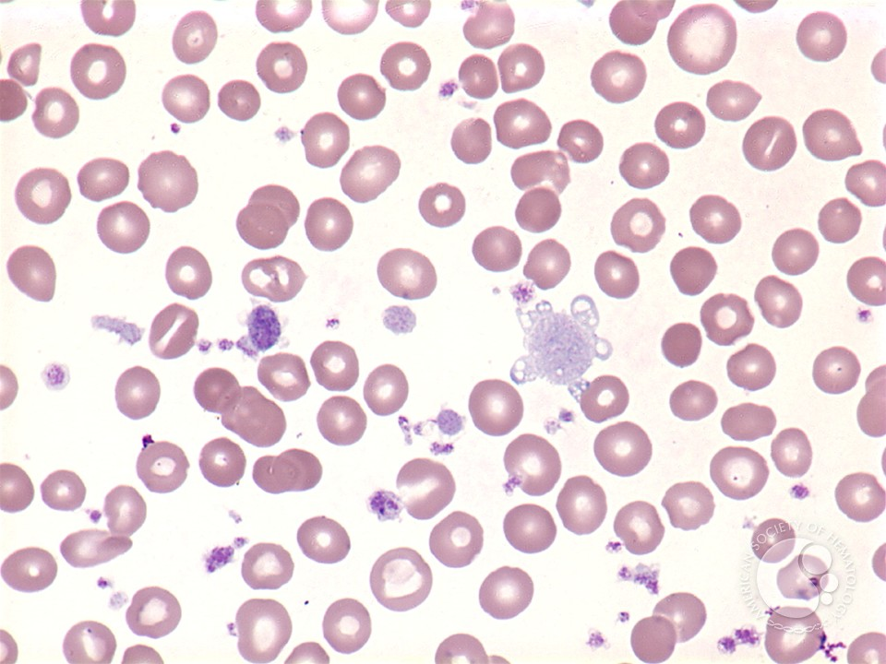
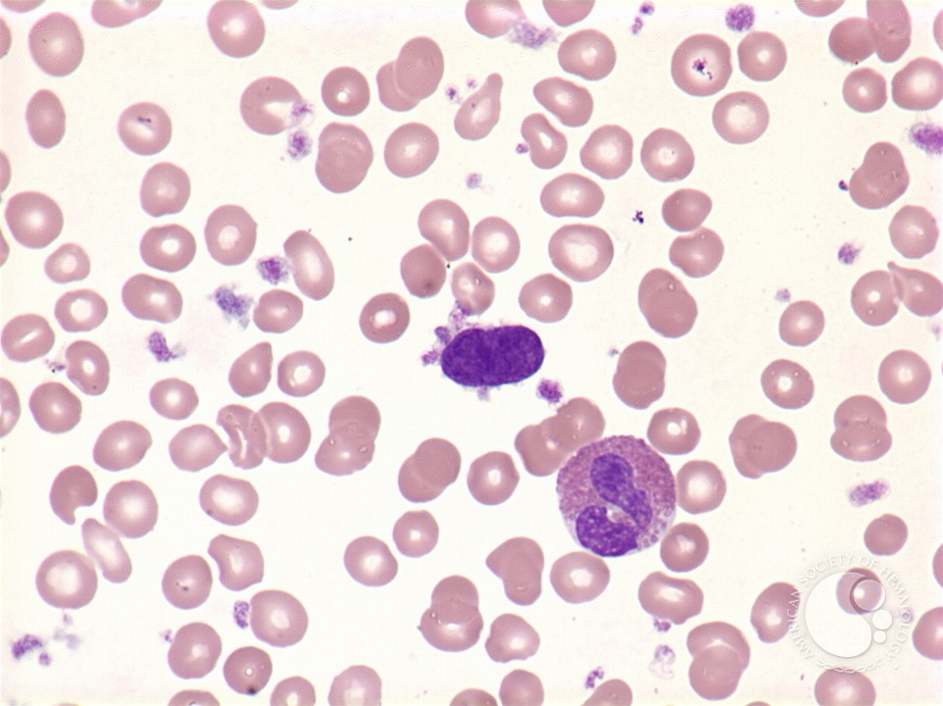
Myelofibrosis: peripheral blood
A megakaryocytic nucleus associated with large platelet forms is pictured with an eosinophil
Large, irregular platelet forms can be seen

Slide 79
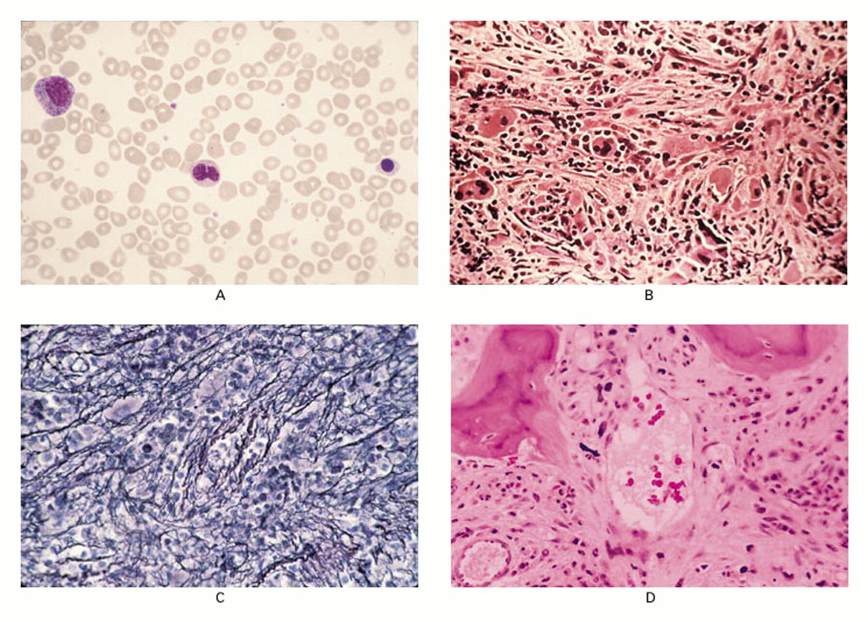
Pathological Features of Peripheral Blood and Bone Marrow in Patients with Myelofibrosis with Myeloid Metaplasia
Panel A: shows myelophthisis of the blood. Immature granulocyte precursors, a nucleated red cell, and teardrop-shaped red cells are visible (Wright-Giemsa, x200).
Panel B: biopsy specimens of the bone marrow core show stromal stranding and atypical megakaryocytes (hematoxylin and eosin, x128).
Panel C: collagen fibrosis on silver-impregnation staining of reticulin - thickening of the bone trabeculae (osteosclerosis) (x128).
Panel D: and intramedullary sinusoidal hematopoiesis (hematoxylin and eosin, x128).
Notes:
Pathological Features of Peripheral Blood and Bone Marrow in Patients with Myelofibrosis with Myeloid Metaplasia.
Panel A shows myelophthisis of the blood. Immature granulocyte precursors, a nucleated red cell, and teardrop-shaped red cells are visible (Wright-Giemsa, x200). Biopsy specimens of the bone marrow core show stromal stranding and atypical megakaryocytes (Panel B; hematoxylin and eosin, x128), collagen fibrosis on silver-impregnation staining of reticulin (Panel C, x128), and thickening of the bone trabeculae (osteosclerosis) and intramedullary sinusoidal hematopoiesis (Panel D; hematoxylin and eosin, x128).

Slide 80
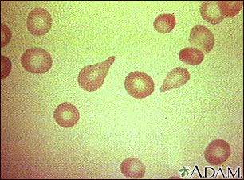
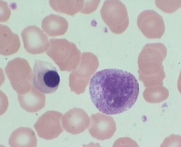
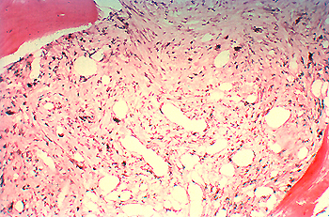
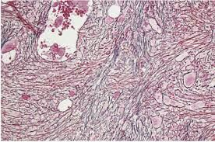
Peripheral Blood and Bone Marrow in Myelofibrosis
Red blood cells, tear-drop shape
A leukoerythroblastic blood smear
Reticulin stain of marrow
Bone marrow fibrosis

Slide 81
Understanding Myelofibrosis
Myelofibrosis can be risk stratified by:
low risk→ intermediate risk 1 & 2 → high risk
–Bone marrow fibrosis
–Symptom burden
–Splenomegaly
–Cytopenias
Although the exact cause of myelofibrosis is unknown, multiple mechanisms are key features of the disease
–Genetic mutations: JAK2, CALR and MPL
–Excessive production of cytokines
–Increased JAK1 signaling

Slide 82
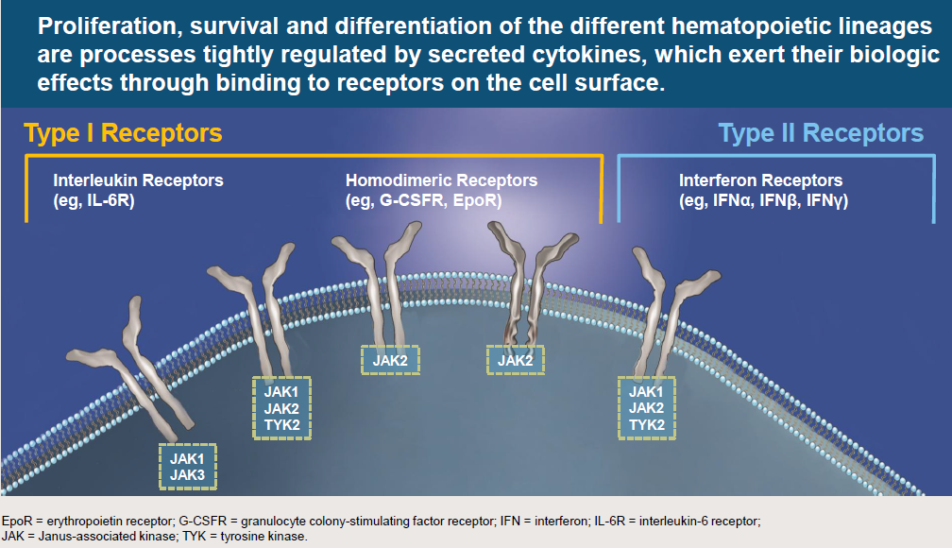
Cytokines Play a Key Role in Myelofibrosis

Slide 83
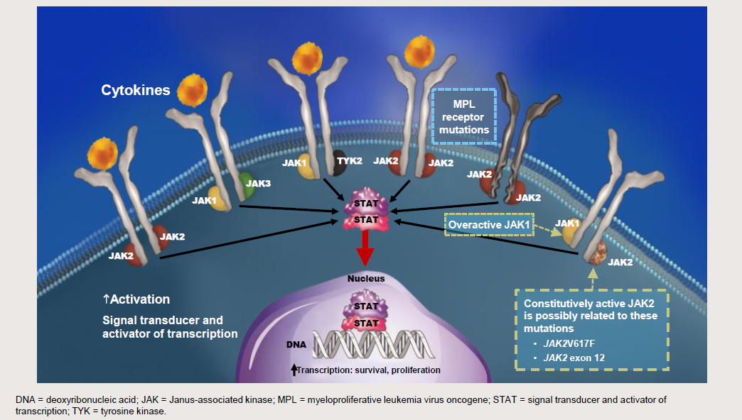
Overactive JAK-STAT Signaling is
Present in all Patients with Myelofibrosis

Slide 84
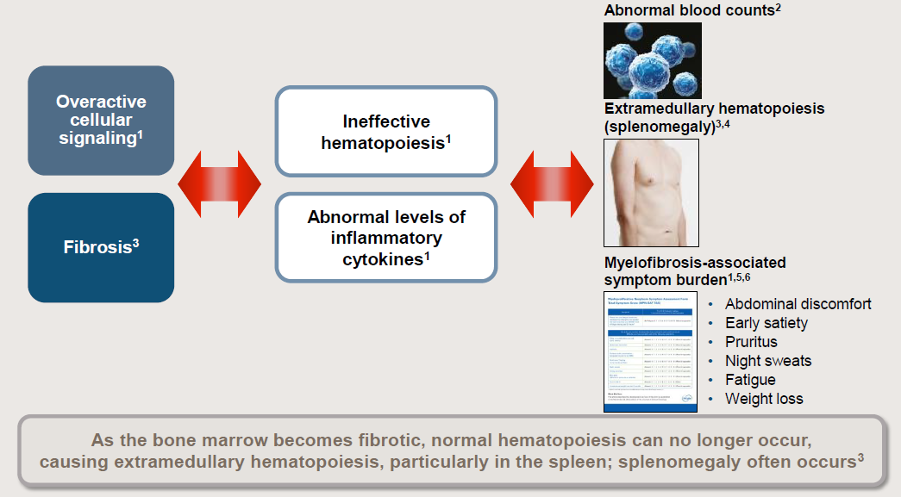
Clinical Relevance of the Progressive Pathology of Myelofibrosis

Slide 85
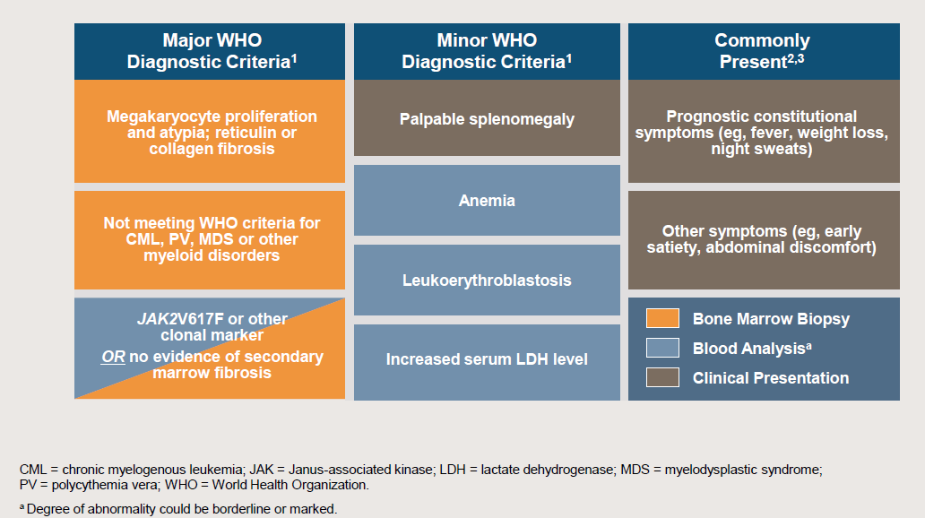
Diagnosing of primary Myelofibrosis:
All major criteria plus ≥2 minor WHO criteria are required for diagnosis

Slide 86
Diagnostic criteria for PMF - conclusion
MUST MEET ALL 3 MAJOR AND 2 MINOR CRITERIA
Major criteria:
Presence of megakaryocyte proliferation and atypia, usually accompanied by either reticulin or collagen fibrosis
Not meeting WHO criteria for polycythemia vera, BCR-ABL1–positive chronic myelogenous leukemia, myelodysplastic syndrome, or other myeloid disorders
Demonstration of JAK2 V617F or other clonal marker, or, in the absence of the above clonal markers, no evidence that bone marrow fibrosis is secondary to other causes
Minor criteria:
Leukoerythroblastosis (immature cells in blood)
Increase in serum lactate dehydrogenase level
Anemia
Palpable splenomegaly (enlarged spleen)

Slide 87
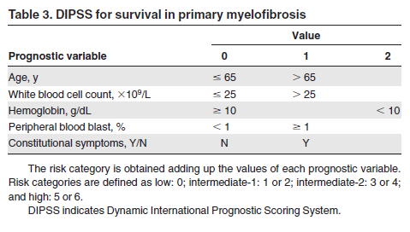
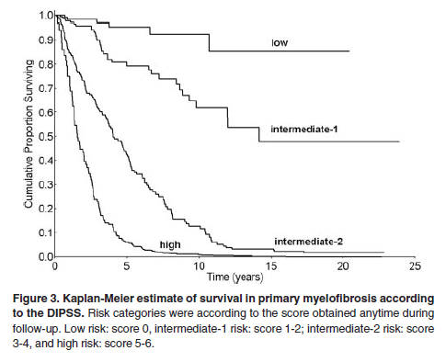
Dynamic international prognostic scoring system for mf (DIPSS)
Obtained at any time during follow-up
0 = Low
1-2 = Intermediate-1
3-4 = Intermediate-2
5-6 = High

Slide 88
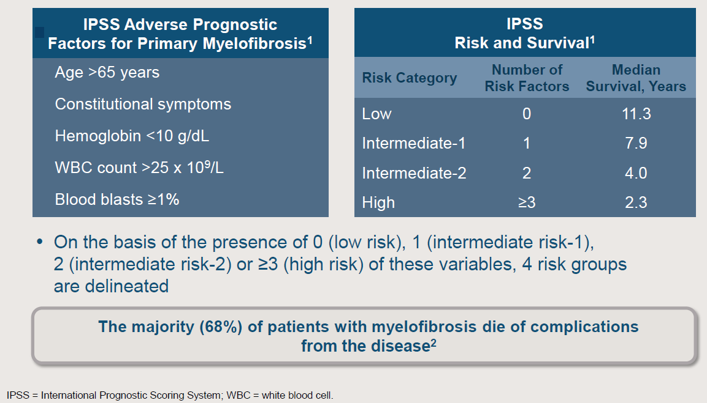
Risk Stratification in Myelofibrosis

Slide 89
Symptomatic Burden in MF
Constitutional
Symptoms
Splenomegaly
Myeloproliferation
Functioning
Percentage of patients reporting symptoms

Slide 90
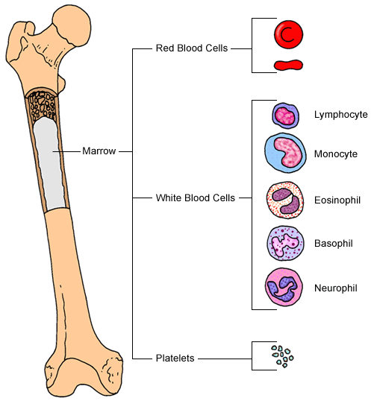

Consequences of Increased Inflammation
HSC
exhaustion
Stress
hematopoiesis
Constitutional Symptoms
-weight loss
-fatigue
-fever

Slide 91
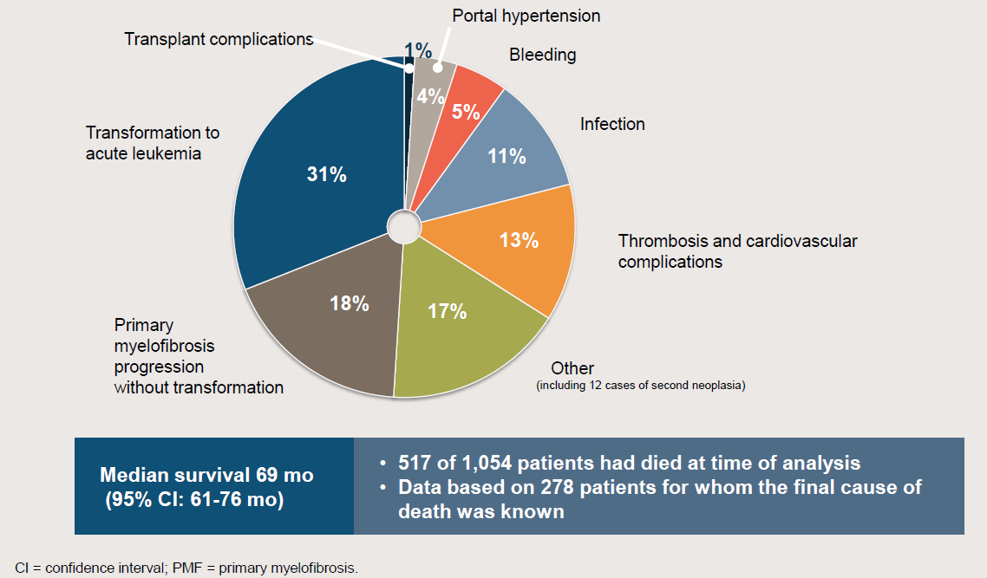
Examining the causes of mortality in PMF

Slide 92
Treatment goals
Prevent hemorrhage
Alleviate constitutional symptoms
Minimize primary and iatrogenic disease progression
Improve QOL and survival

Slide 93
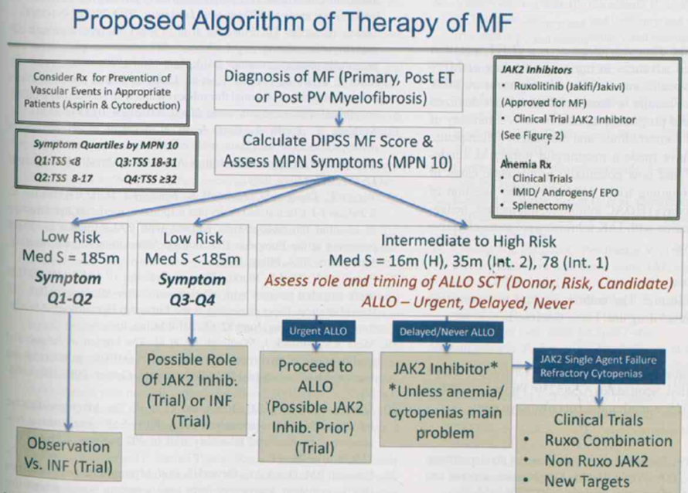

Slide 94
Treatment of MF - 1
Treatment for anemia
Erythropoietin (growth factor)
Corticosteroids
Androgens (danazol) +/- Prednisone
Thalidomide /lenalidomide+ Prednisone
Transfusions
Treatment for splenomegaly
Hydroxyurea
Splenectomy
Ruxolitinib

Slide 95
Treatment of MF - 2
    Androgens (oxymetholone 2-4mg/kg) in anemia from decreased red cell production -overall response is about 40%
    Cortykosteroids (prednisone 1mg/kg) in anemia with shortened red cell life-span-response in 25-50% of patients
    Hydroksyurea (15- 20mg/kg) for the control of leukocytosis, thrombocytosis, or organomegaly
    Allopurinol - to prevent hyperuricaemia
    Vit. D₃-analogues (1,25-dihydroxycholecalciferol-1ug/d (?)
    Transfusions of packed red cells for anemia or platelets for thrombocytopenia with bleeding

Slide 96
MYELOFIBROSIS - TREATMENT
    Splenectomy should be considered for: portal hypertension, painful splenomegaly, refractory anemia and thrombocytopenia, or exccessive transfusion requirement. However,the procedere is hazardous (an operative mortality is up to 38%).
    Splenic irradiation: when there is a contrindication to splenectomy
    Allogeneic stem-cell transplantation: for young patients who have a poor prognosis and have a suitable donor identified.
    Experimental therapies: Interferon-α, antifibrotic and antiangiogenic drugs (anagrelide, suramin, pirfenidone, thalidomide,)

Slide 97
Ruxolitinib (JAKAFI)
Dual JAK1/JAK2 inhibitor
FDA approved in Nov 2011 for:
Intermediate or high-risk Myelofibrosis (=80-90% of MF patients)
JAK2V617F NOT required

Slide 98
Ruxolitinib
WHAT IT DOES:
Reduces spleen size
Relieves symptoms
WHAT IT DOESN’T DO:
Improve anemia
Significantly reduce the JAK2^{V617F} allele burden
WHAT IT MAY DO:
Retard progression of fibrosis
Extend lifespan

Slide 99
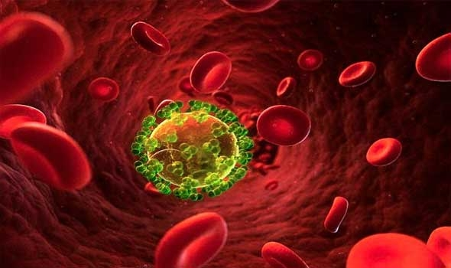
THANK YOU FOR ATTENTION!

