Slide 1

Jaundice

Slide 2
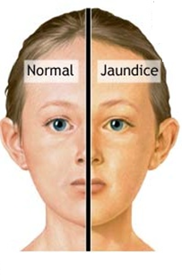
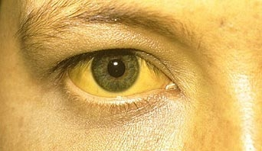
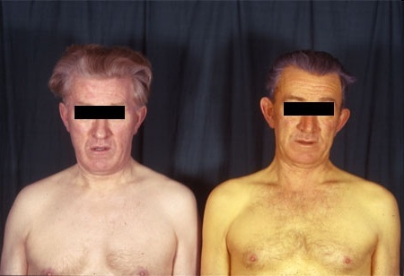
Jaundice
Jaundice is a yellowing of the skin, conjunctiva and mucous membranes caused by hyperbilirubinaemia.
For jaundice to be clinically apparent, the circulating bilirubin levels should be in excess of 35 μmol/L.

Slide 3
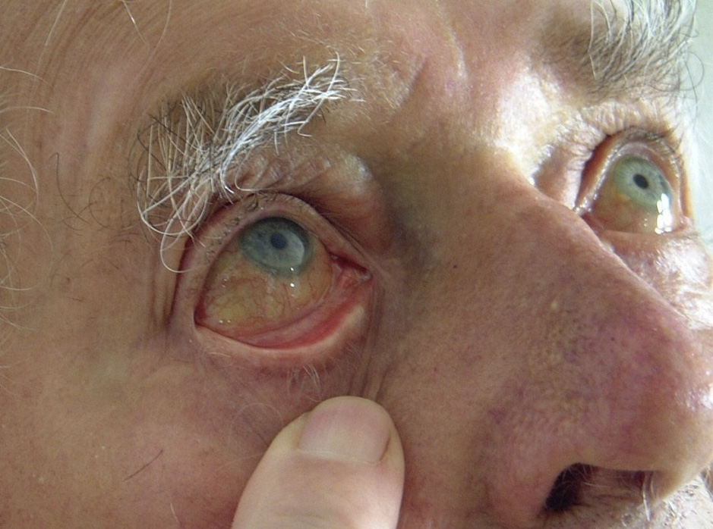
Mild jaundice
is evident in the sclera, there is no obvious jaundice in the skin.
jaundice in the sclera is usually clinically apparent when the circulating bilirubin levels are in excess of 35 μmol/L.
Jaundiced sclera in a patient with hepatitis.

Slide 4
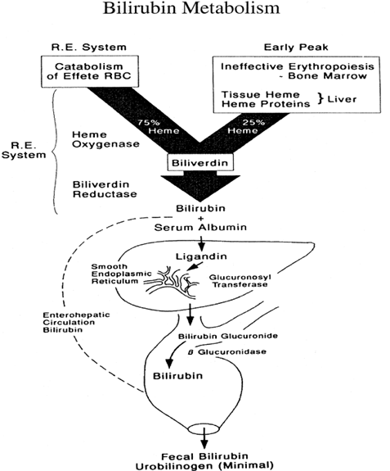
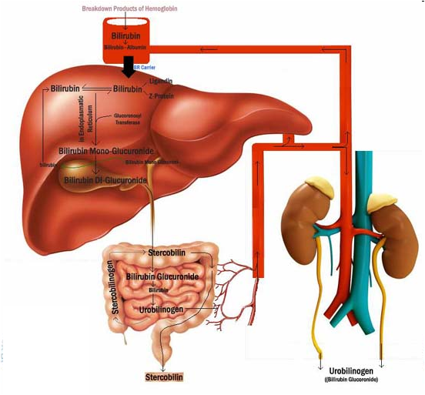

Slide 5
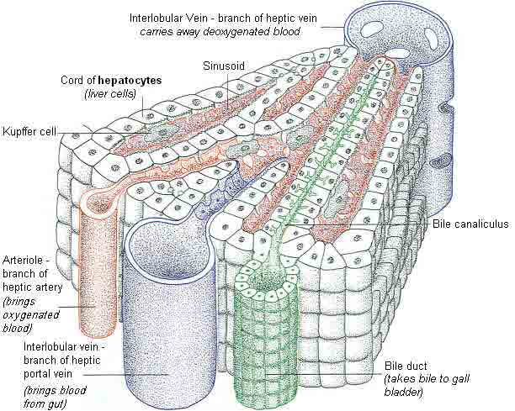
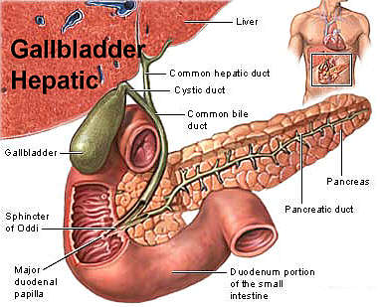

Slide 6
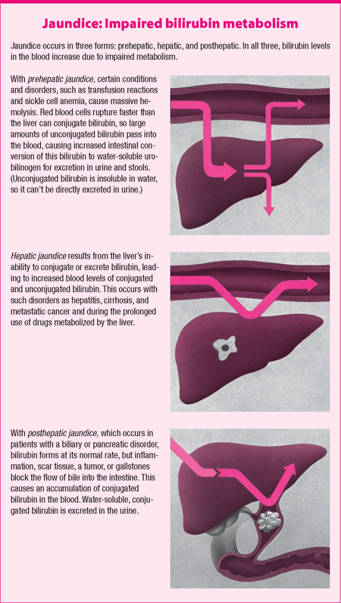
What causes ↑ bilirubin?
Jaundice may be prehepatic (due to
haemolysis),
hepatic (due to intrinsic liver disease)
cholestatic (due to either intrahepatic cholestasis or post-hepatic biliary tract obstruction).

Slide 7
Causes
excess bilirubin production (Haemolysis)
impaired uptake by the hepatocyte (hepatocellular jaundice)
failure of conjugation (hepatocellular jaundice)
impaired secretion of conjugated bile into the bile canaliculi (hepatocellular jaundice)
impairment of bile flow subsequent to secretion by the hepatocyte (obstructive or cholestatic jaundice)

Slide 8
DRUG-INDUCED JAUNDICE
Possible drugs that will cause a biochemical profile similar to that seen in pre-hepatic jaundice, i.e. an unconjugated hyperbilirubinaemia include:
- rifampicin
Possible drug-related causes of intra-hepatic jaundice include:
paracetamol,
halothane,
methyldopa,
barbiturates
Drug-induced cholestasis:
- Ampicillin and other penicillin-based antibiotics
- Anabolic steroids
- Chlorpromazine
- Cimetidine
- Erythromycin estolate
- Estradiol
- Gold salts
- Imipramine
- Nitrofurantoin
- Oral contraceptives
- Prochlorperazine
- Sulindac
- Terbinafine
- Tolbutamide
- Isoniazid
- chlorpromazine
Environmental toxins - vinyl chloride, herbal preparations, pyrrolizidine alkaloids, mushrooms.

Slide 9
PREHEPATIC JAUNDICE (UNCONJUGATED HYPERBILIRUBINAEMIA) CAUSES
CONGENITAL DEFECTS
Gilbert’s disease
Crigler–Najjar syndrome
HAEMOLYSIS
Congenital RBC defects
Hereditary spherocytosis
(congenital acholuric jaundice)
Sickle cell disease
G6PD deficiency
Thalassaemia
Acquired
Malaria (common where malaria is endemic)
Incompatible blood transfusion
Autoimmune
Haemolytic disease of the newborn
Absorbing large haematoma
Hypersplenism

Slide 10
HEPATIC JAUNDICE CAUSES
ACUTE HEPATOCELLULAR DISEASE
Viral hepatitis
Hepatitis A, B, C
EBV
CMV
Leptospirosis
Other infections
Drugs, e.g. paracetamol,
halothane
Toxins, e.g. carbon tetrachloride
Autoimmune
Weils disease-severe presentation of leptospirosis-jaundice, with renal failure ass with headache and myalgias.
CHRONIC HEPATOCELLULAR DISEASE
● Chronic viral hepatitis
● Chronic autoimmune hepatitis
● End-stage liver disease
● Alcohol
● Cirrhosis
● Haemochromatosis
● Wilson’s disease

Slide 11
CHOLESTATIC JAUNDICE CAUSES
EXTRAHEPATIC (OBSTRUCTIVE)
In the lumen
● Gallstones
● Infestation
● Clonorchiasis (liver fluke)
● Schistosomiasis
In the wall
● Stricture, e.g. inflammatory, postoperative
● Cholangitis
● Congenital biliary atresia
● Cholangiocarcinoma
● Sclerosing cholangitis
● Choledochal cyst
Outside the wall
● Carcinoma of the head of the pancreas
● Carcinoma of the ampulla of Vater
● Malignant nodes in the porta hepatis
● Chronic pancreatitis
● Mirizzi syndrome
INTRAHEPATIC
Drugs, e.g. chlorpromazine
TPN
Viral hepatitis
Primary biliary cirrhosis
Pregnancy
Drug-induced
- cholestatic hepatitis: chlorpromazine, erythromycin, imipramine, tolbutamide, sulindac, cimetidine , TMP-SMX, ampicillin, dicloxacillin and clavulinic acid.
- chronic cholestasis: chlorpromazine and prochlorperazine

Slide 12
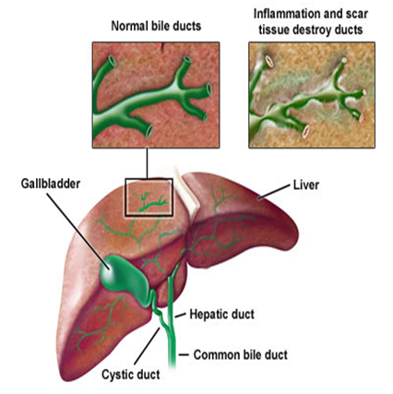
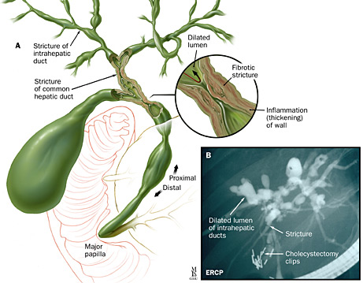
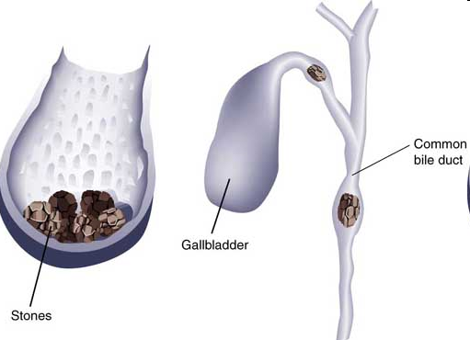
Obstructive jaundice - etiology
1. CHOLEDOCHOLITHIASIS
2. NEOPLASMS
3. BILIARY ATRESIA
4. CHOLEDOCHAL CYST
5. LYMPHADENOPATHY-PORTA HEPATIS
6. TRAUMATIC- POST CHOLECYSECTOMY

Slide 13
OTHER CONSIDERATIONS
Painless progressive jaundice suggests carcinoma of the pancreas, especially in the presence of a palpable gall bladder (Courvoisier’s law).
Sudden onset of jaundice and fever requires detailed HISTORY of foreign travel, drug abuse and sexual history.

Slide 14
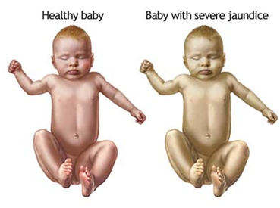
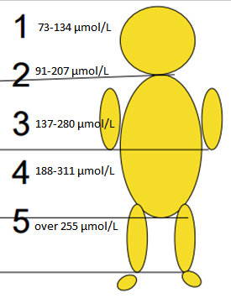
NEONATAL
JAUNDICE
Newborns – 85-90 µmol/L;
Premature term infants - 120µmol/L
Additional signs and symptoms that may be seen in the newborn include:
poor feeding
lethargy
changes in muscle tone
high-pitched crying
seizures.

Slide 15
Pat. neonatal jaundice criteria
appears during 24 hours after delivery;
cord blood bilirubin level >60µmol/l;
indirect bilirubin level increases by more than 85-110mmol/l every 24 hours;
jaundice duration is over 1-2 weeks in newborns and over 2-3 weeks in premature term infants;
max. bilirubin rate is over 205 µmol/L in newborns and over 255 µmol/L in premature term infants;
the level of direct bilirubin is higher than indirect bilirubin level by more than 20%.

Slide 16
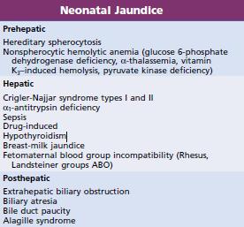

Slide 17
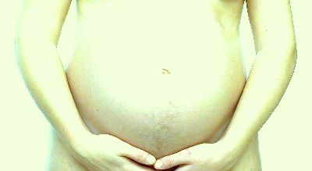
Jaundice in Pregnancy

Slide 18
CAUSES
1 - Cholestasis of pregnancy:
intrahepatic cholestasis;
occurs in pregnant women during the third trimester;
accompanied by itching but infrequently causes jaundice, the itching can be severe, but can be treated with drugs (ursodeoxycholic acid);
it has been hypothesized that it is the increased estrogens during pregnancy that are responsible for the cholestasis of pregnancy.
2 - Pre-eclampsia:
occurs during the second half of pregnancy and involves several systems within the body, including the liver.
It may result in high blood pressure, fluid retention, and damage to the kidneys as well as anemia and reduced numbers of platelets (thrombocytopenia) due to destruction of red blood cells and platelets.
Although the bilirubin level in the blood is elevated in pre-eclampsia, it usually is mildly elevated, and jaundice is uncommon.
3 - Acute fatty liver of pregnancy (AFLP):
occurs late in pregnancyand results in liver failure.
cause of AFLP is unclear, but is often associated with pre-eclampsia
It can almost always be reversed by immediate delivery. There is an increased risk of infant death. Jaundice is common, but is not always present in AFLP.
4 - HELLP syndrome (hemolysis, elevated liver enzymes, and a low platelet count).

Slide 19
Clinical Findings—Hemolytic Jaundice
Decreased hemoglobin
  Explains weakness
  Has moderate anemia
Splenomegaly
  Increased activity of reticuloendothelial system
  Site of RBC filtration
Liver Function Tests:
  Increased Serum bilirubin
  Increased load to the liver (increased hemolysis) => increased hemoglobin metabolism
Notes:
AST, ALT, Alkaline phosphatase => almost normal
Serum protein level => normal
Albumin:globulin ratio => normal

Slide 20
Clinical Findings—Hepatic Jaundice
Seen in both hepatocellular jaundice and cholestatic jaundice
Highly colored urine
  Increased amount of bilirubin excretion
Tender hepatomegaly
Liver function tests
  High serum bilirubin
  AST and ALT highly increased
  Alkaline phosphatase increased moderately
Notes:
Hepatocellular => disproportonate rise in aminotransferases compared to alkaline phosphatase
Cholestatic => disproportonate rise in alkaline phosphatase compared to aminotransferases

Slide 21
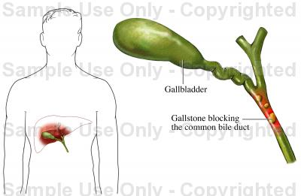
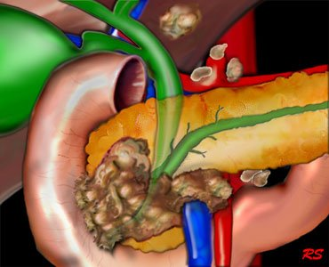
Clinical findings in obstructive jaundice
Deep jaundice
Scratch marks on body
High colored urine
Clay colored stools
Other features
      ?pain
      ?weight loss
      ?palpable gall bladder
      ?ascites

Slide 22
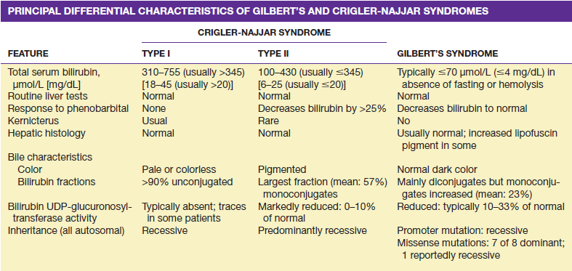

Slide 23
History
Abdominal pain, weight change, fever
Drug history
Injections
Alcohol
Transfusion blood, blood products
Contact with jaundiced individuals
Sexual activity
Ingestion raw shellfish, wild mushrooms

Slide 24
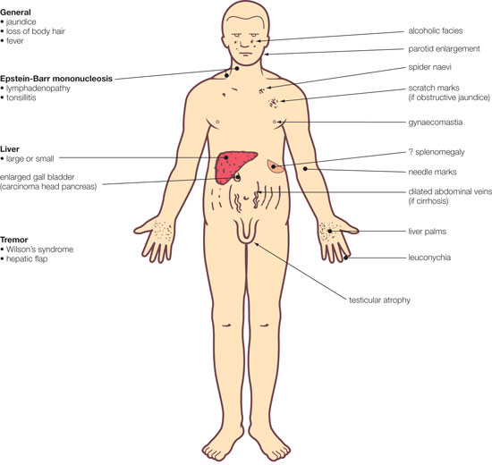
Physical examination
Assessment of patient’s nutritional status,
Temporal and proximal muscle wasting - long standing disease like ca or cirrhosis,
Scratch marks, purpura, fetor hepaticus,
Stigmata of chronic liver disease –spider nevi,
palmar erythema,
gynecomastia,
caput medusa,
dupuytrens contractures,
parotid enlargement or testicular atrophy - advanced alcoholic cirrhosis,
enlarged nodular liver-malignancy,
tender hepatomegaly-alcoholic, viral or parasites, amyloid, hepatic congestion,
MURPHYS sign-cholecystitis,
palpable gall bladder and courvoiser law,
ascites with jaundice- cirrhosis or malignancy with peritoneal spread,
abdominal veins,
Enlarged left supraclavicular lymphnode,
Periumblical nodule-sister mary josephs,
Jvp-right heart failure,
Right side pleural effusion,
Pedal edema, nails- clubbing and white nails,
Tremors or flaps,
Abdominal examination-enlarged left lobe of liver.

Slide 25
OTHER CONSIDERATIONS
Painless progressive jaundice suggests carcinoma of the pancreas, especially in the presence of a palpable gall bladder (Courvoisier’s law).
Sudden onset of jaundice and fever requires detailed HISTORY of foreign travel, drug abuse and sexual history.

Slide 26
Diagnosis of Jaundice
The health care provider will perform a physical exam. This may reveal liver swelling.
A bilirubin blood test will be done.
Other tests vary, but may include:
Hepatitis virus panel to look for infection of the liver
Liver function tests to determine how well the liver is working
Complete blood count to check for low blood count or anemia
Abdominal ultrasound
Abdominal CT scan
Endoscopic retrograde cholangiopancreatography (ERCP)
Percutaneous transhepatic cholangiogram (PTCA)
Liver biopsy
Cholesterol level
Prothrombin time

Slide 27
Table of diagnostic tests
Function test | Pre-hepatic Jaundice | Hepatic Jaundice | Post-hepatic Jaundice
Total bilirubin | Normal / Increased | Increased
Conjugated bilirubin | Normal | Increased | Increased
Unconjugated bilirubin | Normal / Increased | Increased | Normal
Urobilinogen | Normal / Increased | Increased | Decreased / Negative
Urine Color | Normal | Dark (urobilinogen + conjugated bilirubin) | Dark (conjugated bilirubin)
Stool Color | Normal | Normal/Pale | Pale
Alkaline phosphatase levels | Normal | Increased
Alanine transferase and Aspartate transferase levels |  | Increased
Conjugated Bilirubin in Urine | Not Present | Present
Splenomegaly | Present | Present | Absent

Slide 28
Laboratory Tests – Prehepatic jaundice
Bilirubin level in serum (total and direct)
Aminotransferase
Alkaline phosphatase
U/A for bilirubin and urobilogen
Complete blood count
Prothrombin time
Other laboratory tests pertinent to history
Coombs test
Electrophoresis of hemoglobin
Viral hepatitis panel

Slide 29
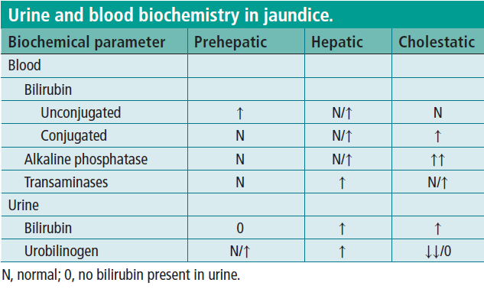

Slide 30
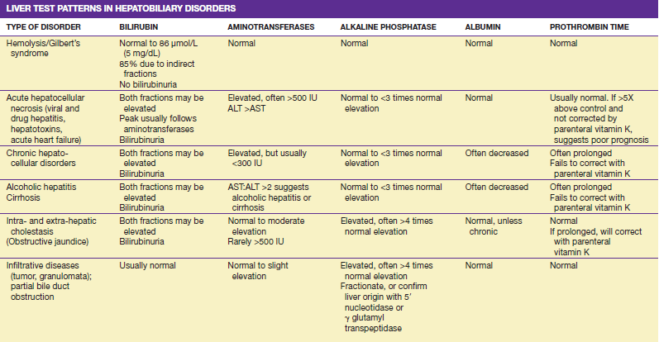

Slide 31
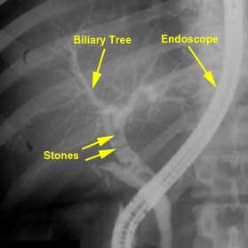
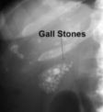
Imaging tests
If intra-hepatic jaundice or post-hepatic jaundice is suspected, it's often possible to confirm the diagnosis using imaging tests to check for any abnormalities inside the liver or bile duct systems

Slide 32
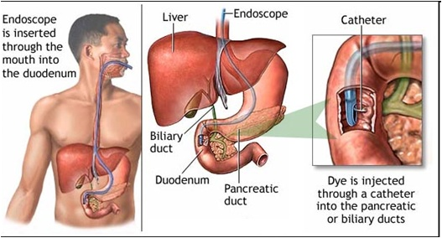
ERCP

Slide 33
Jaundice Treatment
Treatment depends on the cause of the underlying condition leading to jaundice and any potential complications related to it. Once a diagnosis is made, treatment can then be directed to address that particular condition, and it may or may not require hospitalization.
Treatment may consist of expectant management (watchful waiting) at home with rest.
Medical treatment with intravenous fluids, medications, antibiotics, or blood transfusions may be required.
If a drug/toxin is the cause, these must be discontinued.
In certain cases of newborn jaundice, exposing the baby to special colored lights (phototherapy) or exchange blood transfusions may be required to decrease elevated bilirubin levels.
Surgical treatment may be required in case of obstruction jaundice.

Slide 34
Removal of Obstruction Jaundice
Non-surgical
  Extracorporeal Shockwave Lithotripsy
    Non-invasive
    successive shock wave pressure pulses
      fragment the stones into smaller pieces so they can easily pass through the duct
  Endoscopic Retrograde Cholangionpancreatography
    insertion of the endoscope up into the ducts in a direction opposite to or against the normal flow of bile down the ducts (retrograde)

Slide 35
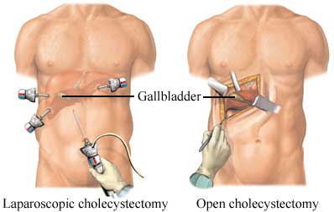
Surgical
  Laparoscopic Cholecystectomy
    aka minimally invasive surgery (MIS), bandaid surgery, keyhole surgery, or pinhole surgery
    small incisions, usually 0.5-1.5 cm
    Laparoscope: a telescopic rod lens system, that is usually connected to a video camera.
    fiber optic cable system connected to a light source and cannula or trocar for view of the operative field

Slide 36
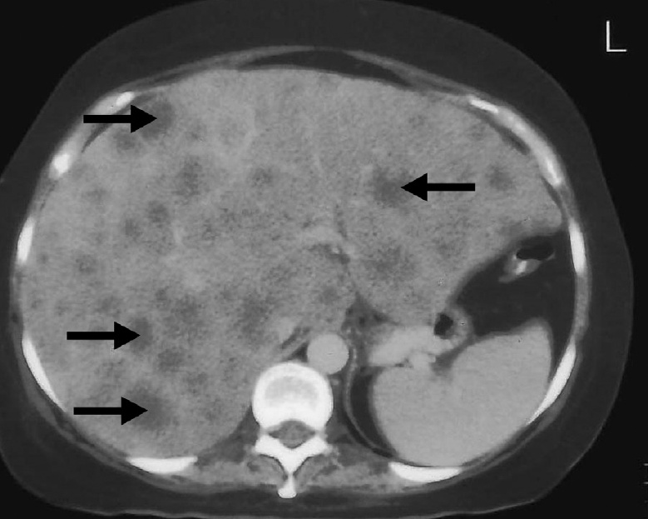
HEPATOMEGALY

Slide 37
CAUSES (1)
HEPATITIS/INFECTION
ACUTE
● Alcohol
● Viruses
● Bacteria
● Protozoans
● Parasites
CHRONIC
Chronic active hepatitis
CONGESTION
● Congestive cardiac failure
● Constrictive pericarditis
● Budd–Chiari syndrome
BILIARY TRACT DISEASE
● Extrahepatic obstruction, e.g. carcinoma of the pancreas, bile
duct stricture
● Sclerosing cholangitis
● Primary biliary cirrhosis
MALIGNANCY
● Metastases
● Hepatoma
● Myeloproliferative disorders
● Myelofibrosis
● Leukaemia
INFILTRATION
● Fatty liver
● Amyloid
METABOLIC
● Glycogen storage diseases
● Haemochromatosis
● Wilson’s disease (hepatolenticular degeneration)
OTHERS
● Cryptogenic cirrhosis

Slide 38
Regular generalised enlargement with jaundice
■ Viral hepatitis
■ Biliary tract obstruction
■ Cholangitis
Irregular generalised enlargement without jaundice
■ Secondary tumours
■ Macronodular cirrhosis
■ Polycystic disease of the liver
■ Primary tumours
Regular generalised enlargement without jaundice
■ Cirrhosis
■ Congestive cardiac failure
■ Reticulosis
■ Budd–Chiari syndrome
■ Amyloid
Irregular generalised enlargement with jaundice
■ Cirrhosis
Localised swellings
■ Riedel’s lobe
■ Hydatid disease
■ Amoebic abscess
■ Primary

Slide 39
SPLENOMEGALY CAUSES
INFECTIVE
BACTERIAL
● Typhoid
● Typhus
● TB
● Syphilis
● Leptospirosis
● Septicaemia
● Abscess
VIRAL
● Glandular fever
PROTOZOAL
● Malaria • (common in Africa)
PARASITIC
● Hydatid cyst
INFLAMMATORY
● Rheumatoid arthritis
● Sarcoidosis
● Lupus
● Amyloid
NEOPLASTIC
● Metastases
● Primary tumours
● Leukaemia
● Lymphoma
● Polycythaemia vera
● Myelofibrosis
HAEMOLYTIC DISEASE
● Hereditary spherocytosis
● Acquired haemolytic anaemia
● Thrombocytopenic purpura
STORAGE DISEASES
● Gaucher’s disease
DEFICIENCY DISEASES
● Severe iron-deficiency anaemia
● Pernicious anaemia
SPLENIC VEIN HYPERTENSION
● Cirrhosis
● Splenic vein thrombosis
● Portal vein thrombosis

Slide 40
Hepatorenal syndrome
Presence of cirrhosis with ascites
Presence of renal failure (creatinine level 1.5 mg/dL)
Lack of improvement in serum creatinine after 48 hours of diuretic withdrawal and volume expansion with intravenous albumin administration (1 g/kg/day up to 100 g/day)
Absence of shock
Use of nephrotoxic drugs, eg, aminoglycosides
Parenchymal renal disease (urine protein 500 mg/day, granular or red cell casts, hematuria, urinary obstruction by sonography).

Slide 41
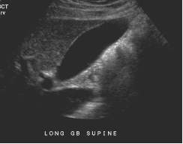
USG abdomen

Slide 42
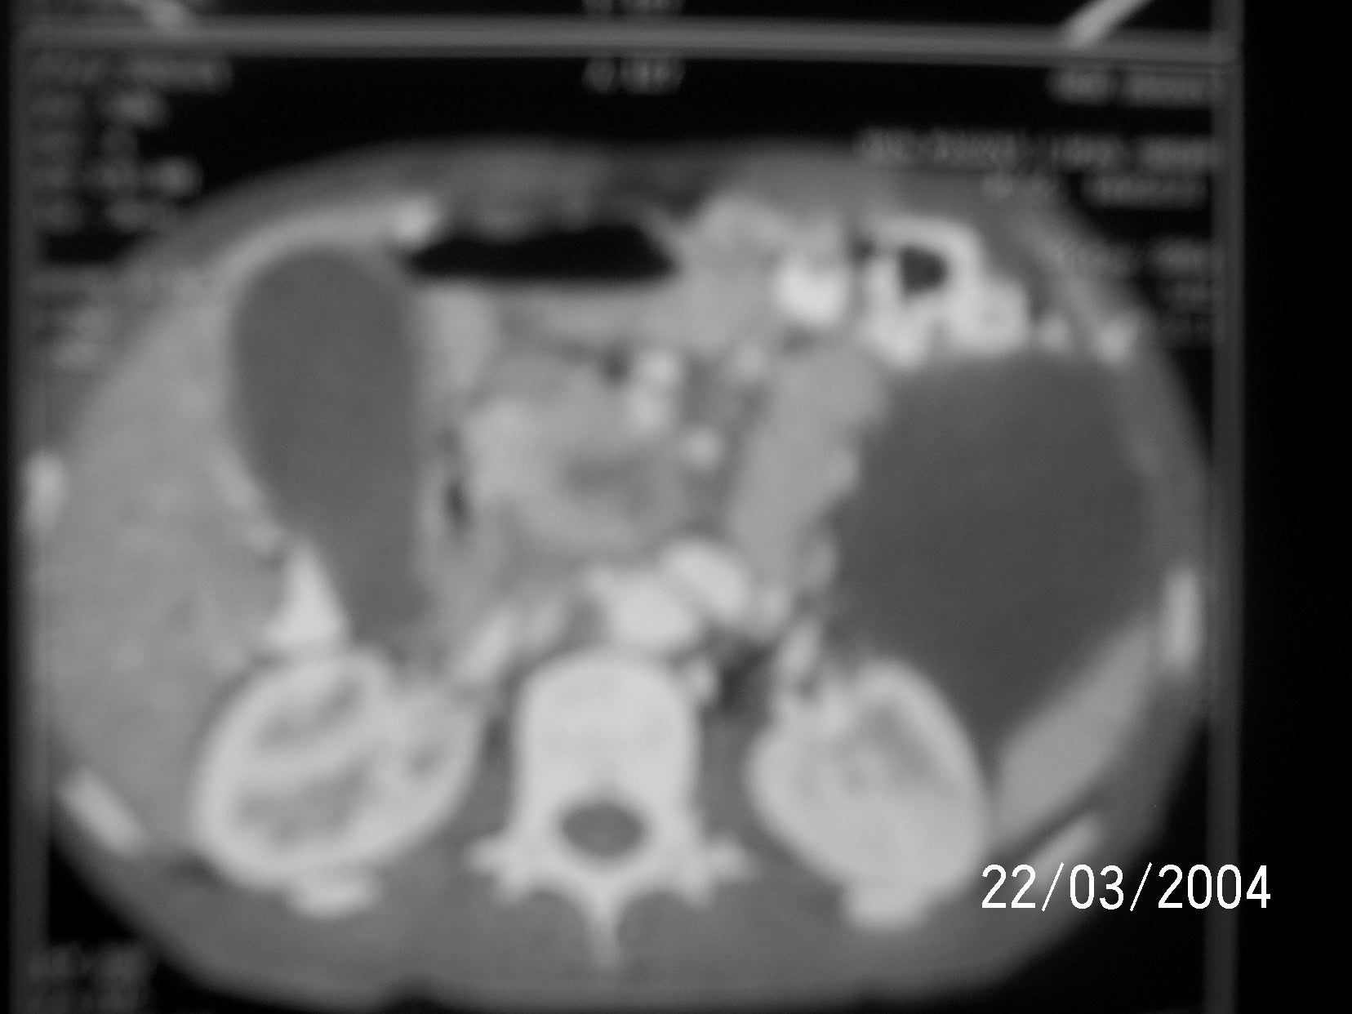
CT abdomen

Slide 43
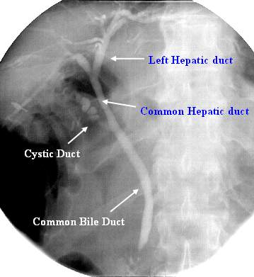
ERCP

Slide 44
Treatment
Choledocholithiasis
  Open / laparoscopic CBD exploration with stone extraction and T tube placement.
  Endoscopic papillotomy and extraction
Periampularry carcinoma
  Curative – whipple’s procedure
  Palliative –
  - endoscopic stenting of ampulla
  - bypass prcodures for
  Food e.g. gastrojejunostomy
  Bile e.g. choledochojejunostomy

Slide 45
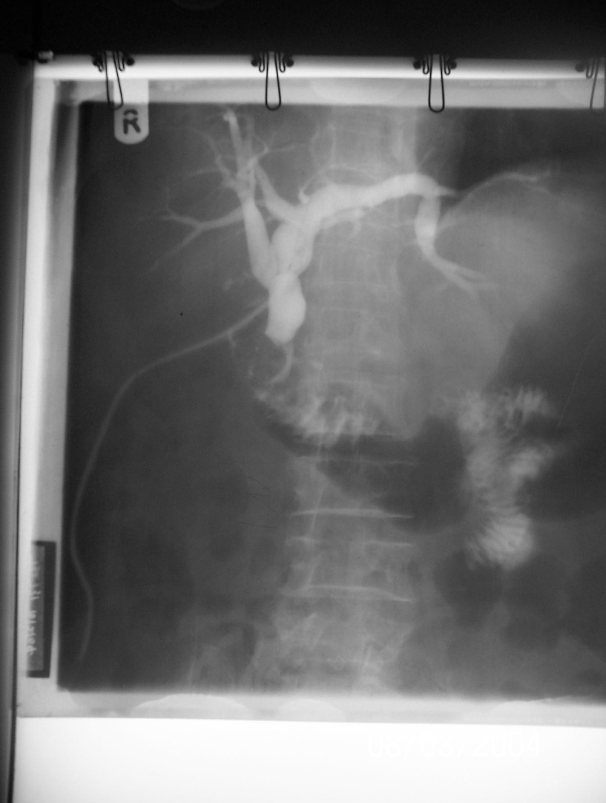
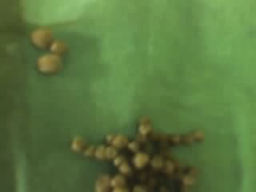
1. Gall stones removed from CBD
2. T-tube cholangiogram

Slide 46
Whipple’s operation
3 structures removed
  C-loop of duodenum
  Head and neck of pancreas
  Pylorus of stomach
3 anastomosis are made
  Gastro-jejunostomy
  Choledocho-jejunostomy
  Pancreatico-jejunostomy

Slide 47
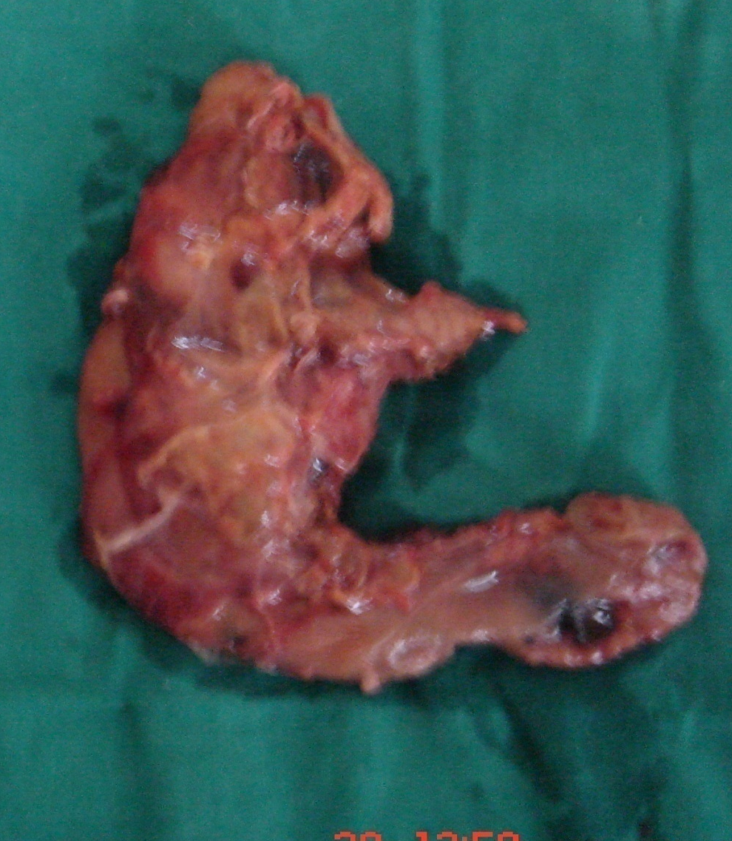
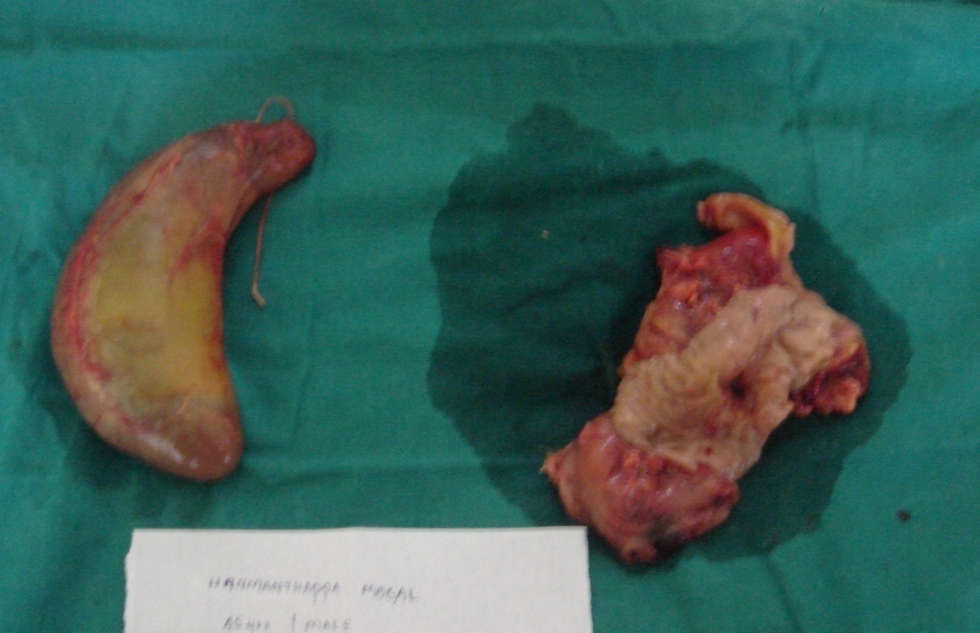
Resected g.b. and opened C-loop showing periampullary growth

Slide 48
Chronic hepatitis (CH) - chronic polyetiological diffuse inflammatory (with dystrophy or destruction elements) process in the liver for more than 6 months, characterized by progressive course, gradual development of fibrosis that can turn into cirrhosis.
In contrast to liver cirrhosis, there are no regenerative nodes in CH.

Slide 49
Phases of hepatitis B and C viral activity
Hepatitis B virus - DNA-containing microorganism of the hepadnavirus family. There are 2 phases of HBV development:
• replicative phase - phase of full virus reproduction (HBV replication involving viral DNA polymerase);
• integrative phase - phase of viral apparatus of genes (DNA fragment) and hepatocyte apparatus of genes integration. From this moment stops full replication of the virus and it becomes impossible to get rid of HBsAg- carriage.

Slide 50
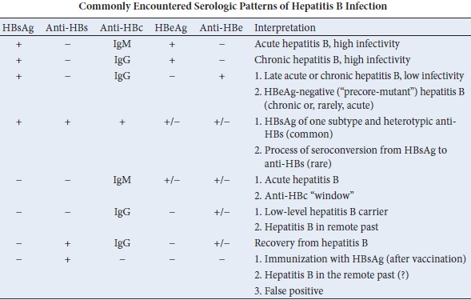

Slide 51
Hepatitis C virus - RNA-containing microorganism of the family Flaviviridae . HCV also has 2 phases of vital activity:
latent phase – long-term absence of clinical picture with low replicative virus activity viraemia;
reactivation phase - development of manifestations with reduction of immune cells functional activity and high viraemia

Slide 52
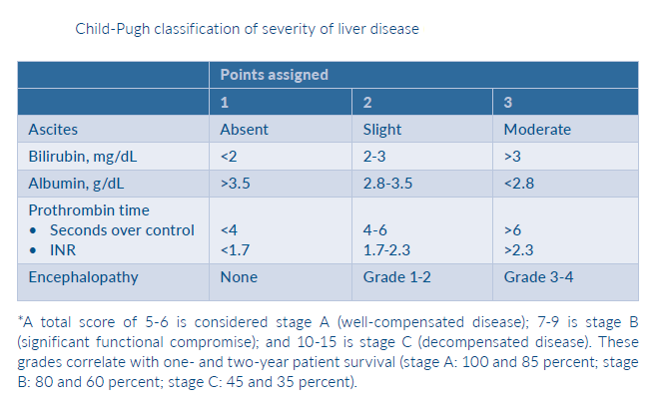

Slide 53
Morphological criteria of liver fibrosis- based on biopsy data, depending on the severity of fibrosis distinguish such morphological stages of CH (0 to 4):
no fibrosis;
minimal periportal fibrosis;
moderate fibrosis with periportal septa;
evident fibrosis without cirrhosis manifestations;
cirrhosis
(Obviously, phase 4 - cirrhosis – belongs to diagnosis of liver cirrhosis, but not hepatitis. Therefore, in our view, it should not be included into the classification of CH, except for cases of CH to cirrhosis transition).

Slide 54
Histological activity index (HAI) of Knodell
HAI criteria:
1. presence and severity of hepatocytes periportal necrosis - 0 to 10 points
2. presence and severity of intralobular focal necrosis and hepatocytes dystrophy - from 0 to 4 points
3. presence and severity of inflammatory infiltrate in a portal area - from 0 to 4 points
4. degree of fibrosis - from 0 to 4 points

Slide 55
HAI, points | Hepatitis | Previous terms
1 −3 | minimal | Nonspecific reactive hepatitis, lobular hepatitis, persistent hepatitis
4 − 8 | light | Lobular hepatitis, persistent hepatitis, soft active hepatitis
9 − 12 | moderate | Moderate chronic active hepatitis
13 − 18 | Severe (with evident activity) | Severe chronic active hepatitis (with bridging necrosis)

Slide 56
CH clinical and biochemical activity of (by clinical and biochemical criteria)
1. Minimal CH (with minimum activity): ALT (N) х3
2. Moderate CH (with moderate activity): ALT (N)х3-5
3. Evident CH (with severe activity): ALT(N)х5

Slide 57
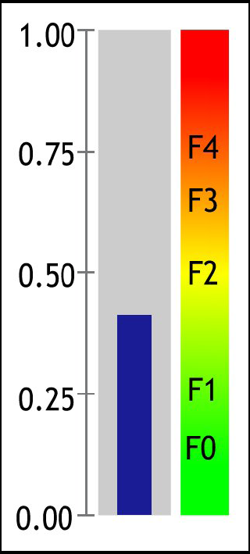
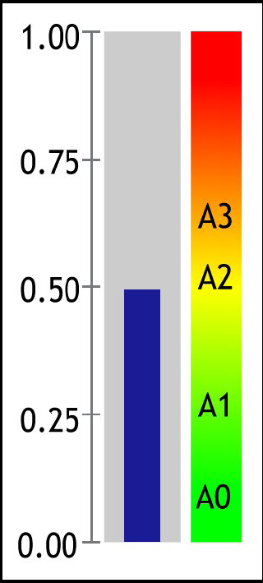
Serological markers of liver fibrosis (non-invasive assessment of liver morphology)
FibroTest
ActiTest
Apolipoprotein A1 (g/l) 1.88
(1,15-1,9)
Bilirubin (μMol/l) 17.80
Haptoglobin (g/l) 1.27
(1,5-2,0)
Gamma GT (IU/l) 113
(10,4-33,8)
ALT (IU/l) 76
Alpha2
Macroglobulin (g/l) 2.90
(1,5-3,5)
Score: 0.41 (F1-F2) Score: 0.50(A1-A2)

Slide 58
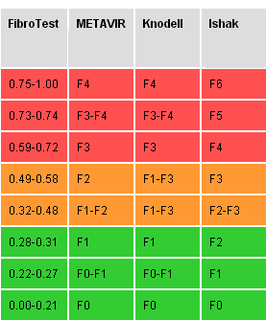
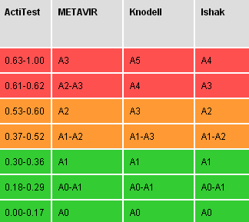

Slide 59
During replication phase of HBV there are:
HBsAg, HBeAg, anti-HBc-IgM, anti-HBc-IgG, DNA HBV
(with presence of HBeAg-negative (mutant) strain of hepatitis B - HBeAg is absent, other markers of replication phase are present)
During integration phase of HBV there are:
HBsAg, anti-HBc-IgG; anti-HBe -IgG appears and HBeAg disappears.
During reactivation phase of HCV there are:
significant level of RNA HCV; anti-HCV-IgM.
During latent phase of HCV there are:
low level of RNA HCV; anti-HCV-IgG are present, anti-HCV-IgM are absent

Slide 60
Diagnostic criteria of Chronic hepatitis (CH)
1. Anamnestic data: previous acute virus hepatitis, chronic alcohol abuse, course of illness for more than 6 months, etc.
2. Complaints: dyspeptic signs, heaviness and pain in the right hypochondrium, jaundice and other "hepatic signs", general condition worsening.
3. Objective data: liver enlargement
Clinical and anamnestic data allows to suspect chronic process in the liver (and sometimes its genesis)
4. Laboratory data (specify genesis and CH level of activity):
presence of one or more biochemical syndromes
(mesenchimal -inflammatory, cytolysis, cholestasis, hepatocellular insufficiency);
virological study: markers of viral replication in blood serum and liver tissue (for viruses of B, delta, G hepatitis), and antibodies to them (for viruses of B, C, delta hepatitis);
with autoimmune hepatitis (or autoimmune CH component of any known genesis) - increase of antibody titer to smooth muscles, specific liver lipoprotein, mitochondria, nuclei; detection of LE- factor

Slide 61
6. Morphological (cytological and histological) data (allows to diagnose the final CH, specify character, severity of lesion and genesis of the disease):
histiolymphoplasmocytic infiltration portal and periportal;
signs of sclerosis, fibrosis of portal and periportal fields with spreading of inflammatory and fibrotic processes on intralobular structure;
dystrophic changes in hepatocytes;
with significant activity of pathological process of viral genesis - large focal necrosis and dystrophy; with viral hepatitis B – detection of Councilman bodies, etc.
with cholestatic syndrome - symptoms of intralobular and portal cholestasis, intrahepatic bile ducts destruction;
with autoimmune hepatitis - early development of significant inflammatory and fibrotic changes;
with alcoholic genesis of CH – perivenular lesion and ballooning degeneration of hepatocytes, presence of Mallory bodies (alcoholic hyalin), etc.

Slide 62
Treatment program of chronic hepatitis
• Diet
• Etiological therapy (alcohol refusal, elimination of other toxic agents influence, interferon therapy in case of viral genesis)
• Pathogenic treatment - correction of immune condition (depending on activity of the process – immunosuppression or immunomodulation)
• Hepatoprotectors
• Desintoxication therapy
• Vitamins

Slide 63
Treatment
Chronic hepatitis, especially with moderate and severe activity, requires hospital treatment to reduce activity of the process, prevent complications, achieve clinical remission and morphological state improvement

Slide 64
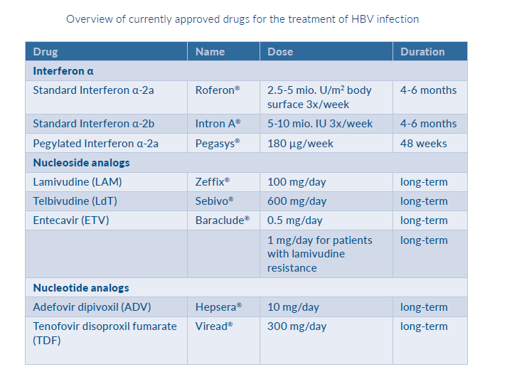

Slide 65
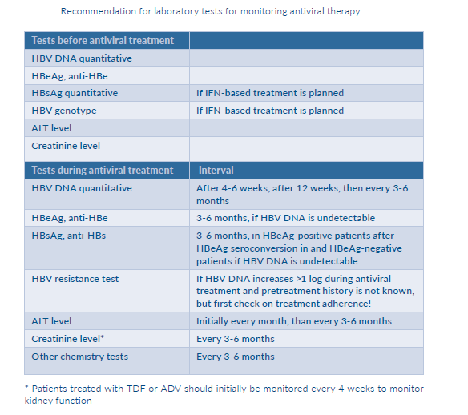

Slide 66
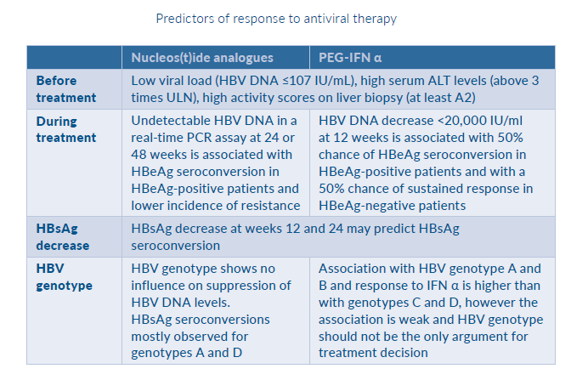

Slide 67
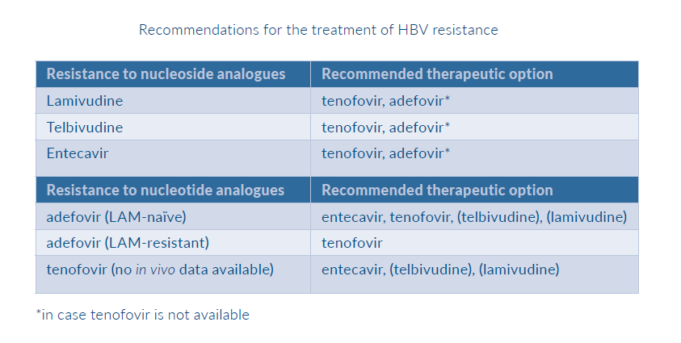

Slide 68
  Pathogenetic therapy
  1. Immunosuppression
  Indications for immunosuppression:
  a) evident activity of CH (more than fivefold increase in transaminases, γ- globulin - more than 30%, etc.), including autoimmune chronic hepatitis;
  b) no effect (or even deterioration) within 1-2 months of treatment
  Variants of immunosuppressive therapy:
  a) monotherapy with prednisolone or other glucocorticoids (budesonide, medrol, metypred, dexamethasone, etc.):
  30-40 mg of prednisolone per day (6 - 8 tablets), gradual dose reducing when improving the patient's condition and reducing of inflammation and cytolysis markers, but no earlier than 2 weeks after beginning of therapy. The following 4 - 8 weeks dose is reduced to 15 mg per day. When reaching clinical - biochemical remission, a maintaining dose of prednisolone is 5-15 mg for at laest 8 - 10 months (with autoimmune chronic hepatitis – life-long).
  b) combined immunosuppressive therapy: a combination of 20 - 30 mg of prednisolone per day and50 - 150 mg of azathioprine (imuran) per day with slow dose reduction to maintaining doses (5-10 mg of prednisolone and 25-50 mg of azathioprine per day).
  When combination of autoimmune changes and cholestasis - prednisolone with ursodeoxycholic acid (2-3 capsules per day).

Slide 69
  Immunosuppression is not indicated (contraindicated) when:
  • asymptomatic disease course;
  • AST < 3 norms;
  • histological signs of portal hepatitis or inactive cirrhosis;
  • decompensated cirrhosis with threat of bleeding;
  • severe cytopenia

Slide 70
  2. Immunomodulation
  Indications:
  • slowly progressive disease course with minor clinical - biochemical manifestations and increasing degenerative and fibrosis changes;
  • improvement of antiviral therapy effect;
  Drugs of choice:
  - 20 mg of timalin per day intramuscularly for 5-7 days, 100 mcg of T - activin per day intramuscularly for 5-7 days or other thymus drugs
  - 2 ml of erbisol per day intramuscularly for 15 - 20 days
  - 2 tablets of chophytol 3 times a day for 20 - 30 days
  - 1,5 g of flamikar per day for 20 - 30 days
  - 3-10 tablets of vobenzim 3 times a day for a month and other immunomodulators (proteflazid, bicyclol, etc.)

Slide 71
Hepatoprotectors and other metabolic drugs
- 5 - 10 ml of essentiale intravenously for 2 weeks, later - 1 -2 capsules 3 times a day;
- carsil (silibor, heparsil, darsil, legalon), gepabene, hepatofalk planta - medium doses orally;
- medicines containing some amino acids and their metabolites: 4 -8 ampules of hepa-merz per day orally; 9 – 18 g of citrarginine (powder bags 3 g) per day; 2 - 6 g of ornicetil 1 - 2 times a day intravenously or intamuscularly; 1 g of glutamic acid 2 - 3 times a day; 0,5-1,5 g (2-6 tablets) of methionine 3-4 times a day; 400 mg of ademetionin (geptral) 1-2 times a day intravenously or intamuscularly or 2-4 tablets per day; 200 - 500 ml of hepasteril A or B infusions, infezol, etc. Drugs with amino acids have both hepatoprotective and detoxificative effects

Slide 72
Modern hepatoprotectors (HP)
1. HP containing bioflavonoids (of vegetable origin):
a) thistle: carsil, darsil, heparsil, silibor, legalon, silehon; gepabene, hepatofalk plant
b) artichoke: chofitol, artichoke extract
c) wild cereals: proteflazid, imunoflazid
d) black alder: altan
e) pea grass: peflamin
e) oat grass: aveol
2. HP containing aromatic bitters (of vegetable origin):
curcuma root - febihol, solaren,
dandelion root -dendeline
3. HP containing so-called essential phospholipids (of vegetable and animal origin):
essentiale H, vessel forte, livolin, essliver forte, livenciale, lipin, lecitin
4. Multicomponent herbal HP:
hepabene (fumaria+ milk thistle), curepar (artichoke+ Paraguay tea+ fillantus), hepafil (fillantus + curcuma), hepatofalk planta (curcuma + artichoke + celandine), antemis (milk thistle + dandelion+ sea-buckthorns + Roman chamomile).

Slide 73
5. Medicines containing natural amino acids and their derivatives (of various origin):
a) mono- or dicomponent: glutargin, citrarginin, hepa-merz, ornicetil, ornitox, lipoic acid (berlition, dialipon, tiogamma, tioctacid), folic acid, methionine, geptral (ademetionin), betaine citrate, glutaxim;
b) multicomponent drugs: infezol, hepasteril, polyamine, vamin, aminosol and others.
6. Preparations containing bile acids (of animal origin): ursofalk, ursohol, ursosan.
7. HP of animal origin containing organ and tissue extracts:
erbisol, protozan, polizim; sirepar, vitohepat, hepadif
8. Synthetic drugs containing complex-forming agents: thiotriazolin, antral, polyoxidonium
9. HP of complex composition and various origins:
lioliv (lipin + antral); homeopathic remedies (hepar compositum, halstena); hepadif (liver extract+ carnitine + vitamins + adenosine); holiver (artichoke + curcuma + medical bile).

Slide 74
Detoxification therapy
• drugs containing amino acids;
• 400 - 800 ml of neogemodez 6% drop-by-drop introduction per day;
• 200 - 400 ml of glucose 5%;
• 200 ml of albumin 5%;
• 400 - 600 ml reopolyglukine 10%;
• plasma substitutes: 200 ml of refortan, 200 - 500 ml of stabizol;
• with symptoms of cholestasis - enterosorbent (enterosgel, cholesteramin, smecta, etc.), preparations of lactulose (dufalak, levolak, normaza and other analogues) 60 ml per day orally
Vitamin therapy: vitamins and paravitamins - B, C, K, D, E, A, lipoic (berlition, dialipon, tiogamma, etc), folic acid; multivitamins, etc.

Slide 75
Portal hypertension has no symptoms

Slide 76
Pressure > 10 mm Hg
Secondary to ⬆resistance to flow
Presents as ascites / variceal bleeding

Slide 77
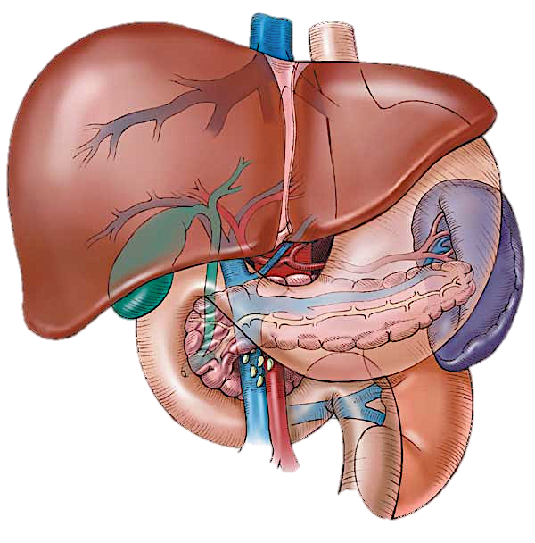
Posthepatic
Hepatic
Prehepatic

Slide 78
Prehapatic
(portal vein obstruction)
Thrombosis of portal vein
Congenital atresia / stenosis
Extrinsic compression

Slide 79
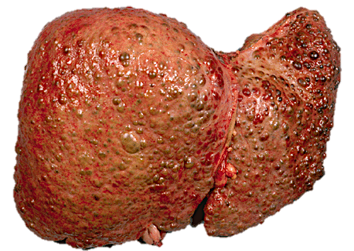
Hepatic
Cirrhosis
Schistosomiasis

Slide 80
Posthepatic
Budd-Chiari syndrome
Cardiac disease

Slide 81
Principles of drug therapy in portal hypertension
Hemodynamic violations | Drug correction
Increased blood volume (CBV) | Diuretics: K-sparing, loop, etc.
Increased cardiac output | Nonselective β-blockers (propranolol, nadolol)
Visceral arterial vasodilation | Vasoconstrictor, somatostatin and vasopressin - bleeding; β2-blockers (if indicated)
Increasing pressure due to vasoconstriction in the portal vein and collaterals | Vasodilators (if indicated), nitrates (isosorbide mononitrate), clonidine, molsydomin blockers, calcium-channel - verapamil, halopamil)
Increased blood flow in theesophagus Varicose veins | Prokinetic, increasing the tone of the lower esophageal opening (metoclopramide, domperidone, mosapryd, itopryd)

Slide 82
Primary prophylaxis and secondary prophylaxis of variceal hemorrhage
Therapy | Starting dose | Therapy goals | Maintenance/follow-up
Propranolol | (1) 20 mg orally twice a day; (2) Adjust every 2-3 d until treatment goal is achieved; (3) Maximal daily dose should not exceed 320 mg | (1) Maximum tolerated dose; (2) Aim for resting heart rate of 50-55 beats per minute | (1) At every outpatient visit make sure that patientis appropriately β-blocked; (2) Continue indefinitely; (3) No need for follow-up EGD
Nadolol | (1) 40 mg orally once a day; (2) Adjust every 2-3 d until treatment goal is achieved; (3) Maximal daily dose should not exceed 160 mg | As for propranolol | As for propranolol
EVL | Every 2-4 wk until the obliteration of varices | Obliteration of varices; Eradication of new varices following initial obliteration | First EGD performed 1-3 mo after obliteration and every 6-12 mo thereafter
ISMN | (1) Only to be used in conjunction with propranolol or nadolol; (2) 10 mg orally at night every day; (3) Adjust every 2-3 d by adding 10 mg in am and then pm; (4) Maximal dose is 20 mg twice a day | (1) Maximal tolerated dose; (2) Systolic blood pressure remains over 95 mmHg | Continue indefinitely
Either one of the three therapies shown in the table are recommended. EGD: Esophagogastroduodenoscopy; EVL: Endoscopic variceal ligation; ISMN: Isosorbide-5-mononitrate.

Slide 83
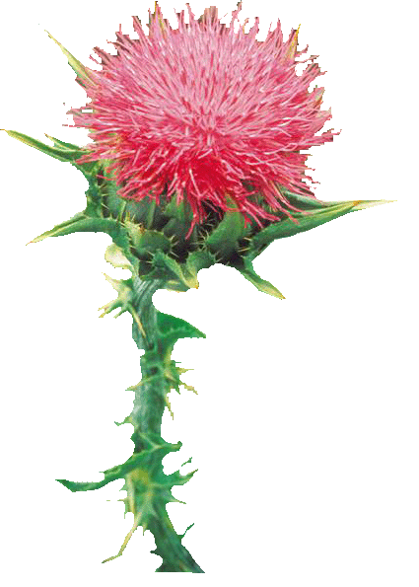
Potential antifibrotic products
( D. Schuppen, N.H. Afdhol, 2008):
1. Inhibition of activated stellate fibrogenic liver cells and fibroblasts:
Recombinant interferon α / β / γ;
Phosphodiesterase inhibitors, pentoxifylline;
Inductors matrix metalloproteinases: halofuhinon;
Prostaglandin E2 (misoprostol)
Angiotensin system inhibitors (captopril, enalapril, perindopril and other ACE inhibitors, losartan, irbesartan, and other AII antagonists);
Donors of nitric oxide (nebivolol, molsydomin, nitrates sildenafil ?,?)
Receptor agonists regulators of lipid metabolism: fibrates (bezofibrat, fenofibrate);
Receptor agonists regulators of glucose metabolism and cell growth, glitazones (pioglitazone, trohlitazon, rozihlitazon);
Herbal drugs with antioxidant effect: hlitsyrryzova acid (from licorice root), quercetin (Buckwheat and others. Plants), resveratrol (from grape seed), silymarin (with thistle) and active components of rooibos tea.
2. The inhibition of migration and proliferation of liver stellate cells and fibroblasts:
Inhibitors of HMG-CoA reductase inhibitors, statins;
K-keepers diuretics: veroshpiron (spironolactone); and a number of other substances that pass preclinical testing.

Slide 84
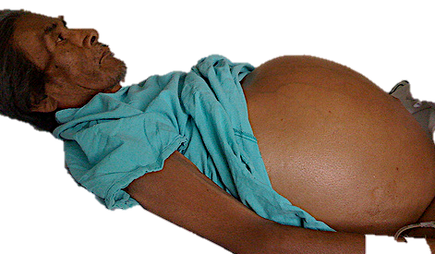
Ascites

Slide 85
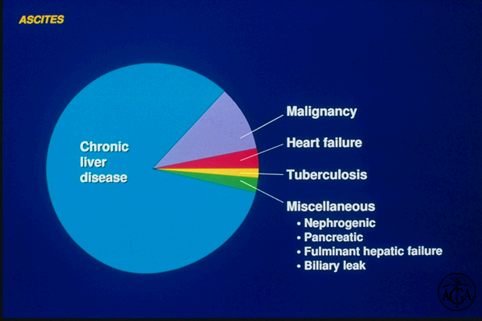

Slide 86
HEPATIC/ PORTAL HYPERTENSION
● Cirrhosis
● Hepatic tumours
MALIGNANT DISEASE
● Carcinomatosis
● Abdominal/pelvic tumour
(primary or secondary)
● Pseudomyxoma peritonei
● Primary mesothelioma
CARDIAC
● Cardiac failure
● Constrictive pericarditis
● Tricuspid incompetence
OTHERS
● Meig’s syndrome
● Chylous ascites
RENAL
● Nephrotic syndrome
PERITONITIS
● TB
● Spontaneous bacterial
VENOUS OBSTRUCTION
● Budd–Chiari syndrome
● Veno-occlusive disease
● Hepatic portal vein obstruction
● Inferior vena cava obstruction
GASTROINTESTINAL
● Pancreatitis
● Malabsorption
● Protein-losing Enteropathy
● Bile ascites

Slide 87
Ascites – Patient Evaluation
Assess liver function
Evaluation of renal and CVS function
Ascitic fluid analysis
Endoscopy for varices

Slide 88
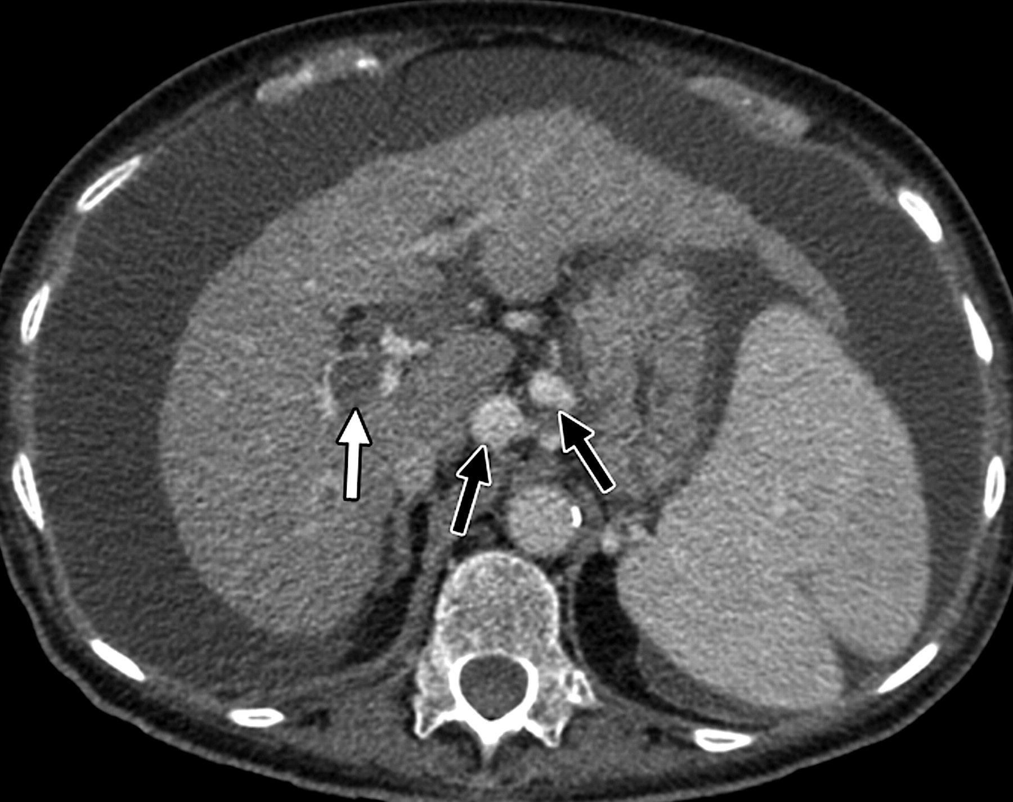
Ascites
Shrunken
Liver
Portal vein
thrombosis
Splenomegaly
Notes:
79-year-old woman with cirrhosis, portal hypertension, hypertensive gastropathy, esophageal varices, and hepatopulmonary syndrome. Axial contrast-enhanced CT scan shows nodular liver, portal vein thrombosis (white arrow), ascitis, and left gastric varices (black arrows

Slide 89


Slide 90


Slide 91


Slide 92


Slide 93
Diuretics Rx in ASCITES (1)
Spironolactone 100-400mg
Furosemide 40-160 mg/d
Serum sodium 126-135 mmol / l, normal serum creatinine. Continue treatment with diuretics controlled electrolytes. Do not limit fluid intake.
Serum sodium 121-125 mmol / l, normal serum creatinine. Continue diuretic therapy.
Serum sodium 121-125 mmol / L, serum creatinine increased (> 150 mg / dL or> 120 mg / dL, and continues to rise). Cancel diuretics and fill fluid volume.
Serum sodium ≤ 120 mmol / L. Cancel diuretics. Volume replacement colloids (gematsel, gelofusin, Voluven) or saline, while avoiding raising serum sodium> 12 mmol / L for 24 hours

Slide 94
Diuretics Rx in ASCITES (2)
Refractory ascites
Diuretic resistant ascites: ascites that is difficult to mobilize, as defined by a failure to lose at least 1.5 kg/week of fluid weight, despite maximal diuretic therapy with spironolactone (400 mg/day) and furosemide (160 mg/day) or an equivalent dose of a distal-acting and loop-acting diuretic, respectively
Diuretic intractable ascites: ascites that is difficult to mobilize, because of the inability to provide effective doses of diuretics because of diuretic-induced adverse effects, eg, azotemia, hyponatremia, and others
Based on International Ascites Club Criteria

Slide 95



Slide 96

Peritoneo-venous shunt
(LeVeen shunt, Denver shunt)

Slide 97


Slide 98




Slide 99

TIPS (transjugular intrahepatic portosystemic shunt)
Notes:
TIPS is a minimally invasive means of creating a portosystemic shunt by creating a direct communication between the portal and the hepatic venous systems within the liver. A catheter is introduced through the internal jugular veinand under radiological control, is positioned in the hepatic vein. From here, the portal vein is accessed through the liver, the tract is dilated and and the channel is kept open by placing an expandable metallic stent.
This technique is of great value in controlling portal hypertension and variceal bleeding. The shunts remain open in ost patients for up to a year, at which point intimal overgrowth leads to thrombosis and occlusion.

Slide 100

TIPS

Slide 101
… in summary
Ascites can be treated with
Medical treatment
Peritoneo-venous shunting
TIPS (transjugular intrahepatic portosystemic shunt)
Liver transplantation

