Slide 1


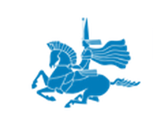

Project idea of
L.N. Gumilyov Eurasian National University
within the framework of
the European Programme
“HORIZON 2020”

Slide 2



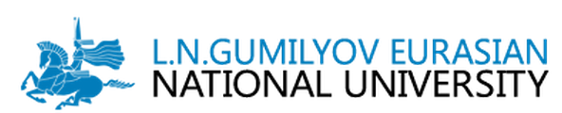
Project idea’s title:
"Dissemination of Destructive Ethnic-Confessional Projects in the Information Space of Eurasia: Elaboration of the System of Planning Public Security"
Project Idea Promoter:
L.N.Gumilyov Eurasian National University
Institute of Modern Studies
Coordinator:
Mukhit Sydyknazarov
Political Science, PhD

Slide 3

Aim and objectives of the project
Aim is
to reveal the main scheme/mechanisms/rules of implementing ethnic and confessional projects directed towards sparking inter-confessional and interethnic disagreement in Eurasia through social network and media
analyzing the perspectives of preventive countermeasures in addressing threats from the sphere of interethnic and inter-confessional relations
analyzing the role of social network and media in disseminating the ideas directed towards kindling the inter-confessional and interethnic discard
studying social and economic aspects of internationalization of ethnic and confessional projects
exploring the experience of implementing ethnic and confessional projects in the Eurasian space: their character and the level of dependence on social network and media
analyzing the ratio of change in social and economic development of a country and the expanding of his information space by taking into account the ethnic and inter-confessional components of population
revealing the exposed and latent tendencies and threats in the sphere of interethnic and inter-confessional relations in Eurasia
comparing the cases of various countries in elaborating the policy of interethnic and inter-confessional consent: finding common basis/rules/mistakes

Slide 4

Elaboration of the preventive counteraction model of
the social network and/or media’s influence in terms of forming an economic model of a country
Main
expected
results

Slide 5


Main foreseen activities
The realization of the monitoring and the analysis of the social and economic aspect of ethnic and confessional projects directed towards the sparking the inter-confessional and interethnic disagreements in Eurasia through social network and media and the elaboration of the preventive counteraction model against these threats
The project suggests the elaboration and approbation of the new approach to the study of interethnic and inter-confessional situation in a country through the lens of social orientation in the Internet space
Innovative character of the project idea

Slide 6




Partners requested:
3 European partners
Estimated Total Budget:
300 000 EUR per year for Kazakhstani side
Estimated duration:
from 12 to 24 months
depending on the agreement
among the partners

