Slide 1


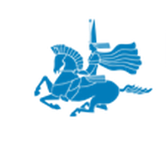

Project idea of
L.N. Gumilyov Eurasian National University
within the framework of
the European Programme
“HORIZON 2020”

Slide 2



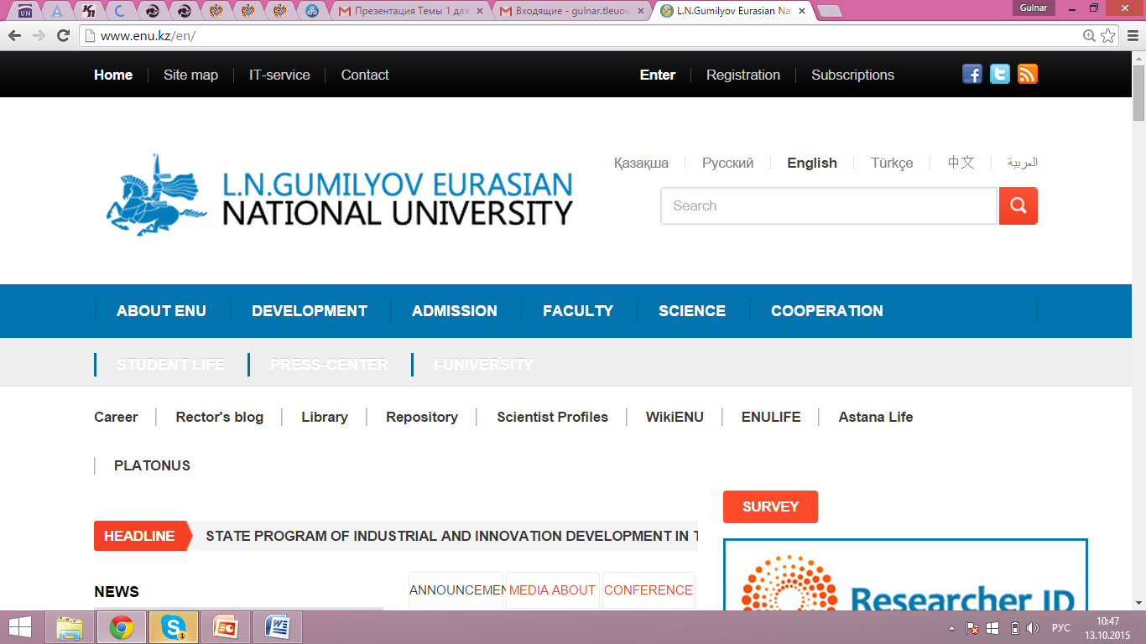
Project idea’s title:
"Agressive Separatism an Secessionism in Social Networks and Media in the Context of Security, Territorial Identity and Integrity"
Project Idea Promoter:
L.N.Gumilyov Eurasian National University
Institute of Modern Studies
Coordinator:
Mukhit Sydyknazarov
Political Science, PhD

Slide 3

Aim and objectives of the project
Aim is to better understand the role of the new social networks and apply the knowledge in order to maintain the public security
With the development of social networks and media, studying the most spread social networks – the platform for contemporary aggressive ideologies of separatism, secessionism and irredentism: their content, the psychology of behaving in the social networks, their focus and ideology
To study history of separatism, secessionism, irredentism and decolonization in the parts of the world, the forms of their successful public legalization, their country-level and international-level legitimization, correlation of international principles of sovereignty, unity and territorial integrity of a country, inviolability of the borders and the right of the peoples and ethnic groups to self-determination
Factors of language, ethnicity, confessional belonging, demography, migration and the new political campaigning that serve to the historically unconfirmed ideological constructs in the ideology of irredentism, secessionism, separatism – theoretical and practical aspects
Genuine and unconfirmed political, financial and economic factors and the interests in the ideology of irredentism, secessionism and separatism
The transformation of irredentist, secessionist and separatist movements into the destructive, extremist, terrorist, militarized forms of organization
Assessing the role and effectiveness of social networks and/or media in the process of activation of aggressive separatist and secessionist ideologies
Analyzing the tendencies of separatism and secessionism in the system of risks and threats to the national security of various countries by taking into account the internal and external factors

Slide 4

Creation of the modern effective system of methodological bases for the analysis of the social networks (starting from their transformation into the virtual forms of interaction), their dissemination, recruiting and evolution of separatist and secessionist organizations in order to provide and build the model of preventive and effective national security
Main
expected
results

Slide 5

Main foreseen activities
Step 1
Research on this topic with the involvement of the top specialists in the fields of information technologies, political science, sociology, law, cyber security, and the fields with the ideological and legal basis
Step 2
Possible involvement of strategies and tactics of current and former adherents of separatist and secessionist movements in the course of the fieldwork (observation, interview, analysis of slogans and texts)
Synthesis of the methodological bases in ideology and practical basis of information security, cyber security in the process of real time. Possible application of methodologies of matrix identification, identifying the existing and/or emerging legal and illegal separatist movements with an aggressive content
Innovative character of the project idea

Slide 6




Partners requested:
3 European partners
Estimated Total Budget:
300 000 EUR per year for Kazakhstani side
Estimated duration:
from 12 to 24 months
depending on the agreement
among the partners

