Slide 1

Technical University of Košice
Slovakia
Presentation of Project Ideas
at the International Consortium Board Meeting
held at
Uzhhorod National University
Vladimír Modrák

Slide 2

Agenda of Presentation
Brief Introduction of TUKE
- Structure of the University
- Short description of the project “ Technicom“
- International partnerships of TUKE
2. Ideas of the project focused on:
Enhancing the competitiveness of young researchers and doctoral students in the fields of mechanical, manufacturing and industrial engineering

Slide 3
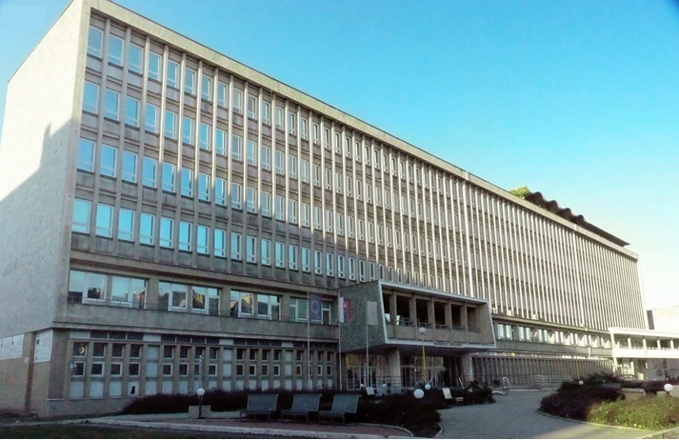
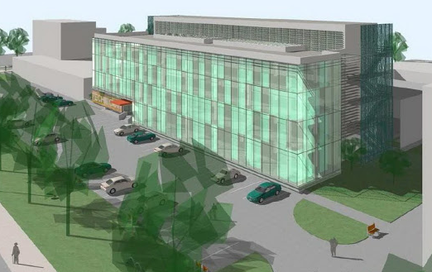
Presentation of Project Ideas
Brief Introduction of TUKE
The Technical University of Košice was founded in 1952
Faculty of Metallurgy
Faculty of Mechanical Engineering
Faculty of Electrical Engineering and Informatics
Faculty of Civil Engineering
Faculty of Economics,
Faculty of Manufacturing Technologies
Faculty of Arts
Faculty of Aeronautics
Faculty of Mining, Ecology, Process Control and
Geo-technology
Currently ,the most important project at the universit is:University Science Park Technicom
Partners of the project:
- Technical University of Kosice – lead partner
- Pavol Jozef šafarik University in Košice – partner
- University of Prešov – partner
Total budget of the project is 41 735 688,04 EUR.
Project focus:
- Building the functional infrastructure of the park
Support of innovation-based companies in the form of "spin-off" or "start-up".
State-of-the-art applied research and development in the five selected scientific disciplines:

Slide 4
Presentation of Project Ideas
R&D in the five selected scientific disciplines:
Information and communication technologies,
(II) Electrical engineering, automation and control systems,
(III) Mechanical engineering,
(IV) Civil engineering (construction, transport, geodesy),
(V) Environmental engineering (mining, metallurgy, water management) including its social and human dimension.

Slide 5
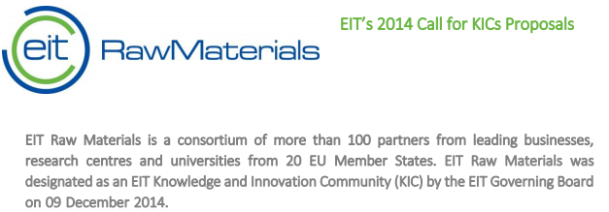
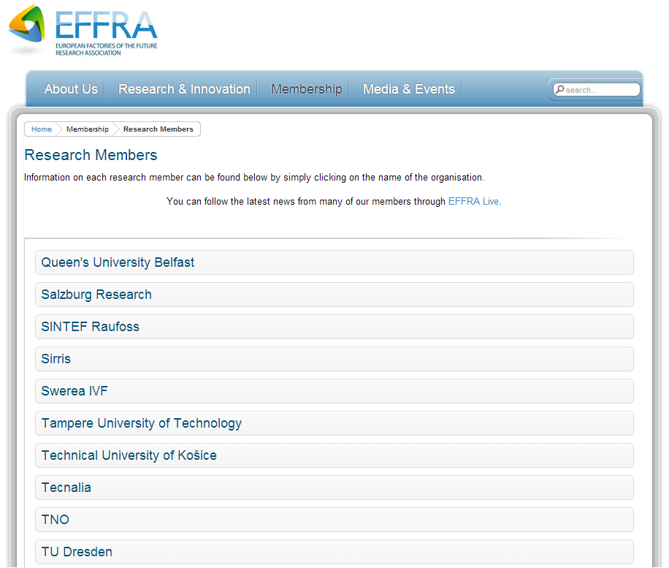
Presentation of Project Ideas
Brief Introduction of TUKE
TUKE is member of the RawMatTERS – winner of EIT Raw Materials
TUKE is the first university from Slovakia involved in
Knowledge and Innovation Community (KIC)
TUKE is research member of EFFRA -European Factories of the Future Research
Association
TUKE is the first University from Slovakia who is a research member of EFFRA

Slide 6
Enhancing the competitiveness of young researchers and doctoral students in the fields of mechanical, manufacturing and industrial engineering
Ideas of the project:
Funding program : The project is planned to be submitted to
H2020-MSCA-ITN-2016 Marie Sklodowska-Curie innovative training networks call. The opening date will be 30 September 2015 and the closing date 14 January 2016.
Project idea’s description:
The project is intended to offer PhD researchers comprehensive training programmes focused on transfer of scientific knowledge and personal development through participation at research projects and specialized courses of hosted universities and industrial companies.
Aim and objectives of the project:
The research programme will be focused on Rapid prototyping and Lean manufacturing techniques with objectives to achieve greater sustainability of production companies through cycle-time reduction of product development and production processes. The main motivation for this research programme topic is to take advantage of the synergy between rapid prototyping technology and various lean manufacturing techniques that are being used to increase company`s competitiveness, especially in SMEs.

Slide 7
Enhancing the competitiveness of young researchers and doctoral students in the fields of mechanical, manufacturing and industrial engineering
Ideas of the project:
Main expected results:
To increase competitiveness of young researchers and doctoral students in the fields of mechanical, manufacturing and industrial engineering.
Main foreseen activities:
Admission of ESRs - Recruitment of all 20 ESRs according to selection criteria at all 10 beneficiary institutions
Introductory courses
Supplementary courses
Secondment activities
Participation at projects
Original research work presentation
Innovative character of the project idea:
Integration of two research domains which are highly topical in terms of enterprices
produsing wide variety products in small batches.

Slide 8
Enhancing the competitiveness of young researchers and doctoral students in the fields of mechanical, manufacturing and industrial engineering
Ideas of the project:
Partners involved at this stage:
TUKE – Lead partner (Slovakia)
Rzeszow University of Technology (Poland)
University of Minho (Portugal)
Politechnic University of Porto (Portugal)
University of Stavanger (Norway)
Politechnic University of Turine (Italy)
University of Osijek (Croatia)
University of Seville (Spain)
University of Zagreb (Croatia)
University of Passau (Germany)
Industrial Partners:
HSTec Hrvatska (Croatia)
DEXTER Technologies, S.A. (Portugal)
ELCOM, s.r.o. (Slovakia)
Fábrica de Utilitades de Tubo, Lda. (Portugal)
Estimated Total Budget 830 000,- Euro Estimated duration 36 months

Slide 9
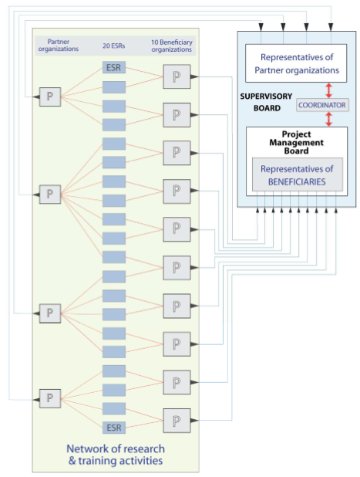
Enhancing the competitiveness of young researchers and doctoral students in the fields of mechanical, manufacturing and industrial engineering
Ideas of the project: Network organisation and management structure

Slide 10

TECHNICAL UNIVERSITY OF KOSICE
Thank you for your attention!

