Slide 1
COURSE OBJECTIVES:
Recognize the growing diversity within the workplace, student body, and local communities.
Identify ways and benefits of promoting the culture of equity and inclusion.
Interpret the necessary steps in developing cultural competence.
Distinguish unique challenges and success strategies in serving minority students.
Examine various DEI training programs and professional development opportunities.

Slide 2
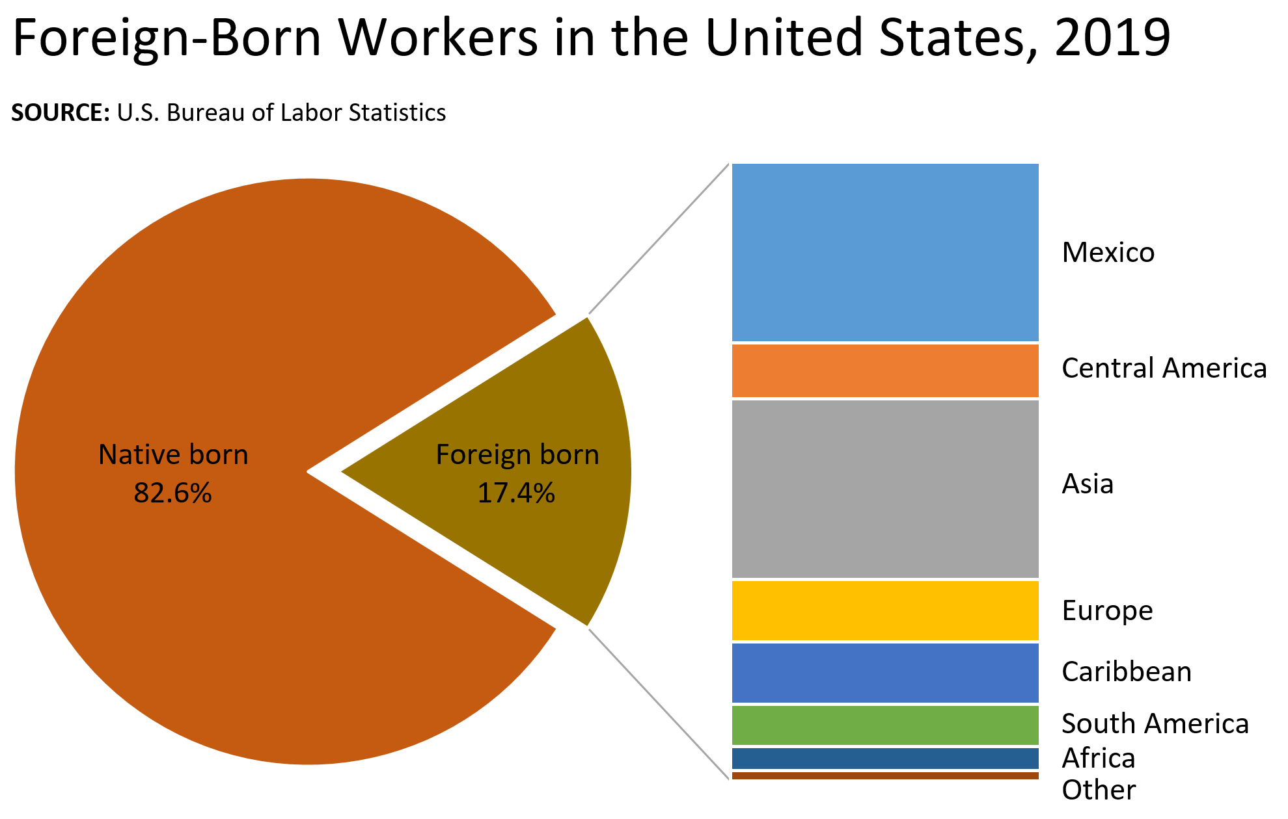
Modern organizations recognize the importance of a diverse workforce as well as diverse customers. In addition to individual and demographic differences, we also have different cultural backgrounds. For example, consider the fact that over 17% (28.4 million) of U.S. workers are foreign-born. Succeeding in today’s workplace and, for that matter, personal life implies the ability to relate effectively to diverse populations from within and outside of someone’s country.

Slide 3
Improving cross-cultural relations and fostering diversity within organizations requires a two-fold approach. One important goal is making sure that all people can achieve their full potential, unrestrained by individual or group identities. An equally important goal is for these groups to work together harmoniously.
The true meaning of appreciating diversity goes beyond simply tolerating different backgrounds and treating everybody the same. It must encompass:
Inclusion, which means that each person feels respected, valued, and welcomed by authentically participating in all organizational processes, activities, and decision-making. Diversity advocate Verna Myers coined the phrase “Diversity is being invited to the party. Inclusion is being asked to dance.”
Equity, which means fair treatment, access, opportunity, and advancement for all while recognizing the existence of certain privileges, barriers, and historically underserved and underrepresented populations. A seemingly simple task of scheduling and conducting a meeting, when done inclusively and equitably, entails considering such individual variables as facility accessibility, access to technology (for virtual meetings), special accommodations, dietary needs, communication barriers, religious observances, family circumstances, travel time, driving conditions, biological clocks, etc.

Slide 4


Showing consideration and empathy is the cornerstone for developing cultural sensitivity (including political correctness), cultural intelligence, and cultural competence as well as avoiding cultural bloopers. The latter can be very costly, and even well-funded corporate and government giants are not immune. One example is the dismal failure of Walmart Inc. in Germany due to grossly misunderstanding the country’s cultural idiosyncrasies (https://medium.com/better-marketing/why-walmart-failed-in-germany-3fdcc6469b89). Another infamous cultural blooper was committed by the U.S. Department of State in a failed bid to improve relations with Russia. Though creative, the “reset button” gift had the Russian word not only written offensively in Roman letters instead of Cyrillic but also fatally misspelled. Instead of perezagruzka (which intended to mean “reset”), it read peregruzka (which actually meant “overload”).
Vincent McIndoe/Picture Press
Image Source/Wikimedia Commons

Slide 5
Cultural sensitivity is the awareness and acceptance of other cultures. It includes the willingness to investigate why people with different cultural backgrounds act as they do. When interacting with diverse populations, one must be patient, adaptable, flexible, and willing to listen and learn. It is also important not to assume that one’s own culture is superior and use it as a standard to evaluate other cultures. This is known as ethnocentrism. How often do people think that other cultures are weird, backward, or primitive?
Political correctness is closely related to cultural sensitivity and means being respectful, civil, and careful not to offend or slight anyone. Again, empathy is key. How would I feel if somebody made fun of my religion or exclaimed “Ew! Gross!” after sampling my favorite ethnic dish?
Cultural intelligence (CQ) is an advanced aspect of cultural sensitivity which allows people to adapt to various cultural environments by observing subtle cues about how a person should act in certain situations. It is an outsider’s ability to perceive someone’s unfamiliar behavior through the eyes of an insider. To practice high cultural intelligence, we must rely on three components: (1) cognitive—what we know and how we can acquire new knowledge; (2) emotional—the motivation and confidence we need to try something new; and (3) physical—translating intentions into actions.

Slide 6
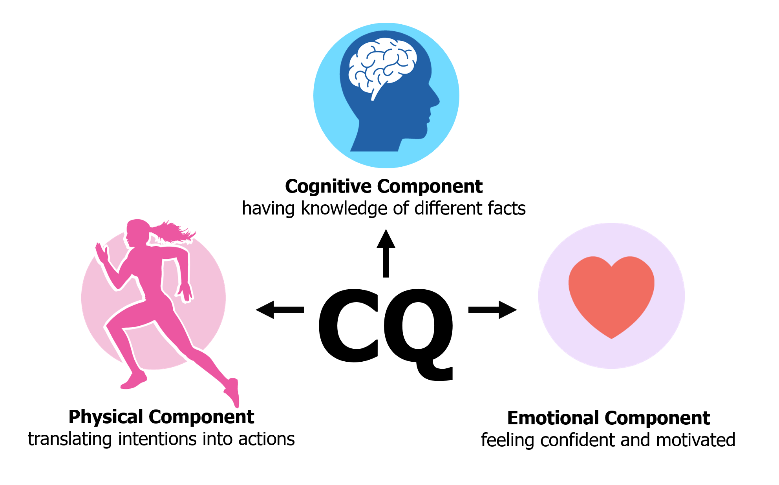
The Components of Cultural Intelligence
For example, you learn that Japanese parents show their children affection by preparing elaborate bento lunches (cognitive). You like the idea and order a bento box kit from Amazon (emotional). And then you find the time to actually prepare authentic Japanese bento lunches for your loved ones (physical).
Do you think you have a high level of cultural intelligence?
Let’s take a CQ Pop Quiz! (Don’t worry—it’s not graded).

Slide 7
What religion is practiced by Hmong Americans?
Shamanism
Buddhism
Christianity
All of the above

Slide 8
ANSWER: D
All of the above
Animism/Shamanism and ancestor worship form the traditional Hmong religion. Laos, where most Hmong Americans came from, is predominantly Buddhist. Up to 50% of Hmong in the U.S. are now Christian.

Slide 9
What is the Día de los Muertos in Mexico?
Halloween
Costume festival
Celebration of lives of the loved ones who have died

Slide 10
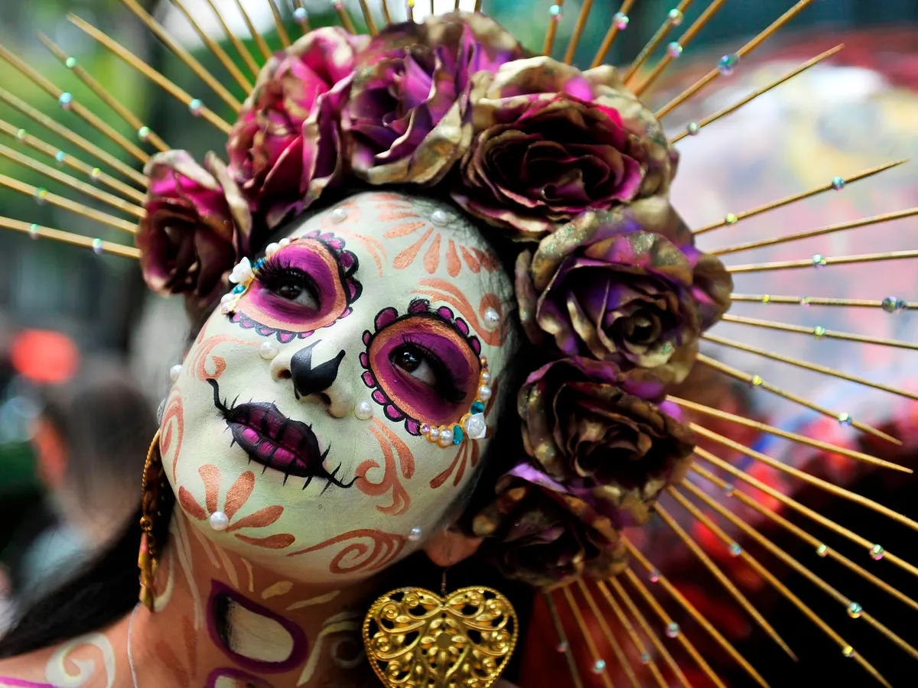
ANSWER: C
Celebration of lives of the loved ones who have died
The Day of the Dead is celebrated in Mexico on November 1 and 2. This multi-day holiday involves family and friends gathering to pray for and to remember friends and family members who have passed away. It is commonly considered a day of celebration rather than mourning.
Claudio Cruz/Getty Images

Slide 11
If a Syrian said Ismee Abdul, what would be the translation?
It is time to pray
My name is Abdul
If God wills it

Slide 12
ANSWER: B
My name is Abdul
Ismee means “my name is” in Arabic. Thus ismee followed by “Abdul” would translate as “My name is Abdul”. Allah is the name for God, and Insha’ Allah means “if God wills it”.

Slide 13
In Kenya, this word appears on the national coat of arms and translates from Swahili as “pulling together”:
Habari
Harambee
Asante
Kwaheri

Slide 14

ANSWER: B
Harambee
Harambee is a Kenyan tradition of community self-help events, e.g. fundraising or development activities. Harambee literally means “all pull together” in Swahili, and is also the official motto of Kenya and appears on its coat of arms. Habari is a form of greeting (“what’s up?”), asante means “thank you”, and kwaheri means “goodbye”.
Ashi Kariuki/Wikimedia Commons

Slide 15
How should a Korean named Kim Jun Ho be referred to in English?
Mr. Kim
Mr. Jun
Mr. Ho

Slide 16
ANSWER: A
Mr. Kim
In Korea, the surname is said first when introducing people. Jun and Ho are given names which are often separated by a hyphen.

Slide 17
Salo is a food that was available and eaten during difficult times in Ukraine when meat was too expensive. Today, Ukrainians continue the tradition and eat this food, which lasts a long time without refrigeration:
Potatoes
Goat cheese
Lard

Slide 18

ANSWER: C
Lard.
Salo (pig fat or lard), which is sometimes spread on bread, has been eaten by Ukrainians as a long-standing tradition.
Image Source/Legion Media

Slide 19
How might a Chilean react after noticing a friend has gained some weight since their last visit?
Casually mention it
Directly say something
Only say something if your friend brings up the subject

Slide 20
ANSWER: B
Directly say something
Chileans are known for stating their observations in a direct manner. Strong comments such as “you look fat, you must have gained 40 pounds,” are not insults but rather truthful observations that are an accepted way of communicating.

Slide 21
Japanese hospitals usually do not count this floor, because the number translated also means death:
3
4
6

Slide 22
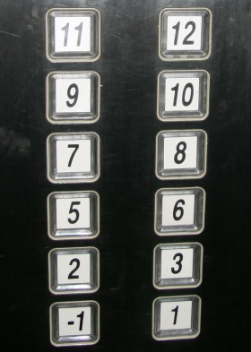
ANSWER: B
4
Japanese superstition attempts to avoid any reminders of death. The word for four, shi, which also means death, is often a skipped floor number in hospitals and other buildings.
Chris O’Byrne/Wikimedia Commons

Slide 23
So far, we have covered awareness, acceptance, respect, and knowledge of other people’s backgrounds. The highest level of understanding cultural differences is achieved by developing cultural competence.
Cultural competence, or cultural fluency, emphasizes various skills that allow individuals and organizations to effectively operate in diverse cultural contexts which includes altering common practices in order to reach different minority groups. In other words, once we have acquired cultural sensitivity and cultural intelligence, we need to embed the lessons learned into our daily routines.
Changing one’s mindset, developing familiarity with other cultures and subcultures, and acquiring the ability to work seamlessly across diverse environments is a lengthy process which takes a lot of time and countless efforts. It can, however, be accelerated through quality training interventions. Diversity training programs that are integrated into institutional operations, reinforced periodically, and tied to the organization’s overall mission, vision, and values deliver long-term positive results.
With the growing diversity of the student body, it is imperative for educational institutions to develop a cultural competence that enables them to interact effectively with students of all backgrounds. Our next activity takes a look at a diverse sample of student voices at WITC.

Slide 24
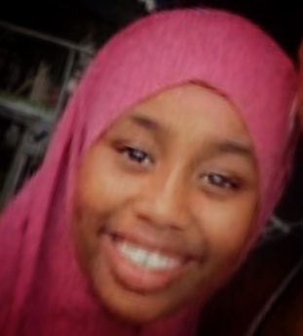
Student Voices
Anisa Adan, WITC Rice Lake
Hello, my name is Anisa. I am 16 years old. I attend Barron High School. My parents are originally from Somalia, but I was born and raised in Wisconsin. Still, I hate cheese and milk. On the plus side, I like milkshakes and cheese curds.
To me, the word “diversity” means that people from different backgrounds, ethnic groups, races, and religions get together and respect everyone for who they are. It also means that various ethnic groups share ideas and blend together as a family. From a young age I was taught to treat people the way you want to be treated. Sadly, when people think of the Middle East, they instantly have negative images and stereotypes because of what they may see and hear in the media. For example, a lot of people still believe that Somalia has always been a war zone. I asked my mom about growing up in Africa. My mom said she never felt scared. She walked the streets, bought ice cream from one of the shops, and she loved it there. I also wish that islamophobia was not a thing because Muslims are regular people who have families and jobs.
In Barron, I would have to say that we are segregated by race. While Caucasians and Hispanics are more likely to live in rural area, the Somalis reside in city close to stores and the school. We have an Islamic school that we go to on the weekends, so it seems reasonable not to live far away. We also have two local Somali restaurants where people usually drink tea and gossip.
Muslims believe in the same God (called “Allah” in Arabic) as the other Abrahamic religions. Muslims are required to pray five times a day. The traditional role of an imam (which means “stand in front of” in Arabic) is to lead a group in prayer, guide in the matters of worship, and perform services like marriage, funeral rites, etc. Muslims believe the Quran was revealed to Prophet Muhammad in the month of Ramadan, which is the ninth month of Islamic calendar. It’s observed as a month of fasting, reflection, forgiveness, and charity. Eid-ul-Fitr marks the end of fasting. The greeting “Eid Mubarak” (Happy Eid) is used to wish each other well on this day. For women, wearing the hijab (head covering) is a mark of devotion and commitment to Faith.
I think that WITC does a great job welcoming students and helping them find their passion in school. I also feel that everyone here does their best to help students understand if they are confused. To help people overcome culture shock, I would recommend taking an interest in multicultural meetings or gatherings and learning more about religions. Also people should not be afraid to share experiences because it opens conversation and leaves the assumption behind.

Slide 25
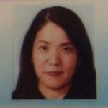
Student Voices
Rika Rose, WITC New Richmond
My name is Rika. I grew up on a small island in the south part of Japan and have always been curious about foreign countries. I was really shy as a child because, in our culture, girls were taught that their opinions did not matter. Since I came to the U.S., my life has changed for the better, and people want to hear my opinions.
When I came to Wisconsin, I first took an ESL class at WITC and then my program classes. I have been very happy with the friendly and helpful teachers and students here. After the 2011 earthquake in Japan, WITC offered to collect donations on campus. I received not only donations but also kind words from everyone. I am so grateful for that. I consider it a privilege to attend WITC. I enjoy meeting all the students of different ages and backgrounds. While I was fortunate to have my husband help me through the school enrollment process, I wonder if there are other foreign students who might need help. One time I spoke with a student counselor and did not have a good experience. I also sent an email to an advisor and received no response, so I have not used student services since then. Maybe it was my English, and they could not understand me. I would be happy to assist Japanese or other foreign students. It would be nice to have such a system in place.
In Japan, I worked for the airlines, shipping companies, and travel agencies where I could practice speaking English. I have traveled all over the world and I think that Japanese customer service is the best. There is a Japanese expression “Our customers are like gods.” Our goal is to welcome our customers with a smile, see them off with a smile, and for them to leave with a smile, too. If you are a Japanese person living outside of Japan, you will get your first culture shock at the lack of customer service. Some things would be considered extremely rude where I come from (e.g., interrupting a customer to answer the phone, not greeting a person who walks in or even politely asking them to wait a moment). The Japanese term “omotenashi” means to provide heartfelt and courteous hospitality to others without expecting something in return.
I am often asked about the food service at Japanese company and university cafeterias. In the past, the focus was primarily on being tasty and inexpensive. In recent years, there’s also been an increased emphasis on health and nutrition. Food service is based on the concept of “eating healthy” and “being able to adjust the nutritional balance” to assist us in our unbalanced, busy lives. TANITA Corporation, a global manufacturer of electronic scales and body fat monitors, introduced a cafeteria model that offered employees a menu to eliminate obesity. It became a bit of a social phenomenon in Japan, with books written and movies made about their menu. A national pastime in Japan is to talk about eating, weight, and health.

Slide 26
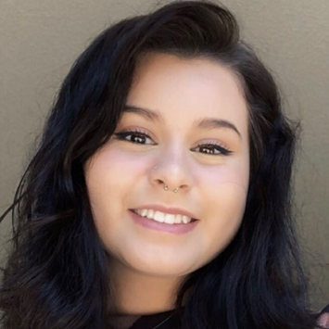
Student Voices
Gisselle Tafolla, WITC New Richmond
My name is Gisselle. I am currently enrolled in my second year of the Human Services program at WITC New Richmond. I am 19 years old and living with my parents in Somerset until I graduate from college and become more financially stable to live on my own. Both of my parents are originally from Mexico and have been living in the United States for around 40 years.
Growing up in a small town with little to no diversity was tough. As a Mexican American female, I have experienced a lot of ignorant comments when it comes to my ethnicity. I learned that the reason why so many people have misconceptions about minority groups is because of how they were raised, the people they surround themselves with, and the media. I think it is important for teachers to educate their students about different cultures, discuss privilege, prejudice, colorism, racism, etc., and clear any ignorance, stereotypes, and false information about people of different races and ethnicities.
When I started elementary school, I had to take ESL classes in order for me to learn English. These kinds of accommodations should be available to every student during elementary school, middle school, high school, and college. The ESL program helped me tremendously to become successful in school; it helped me become a better writer and pass English college classes during high school. Speaking about communication barriers, WITC should offer a choice to deliver our postal mail in different languages. Sometimes my parents want to read what WITC mailed me and have a difficult time understanding what it says, so I have to translate it for them. Other things that I believe would be great for WITC to offer in order to better serve underrepresented minority groups are: counseling if they are experiencing a culture shock, interpreting services, financial assistance, hiring staff that speak different languages to help students at the student center, and being aware of different holidays that would cause some students to miss classes.

Slide 27
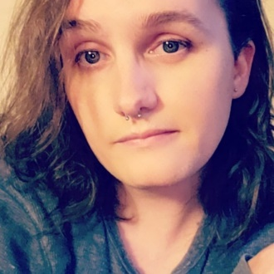
Student Voices
Aubrey Wilson, WITC Ashland
Hello! My name is Aubrey. I am 32 years old, I am a transgender woman, and I have a physical disability which has rendered me wheelchair-bound. I’ve been offered an opportunity to add my perspective in the context of diversity. Of course, it’s important to realize that there is diversity in everything, and my experience may not be similar to the experiences of another transgender or disabled person.
The very first thing I would like to mention with regard to my disability is that I prefer person-first language. What it means is that during introductions I identify myself (Aubrey, she/her) and then, if pertinent to the conversation, I identify that I have a disability. Because a wheelchair is required for me in most situations, my disability is always front and center. What person-first language does is identify me before my disability. I am not my disability, but my disability is a trait that I have.
Another thing I’d like to mention is that people with visible disabilities tend to be more socially isolated. Either they are simply not invited to social events, or the social events they are invited to are not well-suited to their disability. I cannot count the times in high school and my adult life when I was excluded from a social activity with friends and coworkers because they decided an activity would be too much for me, without consulting me. All that needs to be done is to invite a person. People with disabilities know their limitations and can properly gauge if they are physically able to do something or not. They may show up just to spend time with people even if they don’t participate in a certain activity.
Going back to the subject of person-first language, it is much the same with being transgender except that generally it is not in my best interest to share my gender identity. Ultimately, however, I am a woman who is transgender. This typically goes unannounced unless medically relevant. If you as a coworker, friend, sibling, spouse, etc. know that a person is transgender, do not out that person to others. We are progressing socially, but in many cases it is still risky for transgender people to be outed. As of writing this, only 21 states in the U.S. protect a person from employment discrimination based on both sexual orientation and gender identity. Wisconsin is not one of them. Also, if you are cisgender (not trans), please consider using your pronouns when you introduce yourself. It announces to any transgender people that you are someone who is knowledgeable and accepting of their status. I cannot overstress the importance of helping transgender people feel included.

Slide 28
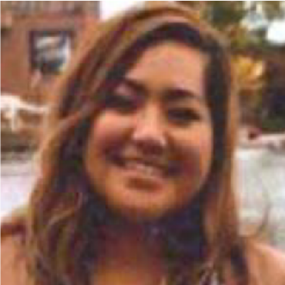
Student Voices
Mai Xiong, WITC online
Hello, my name is Mai. I currently live in Green Bay while finishing my Early Childhood Education degree at WITC. This is my last semester. I’ve learned many things that are useful in the career field I am going for, and there is not much I could complain about my experience at WITC.
Attending school was never easy. Growing up in the Hmong culture, my parents were always strict on me. Their “theory” of being a good Hmong daughter was to finish high school with a 4.0 GPA and go to college to become a nurse or a doctor. Something in the medical field was a plus. I believe most Hmong parents just want their kids to have a successful life, but what they don’t get is that some things aren’t meant to be. I am the only daughter in my family with four brothers, so I understand why my parents were so strict on me. They wanted me to do the best I could to achieve something they wanted, but it’s not what I wanted. When they first found out I was going for teaching, they weren’t happy. They always bragged about how other daughters of Hmong families completed their master’s in the medical field. My parents also gave me the talk about how being a teacher wouldn’t help me much in life. But I told them that at least I was attending school and trying to make something of myself. Now they’ve realized that as long as kids go to college, they are good kids.
Being at WITC has been nothing but a blessing. Counselors and instructors have been very understanding and supportive. Even though my work didn’t always make sense, they were never afraid to ask questions and find out what I meant to say. Using this opportunity, I want to apologize that I am not that fluent in English, but I am happy to say that I’ve always been encouraged to share my work and ideas with classmates and instructors. Hmong was my primary language, and growing up in a Hmong household didn’t teach me much English. I am also thankful to instructors for being very clear and understanding when explaining how to do homework. This made assignments very easy for me to complete.
What do we learn from our students’ stories? Have you identified certain common themes, needs, challenges, and success strategies?

Slide 29
Today organizations and individuals can benefit from a multitude of diversity, equity, and inclusion (DEI) training programs. Below are some examples of such programs:
Diversity training. It covers a broad spectrum of different backgrounds under the diversity umbrella (race, religion, sexual orientation, physical and cognitive abilities, socioeconomic status, etc.) and attempts to reduce prejudice and discrimination, facilitate positive interactions, and bring about workplace harmony. As part of this training, minority members may be asked to share their challenging experiences at work, able-bodied workers may participate in simulations that limit their senses or mobility, and older and younger employees may discuss generational differences in workplace values.
Diversity task forces. These initiatives bring together diverse employees from different departments to participate in strategic decision-making, including hiring practices, which eventually leads to a more inclusive and equitable work environment.
Diversity mentoring programs. This is an advanced method for improving cross-cultural and cross-gender relations where companies assign aspiring minority members experienced mentors to help them achieve their career goals.

Slide 30
Cultural training. Traditionally these programs prepared workers for overseas assignments. In modern business environment, we deal with partners, customers, colleagues, and members of the public from different cultural backgrounds on a daily basis. Cultural training provides learning experiences designed to better understand norms, values, beliefs, and material objects of another culture.
Language training. Being fluent in a foreign language is a valuable skill; however, being aware of how we speak English is also very important. Remember that one of the common themes in student voices was communication barriers. If a well-intentioned person tries to pronounce “telephone” very slowly, not realizing that this is an international word, it may actually sound offensive. Instead, focus on speaking clearly and succinctly; separating words; and minimizing the use of jargon, slang, acronyms, euphemisms, and idioms. So, next time you are in a meeting with non-native speakers, please refrain from excessive “piggybacking,” “going down the rabbit hole,” “flying by the seat of your pants,” and “opening a can of worms.”
Unconscious bias training. Through various socializing influences (media, parents, government, public role models, co-workers, etc.) and individual experiences we form an unconscious tendency to react positively or negatively toward certain groups of people. This has profound implications at work as it affects who is hired, fired, promoted, mentored, or disciplined and may result in a hostile and unproductive work environment. This training program offers individual self-assessment tests as well as group activities (for example, the circle of trust, tag game, and father-son activity). For more information, see: https://cultureplusconsulting.com/2018/08/16/a-ha-activities-for-unconscious-bias-training/

Slide 31
In conclusion, please review the reflection and application section. Consider discussing these topics with your supervisor and incorporating them into your professional development plan.
Reflection & Application
  Why do we value diversity? Why is it an important part of our careers and personal lives?
  How do you feel about diversity at WITC? Would your feelings and reactions change if you were of a different race, ethnicity, gender, sexual orientation, religion, age, etc.?
  What are some of the things you have done in the past and could do in the future to contribute to an inclusive and equitable environment at WITC? How can we ensure that inclusion and equity are real, that we walk our talk?
  Think about a process within WITC in which you are a key player. Can you identify any potential biases that affect individual decision-making? Have you learned or sought out information you need to make the process more equitable?
  What actions can you take to battle some forms of everyday bigotry at work (manifested through casual comments, workplace humor, etc.)?
  What can you do to increase your cultural sensitivity, cultural intelligence, and cultural competence?
  What systemic barriers exist that may limit any diversity efforts you are taking? What changes are required?
Additional Resources
Speak Up: Responding to Everyday Bigotry: https://www.splcenter.org/20150125/speak-responding-everyday-bigotry
Information and videos about cultural diversity in organizations: https://www.diversityinc.com/
Global business culture training services: https://www.globalbusinessculture.com/

Slide 32
QUIZ

Slide 33
In 2019, what was the percentage of foreign-born workers in the U.S.?
3%
17%
36%
64%

Slide 34
True or false? Inclusion means tolerating different backgrounds and equity means treating everybody the same.
True
False

Slide 35
Cultural intelligence relies on all of these components except:
Ethnocentric—assuming that our own culture is superior
Cognitive—what we know and how we can acquire new knowledge
Emotional—the motivation and confidence we need to try something new
Physical—translating intentions into actions

Slide 36
Showing consideration and empathy is the key element in developing
Cultural sensitivity (including political correctness)
Cultural intelligence
Cultural competence
All of the above

Slide 37
Unconscious bias training helps individuals
Tolerate older employees who are technologically challenged
Better understand norms, values, beliefs, and material objects of another culture
Recognize and reduce unconscious tendencies to react positively or negatively toward certain groups of people
Effortlessly become fluent in foreign languages

