Slide 1
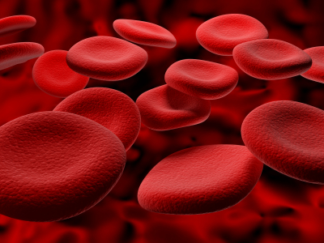
MANAGEMENT OF PATIENTS WITH ANEMIA

Slide 2
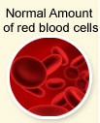
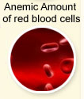
DEFINITION
Anemia (An-without,emia-blood) is a decrease in the RBC count, hemoglobin and/or Hematocrit values resulting in a lower ability for the blood to carry oxygen to body tissues.

Slide 3
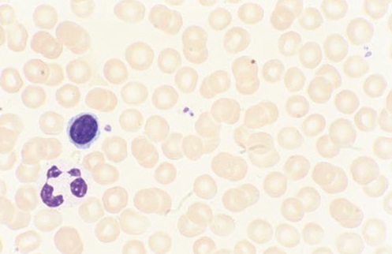
Normal
Peripheral Blood Smear
A drop of blood is applied against a glass slide that is subsequently stained with polychrome stains (Wright-Giemsa) to permit identification of the various cell types.
These stains are mixtures of basic dyes (methylene blue) that are blue and acidic dyes (eosin) that are red.
Thus, acid components of the cell (nucleus, cytoplasmic RNA, basophilic granules) stain blue or purple, and basic components of the cell (eosinophilic granules) stain red or orange.

Slide 4

Human Blood at 400X

Slide 5

Human Blood under microscope

Slide 6
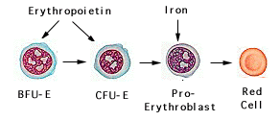
RBC Life Cycle
In the bone marrow, erythropoietin enhances the growth of differentiation of burst forming units-erythroid (BFU-E) and colony forming units-erythroid (CFU-E) into reticulocytes.
Reticulocyte spends three days maturing in the marrow, and then one day maturing in the peripheral blood.
A mature Red Blood Cell circulates in the peripheral blood for 100 to 120 days.
Under steady state conditions, the rate of RBC production equals the rate of RBC loss.

Slide 7
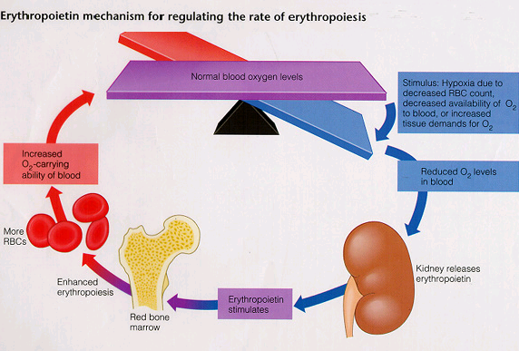

Slide 8
NORMAL Hb and Hct VALUES
Category Values | Reference
Hb
Men | >130 (135) g/l
Women | >120 g/l
Pregnant women | >110g/l
Infants 2-6 months | >95 g/l
Children from 6 months to 24 months | >105 g/l
2yrs to 11 yrs | >115 g/l
Children from 12 years | >120 g/l
Hct
Men | >41
Women | >36

Slide 9
Anemia is a laboratory diagnosis
Category Values | Men | Women
Hemoglobin (g/dL) | 14-17.4 | 12.3-15.3
Hematocrit (%) | 42-50% | 36-44%
RBC Count (10⁶/mm³ or 10¹²/l) | 4.5-5.9 | 4.1-5.1
Reticulocytes | 1.6 ± 0.5% | 1.4 ± 0.5%
WBC (cells/mm³ or 10⁹/l) | ~4,000-11,000
MCV (fL) | 80-96
MCH (pg/RBC) | 30.4 ± 2.8
MCHC (g/dL of RBC) | 34.4 ± 1.1
RDW (%) | 11.7-14.5%

Slide 10
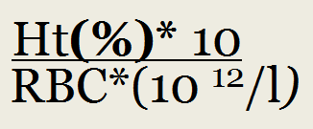


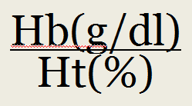
RBC Ind-s
MCV =
MCH =
MCHC =

Slide 11
ICD-10 Chapter III: Diseases of the blood and blood-forming organs, and certain disorders involving the immune mechanism
1. D50–D89 – Diseases of the blood and blood-forming organs and certain disorders involving the immune mechanism
1.1(D50–D53) Nutritional anemias
1.2(D55–D59) Haemolytic anaemias
1.3(D60–D64) Aplastic and other anaemias
1.4(D65–D69) Coagulation defects, purpura and other haemorrhagic conditions
1.5(D70–D77) Other diseases of blood and blood-forming organs
1.6(D80–D89) Certain disorders involving the immune mechanism

Slide 12
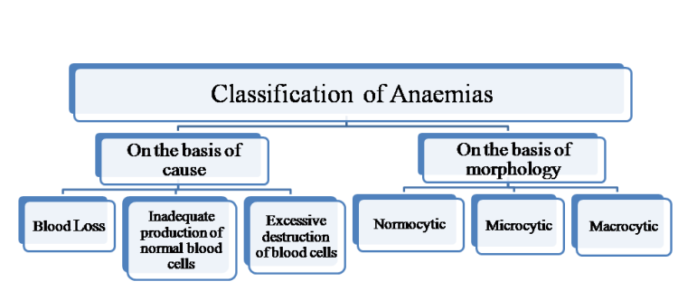
CLASSIFICATION

Slide 13
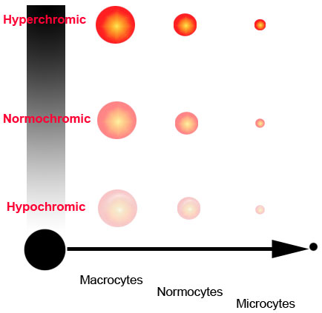
TYPES OF ANEMIA

Slide 14
Blood Loss
Acute blood loss :
Accident (injuries),
GI bleeding
Childbirth
Surgery
Chronic blood loss:
Hypermenorrhea
Parasitic infestation
Bladder tumors
Cancer or polyps in GI tract
Kidney tumors
Ulcers in the stomach or small intestine

Slide 15
BLEEDING SEVERETY CRITERIA
Index | N | Shock I | Shock II | Shock III | Shock IV
Blood loss (ml) | ‹750 | 750-1000 | 1000-1500 | 1500-2500 | ›2500
Blood loss (%) | ‹15 | 15-20 | 21-30 | 31-40 | ›40
HR /min | ‹100 | 100-110 | 110-120 | 120-140 | ›140 or ‹40
BP syst., mm Hg | N | 90-100 | 70-90 | 50-70 | ‹50
Shock index | 0.54-0.8 | 0.8-1 | 1-1.5 | 1.5-2 | ›2
CVP, mm | 60-80 | 40-60 | 30-40 | 0-30 | ≤0
Ht | 0.38-0.42 | 0.3-0.36 | 0.25-0.3 | 0.2-0.25 | ‹0.2
RR / min | 14-20 | 20-25 | 25-30 | 30-40 | ›40
Urine output, ml/h | 50 | 39-50 | 25-30 | 5-15 | 0-5
Ht = blood loss:
0.44-0.4 - ‹500ml;
0.38-0.32 ~ 1000ml;
0.3-0.22 ~1500;
‹0.22 - ›1500

Slide 16
Impaired RBC Production
1. Microcytic (MCV < 80):
Iron deficiency
Iron-transport deficiency
Iron utilization defect
Iron reutilization defect
Thalassemias (also classified under excessive hemolysis due to intrinsic RBC defects)
2. Macrocytic (MCV > 94):
Copper deficiency
Folate deficiency
Vitamin B12 deficiency
Vitamin C deficiency
Normochromic-normocytic (MCV 82 – 92, MCHC > 30):
Aplastic anemia, incl. drug-induced (zidovudine, carbamazepine, karbimazol, mefenitoin, oksyfenbutazon, propylthiouracil, sulfonamides, thiazide diuretics trimetadion, phenylbutazone, chloramphenicol, cytostatics - melphalan, alkeran).
Hypoproliferation
In kidney disease
In endocrine failure (thyroid, pituitary)
In protein depletion
Myelodysplasia
Myelophthisis

Slide 17
Excessive Destruction of RBC (1)
Excessive hemolysis due to extrinsic RBC defects
1. Reticuloendothelial hyperactivity with splenomegaly - hypersplenism
2. Immunologic abnormalities:
Autoimmune hemolysis
Cold antibody hemolysis (paroxysmal cold hemoglobinuria)
Warm antibody hemolysis
Isoimmune (isoagglutinin) hemolysis
3. Mechanical injury
Infection
Trauma

Slide 18
Excessive Destruction of RBC (2)
Excessive hemolysis due to intrinsic RBC defects
1. Membrane alterations, congenital:
Hereditary elliptocytosis
Hereditary spherocytosis
2. Membrane alterations, acquired:
Hypophosphatemia
Paroxysmal nocturnal hemoglobinuria
Stomatocytosis
3. Metabolic disorders (inherited enzyme deficiencies):
Embden-Meyerhof pathway defects
G6PD deficiency
4. Hemoglobinopathies:
Hb C disease
Hb E disease
Hb S-C disease
Hb S–β-thalassemia disease
Sickle cell disease (Hb S)
Thalassemias (β,β-δ, and α)

Slide 19
Macrocytic Anemia
MCV > 94
MCHC > 31
● Megaloblastic dyspoiesis:
- Pernicious anaemia
- Vitamin B12 deficiency
Folate deficiency
Sprue, other malabsorption
● Alcoholism
● Liver disease
● Hypothyroidism
● Hyperthyroidism (Graves’ disease)
● Addison’s disease
● Marrow infiltration
● Drugs, e.g. Chemotherapy (azathioprine, methotrexate), Anticonvulsant, Oral contraceptives, pentamidine, triamterene, trimethoprim, fenitoin, phenobarbital.
● Metabolism disoders: Orotic aciduria, etc.

Slide 20
Microcytic (Hypochromic) Anemia
MCV < 80
MCHC < 31
1. Iron deficiency anemia : Chronic blood loss,
Inadequate diet, Malabsorption, Increased
demand, etc.
2. Anaemia of chronic disease.
3. Abnormal globin synthesis : Thalassemia with or without Hemoglobinopathies
4. Abnormal porphyrin and heme synthesis:
Pyridoxine responsive anemia, etc.
5. Other abnormal Fe metabolism.

Slide 21
Normocytic Normochromic Anemia
MCV 82 – 92, MCHC > 30
1. Acute blood loss
2. Increased plasma volume : Pregnancy, Overhydration
3. Hemolytic anemia :
● Hereditary spherocytosis
● Sickle cell disease (most common in sub-Saharan Africa)
● G6PD deficiency (varies with ethnicity)
● Autoimmune haemolytic anaemia (due to respiratory tract infections with mycoplasma,
infectious mononucleosis; lymphomas and connective tissue diseases)
● Malaria (geographic variability)
● Drugs (e.g. dapsone, quinine, sulphonamides)
● Red cell trauma (burns, mechanical heart valves)
Hypoplastic marrow : Aplastic anemia, RBC aplasia due to:
viral hepatitis
exposure to radiation
drugs (chemotherapeutic agents, chloramphenicol and sulphonamides)
5. Bone marrow failure, Infiltrate bone marrow: Leukemia, Multiple myeloma,
Myelofibrosis, etc.
6. Abnormal endocrine : Hypothyroidism, Adrenal insufficiency, etc.
Secondary anaemia: Kidney disease / Liver disease / Cirrhosis
Mixed deficiencies

Slide 22
SEVERITY
Mild (І) – Нb – 110-91 g/l,
Moderate (ІІ) – Нb – 90-71 g/l,
Severe (III) – Hb – 70-51 g/l,
Very Severe – Hb ˂51 g/l.

Slide 23

SIGNS & SYMPTOMS

Slide 24
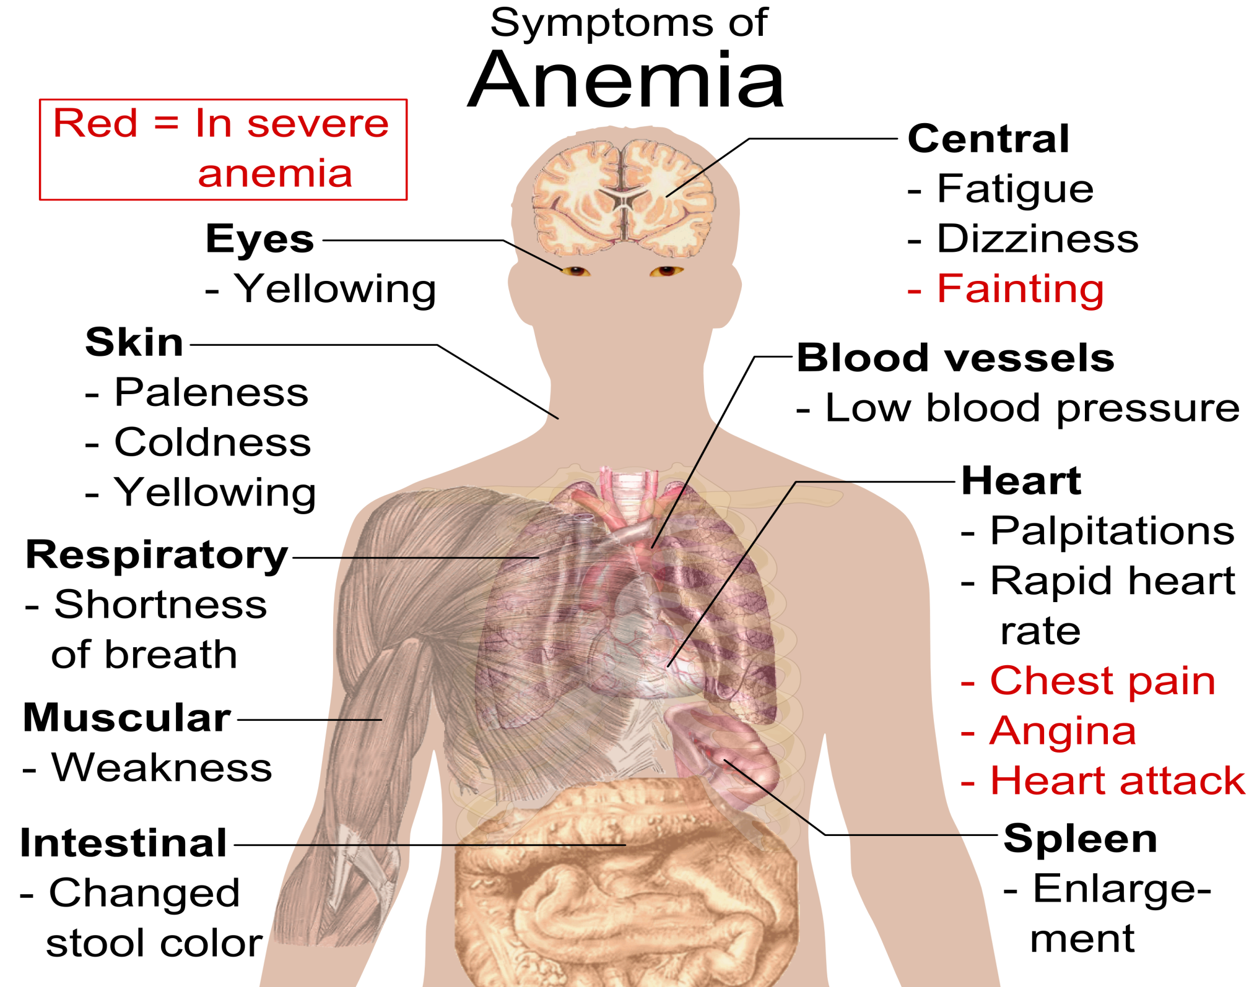

Slide 25
HISTORY
History of the underlying disorder;
Dietary history;
Past medical and drug history;
Family history.

Slide 26
INVESTIGATIONS
(Microcytic anaemia)
FBC and blood film
Serum iron and TIBC
Serum ferritin
Serum ferritin
Faecal occult blood and faecal microscopy
Free erythrocyte protoporphyrin
Hb electrophoresis

Slide 27
INVESTIGATIONS
(Normocytic anaemia)
FBC and film;
Tests for haemolysis;
Urinalysis;
Bone marrow aspiration

Slide 28
INVESTIGATIONS
(Macrocytic anaemia)
FBC and film
Serum vitamin B12 level
Antiparietal cell antibodies and anti-intrinsic factor antibodies
Serum and red cell folate
Bone marrow aspiration
Further tests

Slide 29
Special Considerations in Determining Anemia
Acute Bleeding
    Drop in Hb or Hct may not be shown until 36 to 48 hours after acute bleeding (even though patient may be hypotensive)
Pregnancy
    In third trimester, RBC and plasma volume are expanded by 25 and 50%, respectively.
    Labs will show reductions in Hgb, Hct, and RBC count, often to anemic levels, but according to RBC mass, they are actually polycythemic
Volume Depletion
    Patient’s who are severely volume depleted may not show anemia until after rehydrated

Slide 30
ANEMIA EVALUATION (CBC) - 1
Sign / Index
IRON DEFICIENT ANEMIA
Hb
RBC
CI
RBC diameter
МСV
МСН
МССН
Reticulocytes
Decreased
Decreased
Decreased
Decreased
N (Decreased)
Decreased
Decreased
N

Slide 31
ANEMIA EVALUATION (CBC) - 2
Sign / Index
HEMOLYTIC ANEMIA
Sharply reduced
Decreased
N
Decreased
N (Increased)
N (Increased)
N
Highly increased
Hb
RBC
CI
RBC diameter
МСV
МСН
МССН
Reticulocytes

Slide 32
ANEMIA EVALUATION (CBC) - 3
Sign / Index
HYPOPLASTIC ANEMIA
Hb
RBC
CI
RBC diameter
МСV
МСН
МССН
Reticulocytes
Decreased
Decreased
N
N
N
N
N
Sharply reduced (may be 0)

Slide 33
ANEMIA EVALUATION (CBC) - 4
Sign / Index
MEGALOBLASTIC ANEMIA
Hb
RBC
CI
RBC diameter
МСV
МСН
МССН
Reticulocytes
Decreased
Decreased
Increased
Increased
Highly increased
Increased
Increased
Decreased

Slide 34
IND-S TO BONE MARROW ASPIRATION AND BYOPSY
Unexplained anemias
Other cytopenias
Unexplained leukocytosis
Thrombocytosis
Suspected leukemia, multiple myeloma, or myelophthisis

Slide 35
DIFFERENTIAL DIAGNOSIS (1)
Etiology or Type | Morphologic Changes | Special Features
Blood loss, acute | Normochromic-normocytic, with polychromatophilia Hyperplastic marrow | If severe, possible nucleated RBCs and left shift of WBCs Leukocytosis Thrombocytosis
Iron deficiency | Microcytic, with anisocytosis and poikilocytosis Reticulocytopenia Hyperplastic marrow, with delayed hemoglobination | Possible achlorhydria, smooth tongue, and spoon nails Absent stainable marrow iron Low serum iron Increased total iron-binding capacity Low serum ferritin
Blood loss, chronic | Same as iron deficiency | Same as iron deficiency

Slide 36
DIFFERENTIAL DIAGNOSIS (2)
Etiology or Type | Morphologic Changes | Special Features
Infection or chronic inflammation | Normochromic-normocytic early, then microcytic Normoblastic marrow Normal iron stores | Decreased serum iron Decreased total iron-binding capacity Normal serum ferritin Normal marrow iron content
Vitamin B12 deficiency | Oval macrocytes Anisocytosis Reticulocytopenia Hypersegmented WBCs Megaloblastic marrow | Serum B12< 180 pg/mL (< 130 pmol/L) Frequent GI and CNS involvement Positive Schilling test (although no longer done) Elevated serum bilirubin, Increased LDH Antibodies to intrinsic factor in serum (common) Sometimes absent gastric intrinsic factor secretion
Folate deficiency | Same as vitamin B12 deficiency | Serum folate < 5 ng/mL (< 11 nmol/L) RBC folate < 225 ng/mL RBCs (< 510 nmol/L) Nutritional deficiency and malabsorption (in sprue, pregnancy, infancy, or alcoholism)

Slide 37
DIFFERENTIAL DIAGNOSIS (3)
Etiology or Type | Morphologic Changes | Special Features
Hemolysis, acute | Normochromic-normocytic Reticulocytosis Marrow erythroid hyperplasia | Increased serum bilirubin and LDH Increased stool and urine urobilinogen Hemoglobinuria in fulminating cases Hemosiderinuria
Hemolysis, chronic | Normochromic-normocytic Reticulocytosis Marrow erythroid hyperplasia Basophilic stippling (especially in lead poisoning) | Increased serum bilirubin and LDH Shortened RBC life span Increased radioiron turnover Hemosiderinuria
Sickle cell anemia | Anisocytosis and poikilocytosis Some sickle cells in peripheral smear Sickling of all RBCs in preparation with hypoxia or hyperosmolar exposure | Largely limited to blacks Urinary isosthenuria Hb S detected during electrophoresis Possibly painful vaso-occlusive crises and leg ulcers Bone changes on x-ray

Slide 38
DIFFERENTIAL DIAGNOSIS (4)
Etiology or Type | Morphologic Changes | Special Features
Marrow failure | Normochromic-normocytic (may be macrocytic) Reticulocytopenia Failed marrow aspiration (often) or evident hypoplasia of erythroid series or of all elements | Idiopathic (> 50%) or secondary to exposure to toxic drugs or chemicals (eg,chloramphenicol, quinacrine, hydantoins, insecticides)
Marrow replacement (myelophthisis) | Anisocytosis and poikilocytosis Nucleated RBCs Early granulocyte precursors Marrow aspiration possibly failing or showing leukemia, myeloma, or metastatic cells | Marrow infiltration with infectious granulomas, tumors, fibrosis, or lipid histiocytosis Possible hepatomegaly and splenomegaly Possible bone changes Radioiron uptake greater over spleen and liver than over sacrum
Hereditary spherocytosis | Spheroidal microcytes Normoblastic erythroid hyperplasia | Increased mean RBC Hb level Increased RBC fragility Shortened survival of labeled RBCs Increased radioactivity of spleen (exceeds that of liver)

Slide 39
DIFFERENTIAL DIAGNOSIS (5)
Etiology or Type | Morphologic Changes | Special Features
Paroxysmal cold hemoglobinuria | Normochromic-normocytic | Follows exposure to cold Results from a cold agglutinin or hemolysin Often associated with syphilis or other infections
Paroxysmal nocturnal hemoglobinuria | Normocytic (may be hypochromic because of iron deficiency) Marrow may be hypercellular or hypocellular | Dark morning urine Hemosiderinuria Positive acid hemolysis (Ham test) and sugar-water tests (mostly replaced by flow cytometric testing)
Thalassemia | Microcytic Thin cells Target cells Basophilic stippling Anisocytosis and poikilocytosis Nucleated RBCs in homozygotes | Decreased RBC fragility Elevated Hb A2 and Hb F (often) Mediterranean ancestry (common) In homozygotes, anemia from infancy Splenomegaly Bone changes on x-ray
Sideroblastic anemia | Usually hypochromic but dimorphic with normocytes and macrocytes Hyperplastic marrow, with delayed hemoglobination Ringed sideroblasts | Inborn or acquired metabolic defect Stainable marrow iron (plentiful) Response to vitamin B6 administration (rare) Commonly part of myelodysplastic syndrome

Slide 40
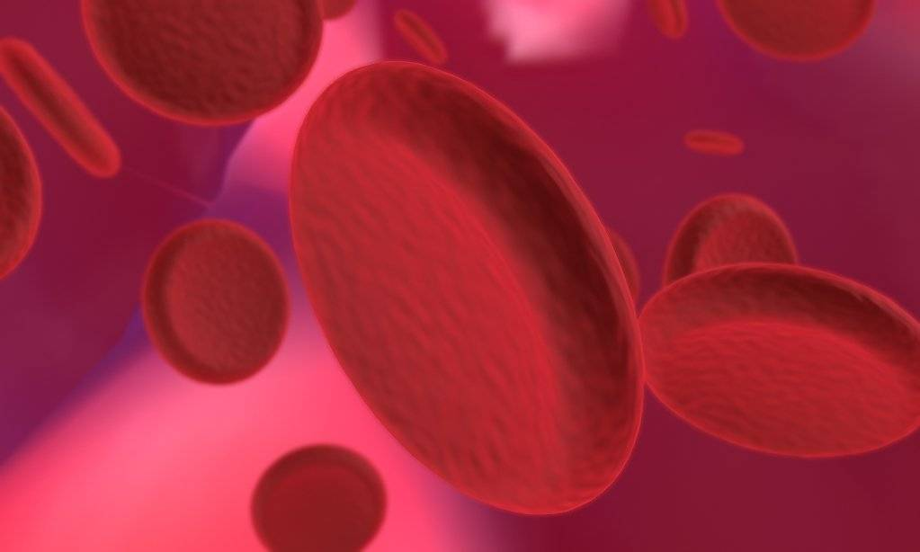
Iron deficiency anemia

Slide 41
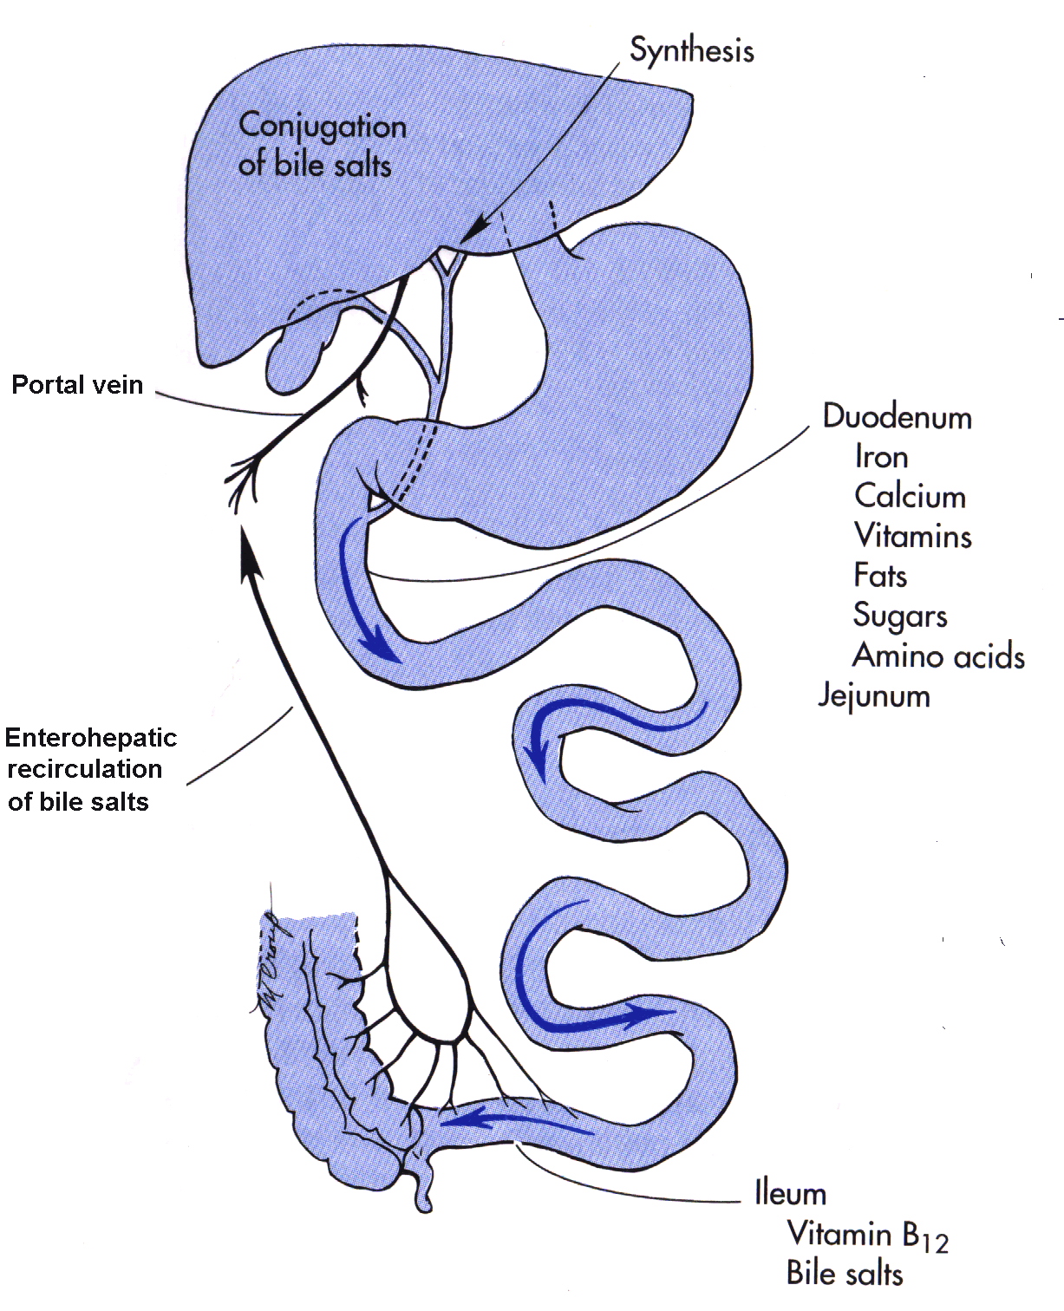
Sites of iron and vitamin B12 absorption
IF secretion

Slide 42
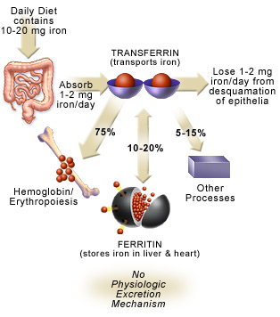
Notes:
42
42

Slide 43
Physiological iron loss
1. Children 0,1-0,3 mg/d
2. Adolescents 0,5-1,0 mg/d
3. Adults 1,0-1,5 mg/d
4. Women (during menstruation) 3,0 mg/d (total iron loss near 40 mg).

Slide 44
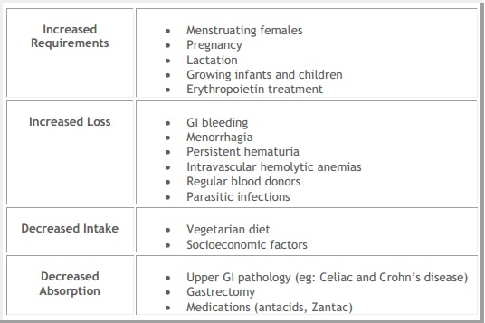
RISK FACTORS / CAUSES

Slide 45
EFFECTS OF SOME MEDICINES
Fe level decreases:
• Allopurinol
• Anabolic steroids
• Corticotropin
• Cortisone
• Metformin
• Aspirin in high doses
Fe level increases:
Estrogen
• Ethanol
• Methotrexate
• Oral contraceptives

Slide 46
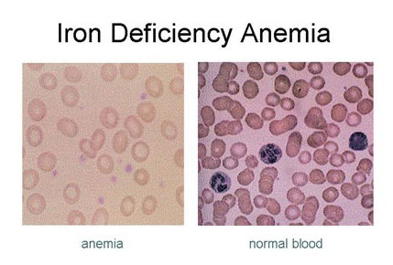

Slide 47
ICD-10: Nutritional anaemias (D50-D53)
D50 Iron deficiency anaemia
Incl.:
  anaemia:
      asiderotic
      hypochromic
D50.0 Iron deficiency anaemia secondary to blood loss (chronic)
  Posthaemorrhagic anaemia (chronic)
Excl.:
  acute posthaemorrhagic anaemia (D62)
  congenital anaemia from fetal blood loss (P61.3)
D50.1 Sideropenic dysphagia
  Kelly-Paterson syndrome
  Plummer-Vinson syndrome
D50.8 Other iron deficiency anaemias
D50.9 Iron deficiency anaemia, unspecified

Slide 48

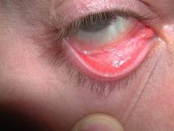
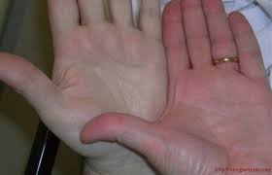

SIGNS & SYMPTOMS - anemia syndrome
Pale skin ;
Headache;
Dizziness or lightheadedness;
Fatigue (tiredness);
Tinnitus
Tachycardia, hypotension, chest pain,
sinus arrhythmia, systolic murmur at the apex;
Reduced memory;
Irritability;
Shortness of breath;
Swelling or soreness of the tongue;
Cold hands and feet.
cracks in the sides of the mouth

Slide 49
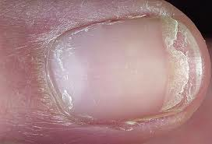
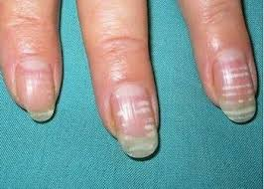
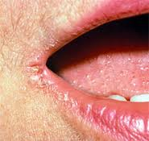
SIGNS & SYMPTOMS - sideropenia syndrome
Muscle weakness and atrophy,
restless legs syndrome (RLS) - a disorder that causes a strong urge to move the legs;
Dystrophic skin changes;
Hair loss
Brittle nails
Glossitis
Atrophic gastritis
Pain when swallowing
Urine incontinence
Low-grade fever
Frequent respiratory infections
Pica (unusual craving for non-nutritive substances such as ice, dirt, paint)
Violation of smell

Slide 50
SIGNS & SYMPTOMS (cont-d)
Some signs and symptoms of iron-deficiency anemia are related to the condition's causes.
A sign of intestinal bleeding is bright red blood in the stools or black, tarry-looking stools.
Very heavy menstrual bleeding, long periods, or other vaginal bleeding may suggest that a woman is at risk for iron-deficiency anemia.

Slide 51
Severe iron-deficiency anemia can lead to:
problems with growth and development
in children
angina (chest pain)
leg pain (intermittent claudication)
A sign of intestinal bleeding is bright red blood in the stools or black, tarry-looking stools.
Very heavy menstrual bleeding, long periods, or other vaginal bleeding may suggest that a woman is at risk for iron-deficiency anemia.

Slide 52
Iron Deficiency Anemia – Lab Findings
Serum Iron
    LOW (< 60 micrograms/dL)
Total Iron Binding Capacity (TIBC)
    HIGH ( > 360 micrograms/dL)
Serum Ferritin
    LOW (< 20 nanograms/mL)
    Can be “falsely”normal in inflammatory states

Slide 53
SECONDARY HYPOCHROMIC ANEMIAS
Group of diseases | Examples
Acute infections | Bacterial, fungal, viral
Chronic infections | Buberculosis, endocarditis, urinary tract infections, chron. fungal infections
Chronic inflammatory diseases | Arthosis, rheumatoid arthritis, polymyalgia rheumatica, acute and chronic hepatitis
Malignancies | Metastatic carcinoma, hematological malignancies
Acute states | Operations, significant trauma
Other diseases | Diabetes, congestive heart failure, malnutrition, bedsores

Slide 54
Anemia associated with iron redistribution
3 main factors in anemia of chronic disease:
short life span of RBCs
changes in BM response to anemia
disturbed iron transfer from reticuloendothelial cells to BM erythroblasts.
Characteristics:
Mild hypochromic anemia
Normal serum iron level (or slightly decreased)
Decreased TIBC (or N)
High serum ferritin level
Reduced sideroblasts rate in BM
Clinical or lab. signs of active inflammation or neoplasm

Slide 55
DIFFERENTIAL DIAGNOSIS OF HYPOCHROMIC ANEMIAS
Sign | Iron deficiency | Anemia in chronic diseases | Sideroblastic anemia
Symptoms | Sideropenia syndrome | Symptomes of the main disease, may be hemosiderosis of inner organs | Hemosiderosis, hepatosplenomegaly, may be diabetes mellitus
RBCs | Microcytes, anisocytosis, hypochromia | Micro- or normocytes, may be basophilic stippling | Microcytes or siderocytes, may be basophilic stippling
BM: 1. Cells | Micronormoblasts, sideroblasts <15% or absent, siderocytes <1% | Normoblasts, uncommonly - micronormoblasts – <15% | Macronormoblasts, sideroblasts up to 100% (mostly grossly granular form) Siderocytes > 2%
2. Iron storages | Absent | N or high | High, rare - N
Serum iron |  |  | N or
TIBC |  | N or | N or
TS |  | N or | N or
Desferal (Deferoxamine) test |  | or N | or N (in thalassemia)
Serum ferritin |  | N or
FEP |  | or N | or N (in thalassemia)
Non-heme RBC iron | or absent | N or
Treatment with iron | Effective | Ineffective | Effective treatment with desferal

Slide 56
Trial of FeSO₄
if a patient has microcytic hypochromic anemia with a low reticulocyte count, it would be reasonable to use a trial of FeSO₄ to diagnose
5-10 days after initiating therapy, rise in reticulocytes confirms the diagnosis

Slide 57
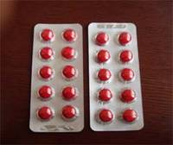
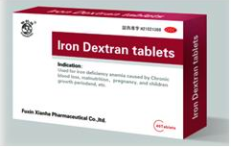
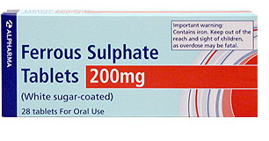
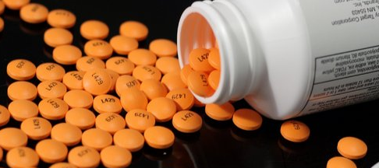
TREATMENT
IRON SUPPLEMENT

Slide 58
MANAGEMENT
Care Objectives
Determine the Cause of Iron Deficiency
  The etiology is often multifactorial; even when there is an obvious cause, investigation of serious underlying causes (e.g.cancer in adults) is recommended.
Aim of Treatment
  Normalize hemoglobin levels and red cell indices; replenish iron stores.
  Individualize disease-specific management depending on underlying cause.
Lifestyle Management
It is recommended that patients with iron deficiency receive dietary advice .

Slide 59
MANAGEMENT
Complimentary parasite control measures
Anti-helminthic therapy with 400 mg of single dose of albendazole is given to eliminate hook worms before the initiation of iron and folic acid therapy.
Child <2yrs-200mg/day single dose
Pregnancy - Albendazole is contraindicated in first trimester, can be administered in second or third trimester.

Slide 60
NON PHARMOCOLOGICAL MANAGEMENT
- Tea and coffee inhibit iron absorption when consumed with a meal or shortly after a meal.
- Vitamin C (ascorbic acid) is also a powerful enhancer of iron absorption from nonmeat foods when consumed with a meal. The size of the vitamin C effect on iron absorption increases with the quantity of vitamin C in the meal.
- Germination and fermentation of cereals and legumes improve the bioavailability of iron by reducing the content of phytate, a substance in food that inhibits iron absorption.
- Promote and support exclusive breastfeeding for about 6 months followed by breastfeeding with appropriate complementary foods, including iron-rich through the second year of life.

Slide 61
TREATMENT OF IRON DEFICIENCY ANEMIA.
Iron deficiency anemia is treated with oral or parenteral iron preparation. Oral iron corrects the anemia just as rapidly and completely as parenteral iron in most cases if iron absorption from the GIT is normal.
Different iron salts provide different amount of elemental iron.
In iron deficient individual, about 50-80mg of iron can be incorporated in hemoglobin daily and about 25% of oral ferrous salt can be absorbed.

Slide 62
IRON FORMULATIONS
ORAL:
Ferrous sulfate
Ferrous gluconate
Ferrous fumarate
PARENTERAL:
Iron Dextran
Iron-sucrose complex
Iron sodium gluconate complex
Notes:
62
62

Slide 63
RECOMMENDED DIETARY ALLOWANCE | Mg/DAY
Men Adult | 8 mg
Women Adult (age over 50) | 8 mg
Adult (ages 19 to 50) | 18 mg
Pregnant | 27 mg
Lactating | 9 mg to 10 mg
Adolescents (ages 9 to 18) Girls Boys | 8 mg to 15 mg 8 mg to 11 mg
Children (birth to age 8) Ages 4 to 8 | 10 mg
Infants (7 months to 1 year) Infants (birth to 6 months) | 11 mg 0.27 mg

Slide 64
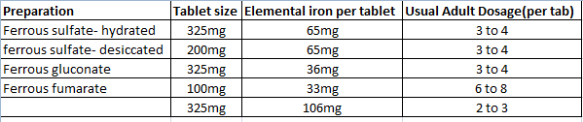
ORAL IRON THERAPY
Oral iron treatment may require 3-6 months to replenish body stores.
Most iron medication are taken on an empty stomach, at least 1 hour before or 2 hours after meal.

Slide 65
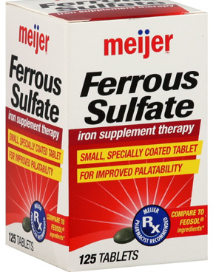
Ferrous sulfate.
Dosage: 325 mg tid, which provides 180 mg of iron daily of which 10mg is usually absorbed.
Patients who cannot tolerate iron on an empty stomach should take it with food.
Administration: PO

Slide 66
GENERAL MECHANISM OF ACTION OF IRON SUPPLEMENT
During the process of absorption, oxygen combines with iron and is transported into the plasma portion of blood by binding to transferrin.
From there, iron and transferrin are used in the production of hemoglobin (the molecule that transports oxygen in the blood) and myoglobin( helps your muscle cells store oxygen.)

Slide 67
TREATMENT FOR 6-24 MONTHS
Dosage | Birth-weight category | Duration
12.5 mg iron + 50 ug folic acid daily | Normal Low birth weight (<2500 g) | 6-24 months of age 2-24 months of age

Slide 68
TREATMENT OF MILD &MODERATE ANEMIA
GROUP | DOSAGE/day
Children 2-5 years | 20-30 mg iron
Children 6-11 years | 30-60 mg iron
Adolescents and adults | 60 mg iron
Anemia will be corrected within 2 to 4 months if appropriate iron dosages are administered and underlying cause of iron deficiency is corrected.
Continue iron therapy an additional 4 to 6 months (adults) after the hemoglobin normalizes to replenish the iron stores.

Slide 69
TREATMENT OF SEVERE ANEMIA
AGE GROUP | DOSE | DURATION
<2 years | 25 mg iron + 100-400 ug folic acid daily | 3 months
2-12 years | 60 mg iron + 400 ug folic acid daily | 3 months
Adolescents and adults, including pregnant women | 120 mg iron + 400 ug folic acid daily | 3 months
After completing 3 months of therapeutic supplementation, pregnant women and infants should continue preventive supplementation program

Slide 70
PREGNANCY
Prevalence of anemia in pregnancy | Dose | Duration
>40 % in population | 60 mg iron + 400 ug folic acid daily | 6 months in pregnancy, and continuing to 3 months postpartum

Slide 71
COMMON ADVERSE EFFECTS OF ORAL IRON THERAPY
Nausea
Epigastric discomfort
Abdominal cramps
Constipation and diarrhea.
Black stool
These effects are usually dose-related.

Slide 72
CONTRAINDICATIONS
Avoid taking any other multivitamin or mineral product within 2 hours before or after taking iron supplement.
Avoid antibiotics such as ciprofloxacin, demeclocycline, doxycycline, levofloxacin, lomefloxacin, minocycline, norfloxacin, ofloxacin, or tetracycline.
Avoid antacids, sorbents within 2 hours before or after meals when taking iron medication.
in bleeding disorders, avoid non-steroidal anti-inflammatory (NSAID) drugs, as well as aspirin.

Slide 73
Failure to respond to oral iron
Incorrect diagnosis (eg, thalassemia)
Presence of a coexisting disease interfering with response
(eg, anemia of chronic disease, renal failure)
Patient is not taking the medication
Medication is not being absorbed
(eg, enteric coated tablets, concomitant use of antacids, malabsorption)
Iron (blood) loss or need is in excess of the amount ingested (eg, severe continuous GI bleeding, dialysis patient)

Slide 74
Parenteral Iron Therapy
Parenteral iron, given IM or IV, is used in the rare patient who is unable to tolerate even modest doses of oral iron, or in patients whose level of continued gastrointestinal bleeding exceeds the ability of the gastrointestinal tract to absorb iron (eg, hereditary hemorrhagic telangiectasia).

Slide 75
Intramuscular iron
Mobilization of iron from intramuscular sites is slow and occasionally incomplete
As a result, the rise in the hemoglobin concentration is only slightly faster then that which occurs with oral iron
s/e pain, muscle necrosis, and phlebitis
Anaphylactic reactions occur in about 1% of patients

Slide 76
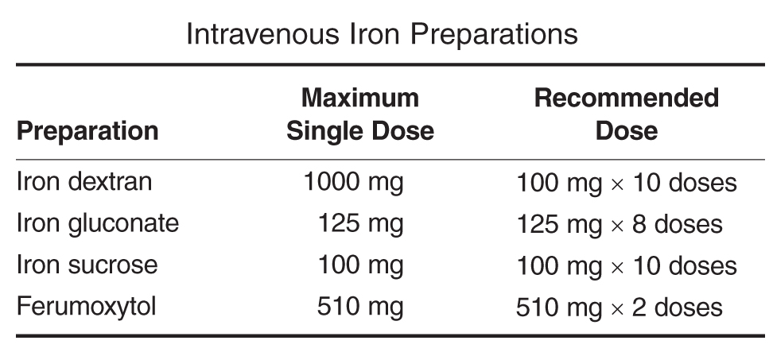

Slide 77
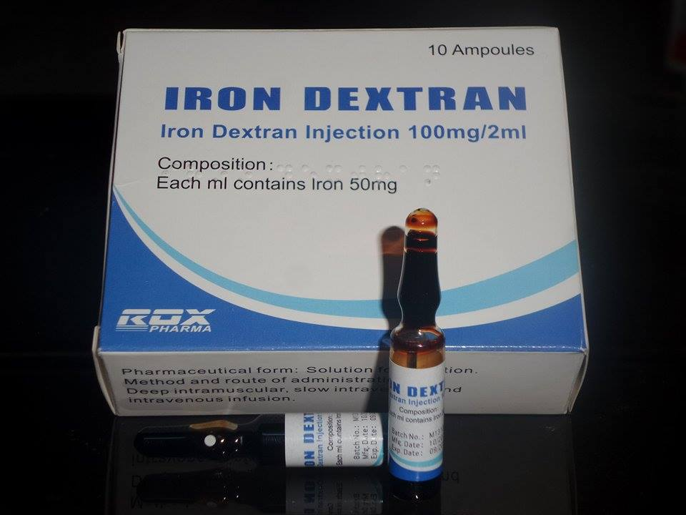
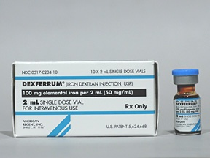
PARENTERAL IRON THERAPY
Iron Dextran - is a stable complex of ferric hydroxide and low-molecular-weight dextran containing 50mg of elemental iron per milliliter of solution.
It can be given deep IM injection or IV infusion.
Adverse effects:
light-headedness, fever, arthralgias,
back pain, urticaria, bronchospasm
and hypersensitivity reaction.
Notes:
What is arthralgias?

Slide 78
Iron sucrose complex
Iron sodium gluconate complex
indicated for patient with hypersensitivity reactions to oral iron salts.
only IV
For patient who are treated chronically with iron, it is important to monitor the iron level to avoid serious toxicity associated with iron overload.
Adverse effect same as iron dextran.

Slide 79
Iron overload
Venesection eg haemochromatosis
Iron chelators
Complex with trivalent ions (ferric ions) to form ferrioxamine, which is excreted by the kidneys
Desferrioxamine iv or s/c infusion
Deferiprone po s/e blood dyscrasias

Slide 80
Non- pharmacological treatment
Iron-rich diet
Good sources of iron includes:
  meats - beef, pork, lamb, liver, and other organ meats
  poultry - chicken, duck, turkey, liver (especially dark meat)
  fish - shellfish, including clams, mussels, and oysters, sardines, anchovies
  leafy greens of the cabbage family, such as broccoli, kale, turnip greens, and collards
  legumes, such as lima beans and green peas; dry beans and peas, such as pinto beans, black-eyed peas, and canned baked beans

Slide 81
Folate/B12 deficiency anemia

Slide 82
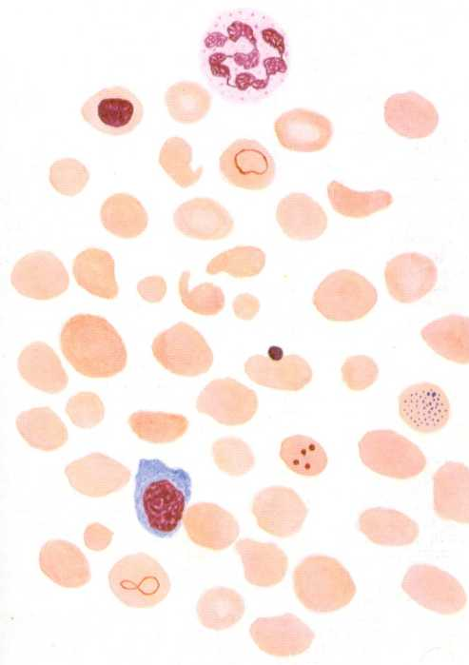
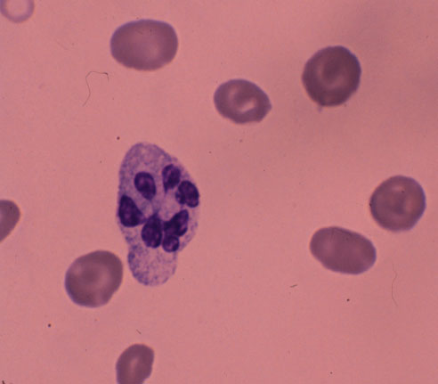
Vitamin B12 / folate Deficiency

Slide 83
IDC-10: D51Vitamin B12 deficiency anaemia
  Excl.:
  Vitamin B12 deficiency (E53.8)
D51.0Vitamin B12 deficiency anaemia due to intrinsic factor deficiency
  Anaemia:
      Addison
      Biermer
      pernicious (congenital)
  Congenital intrinsic factor deficiency
D51.1Vitamin B12 deficiency anaemia due to selective vitamin B12 malabsorption with proteinuria
  Imerslund(-Gräsbeck) syndrome
  Megaloblastic hereditary anaemia
D51.2Transcobalamin II deficiency
D51.3Other dietary vitamin B12 deficiency anaemia
  Vegan anaemia
D51.8Other vitamin B12 deficiency anaemias
D51.9Vitamin B12 deficiency anaemia, unspecified

Slide 84
Cobalamin (Vitamin B12) Deficiency
Daily requirement: 2-3 μg/day
Therapeutic dose: 100-1000ug/day i.m
Anemia due to Decreased Response to Erythropoietin
    Macrocytic anemia
    Lab Values
      Cobalamin level < 200 pg/mL
      Elevated serum methylmalonic acid
      Elevated serum homocysteine
    Vit. B12 is needed for DNA synthesis
    Binds to intrinsic factor in the small bowel in order to be absorbed
        Pernicious anemia: antibodies to intrinsic factor
        Diagnosed by checking antibody levels (rather than Schilling test)
    Deficiency can result in neuropsychiatric symptoms
        Spastic ataxia, psychosis, loss of vibratory sense, dementia
        Frequently not reversible with cobalamin replacement
    Smear shows macrocytosis with hypersegmentation of polymorphonuclear cells, with possible basophilic stippling.

Slide 85
Treatment of Vitamin B12 Deficiency
Vitamin B12 – 1000 micrograms intramuscularly monthly
  -OR-
Vitamin B12 – 1000-2000 micrograms po QDaily
Cyanocobalamine
Hydroxocobalamine
Methylcobalamine

Slide 86
IDC-10: D52 Folate deficiency anaemia
D52.0 Dietary folate deficiency anaemia
  Nutritional megaloblastic anaemia
D52.1 Drug-induced folate deficiency anaemia
D52.8 Other folate deficiency anaemias
D52.9 Folate deficiency anaemia, unspecified
  Folic acid deficiency anaemia NOS

Slide 87
Folate Deficiency Anemia
Daily requirement: 50µg
Therapeutic doses: 1-5mg/day
Anemia due to Decreased Response to Erythropoietin:
  Macrocytic anemia
  Lab Values
      Low folate
      Increased serum homocystine
      NORMAL methylmalonic acid
  Often occurs with decreased oral intake, increased utilization, or impaired absorption of folate
      Folate is normally absorbed in duodenum and proximal jejunum – deficiency found in celiac disease, regional enteritis, amyloidosis
      Deficiency frequently in alcoholics, because enzyme required for deglutamation of folate is inhibited by alcohol.
      Deficiency often found in pregnant women, persons with desquamating skin disorders, patients with sickle cell anemia (and other conditions associated with rapid cell division and turnover)
  Smear shows macrocytosis with hypersegmented neutrophils

Slide 88
Treatment of Folate Deficiency
Folate – 1 to 5 mg po Qday
    Vit. B12 deficiency must be excluded in folate-deficient patients, because supplemental folate can improve the anemia of Vit. B12 deficiency but not the neurologic sequelae.

Slide 89
Vitamin B12 Deficiency Versus Folate Deficiency
 | Vitamin B 12 Deficiency | Folate Deficiency
MCV | > 100 | > 100
Smear | Macrocytosis with hypersegmented neutrophils | Macrocytosis with hypersegmented neutrophils
Pernicious anemia | Yes | NO
Homocystine | Elevated | Elevated
Methylmalonic Acid | Elevated | NORMAL

Slide 90
Haematopoietic growth factors
Erythropoietin;
Colony stimulating factor (CSF) - G-CSF & GM-CSF (Filgrastim & pegfilgrastim 300µg/inj);
Megakaryocyte growth factors;
Interleukin-11.

Slide 91
Erythropoietin
Cytokine produced in juxtatubular cells in the kidney and also in macrophages.
Produced by recombinant technology.
Available as epoeitin α and β.
25-100 IU/kg, s.c. or i.v. 3 times a week.
Erythropoietin, EPOX, ZYROL, EPREX 2000 IU, 4000 IU/ml inj.

Slide 92
INDICATIONS
Anaemia due to:
Chronic renal failure.
Cancer chemotherapy.
AIDS.
Premature infants.
Blood transfusion
Adverse effects: flu-like symptoms, mild hypertension, encephalopathy, occasionally convulsions, risk of thrombosis due to hematocrit rises.

Slide 93
