Slide 1
Lecture 15
Blood Vessels and Hemodynamics
Plan.
Structure and function of blood vessels.
Hemodynamics principles and their physiological interpretation.
Capillary exchange and its mechanisms.
Blood pressure and factors affecting it.
Control of blood pressure and blood flow

Slide 2
Structure and function of blood vessels
5 main types
  Arteries – carry blood AWAY from the heart
  Arterioles
  Capillaries – site of exchange
  Venules
  Veins – carry blood TO the heart

Slide 3
Basic structure
  3 layers or tunics
    Tunica interna (intima)
    Tunica media
    Tunica externa
  Modifications account for 5 types of blood vessels and their structural/ functional differences

Slide 4
Structure
Tunica interna (intima)
  Inner lining in direct contact with blood
  Endothelium continuous with endocardial lining of heart
  Active role in vessel-related activities
Tunica media
  Muscular and connective tissue layer
  Greatest variation among vessel types
  Smooth muscle regulates diameter of lumen
Tunica externa
  Elastic and collagen fibers
  Vasa vasorum
  Helps anchor vessel to surrounding tissue

Slide 5
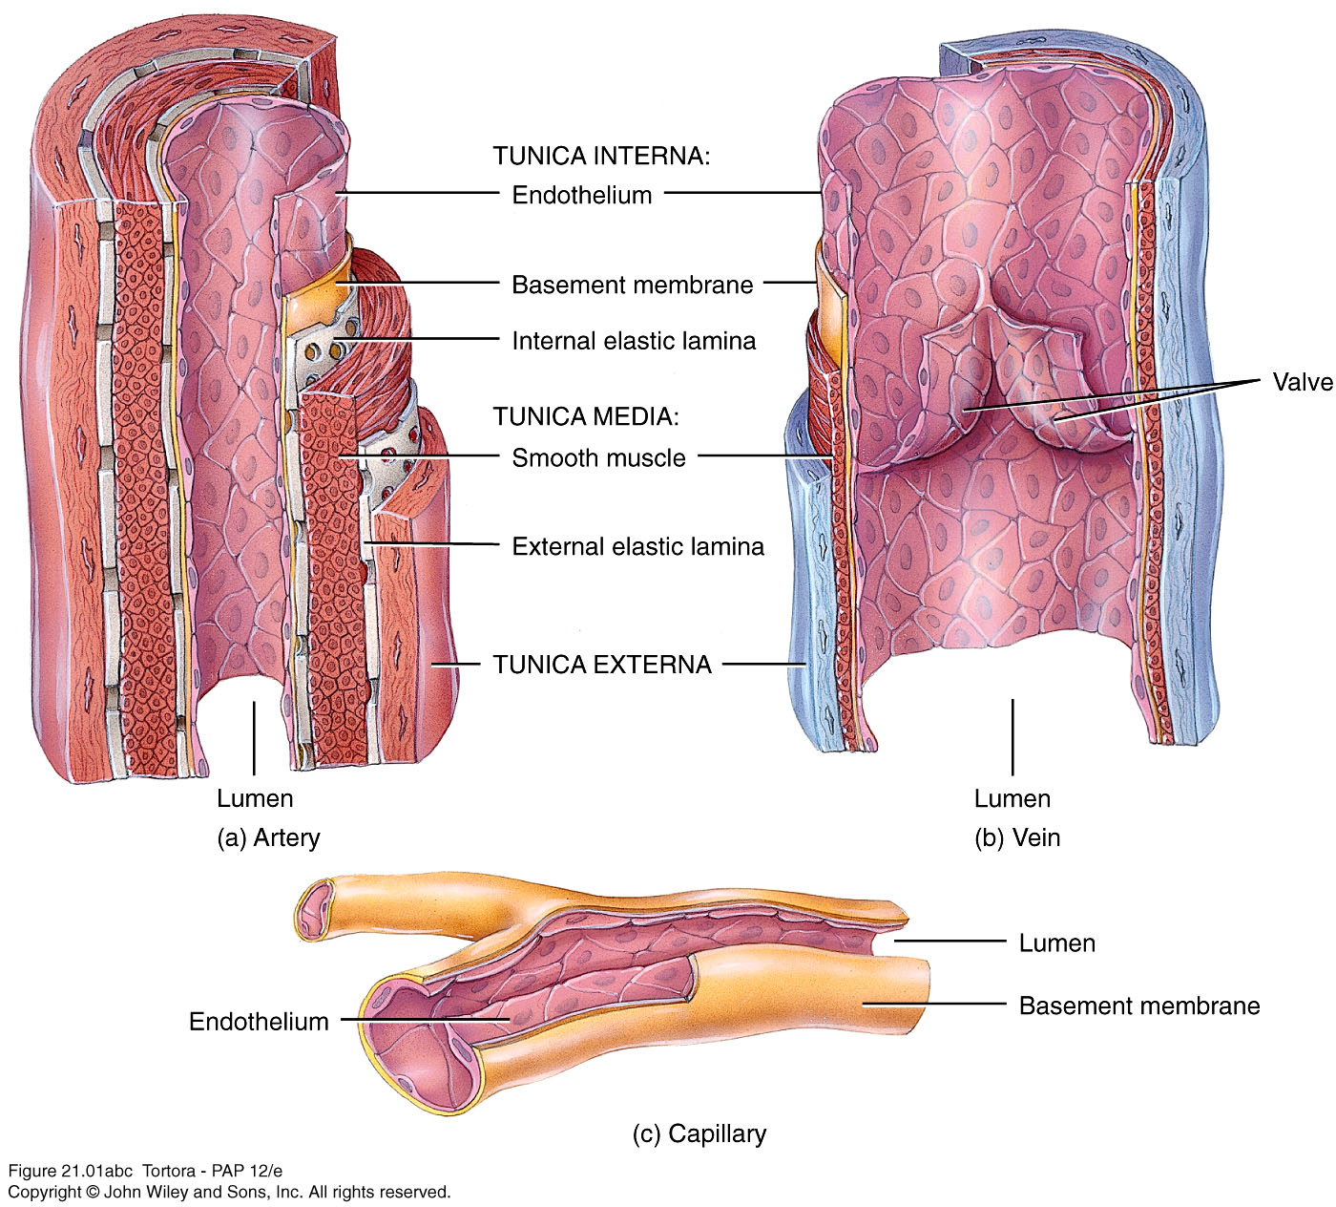

Slide 6
Arteries
  3 layers of typical blood vessel
  Thick muscular-to-elastic tunica media
  High compliance – walls stretch and expand in response to pressure without tearing
  Vasoconstriction – decrease in lumen diameter
    Vasodilation – increase in lumen diameter

Slide 7
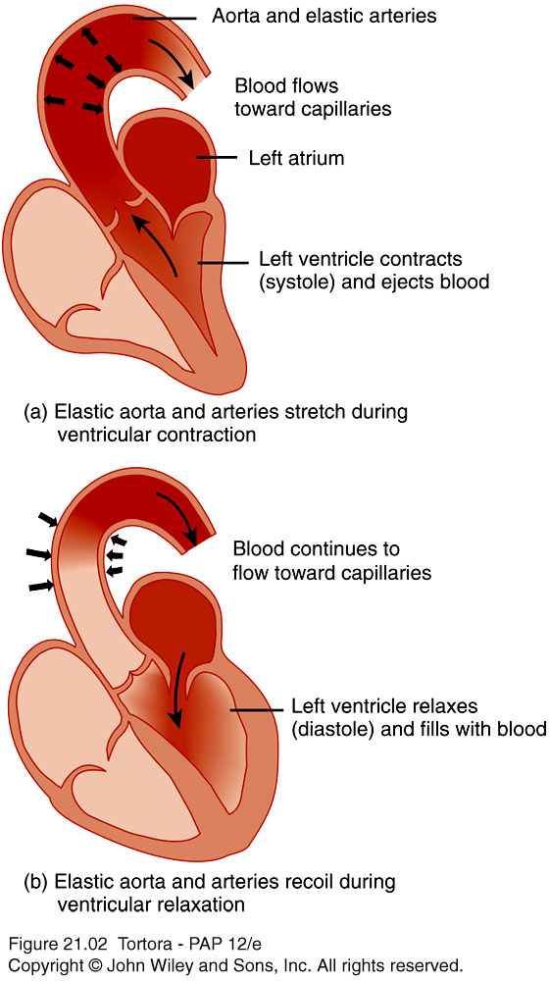
Elastic Arteries
  Largest arteries
  Largest diameter but walls relatively thin
  Function as pressure reservoir
  Help propel blood forward while ventricles relaxing
  Also known as conducting arteries – conduct blood to medium-sized arteries

Slide 8
Arteries
Muscular arteries
  Tunica media contains more smooth muscle and fewer elastic fibers than elastic arteries
  Walls relatively thick
  Capable of great vasoconstriction/ vasodilatation to adjust rate of blood flow
  Also called distributing arteries
Anastomoses
  Union of the branches of 2 or more arteries supplying the same body region
  Provide alternate routes – collateral circulation

Slide 9
Arterioles
  Abundant microscopic vessels
  Metarteriole has precapillary sphincter which monitors blood flow into capillary
  Sympathetic innervation and local chemical mediators can alter diameter and thus blood flow and resistance
  Resistance vessels – resistance is opposition to blood flow
  Vasoconstriction can raise blood pressure

Slide 10
Capillaries
Capillaries
  Smallest blood vessels connect arterial outflow and venous return
  Microcirculation – flow from metarteriole through capillaries and into postcapillary venule
  Exchange vessels – primary function is exchange between blood and interstitial fluid
  Lack tunica media and tunica externa
    Substances pass through just one layer of endothelial cells and basement membrane
  Capillary beds – arise from single metarteriole
    Vasomotion – intermittent contraction and relaxation
    Throughfare channel – bypasses capillary bed

Slide 11
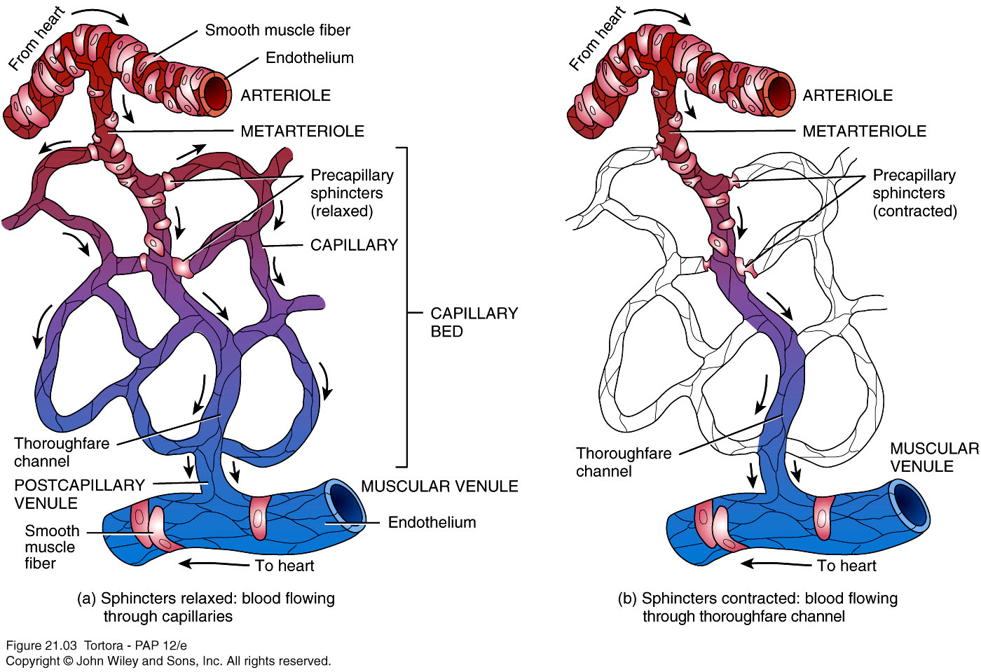
Arteries, Capillaries, and Venule

Slide 12
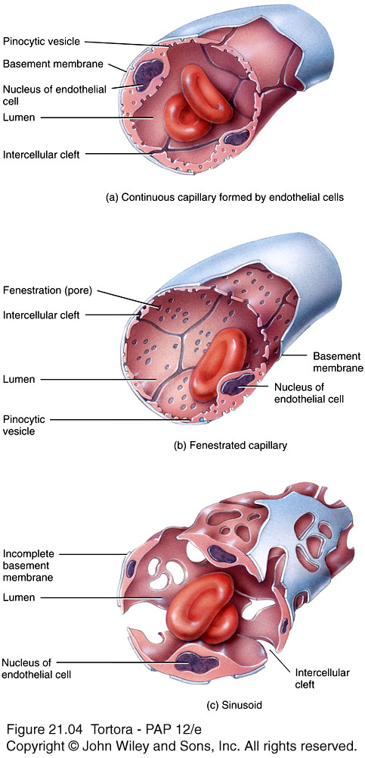
Types of Capillaries
3 types
Continuous
  Endothelial cell membranes from continuous tube
Fenestrated
  Have fenestrations or pores
Sinusoids
  Wider and more winding
  Unusually large fenestrations

Slide 13
Portal vein – blood passes through second capillary bed
  Hepatic or hypophyseal
Venules
  Thinner walls than arterial counterparts
  Postcapillary venule – smallest venule
  Form part of microcirculatory exchange unit with capillaries
  Muscular venules have thicker walls with 1 or 2 layers of smooth muscle

Slide 14
Veins
  Structural changes not as distinct as in arteries
  In general, very thin walls in relation to total diameter
  Same 3 layers
    Tunica interna thinner than arteries
    Tunica interna thinner with little smooth muscle
    Tunica externa thickest layer
  Not designed to withstand high pressure
  Valves – folds on tunica interna forming cusps
    Aid in venous return by preventing backflow

Slide 15
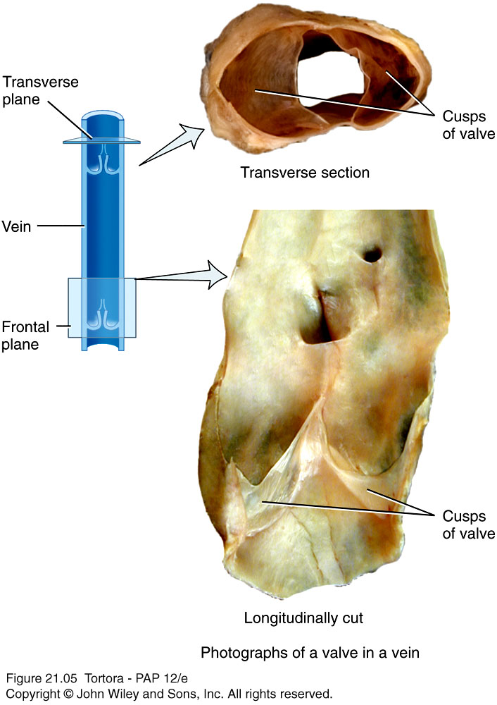
Venous Valves

Slide 16
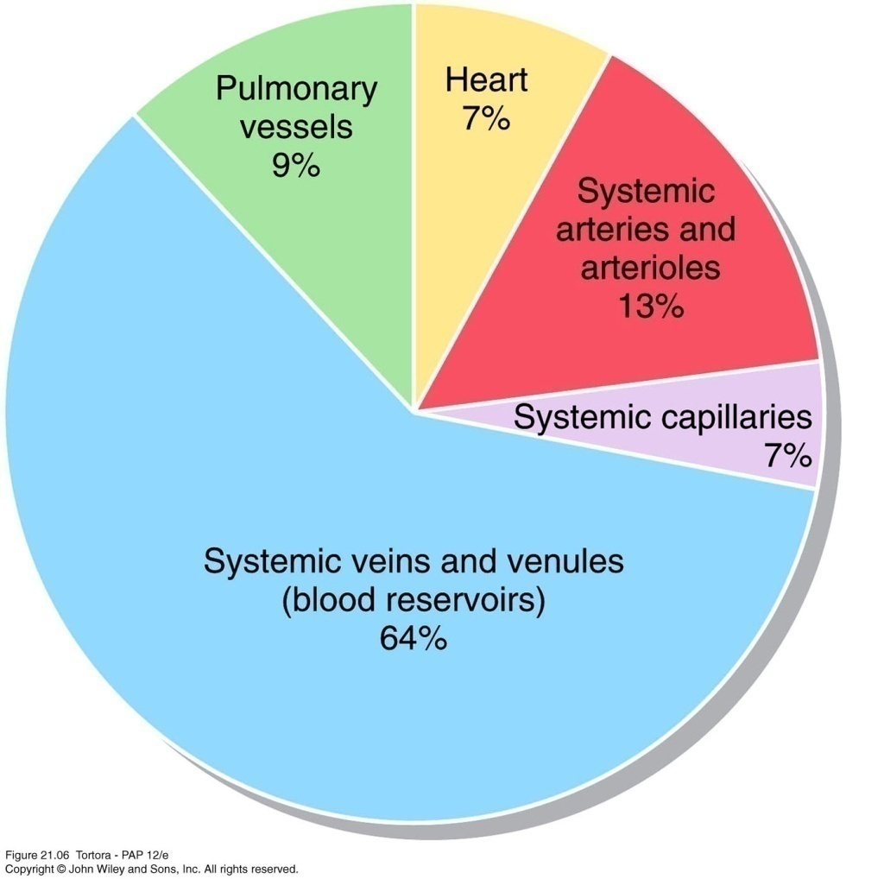
Blood Distribution
  Largest portion of blood at rest is in systemic veins and venules
    Blood reservoir
  Venoconstriction reduces volume of blood in reservoirs and allows greater blood volume to flow where needed

Slide 17
II Basic Concept of Hemodynamics:
Blood Flow,
Resistance of Blood Flow
and Blood Pressure

Slide 18
1. Blood Flow (Q)
Concept: The quantity of blood that passes a given point in the circulation in a given period of time.
The overall blood flow in the systemic circulation is identical to the cardiac output

Slide 19
(2) Factors determining blood flow
(interrelationships among blood flow, pressure and resistance.)
ΔP: the pressure difference between the two ends of the vessels
R: frictional force produced when blood fIows through blood vessels.
  Q = ΔP / R

Slide 20
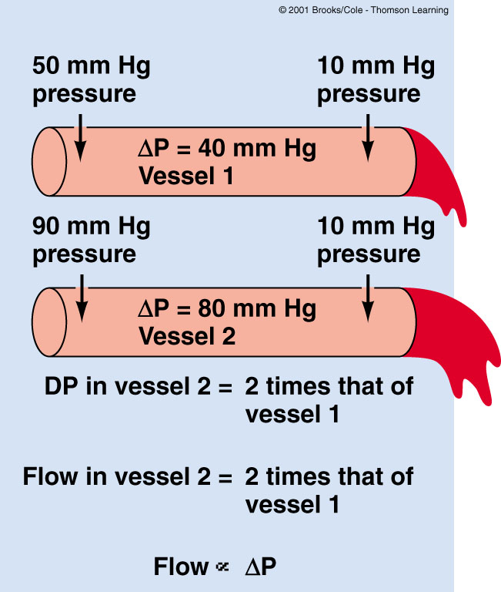
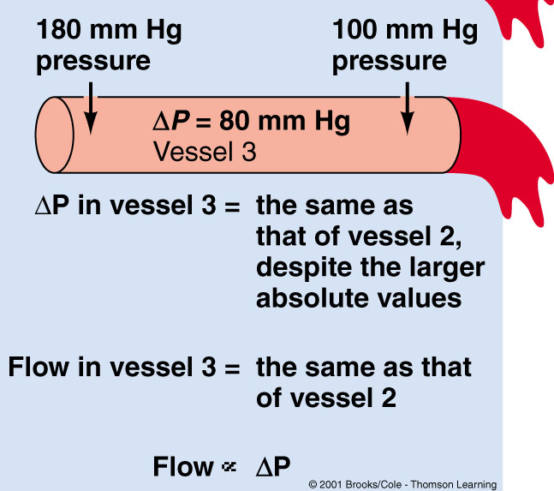
Pressure gradients
Pressure difference affects flow
not absolute pressure
Δ
Sherwood Fig 10-3
Notes:
20

Slide 21
Resistance to Blood Flow
Poiseuille equation
R = 8ηL
πr⁴
R = resistance
= viscosity of blood
L = length of blood vessel
r⁴ = radius of blood vessel raised to the fourth power
If radius decreases by one half, resistance increases by 16-fold (= 2⁴)!!!
(πr⁴ = area)
Notes:
Inc blood viscosity and length of vessel – inc resistance.
Dec radius by ½ - inc resistance by 16fold

Slide 22
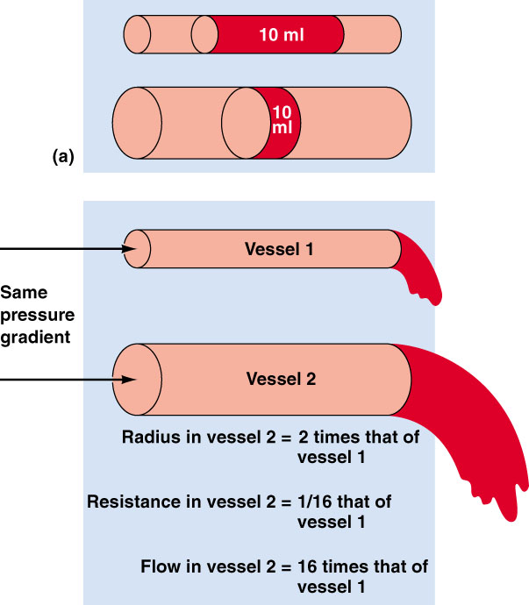
Radius profoundly affects blood flow
R~ 1/r⁴
Q = ΔP/R
Flow ~ r⁴
Sherwood Fig 10-4
Notes:
If resistance goes down (a minimal change), it will have a robust effect on flow. You can control flow just by changing arterial radius.

Slide 23
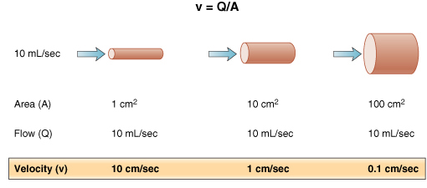
Velocity of Blood Flow
v = Q/A
v = velocity of flow (cm/sec)
Q = flow (ml/sec)
A = cross-sectional area (cm²)
Costanzo Fig 4-4
Notes:
Velocity
Rate: distance/ time

Slide 24
Velocity of blood flow
  Speed in cm/sec in inversely related to cross-sectional area
  Velocity is slowest where total cross sectional area is greatest
  Blood flow becomes slower farther from the heart
  Slowest in capillaries
  Aids in exchange
  Circulation time – time required for a drop of blood to pass from right atrium, through pulmonary and systemic circulation and back to right atrium
    Normally 1 minute at rest

Slide 25
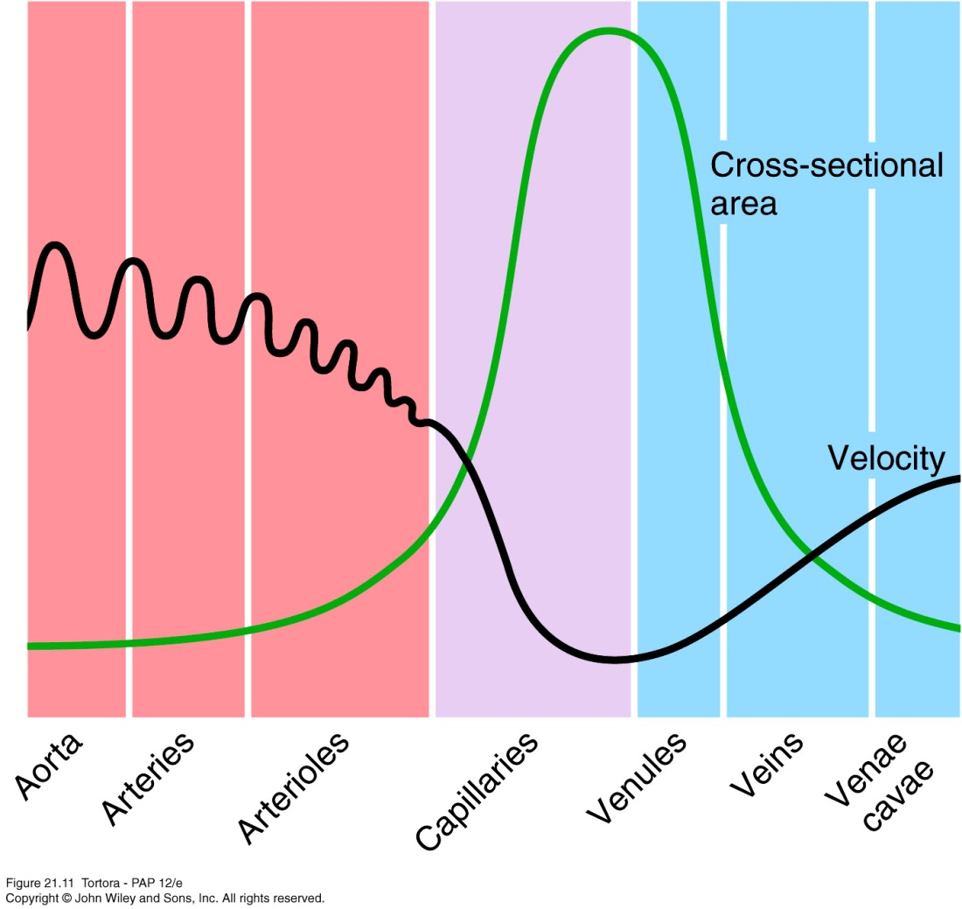
Relationship between Velocity of Blood Flow and Total Cross-sectioned area in Different Types of Blood Vessels

Slide 26
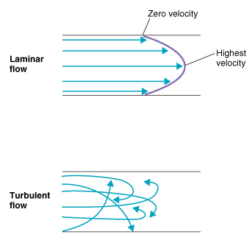
Laminar flow and Turbulence
Laminar flow is parabolic, highest velocity in center (least resistance), lowest adjacent to vessel walls
quiet
Turbulent flow is disoriented, no longer parabolic, energy wasted, thus more pressure required to drive blood flow.
noisy
Costanzo Fig 4-6
Notes:
Blood against lumen has greatest resistance. Middle of the lumen has a higher velocity.
If something interupts it (plaque) you lose laminar flow and get noise. Can be disruptive and cause destruction. Needs higher pressure to keep it going due to loss of energy.

Slide 27
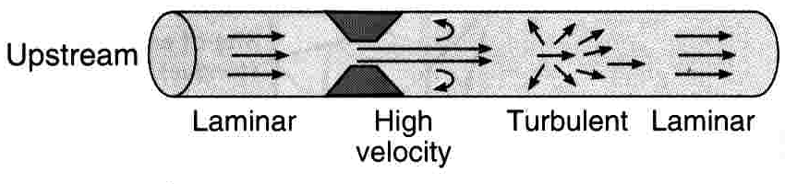
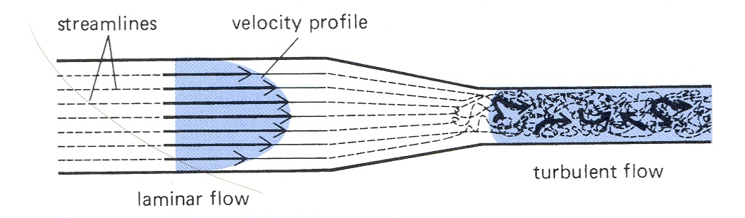
Turbulence is ∝ velocity of blood flow
diameter of blood vessel
1/ viscosity of blood
Ganong Fig 30-8
Mohrman and Heller Fig 6-6
Notes:
Turb is proportional to velocity. Higher more likely to have turb flow.
Also proportional to diameter of blood vessel. Wider has greater chance for turb.
Inversly proportional to viscosity. As it thickens, it loses turbulence.

Slide 28
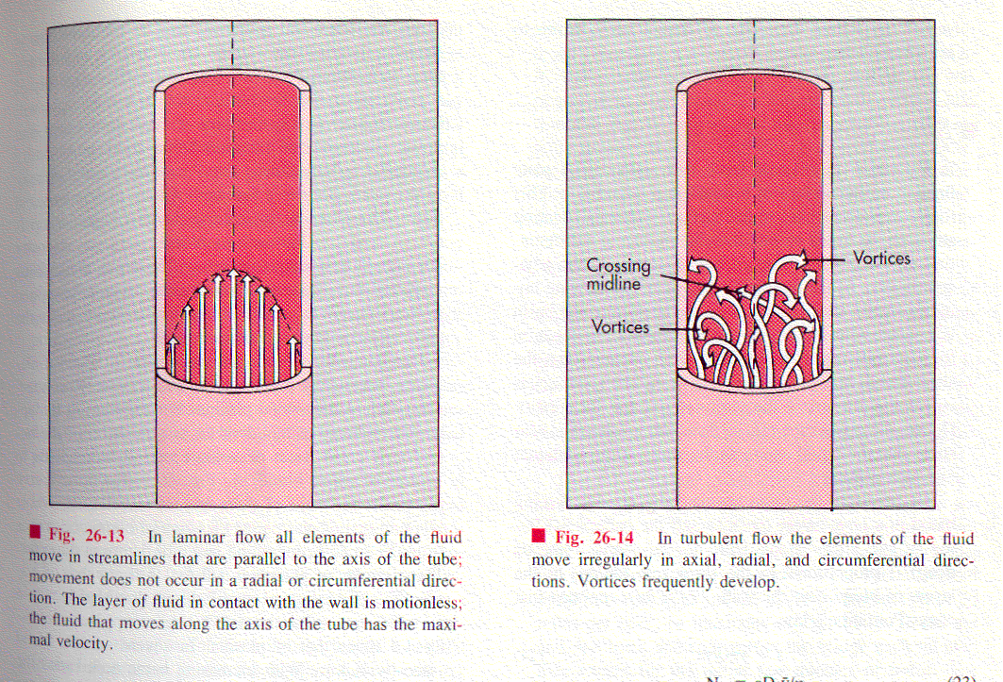
More Considerations ….
c. Different types of flow exist:
i. Plug flow: all molecules move at the same speed. Happens only at very small diameters, and slow flows.
ii. Laminar Flow. Due to friction against vessel walls, the blood near the center of the tube flows faster than that on the periphery. Infinitesimally thin concentric cylinders sliding past each other. The velocity profile is shaped like a parabola.
iii. Turbulent flow. Chaotic, “random”. Occurs when the Reynolds number for a fluid is exceeded .

Slide 29
Law of Laplace:
T = tension in vessel wall,
P = intraluminal pressure
r = radius of vessel
Implication → thin walled capillaries can stand high internal pressures, because of their small lumen
Stress : force per unit area on the vessel wall. Strain is the resultant deformation. Stress in vessel wall
.
σ = vessel wall stress
w = wall thickness
BUT: As the vessel gets stretched out, the wall gets thinner, more fragile (ie greater stress with the same pressure), less compliant.

Slide 30
3. Blood pressure
the force exerted by the blood against the vessel wall
stored energy (potential energy)

Slide 31
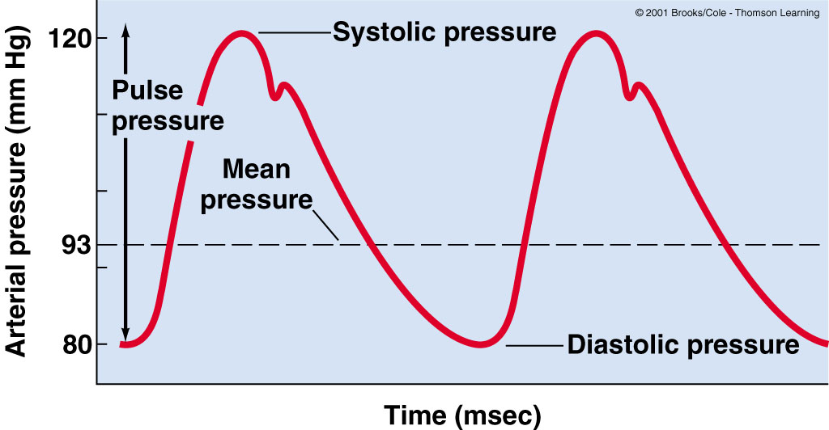
MAP = diastolic pressure + 1/3 pulse pressure
(at rest)
80 mph for 40 min
120 mph for 20 min
2/3 time in diastole
1/3 time in systole
Sherwood Fig 10-7
Notes:
Pulse pressure is difference between diastolic and systolic pressures.
It’s the driving force for blood flow through the entire body. Allows the blood flow through the systemic system.
Aortic valve closes and causes little “bounce”, aortic stretch recoiling

Slide 32
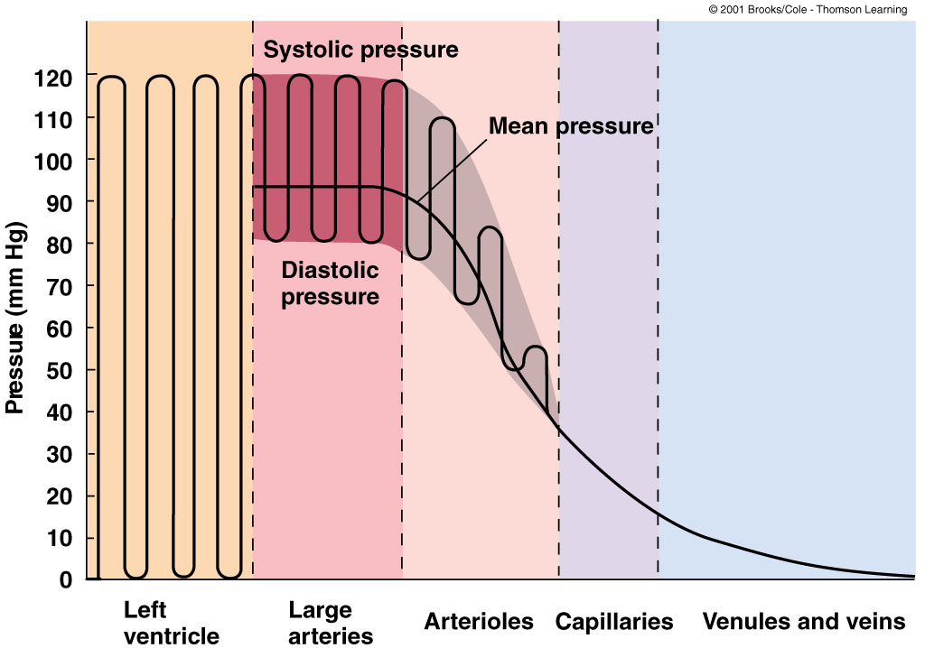
Cardiac Output (CO) = MAP
TPR
What does systolic pressure tell you?
CO & TPR
What does diastolic pressure tell you?
TPR
Sherwood Fig 10-9
Notes:
Represents LV pressure. Even flow when it gets to caps – less of a pulse pressure.
TPR – total peripheral resistance
When diastolic pressure is high, PR is high. There is no CO so it only tells us about the integrity of vasculature distal to the heart. Takes out the ht pumping by itself.

Slide 33
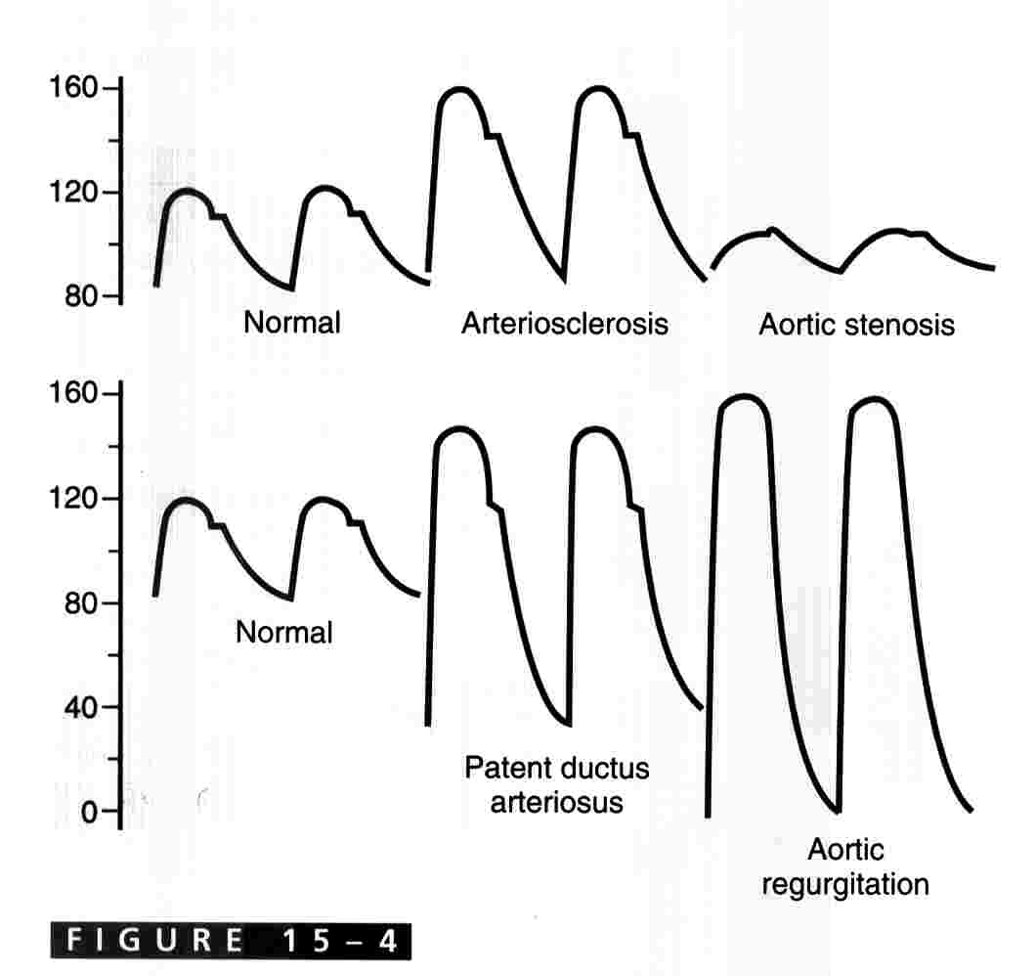
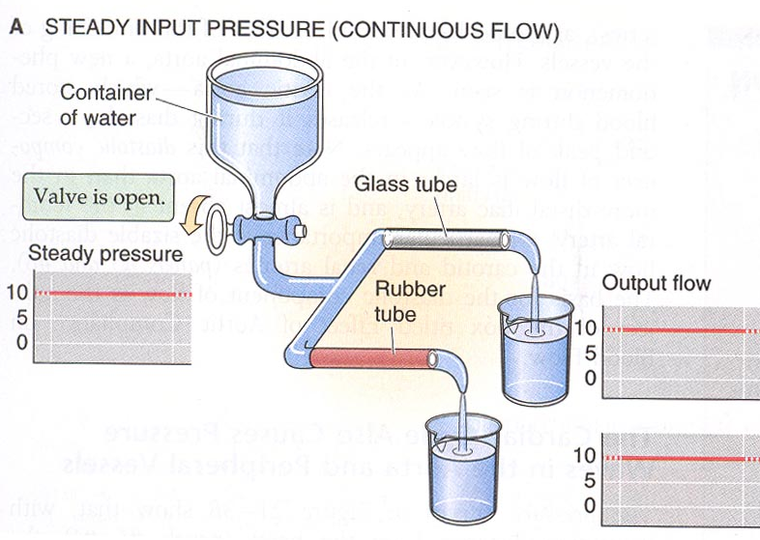
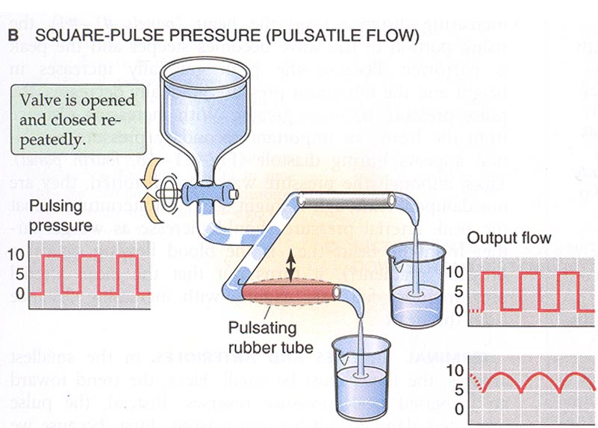
Aortic pressure changes
rigid
G&H Fig 15-4 and B&B
Notes:
Ht pumping against rigid tube system. Part of the energy is used to expand tube, then uses some. The flow doesn’t stop with the rubber tube.
Arteriosclerosis – inc pulse pressure, get augmented pulse pressure.
Aortic Stenosis – lower pulse pressure, CO is less so systolic peak arterial pressure is less. Not as much is flowing through the vavle.
A reduction in flow pressure can result in reduction of CO and pressure generation.

Slide 34
Aortic pressure changes
G&H Fig 15-4
Notes:
Aortic regurgitation – reflects Vent pressure b/c there is no valve to stop it. Added 0 resistance b/c of faulty aortic valve. No notch b/c aortic valve is incompetent.
Patent Ductus – (look at next slide) have ligamentum arteriosum, but it doesn’t close (nl closes at first breath). Lower diastolic pressure (tells us peripheral resistance) b/c you are adding another circuit to the system (pulm – low pressure system), when you add other systems, total pressure goes down. Higher systolic Pressure – inc CO, from blood added to pulmonary side. Increased venous return.
Need to understand the mechanisms of the pressures and how it changes flow/pressure.

Slide 35
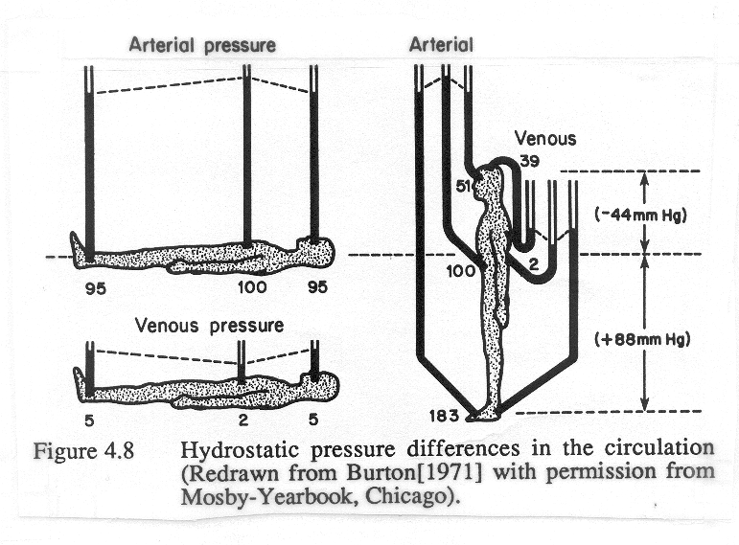

Slide 36
Capillary exchange
Movement of substances between blood and interstitial fluid
3 basic methods
  Diffusion
  Transcytosis
  Bulk flow

Slide 37
Diffusion
  Most important method
  Substances move down their concentration gradient
    O₂ and nutrients from blood to interstitial fluid to body cells
    CO₂ and wastes move from body cells to interstitial fluid to blood
  Can cross capillary wall through intracellular clefts, fenestrations or through endothelial cells
    Most plasma proteins cannot cross
    Except in sinusoids – proteins and even blood cells leave
    Blood-brain barrier – tight junctions limit diffusion

Slide 38
Transcytosis
  Small quantity of material
  Substances in blood plasma become enclosed within pinocytotic vessicles that enter endothelial cells by endocytosis and leave by exocytosis
  Important mainly for large, lipid-insoluble molecules that cannot cross capillary walls any other way

Slide 39
Bulk Flow
  Passive process in which large numbers of ions, molecules, or particles in a fluid move together in the same direction
  Based on pressure gradient
  Diffusion is more important for solute exchange
  Bulk flow more important for regulation of relative volumes of blood and interstitial fluid
  Filtration – from capillaries into interstitial fluid
  Reabsorption – from interstitial fluid into capillaries

Slide 40
NFP = (BHP + IFOP) – (BCOP + IFHP)
Net filtration pressure (NFP) balance of 2 pressures
2 pressures promote filtration
  Blood hydrostatic pressure (BHP) generated by pumping action of heart
    Falls over capillary bed from 35 to 15 mmHg
  Interstitial fluid osmotic pressure (IFOP)
    4 mmHg

Slide 41
NFP = (BHP + IFOP) – (BCOP + IFHP)
2 pressures promote reabsorption
  Blood colloid osmotic pressure (BCOP) promotes reabsorption
    Due to presence of blood plasma proteins to large to cross walls
    Averages 25 mmHg
  Interstitial fluid hydrostatic pressure (IFHP)
    About 3 mmHg

Slide 42
Starling’s Law
Nearly as much reabsorbed as filtered
  At the arterial end, net outward pressure of +11 mmHg and fluid leaves capillary (filtration)
  At the venous end, fluid moves in (reabsorption) due to -9 mmHg
  On average, about 85% of fluid filtered in reabsorped
  Excess enters lymphatic capillaries (about 3L/ day) to be eventually returned to blood

Slide 43
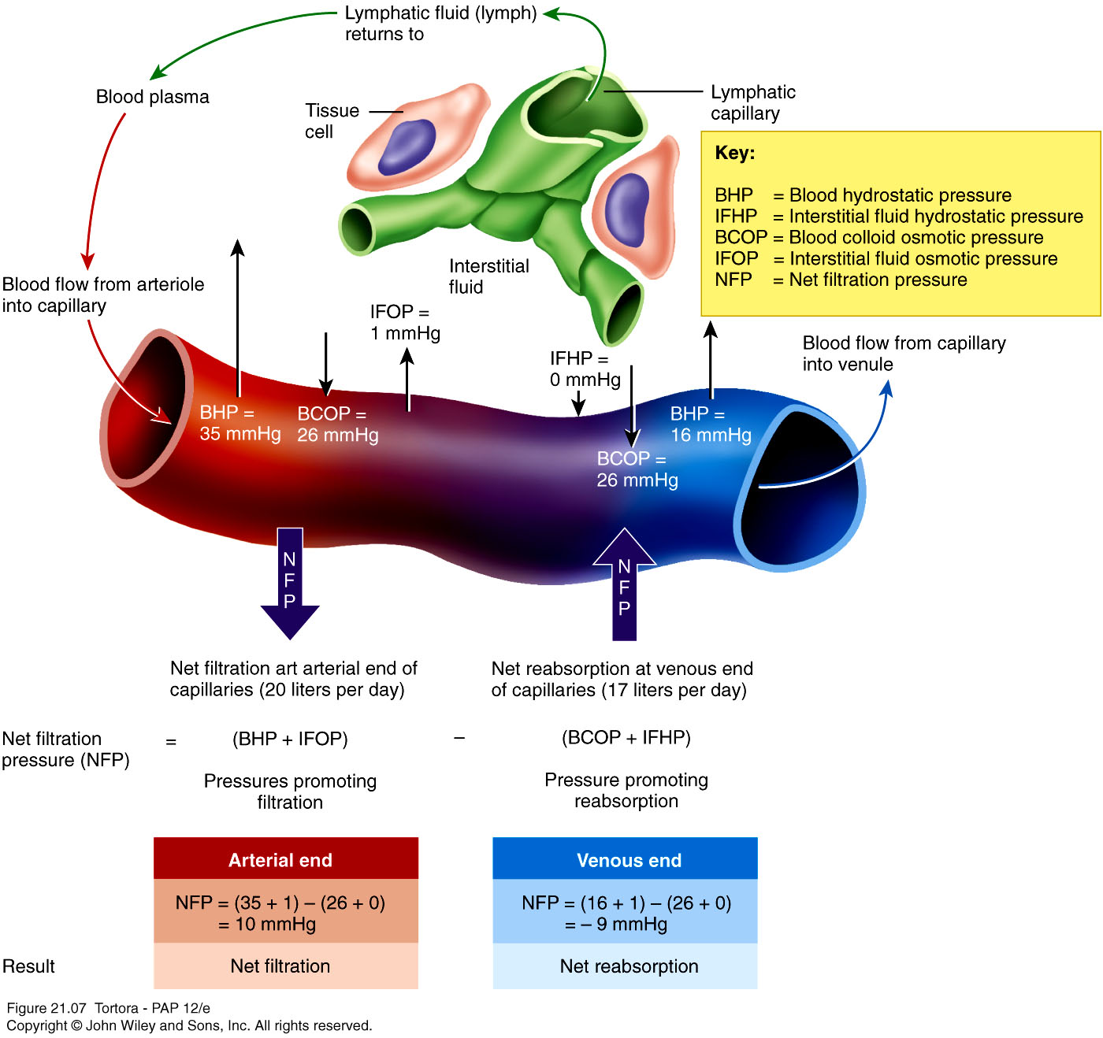
Dynamics of Capillary Exchange

Slide 44
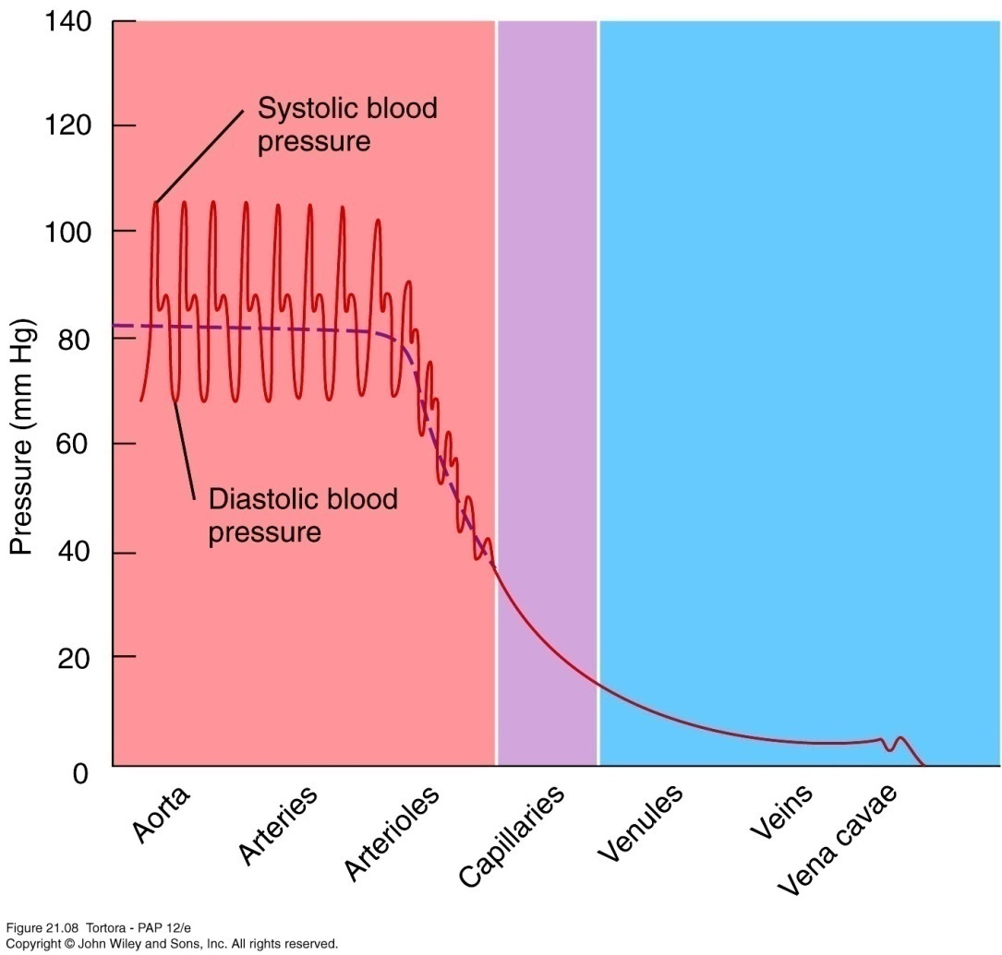
Blood Pressure and its control
  Contraction of ventricles generates blood pressure
  Systolic BP – highest pressure attained in arteries during systole
  Diastolic BP – lowest arterial pressure during diastole
  Pressure falls progressively with distance from left ventricle
  Blood pressure also depends on total volume of blood

Slide 45
2. Normal Range of Arterial Pressure
Systolic pressure (Ps) – the maximum of the pressure during systole
Diastole pressure (Pd) – the minimum pressure during diastole
Pulse pressure – the difference between Ps and Pd
Mean arterial pressure – the average pressure throughout each cardiac cycle.
  Mean arterial pressure (Pm) = Pd + Pulse pressure / 3

Slide 46
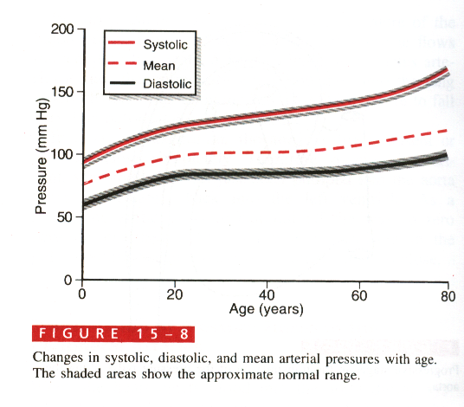

Slide 47
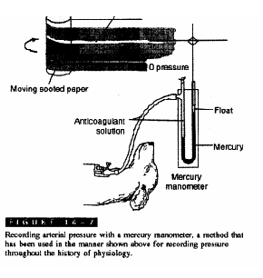
Measurement of the arterial pressure
Direct (inserting a cannula into the artery)

Slide 48
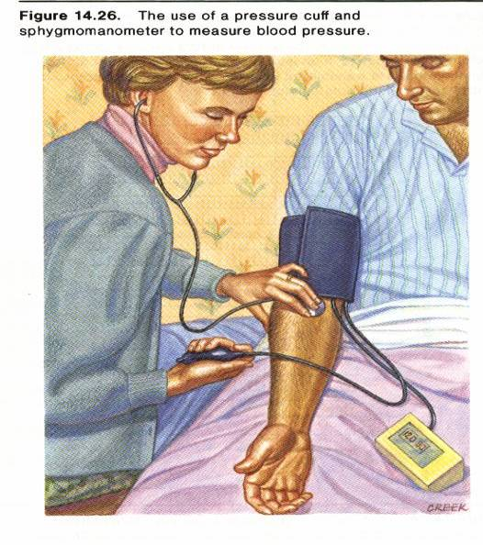
Measurement of the arterial pressure
Indirect (auscultatory) method
  Stethoscope

Slide 49
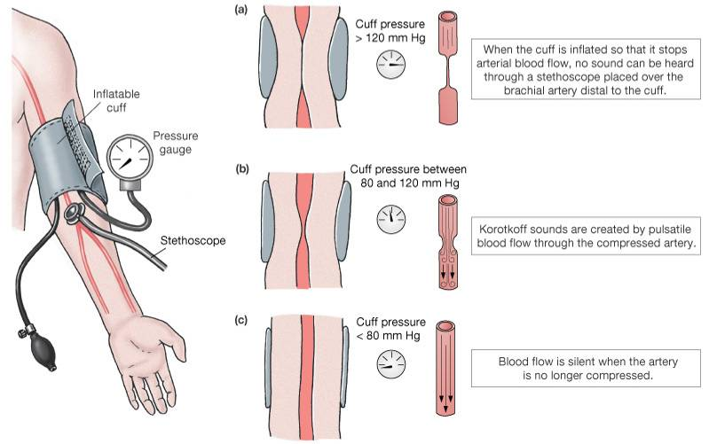
Blood Pressure (BP):

Slide 50
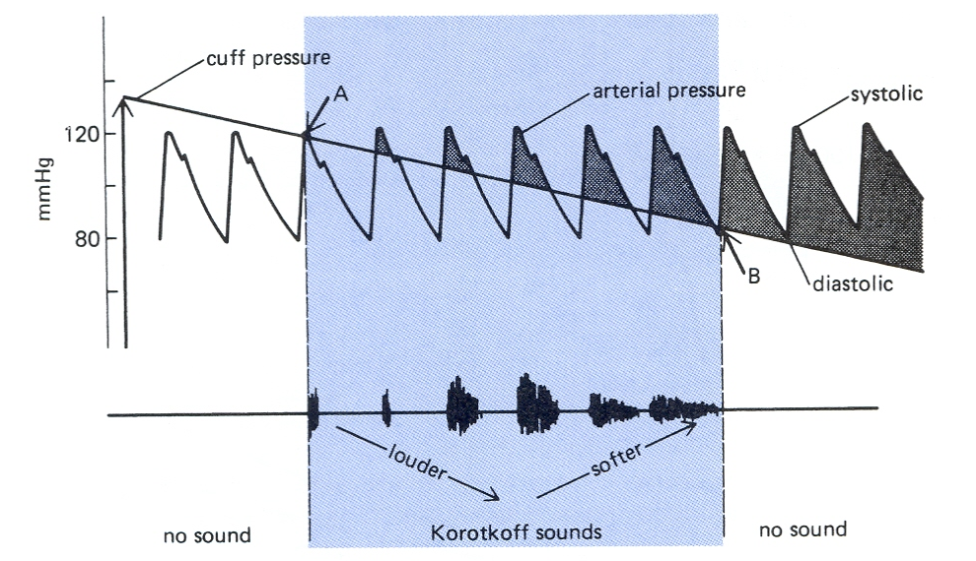
Basis of auscultatory method for measuring BP
(Sounds of Korotkoff)
Turbulent flow is noisy
Mohrman and Heller Fig 6-9
Notes:
Get intermittent (turbulent) blood flow. The tip of systolic pressure exceeds cuff pressure. When below diastolic, you get continual flow so no sounds.

Slide 51
Vascular resistance
  Opposition to blood flow due to friction between blood and walls of blood vessels
  Depends on
    Size of lumen – vasoconstriction males lumen smaller meaning greater resistance
    Blood viscosity – ratio of RBCs to plasma and protein concentration, higher viscosity means higher resistance
    Total blood vessel length – resistance directly proportional to length of vessel
      400 miles of additional blood vessels for each 2.2lb. of fat

Slide 52
Venous return
  Volume of blood flowing back to heart through systemic veins
  Occurs due to pressure generated by constriction of left ventricle
  Small pressure difference from venule (16 mmHg) to right ventricle (0 mmHg) sufficient

Slide 53
Skeletal Muscle Pump
2 other mechanisms
  Skeletal muscle pump – milks blood in 1 direction due to valves
  Respiratory pump – due to pressure changes in thoracic and abdominal cavities

Slide 54
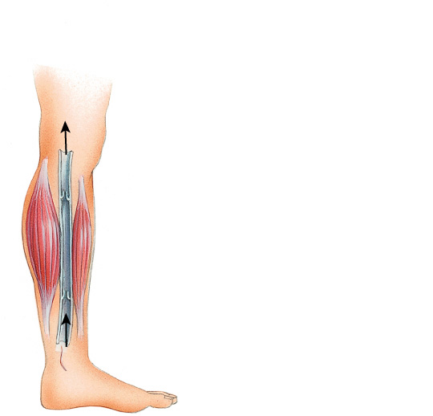
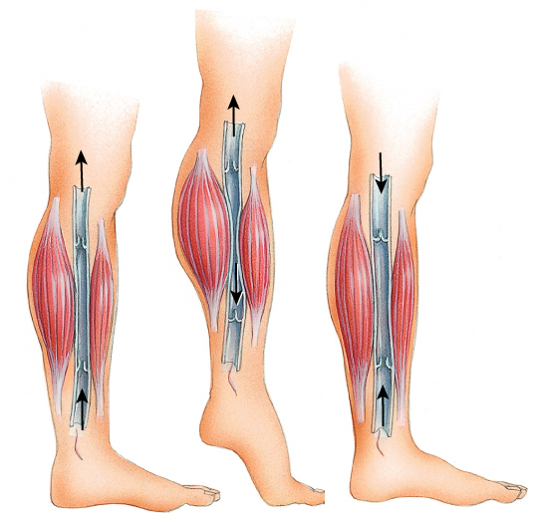
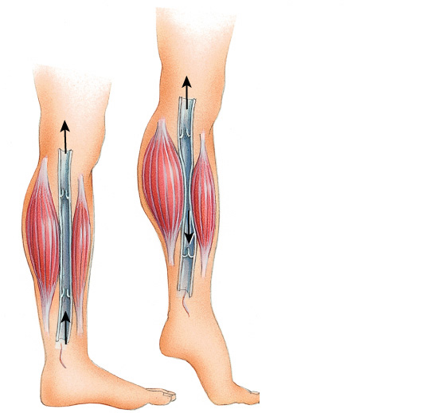
Proximal
valve
Proximal
valve
Proximal
valve
Distal
valve
Distal
valve
Distal
valve
1
1
1
2
2
3

Slide 55
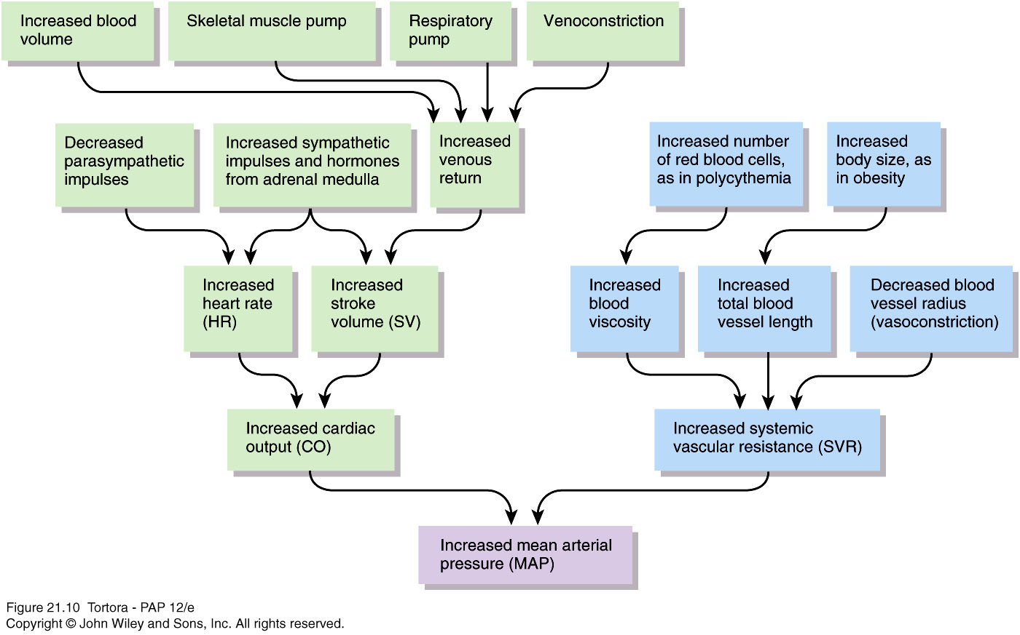

Slide 56
Role of cardiovascular center (CV)
  In medulla oblongata
  Helps regulate heart rate and stroke volume
  Also controls neural, hormonal, and local negative feedback systems that regulate blood pressure and blood flow to specific tissues
  Groups of neurons regulate heart rate, contractility of ventricles, and blood vessel diameter
  Cardiostimulatory and cardioinhibitory centers
  Vasomotor center control blood vessel diameter
  Receives input from both higher brain regions and sensory receptors

Slide 57
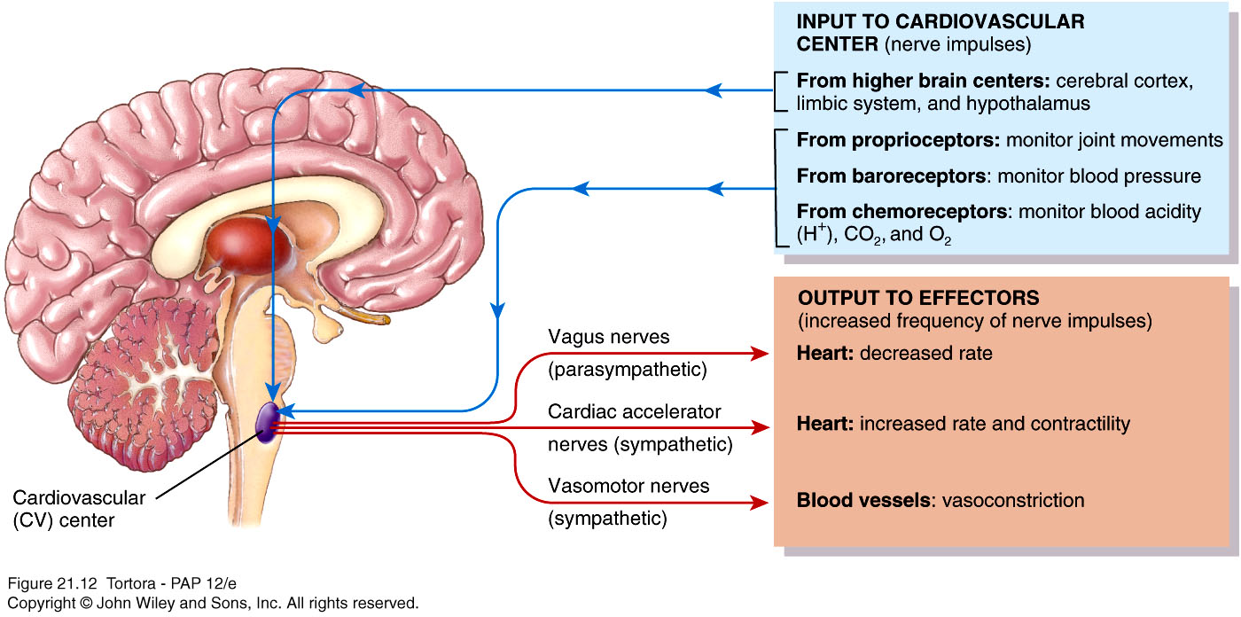
CV Center

Slide 58
3 main types of sensory receptors
  Proprioceptors – monitor movements of joints and muscles to provide input during physical activity
  Baroreceptors – monitor pressure changes and stretch in blood vessel walls
  Chemoreceptors – monitor concentration of various chemicals in the blood
Output from CV flows along neurons of ANS
  Sympathetic (stimulatory) opposes parasympathetic (inhibitory)

Slide 59
Neural regulation of blood pressure
  Negative feedback loops from 2 types of reflexes
  Baroreceptor reflexes
    Pressure-sensitive receptors in internal carotid arteries and other large arteries in neck and chest
      Carotid sinus reflex helps regulate blood pressure in brain
      Aortic reflex regulates systemic blood pressure
    When blood pressure falls, baroreceptors stretched less, slower rate of impulses to CV
    CV decreases parasympathetic stimulation and increases sympathetic stimulation

Slide 60
Neural regulation of blood pressure
  Chemoreceptor reflexes
    Receptors located close to baroreceptors of carotid sinus (carotid bodies) and aortic arch (aortic bodies)
    Detect hypoxia (low O₂), hypercapnia (high CO₂), acidosis (high H⁺) and send signals to CV
    CV increases sympathetic stimulation to arterioles and veins, producing vasoconstriction and an increase in blood pressure
    Receptors also provide input to respiratory center to adjust breathing rate

Slide 61
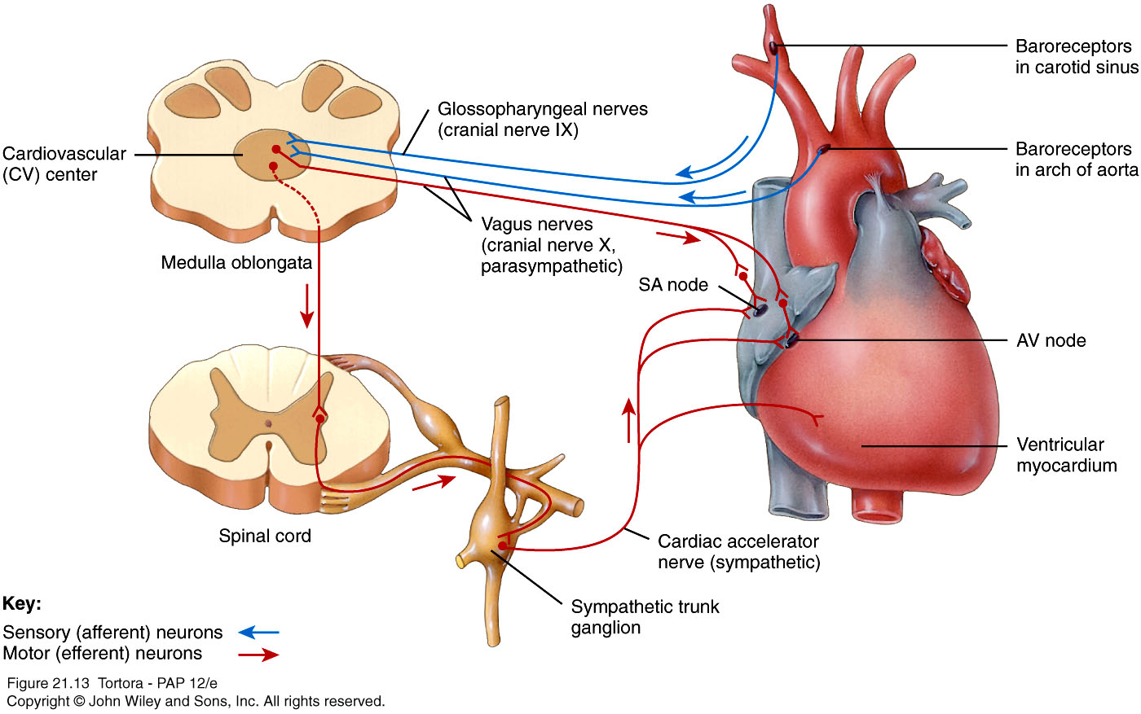

Slide 62
Hormonal regulation of blood pressure
  Renin-angiotensin-aldosterone (RAA) system
    Renin (released by kidney when blood volume falls or blood flow decreases) and angiotensin converting enzyme (ACE) act on substrates to produce active hormone angiotensin II
      Raises BP by vasoconstriction and secretion of aldosterone (increases water reabsorption in kidneys to raise blood volume and pressure)

Slide 63
Hormonal regulation of blood pressure
  Epinephrine and norepinephrine
    Adrenal medulla releases in response to sympathetic stimulation
    Increase cardiac output by increasing rate and force of heart contractions
  Antidiuretic hormone (ADH) or vasopressin
    Produced by hypothalamus, released by posterior pituitary
    Response to dehydration or decreased blood volume
    Causes vasoconstriction which increases blood pressure

Slide 64
Atrial natriuretic peptide (ANP)
    Released by cells of atria
    Lowers blood pressure by causing vasodilation and promoting loss of salt and water in urine
    Reduces blood volume

Slide 65
Autoregulation of blood pressure
  Ability of tissue to automatically adjust its blood flow to match metabolic demands
  Demand of O₂ and nutrients can rise tenfold during exercise in heart and skeletal muscles
  Also controls regional blood flow in the brain during different mental and physical activities
  2 general types of stimuli
    Physical – temperature changes, myogenic response
    Vasodilating and vasoconstricting chemicals alter blood vessel diameter

Slide 66
Circulation
Important difference between pulmonary and systemic circulation in autoregulatory response
  Systemic blood vessel walls dilate in response to low O₂ to increase O₂ delivery
  Walls of pulmonary blood vessels constrict under low O₂ to ensure most blood flows to better ventilated areas of lung

