Slide 1
Lecture 13
Physiology of the heart.
Plan.
Anatomical and functional properties of the cardiovascular system. Functions of the heart.
Electrical Activity of the heart. Cardiac conduction system and its features.
Cardiac cycle and its phases.
Cardiac output and its control.

Slide 2
Circulatory System
Three basic components
  Heart
    Serves as pump that establishes the pressure gradient needed for blood to flow to tissues
  Blood vessels
    Passageways through which blood is distributed from heart to all parts of body and back to heart
  Blood
    Transport medium within which materials being transported are dissolved or suspended

Slide 3
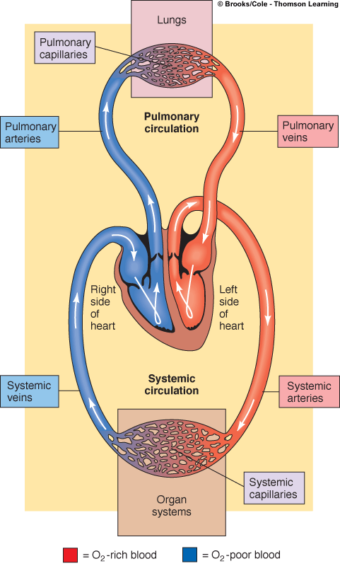
Circulatory System
Pulmonary circulation
  Closed loop of vessels carrying blood between heart and lungs
Systemic circulation
  Circuit of vessels carrying blood between heart and other body systems

Slide 4
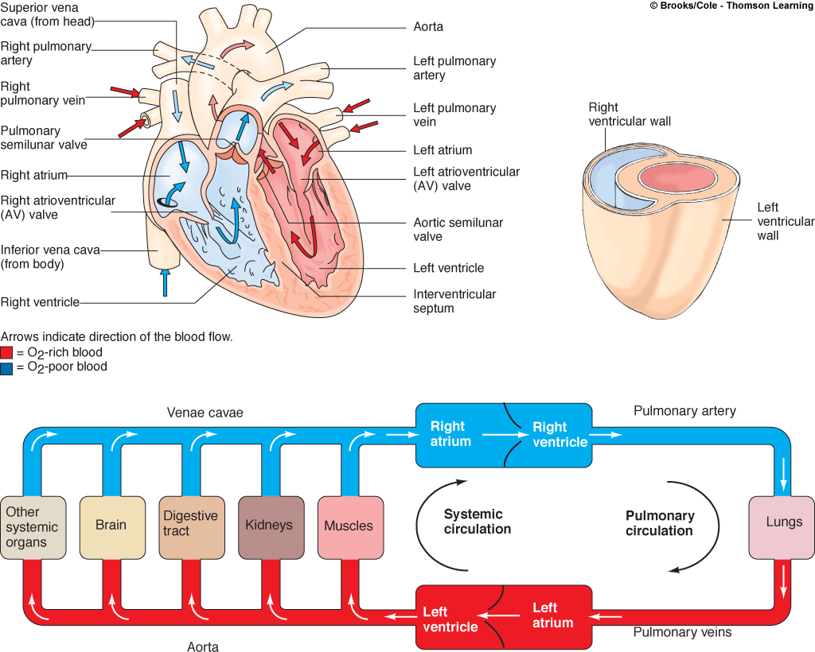
Blood Flow Through and Pump Action of the Heart

Slide 5
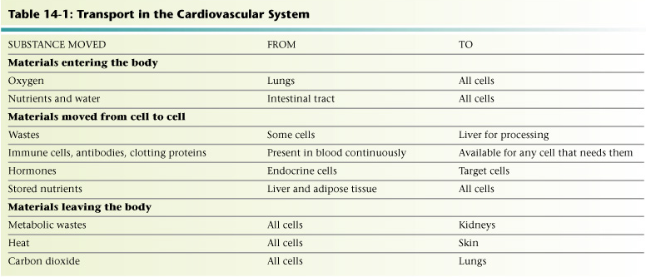
Overview of the Cardiosvascular System
Heart and Blood vessels
Products transported to sustain all cells
Table 14-1: Transport in the Cardiovascular System

Slide 6
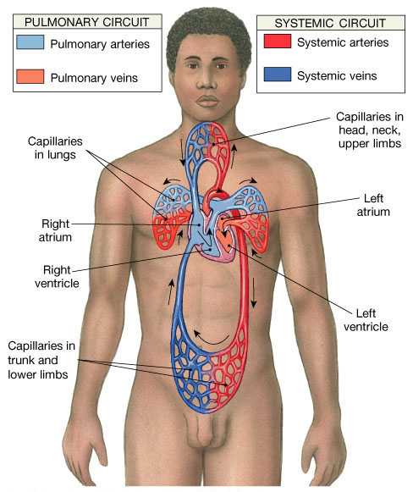
Functions of the Heart
Generating blood pressure
Routing blood
  Heart separates pulmonary and systemic circulations
  Ensuring one-way blood flow
Regulating blood supply
  Changes in contraction rate and force match blood delivery to changing metabolic needs

Slide 7
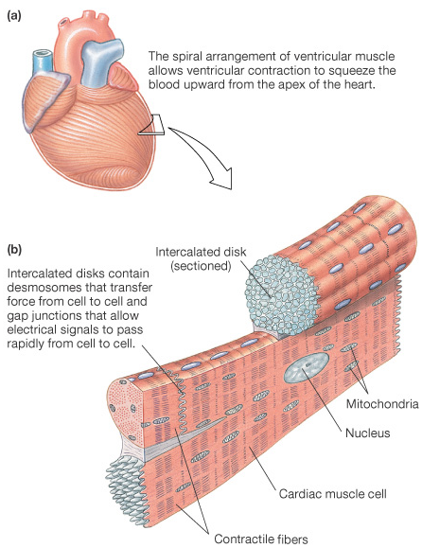
Cardiac Muscle Cells
Myocardial Autorhythmic Cells
  Membrane potential “never rests” pacemaker potential.
Myocardial Contractile Cells
  Have a different looking action potential due to calcium channels.
Cardiac cell histology
  Intercalated discs allow branching of the myocardium
  Gap Junctions (instead of synapses) fast Cell to cell signals
  Many mitochondria
  Large T tubes

Slide 8
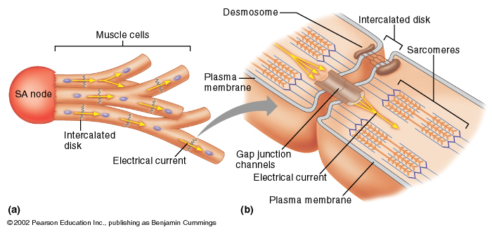

Slide 9
Electrical Activity of Heart
Heart beats rhythmically as result of action potentials it generates by itself (autorhythmicity)
Two specialized types of cardiac muscle cells
  Contractile cells
    99% of cardiac muscle cells
    Do mechanical work of pumping
    Normally do not initiate own action potentials
  Autorhythmic cells
    Do not contract
    Specialized for initiating and conducting action potentials responsible for contraction of working cells

Slide 10
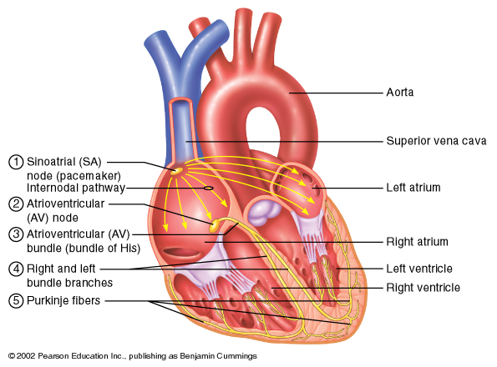

Slide 11
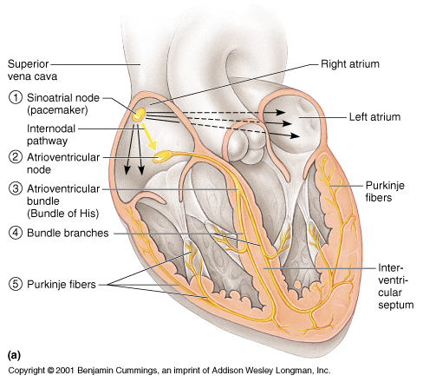
Intrinsic Cardiac Conduction System
Approximately 1% of cardiac muscle cells are autorhythmic rather than contractile
70-80/min
40-60/min
20-40/min
Notes:
Approximately 1% of the cardiac muscle cells are autorhythmic rather than contractile. * These specialized cardiac cells don’t contract but are specialized to initiate and conduct impulses through the heart to coordinate its activity. * These constitute the intrinsic cardiac conduction system. These autorhythmic cells constitute the following components of the intrinsic conduction system:
* the sinoatrial (SA) node, just inferior to the entrance of the superior vena cava into the right atrium,
* the atrioventricular node (AV) node, located just above the tricuspid valve in the lower part of the right atrium,
* the atrioventricular bundle (bundle of HIS), located in the lower part of the interatrial septum and which extends into the interventricular septum where it splits into right and left bundle branches * which continue toward the apex of the heart and the purkinje fibers * which branch off of the bundle branches to complete the pathway into the apex of the heart and turn upward to carry conduction impulses to the papillary muscles and the rest of the myocardium.
Although all of these are autorhythmic, they have different rates of depolarization. * For instance, the SA node * depolarizes at a rate of 75/min. * The AV node depolarizes at a rate of 40 to 60 beats per minute, * while the rest have an intrinsic rate of around 30 depolarizations/ minute. * Because the SA node has the fastest rate, it serves as the pacemaker for the heart. *

Slide 12
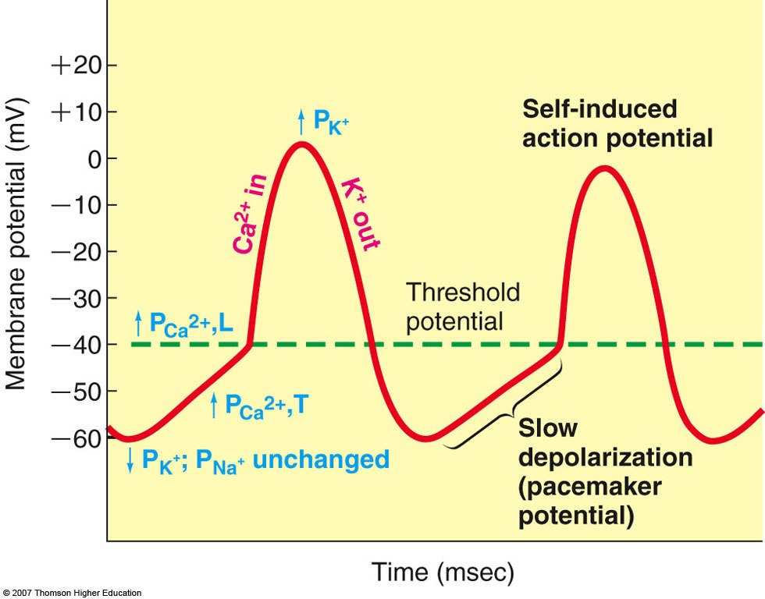
Intrinsic Conduction System
Autorhythmic cells:
  Initiate action potentials
  Have “drifting” resting potentials called pacemaker potentials
  Pacemaker potential - membrane slowly depolarizes “drifts” to threshold, initiates action potential, membrane repolarizes to -60 mV.
  Use calcium influx (rather than sodium) for rising phase of the action potential

Slide 13
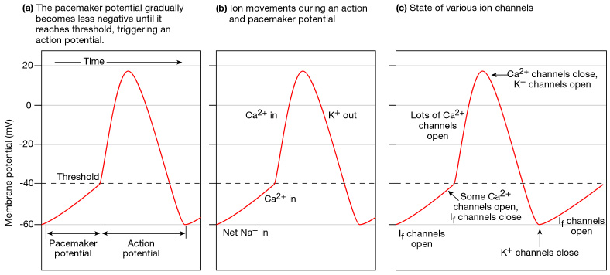
Action potentials of autorhythmic cells: Pacemaker potential; FUNNY Ca++ CURRENTS
Depolarization due to calcium NOT sodium!
Figure 14-16: Action potentials in cardiac autorhythmic cells
Notes:
THERE’S net sodium in at negative membrane potentials

Slide 14
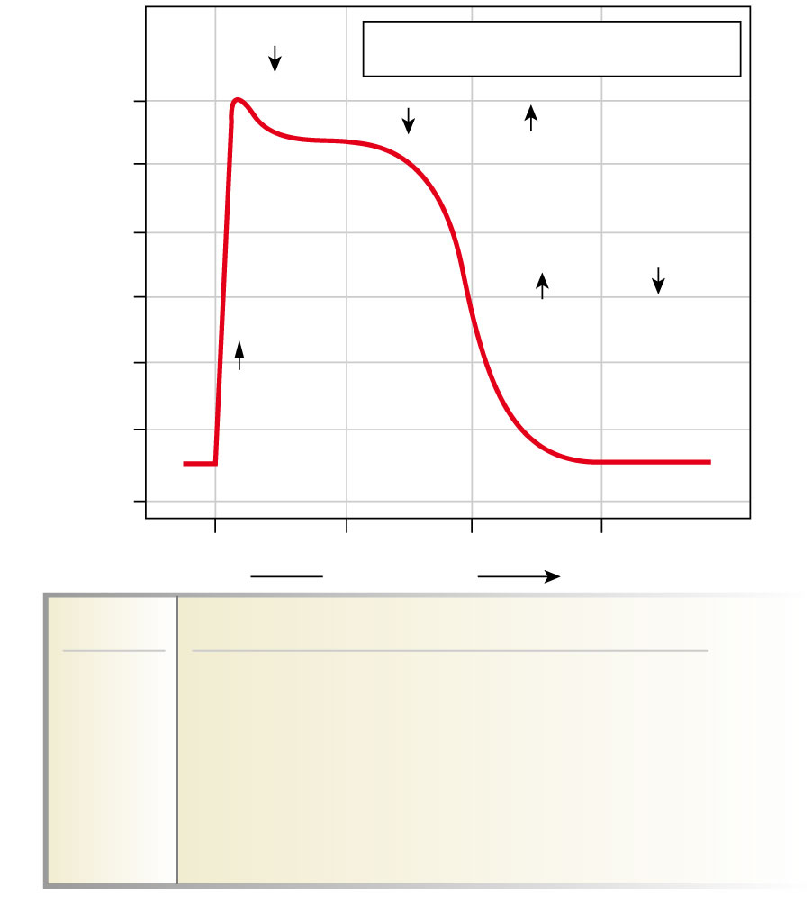
AP of Contractile Cardiac cells
  Rapid depolarization
  Rapid, partial early repolarization, prolonged period of slow repolarization which is plateau phase
  Rapid final repolarization phase
1
P_{Na}
P_{X} = Permeability to ion X
+20
2
P_{K} and P_{Ca}
0
-20
-40
0
3
P_{K} and P_{Ca}
Membrane potential (mV)
P_{Na}
-60
-80
4
4
-100
0
100
200
300
Time (msec)
Phase
Membrane channels
0
Na⁺ channels open
1
Na⁺ channels close
2
Ca²⁺ channels open; fast K⁺ channels close
3
Ca²⁺ channels close; slow K⁺ channels open
4
Resting potential

Slide 15
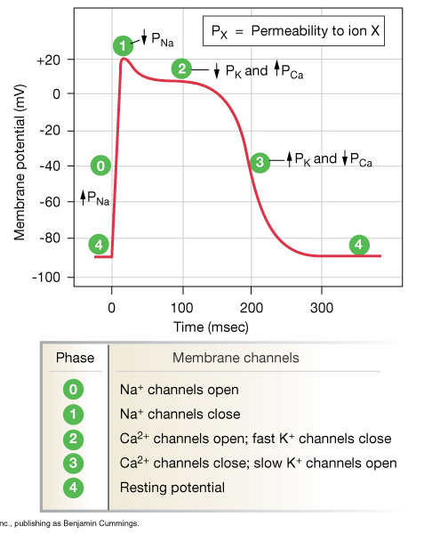
AP of Contractile Cardiac cells
Action potentials of cardiac contractile cells exhibit prolonged positive phase (plateau) accompanied by prolonged period of contraction
  Ensures adequate ejection time
  Plateau primarily due to activation of slow L-type Ca²⁺ channels

Slide 16
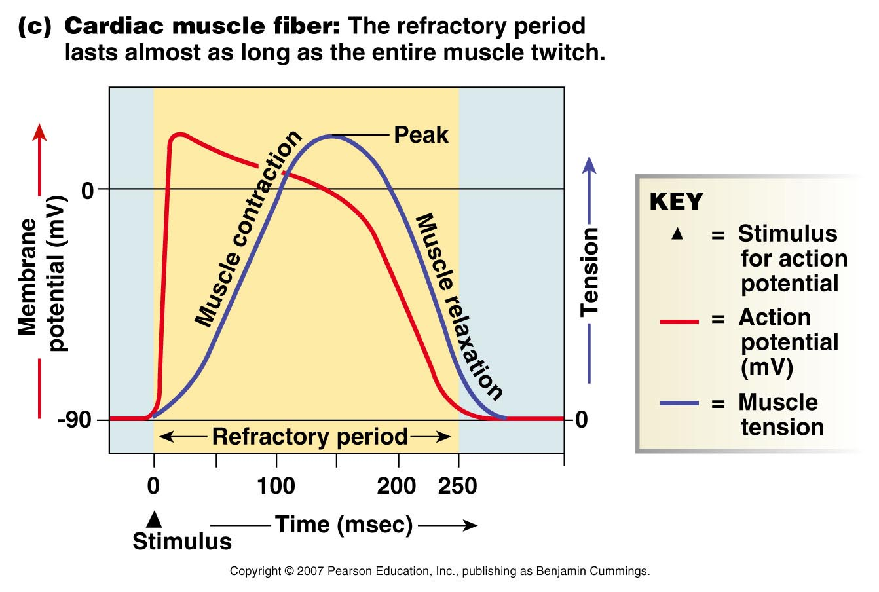
Why A Longer AP In Cardiac Contractile Fibers?
We don’t want Summation and tetanus in our myocardium.
Because long refractory period occurs in conjunction with prolonged plateau phase, summation and tetanus of cardiac muscle is impossible
Ensures alternate periods of contraction and relaxation which are essential for pumping blood

Slide 17
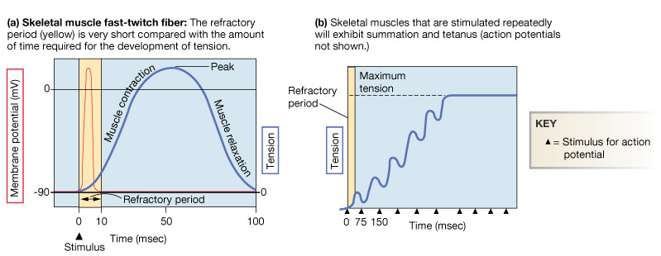
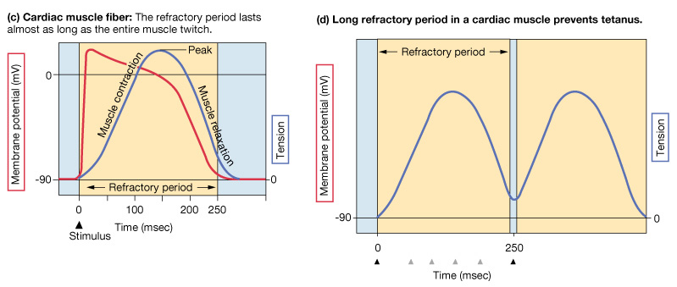
Refractory period

Slide 18
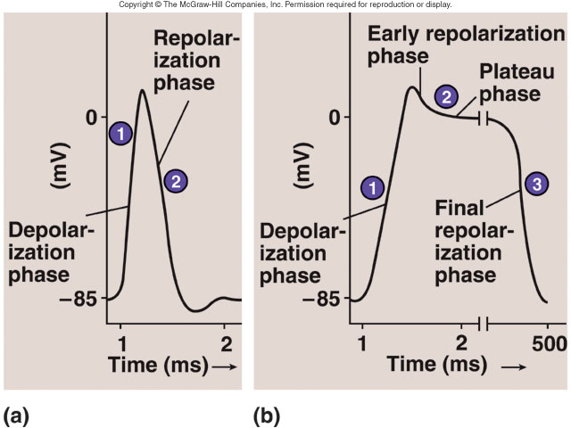
Membrane Potentials in SA Node and Ventricle

Slide 19
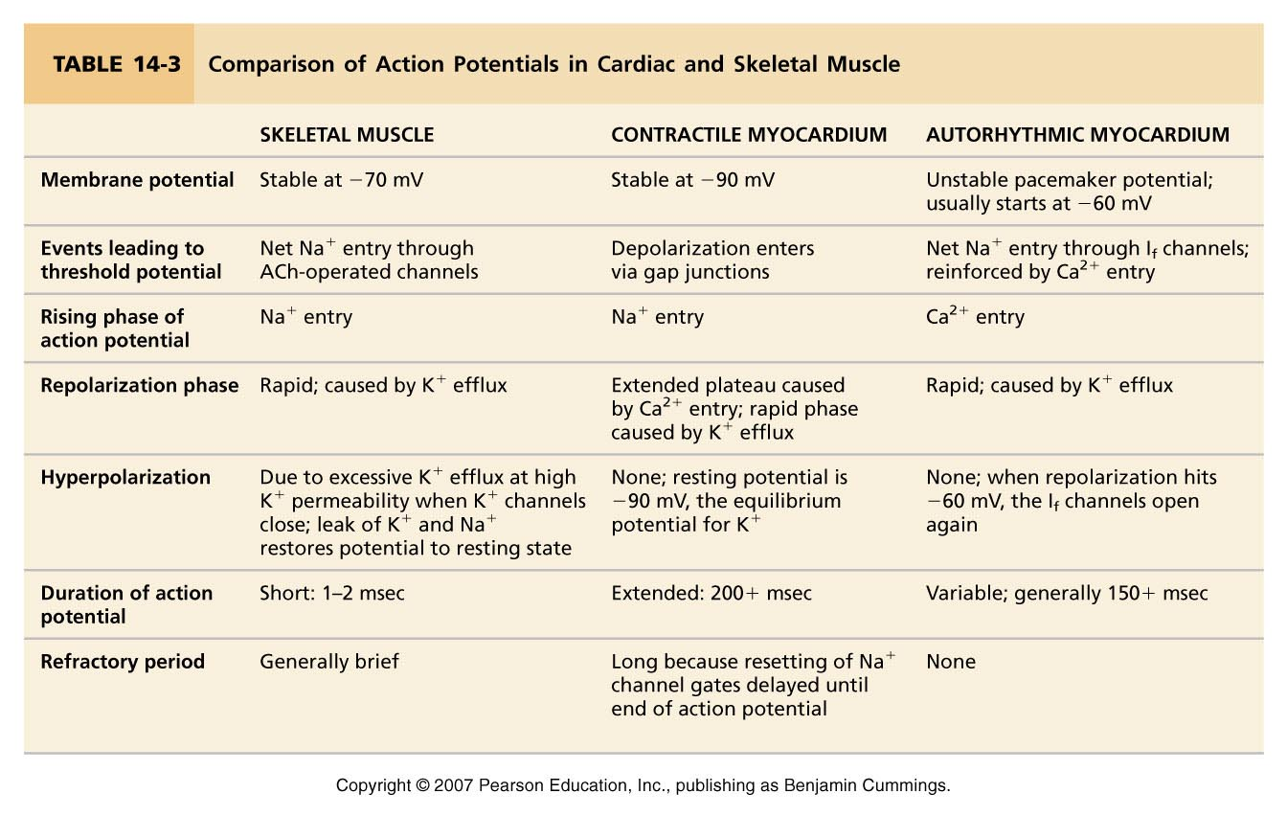
Action Potentials

Slide 20
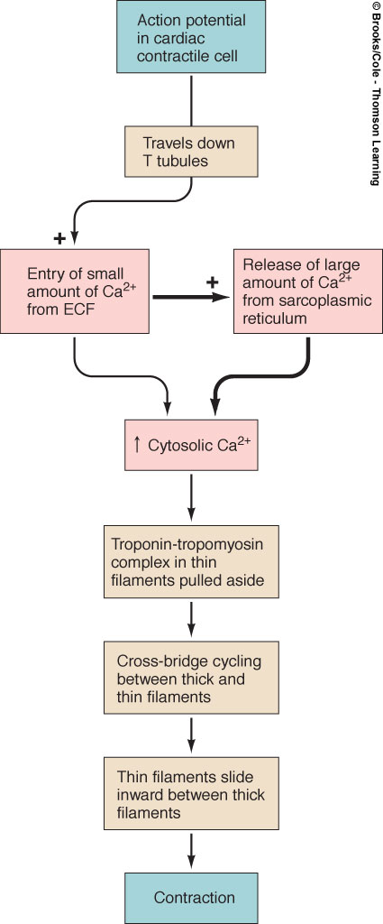
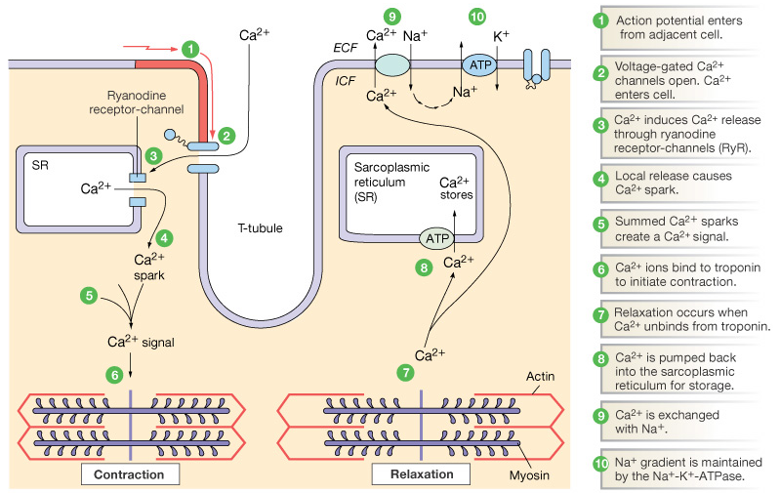
Excitation-Contraction Coupling in Cardiac Contractile Cells
Ca²⁺ entry through L-type channels in T tubules triggers larger release of Ca²⁺ from sarcoplasmic reticulum
  Ca²⁺ induced Ca²⁺ release leads to cross-bridge cycling and contraction

Slide 21
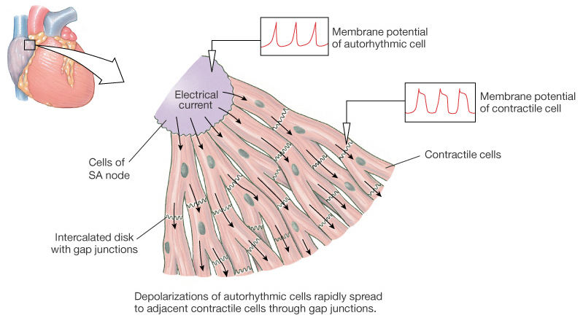
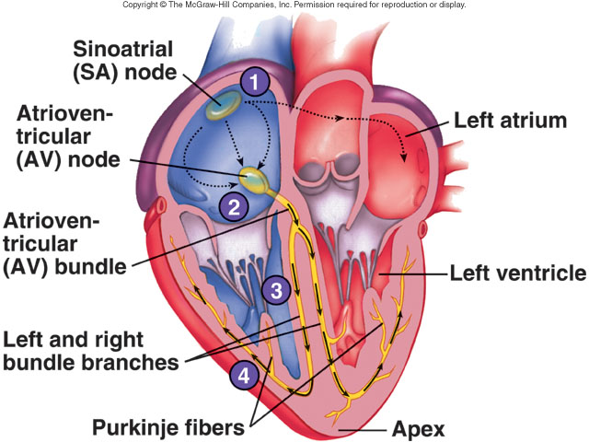
Electrical Signal Flow - Conduction Pathway
Cardiac impulse originates at SA node
Action potential spreads throughout right and left atria
Impulse passes from atria into ventricles through AV node (only point of electrical contact between chambers)
Action potential briefly delayed at AV node (ensures atrial contraction precedes ventricular contraction to allow complete ventricular filling)
Impulse travels rapidly down interventricular septum by means of bundle of His
Impulse rapidly disperses throughout myocardium by means of Purkinje fibers
Rest of ventricular cells activated by cell-to-cell spread of impulse through gap junctions

Slide 22
The Cardiac Cycle
Includes all events associated with the flow of blood through the heart during a single, complete heartbeat
During the cardiac cycle, pressure changes occur as the atria and ventricles alternately contract and relax
  When a chamber of the heart contracts, there is an increase in blood pressure inside the chamber
  When a chamber of the heart relaxes, there is a decrease in blood pressure inside the chamber
Blood always flows from regions of high pressure to low pressure

Slide 23
The Cardiac Cycle
Mechanical events of the cardiac cycle are associated with changes in pressure and blood volume in the heart
The pressure differences cause opening and closing of heart valves that allow one-way blood flow through heart
Changes in pressure and blood volume correspond with electrical events on the EKG

Slide 24
The Cardiac Cycle – 5 Aspects
Pump Cycle
  Phases of the pumping action of the heart
Periods of valve opening and closure
Changes in pressure within the atria and ventricles
Changes in ventricular volume
  Reflect the amount of blood entering and leaving the ventricle during each heartbeat
Heart sounds

Slide 25
The Pump Cycle
One complete cardiac cycle includes both contraction and relaxation of the atria and ventricles
Two main stages:
Systole
      Contraction of a heart chamber forcing blood out
Diastole
      Relaxation of a heart chamber allowing blood filling

Slide 26
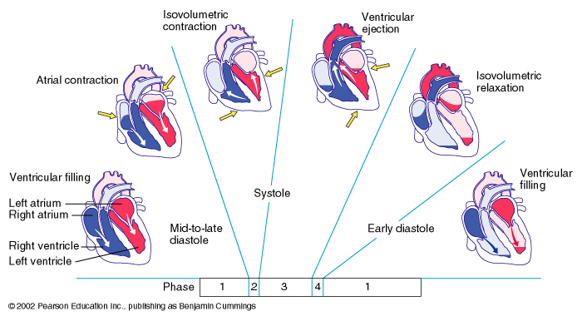
Phases of the Pump Cycle:
Phase 1: Mid-to-late Diastole
Two components
  Ventricular Filling
  Atrial Contraction

Slide 27
Phases of the Pump Cycle:
Phase 1: Mid-to-late Diastole
Ventricular filling
Ventricles are relaxed
  Intraventricular pressure is low
AV valves are open
Semilunar valves are closed
Most ventricular filling is passive
  Passive blood flow from the atria into the ventricles accounts for about 70 - 80% of ventricular filling

Slide 28
Phases of the Pump Cycle:
Phase 1: Mid-to-late Diastole
Atrial contraction
  Occurs following SA node depolarization
Relatively little contribution to ventricular filling in normal, resting heart
Atria contract and compress blood in the atria
  Slight rise in atrial pressure
  Last squirt of blood into ventricles
Atria relax and are in atrial diastole for the rest of the cardiac cycle

Slide 30
Phases of the Pump Cycle:
Phase 2: Systole
Two components
  Isovolumetric Contraction
  Ventricular Ejection
Atria are relaxed
Ventricles are contracting
  Increase in ventricular pressure
  Pressure gradient exists between the ventricles and atria

Slide 31
Phases of the Pump Cycle:
Phase 2: Systole
Isovolumetric Contraction
Ventricular contraction
Increased ventricular pressure
  All four heart valves are momentarily closed
    When ventricular pressure exceeds atrial pressure, the AV valves close
    The semilunar valves remain closed until the ventricular pressure exceeds the pressure in the pulmonary trunk or aorta
Once the ventricular pressure exceeds the pressure in the pulmonary trunk and aorta, the semilunar valves open
Blood is ejected from the ventricles

Slide 32
Phases of the Pump Cycle:
Phase 2: Systole
Ventricular Ejection
Begins when the semilunar valves open
Blood is pumped out of the ventricles and into the pulmonary trunk and aorta
Ventricular volume decreases

Slide 34
Phases of the Pump Cycle:
Phase 3: Early Diastole
Begins as ventricular contraction stops
Two components
  Isovolumetric Relaxation
  Ventricular Filling Phase

Slide 35
Phases of the Pump Cycle:
Phase 3: Early Diastole
Isovolumetric relaxation
Begins with ventricular relaxation
Decreased ventricular pressure
  Semilunar valves close
During this time, atria have been in diastole
  Filling with blood
  Increased atrial pressure

Slide 36
Phases of the Pump Cycle:
Phase 3: Early Diastole
Ventricular Filling
In early diastole, the atrial blood pressure begins to exceed the pressure in the ventricles
  The AV valves open
  Blood flows from the atria into the ventricles
Ventricular filling begins
Mid-to-late Diastole (discussed earlier)
  Ventricles are relaxed
  AV valves are open
  Semilunar valves are closed

Slide 38
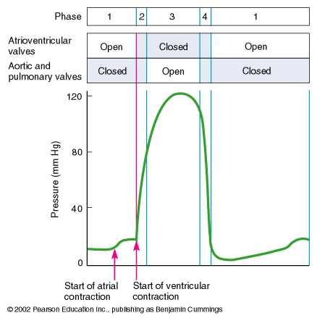

Slide 39
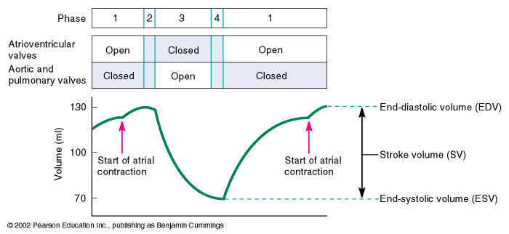

Slide 40
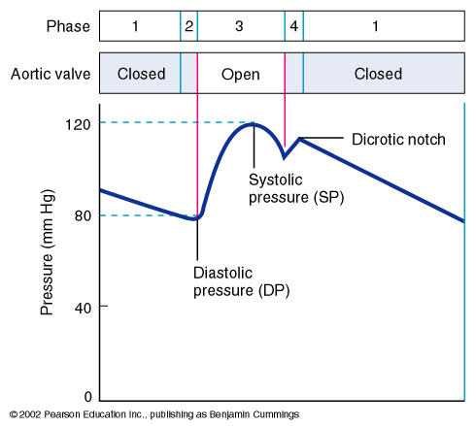

Slide 41
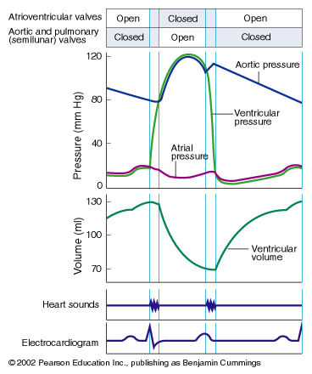

Slide 42
Other Features of the Cardiac Cycle
Quiescent period
  Follows ventricular systole
  The entire heart is relaxed for ~ 0.4 sec
Atrial systole lasts ~ 0.1 sec
Ventricular systole lasts ~ 0.3 sec
Note that pressure gradients keep blood moving one-way through heart and cause valve opening/closing

Slide 43
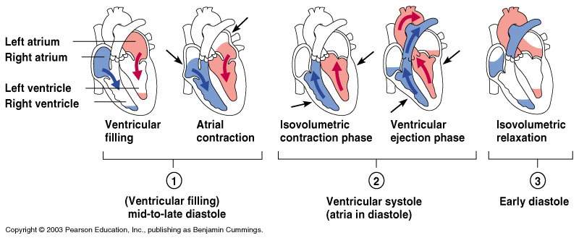
Cardiac Cycle - Filling of Heart Chambers
Heart is two pumps that work together, right and left half
Repetitive contraction (systole) and relaxation (diastole) of heart chambers
Blood moves through circulatory system from areas of higher to lower pressure.
  Contraction of heart produces the pressure

Slide 44
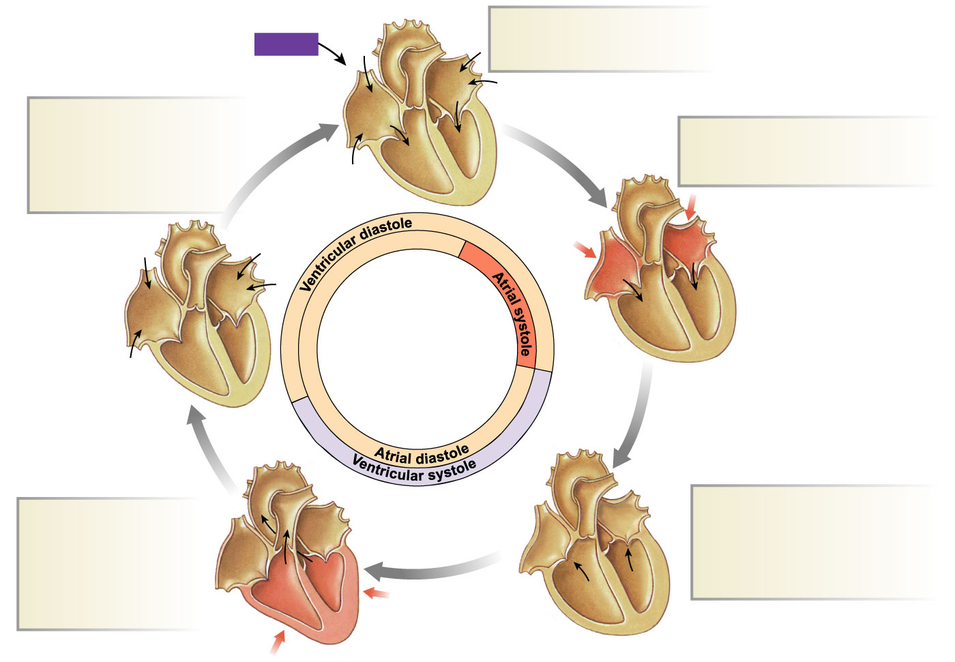
Cardiac Cycle - Mechanical Events
1
Late diastole: both sets of
chambers are relaxed and
ventricles fill passively.
START
5
Isovolumic ventricular
relaxation: as ventricles
relax, pressure in ventricles
falls, blood flows back into
cups of semilunar valves
and snaps them closed.
2
Atrial systole: atrial contraction
forces a small amount of
additional blood into ventricles.
Ventricular ejection:
as ventricular pressure
rises and exceeds
pressure in the arteries,
the semilunar valves
open and blood is
ejected.
3
Isovolumic ventricular
contraction: first phase of
ventricular contraction pushes
AV valves closed but does not
create enough pressure to open
semilunar valves.
4
Figure 14-25: Mechanical events of the cardiac cycle

Slide 45
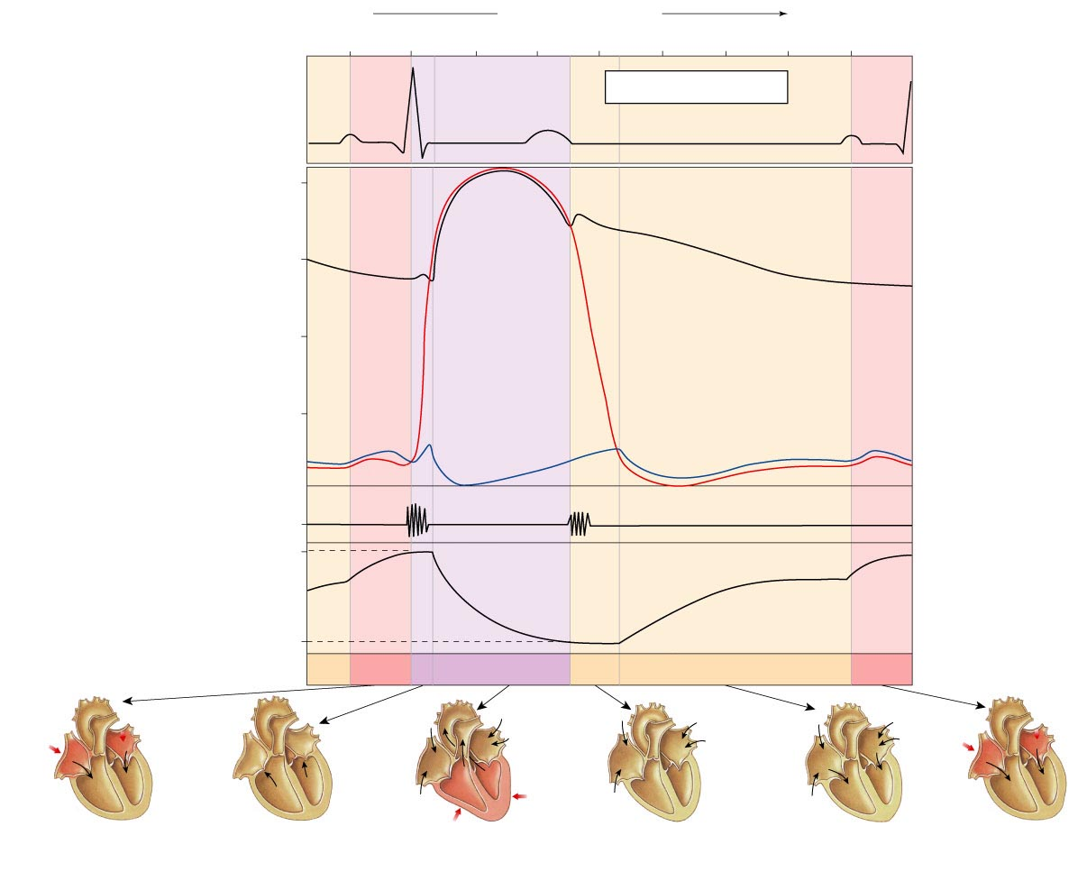
Wiggers Diagram
Time (msec)
0
100
200
300
400
500
600
700
800
Electro-
cardiogram
(ECG)
QRS
complex
Cardiac cycle
QRS
complex
P
T
P
120
90
Aorta
Dicrotic
notch
Pressure
(mm Hg)
60
Left
ventricular
pressure
Left atrial
pressure
30
Heart
sounds
S₁
S₂
EDV
135
Left
ventricular
volume
(mL)
ESV
65
Atrial
systole
Ventricular
systole
Ventricular
diastole
Atrial
systole
Atrial systole
Isovolumic
ventricular
contraction
Ventricular
systole
Early
ventricular
diastole
Late
ventricular
diastole
Atrial
systole
Figure 14-26

Slide 46
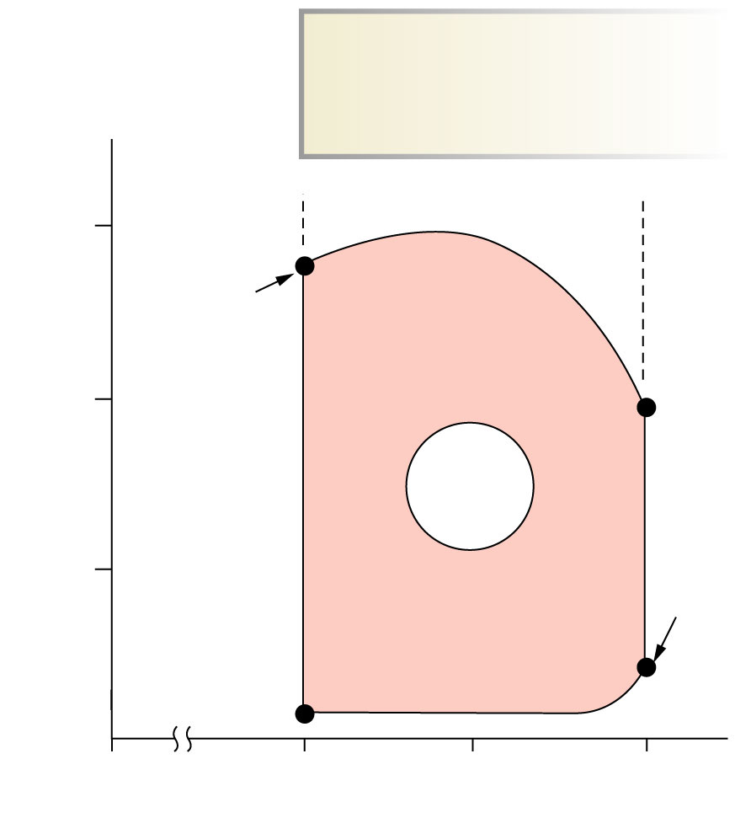
Cardiac Cycle
Left ventricular pressure-volume changes during one cardiac cycle
KEY
EDV = End-diastolic volume
ESV = End-systolic volume
120
Stroke volume
D
ESV
80
C
One
cardiac
cycle
Left ventricular pressure (mm Hg)
40
EDV
B
A
0
65
100
135
Left ventricular volume (mL)
Figure 14-25

Slide 47
Cardiac Output and its Control
Heart Rate (HR)
  The number of ventricular contractions per minute
Stroke Volume (SV)
  The amount of blood pumped out of the ventricle with each contraction
  Stroke volume is usually about 80ml/beat at rest.

Slide 48
Cardiac Output and its Control
Cardiac Output (CO)
The volume of blood pumped by each ventricular contraction per minute
  CO = SV x HR
  Example (normal resting adult):
    SV = 70 ml/beat and HR = 72 bpm
    CO = 70 ml/beat x 72 bpm = 5,040 ml/min or about 5 L/min
At rest, CO is ~ 5 L/min
During stress such as exercise, the normal heart has the capacity to increase CO by 4 - 5 times that of resting
  ~ 20 – 25 L/min
Athletes can increase CO by as much as 7 times that of resting
  ~ 35 L/min,
  This is known as the Cardiac Reserve

Slide 49
Variables that Determine CO
CO may be altered by changes in SV and/or HR
  Direct Relationship
Heart Rate
  ↑ HR = ↑ CO; ↓ HR = ↓ CO
Stroke Volume
  ↑ SV = ↑ CO; ↓ SV = ↓ CO

Slide 50
Variables that Determine CO
Force of heart muscle contraction (contractility)
Factors that affect heart rate and contractility
  Extrinsic control: Factors from outside of the heart
      Neural Input
      Circulating hormones (drugs, neurotransmitters, etc.)
  Intrinsic control: Factors from within the heart
      Starling’s Law of the Heart

Slide 51
Factors Affecting CO: Changes in HR
Autonomic Control of HR
Heart rate is influenced by 3 types of factors:
    Sympathetic control
    Parasympathetic control
    Hormonal control
Fibers of the ANS project to almost every part of the heart:
  SA node
  AV node
  Ventricular myocardium
The ANS regulates both HR and SV (contractility)

Slide 52
Factors Affecting CO: Changes in HR
Sympathetic nervous system activation causes
  ↑ HR
  ↑ SV (contractility)
Sympathetic input to the heart
Sympathetic cardiac nerves emerge from the sympathetic trunk from thoracic region of spinal cord
Provides innervations to the:
  SA node
  AV node
  Ventricular myocardium
Neurotransmitter is norepinephrine

Slide 53
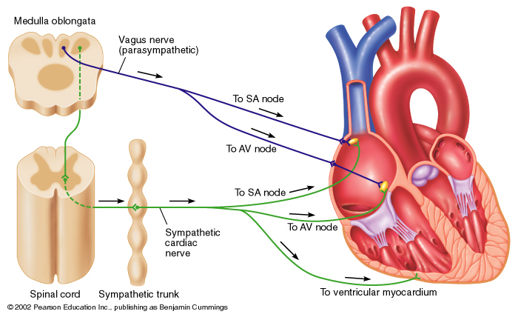

Slide 54
Factors Affecting CO: Changes in HR
Parasympathetic nervous system activation causes
  ↓ HR
  ↓ SV (contractility)
Parasympathetic input to the heart
The vagus nerve (X) emerges from the medulla oblongata
Primarily innervates the
  SA node
  AV node
Neurotransmitter is acetylcholine

Slide 56
Sympathetic Control of HR
Increased sympathetic activity
Increases action potential frequency
Action potential is transmitted faster
  Reduced delay of impulse conduction between the atria and ventricles
  Shortens the time it takes for action potentials to travel through the ventricles
↑ HR
↑ CO

Slide 57
Parasympathetic Control of HR
Increased parasympathetic activity
Vagus Nerve Stimulation
  Decreases depolarization
Decreases action potential frequency
Action potential is transmitted slower
  Decreased conduction between atria and ventricles
  Lengthens the time it takes action potentials to travel through the ventricles
↓ HR
↓ CO

Slide 58
Hormonal Control of HR
Epinephrine (Catecholemines)
Secreted by the adrenal medulla, usually in response to sympathetic nervous stimulation
Travels through the bloodstream to the heart
Exerts minute-by-minute control
Increases the frequency of action potentials generated by the SA node, thus ↑ HR
Increases speed of action potential conduction through heart, thus ↑ HR

Slide 59
Hormonal Control of HR
Thyroid Hormones (Thyroxine)
Causes proliferation of adrenergic receptors, the binding sites for catecholamines resulting in:
  ↑ HR
  ↑ SV
  ↑ CO
  Decreased total peripheral resistance (when present in very large amounts)
Inadequate thyroid function can produce decreased HR, SV, and CO

Slide 60
Integration of Heart Rate Control
Three influences are active at all times:
  Sympathetic
  Parasympathetic
  Hormonal
Parasympathetic nervous control dominates the heart at rest
  Parasympathetic fibers are connected to the heart by the vagus nerve, which exerts beat-by-beat control of the SA and AV nodes
Parasympathetic fibers release acetylcholine
  Vagal tone (suppressive effect)
  Acetylcholine inhibits the SA node and AV node
  Results in ↓ HR
Decreased parasympathetic input
  Allows sympathetic input to dominate
  Results in ↑ heart rate

Slide 61
Other Factors that Influence HR
Age.
  HR is fastest in fetus (140 - 160 bpm)
  HR gradually decreases through childhood and most of adult life
  The elderly commonly develop tachycardia
Gender.
  HR is faster in women (72 - 80 bpm) compared to men (64 - 72 bpm)
Physical fitness.
  Highly-fit individuals have lower resting HR due to increased vagal tone and decreased sympathetic tone
Body temperature.
  Increased body temperature (hyperthermia) as in fever or strenuous exercise increases HR
  Decreased body temperature (hypothermia) decreases HR
  Both conditions are associated with changes in metabolic rate of the myocardium

Slide 62
Factors Affecting CO: Changes in SV
Ventricular Contractility
  The capacity of the ventricles to produce force
Preload
  Also called End Diastolic Volume (EDV)
  The amount of blood in the heart at the end of ventricular filling
Afterload
  Also called End Systolic Volume (ESV)
  The pressure the ventricles must overcome to eject blood out of the left ventricle

Slide 63
The Influence of Ventricular Contractility on SV
Contractility
  Any factor that causes an ↑ in contractility = ↑ SV (↑ CO)
  Any factor that causes a ↓ in contractility = ↓ SV (↓CO)
Control of Ventricular Contractility
  Sympathetic nervous system
  Hormonal

Slide 64
The Influence of Ventricular Contractility on SV
Sympathetic Nervous System Control
Stimulation of cardiac muscle cells by sympathetic fibers results in the release of norepinephrine
Norepinephrine
  Binds to beta adrenergic receptors on cardiac muscle cell membrane
  Stimulates a second messenger (cyclic AMP) to open Ca++ channels on the membrane
↑ Ca++ = ↑ ventricular contractility
  ↑ SV
  ↑ CO

Slide 65
The Influence of Ventricular Contractility on SV
Hormonal Control
Epinephrine circulating in the bloodstream binds to beta adrenergic receptors on cardiac muscle cells
Epinephrine
  Stimulates second messengers (cyclic AMP) to open Ca++ channels on the membrane
↑ Ca++ = ↑ ventricular contractility
  ↑ SV
  ↑ CO

Slide 66
The Influence of Ventricular Contractility on SV
Summary
Contractility refers to force of contraction at any given preload
  The more blood in the ventricles at beginning of systole…
    The greater the force of contraction
    the more blood ejected by the ventricles
Results:
  ↑ SV and ↑ CO
  ↓ Afterload (ESV)

Slide 67
The Influence of Preload (EDV) on SV
Starling’s Law of the Heart
When the rate at which blood flows into the heart from the veins (venous return) changes, the heart automatically adjusts its output to match the inflow.
Starling’s Law is based on the observed changes that occur in EDV and preload as a result of venous return
  This observation is called the Starling Effect

Slide 68
Starling’s Law of the Heart
End diastolic volume (EDV)
Determined by venous return, which is the amount of blood returned to the heart
  Influenced by central venous pressure
↑ EDV = ↑ force of contraction (contractility)
↑ EDV = ↑ SV
↑ EDV = ↑ CO

Slide 69
Starling’s Law of the Heart
Preload
The amount of tension, or stretch, on the ventricular myocardium
The cardiac muscle fibers are stretched due to the blood filling the chambers
The effect of stretching ventricular walls = ↑ force of ventricular contraction
  This is an example of intrinsic control of the heart

Slide 70
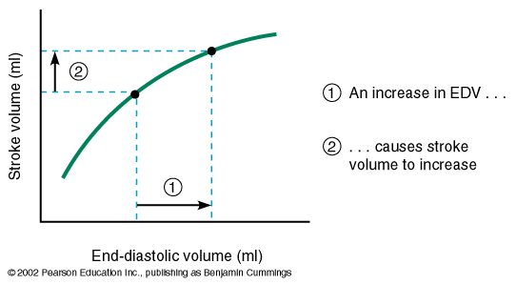
Starling’s Law of the Heart
Starling Curves
Within normal limits, any factor that increases venous return will result in:
  ↑ preload (EDV)
  ↑ force of contraction
Ultimately, ↑ SV

Slide 71
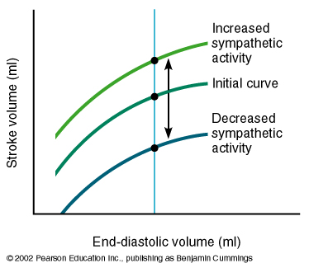
Starling’s Law of the Heart
Starling Curves
↑ sympathetic input = ↑ SV
↓ sympathetic input = ↓ SV

Slide 72
The Influence of Afterload (ESV) on SV
Afterload
The pressure the left ventricle must exceed before the aortic valve opens
Indicates how hard the cardiac muscle must work to push blood into the arterial system
  Must push blood against the mean (average) arterial pressure
    ↑ mean arterial pressure = ↑ afterload (ESV)
  Must push blood against the total peripheral resistance
    ↑ total peripheral resistance = ↑ afterload (ESV)
An Increased afterload (ESV) results in:
  ↓ SV
  ↓ CO

Slide 73
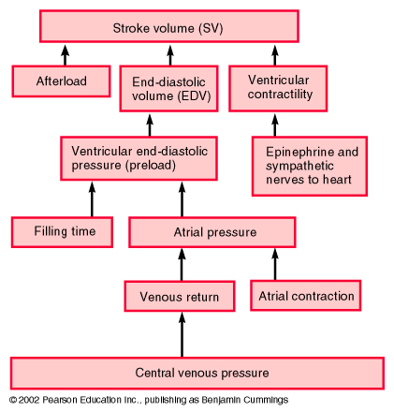

Slide 74
Heart Rate Abnormalities
Tachycardia
HR > 100 bpm
Causes:
  Fever
  SNS stimulation
  Exercise
  Certain hormones
  Certain drugs
Bradycardia
HR < 60 bpm
Common in endurance-trained individuals
Causes:
  Hypothermia
  PNS stimulation
  Certain drugs

Slide 75
Cardiac Output (CO) and Reserve
CO is the amount of blood pumped by each ventricle in one minute
CO is the product of heart rate (HR) and stroke volume (SV)
HR is the number of heart beats per minute
SV is the amount of blood pumped out by a ventricle with each beat
Cardiac reserve is the difference between resting and maximal CO

Slide 76
Cardiac Output = Heart Rate X Stroke Volume
Around 5L :
(70 beats/m × 70 ml/beat = 4900 ml)
Rate: beats per minute
Volume: ml per beat
  SV = EDV - ESV
  Residual (about 50%)

Slide 77
Factors Affecting Cardiac Output
Cardiac Output = Heart Rate X Stroke Volume
Heart rate
  Autonomic innervation
  Hormones - Epinephrine (E), norepinephrine(NE), and thyroid hormone (T3)
  Cardiac reflexes
Stroke volume
  Starlings law
  Venous return
  Cardiac reflexes

Slide 78
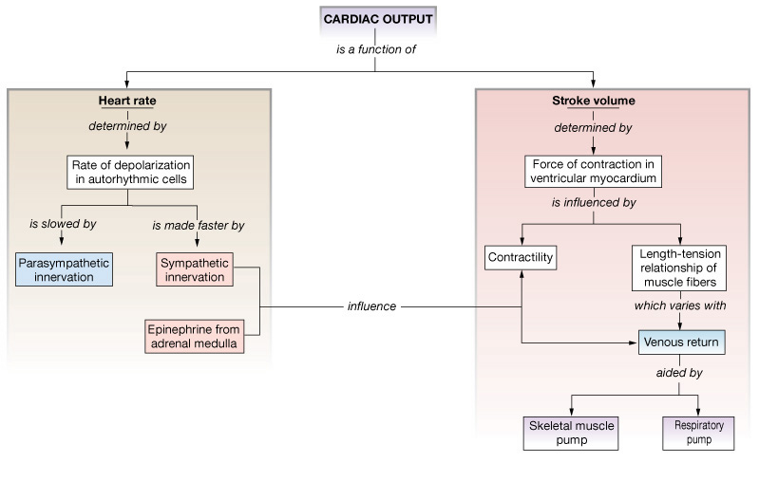
Factors Influencing Cardiac Output
Intrinsic: results from normal functional characteristics of heart - contractility, HR, preload stretch
Extrinsic: involves neural and hormonal control – Autonomic Nervous system

Slide 79
Stroke Volume (SV)
  Determined by extent of venous return and by sympathetic activity
  Influenced by two types of controls
    Intrinsic control
    Extrinsic control
  Both controls increase stroke volume by increasing strength of heart contraction

Slide 80
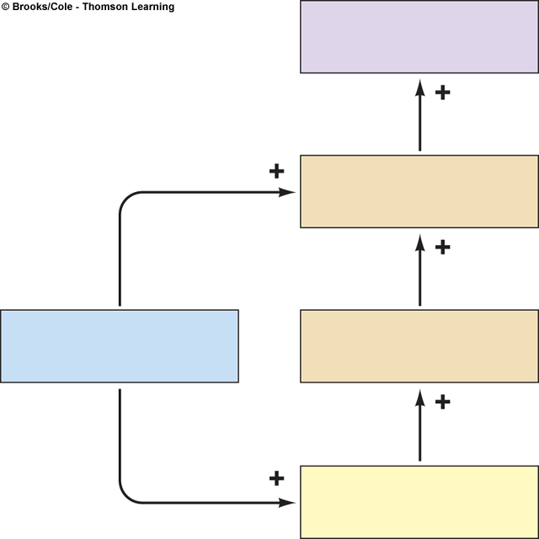
Intrinsic Factors Affecting SV
Contractility – cardiac cell contractile force due to factors other than EDV
Preload – amount ventricles are stretched by contained blood - EDV
Venous return - skeletal, respiratory pumping
Afterload – back pressure exerted by blood in the large arteries leaving the heart
Stroke volume
Strength of
cardiac contraction
End-diastolic
volume
Venous return

Slide 81
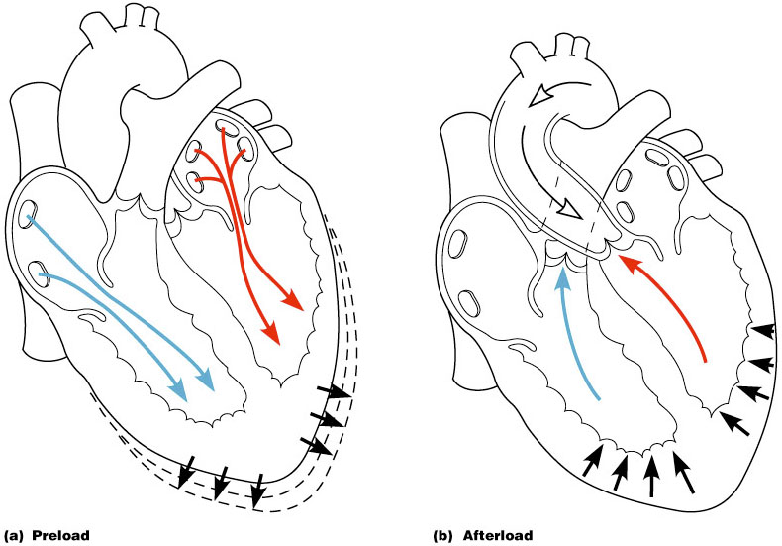
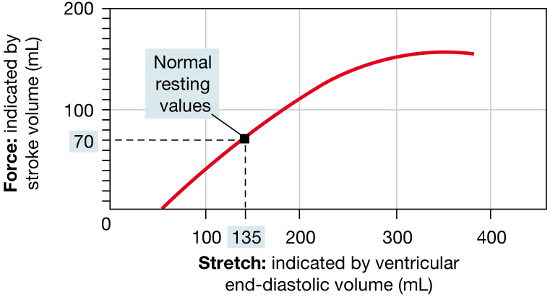
Frank-Starling Law
Preload, or degree of stretch, of cardiac muscle cells before they contract is the critical factor controlling stroke volume

Slide 82
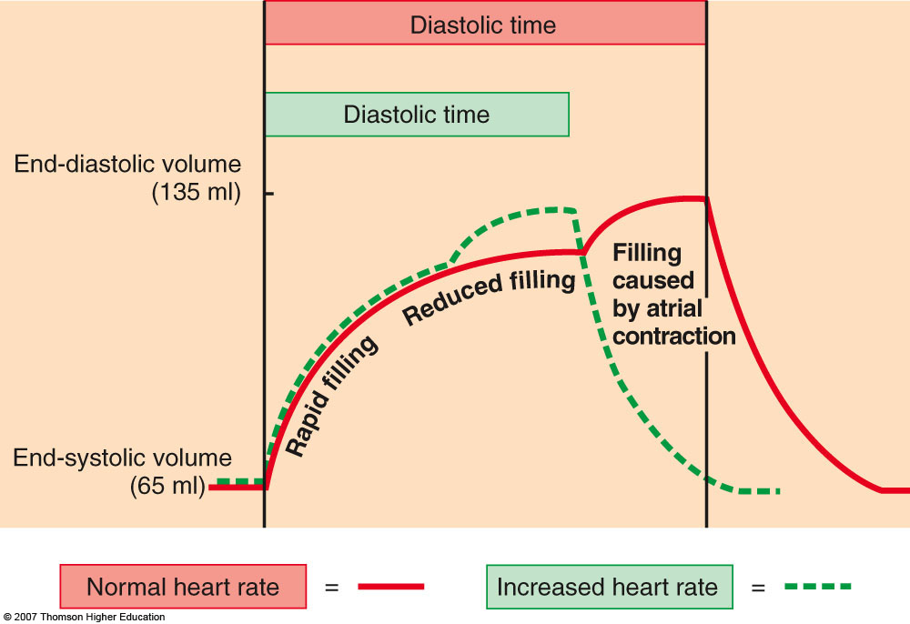
Frank-Starling Law
Slow heartbeat and exercise increase venous return to the heart, increasing SV
Blood loss and extremely rapid heartbeat decrease SV

Slide 83
Extrinsic Factors Influencing SV
Contractility is the increase in contractile strength, independent of stretch and EDV
Increase in contractility comes from
  Increased sympathetic stimuli
  Hormones - epinephrine and thyroxine
  Ca2+ and some drugs
  Intra- and extracellular ion concentrations must be maintained for normal heart function

Slide 84
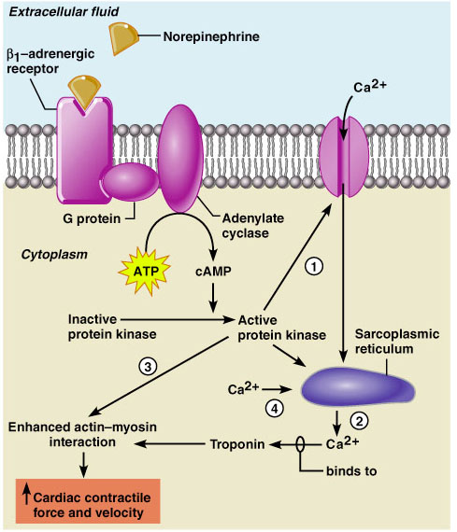
Contractility and Norepinephrine
Sympathetic stimulation releases norepinephrine and initiates a cAMP second-messenger system
Figure 18.22

Slide 85
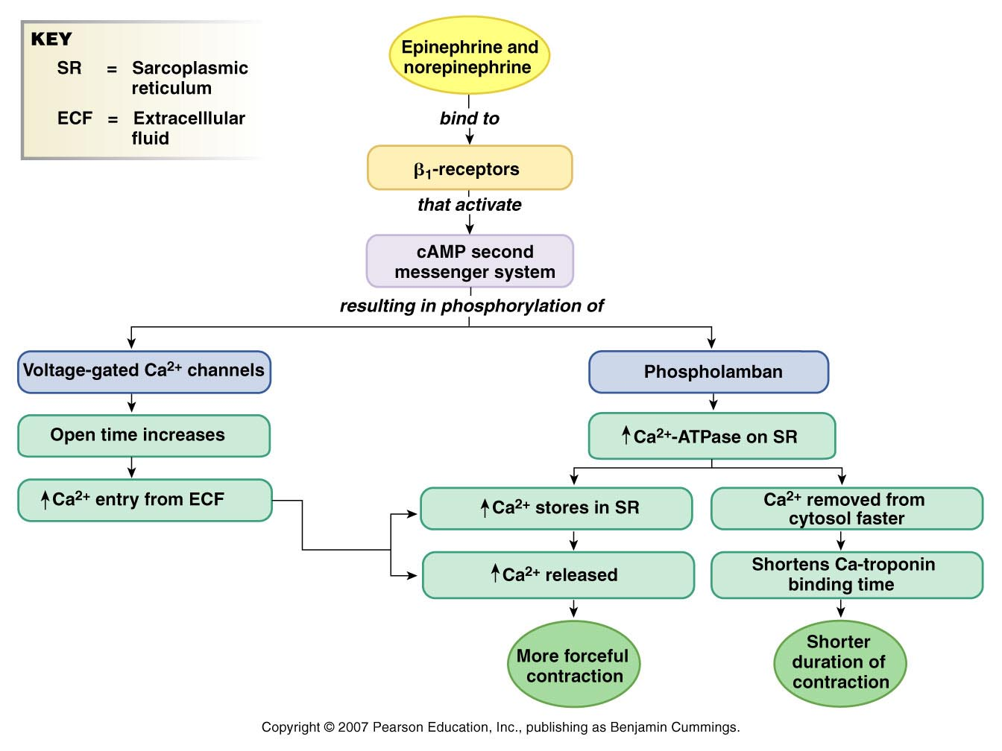
Modulation of Cardiac Contractions
Figure 14-30

Slide 86
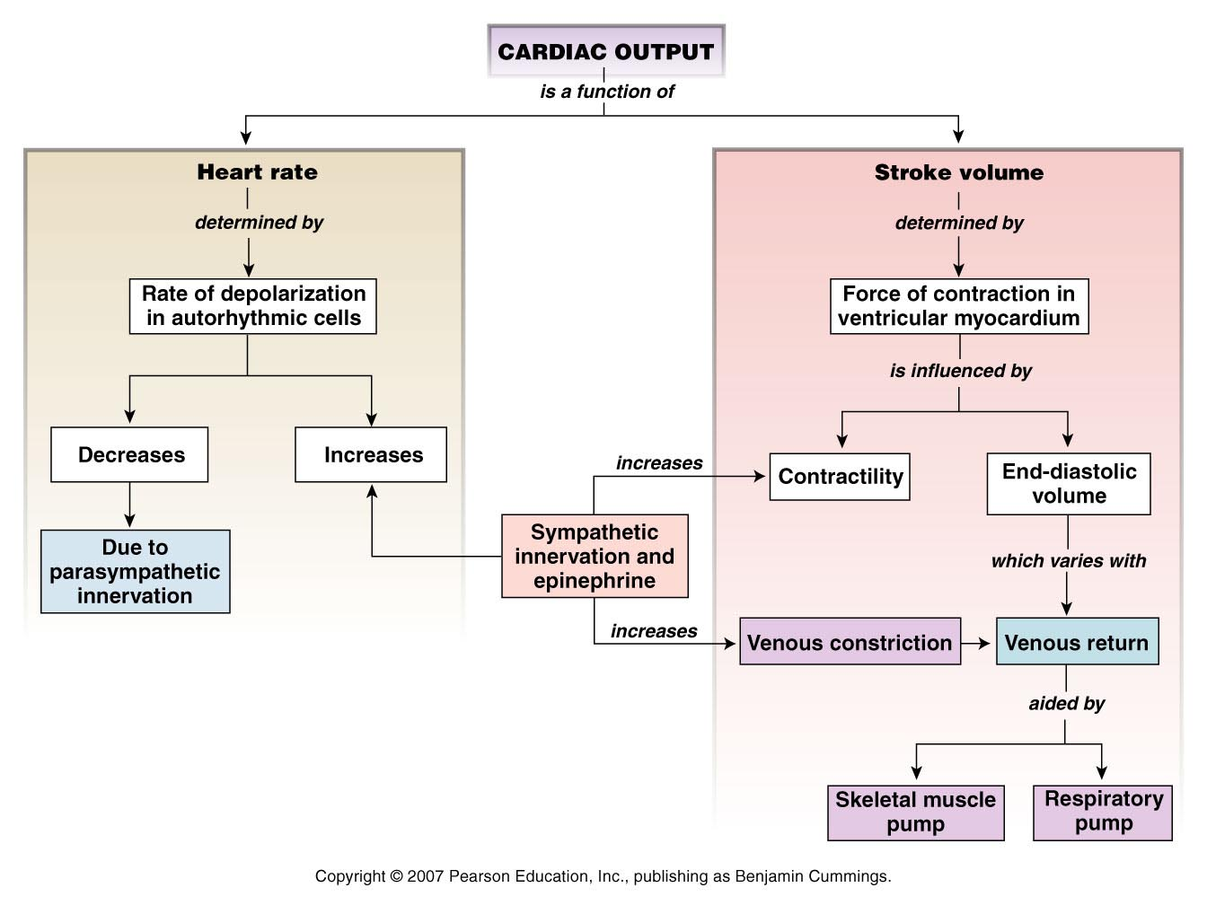
Factors that Affect Cardiac Output
Figure 14-31

Slide 87
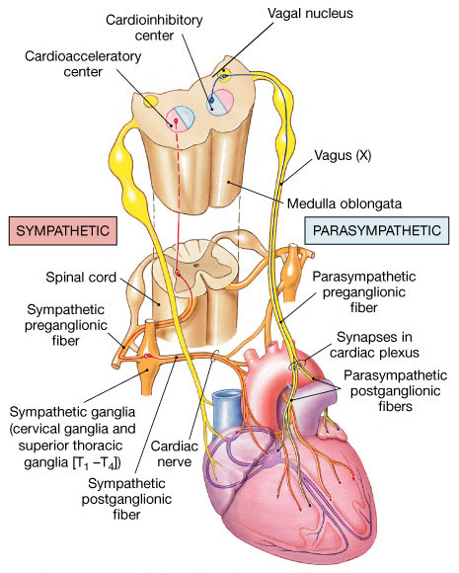
Medulla Oblongata Centers Affect Autonomic Innervation
Cardio-acceleratory center activates sympathetic neurons
Cardio-inhibitory center controls parasympathetic neurons
Receives input from higher centers, monitoring blood pressure and dissolved gas concentrations

Slide 88
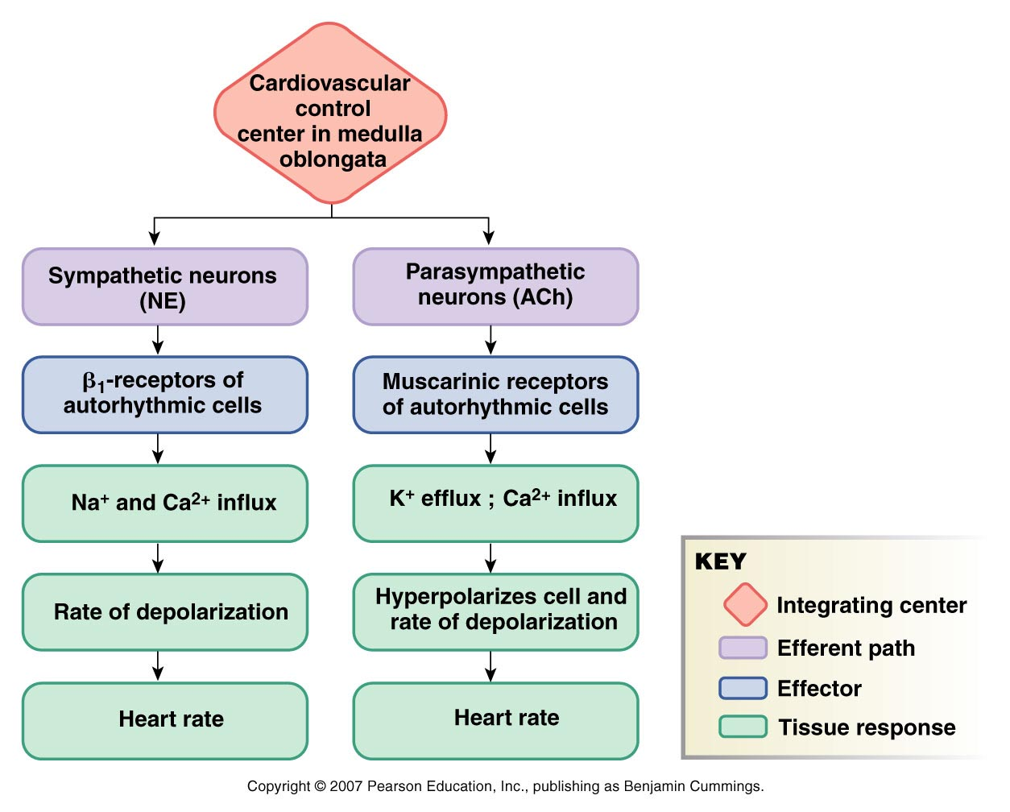
Reflex Control of Heart Rate
Figure 14-27

Slide 89
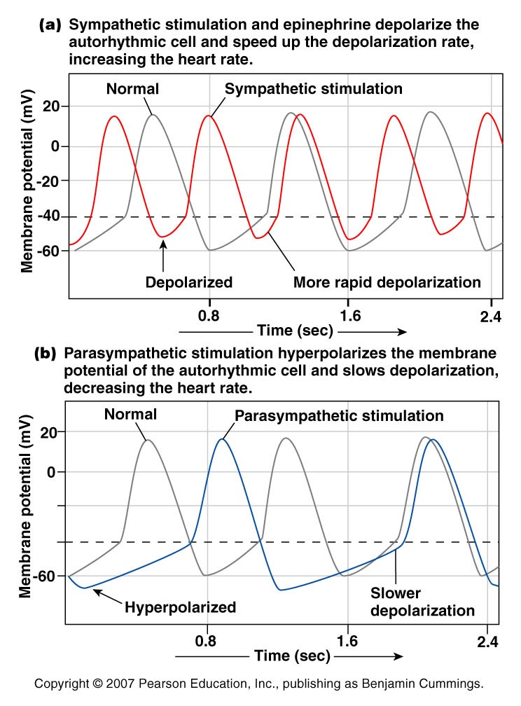
Modulation of Heart Rate by the Nervous System
Figure 14-16

Slide 90
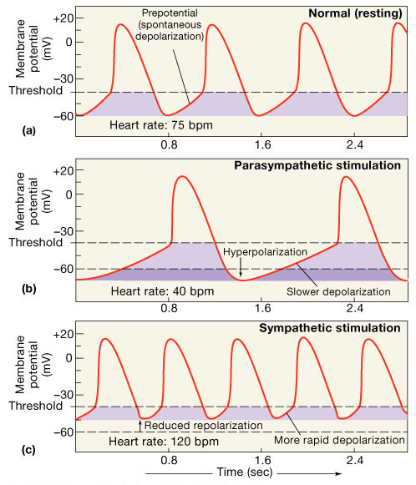
Establishing Normal Heart Rate
SA node establishes baseline
Modified by ANS
  Sympathetic stimulation
    Supplied by cardiac nerves
    Epinephrine and norepinephrine released
    Positive inotropic effect
    Increases heart rate (chronotropic) and force of contraction (inotropic)
  Parasympathetic stimulation - Dominates
    Supplied by vagus nerve
    Acetylcholine secreted
    Negative inotropic and chronotropic effect

Slide 91
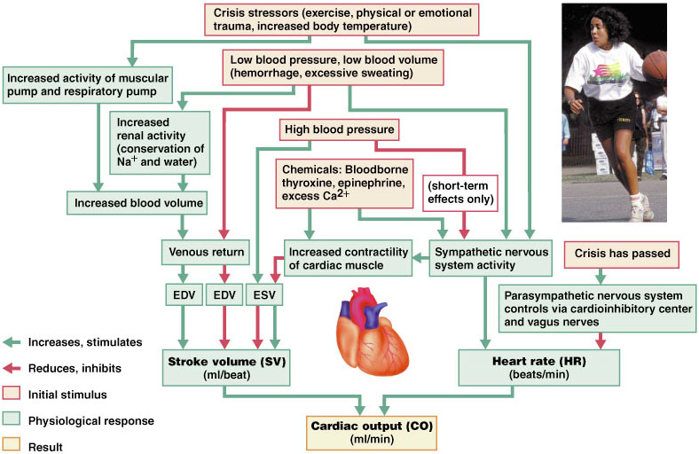
Regulation of Cardiac Output
Figure 18.23

Slide 92
Congestive Heart Failure (CHF)
Congestive heart failure (CHF) is caused by:
  Coronary atherosclerosis
  Persistent high blood pressure
  Multiple myocardial infarcts
  Dilated cardiomyopathy (DCM)

Slide 93
Intrinsic Cardiac Conduction System
Approximately 1% of cardiac muscle cells are autorhythmic rather than contractile
70-80/min
40-60/min
Heart block
Ectopic
focus
20-40/min
Notes:
Approximately 1% of the cardiac muscle cells are autorhythmic rather than contractile. * These specialized cardiac cells don’t contract but are specialized to initiate and conduct impulses through the heart to coordinate its activity. * These constitute the intrinsic cardiac conduction system. These autorhythmic cells constitute the following components of the intrinsic conduction system:
* the sinoatrial (SA) node, just inferior to the entrance of the superior vena cava into the right atrium,
* the atrioventricular node (AV) node, located just above the tricuspid valve in the lower part of the right atrium,
* the atrioventricular bundle (bundle of HIS), located in the lower part of the interatrial septum and which extends into the interventricular septum where it splits into right and left bundle branches * which continue toward the apex of the heart and the purkinje fibers * which branch off of the bundle branches to complete the pathway into the apex of the heart and turn upward to carry conduction impulses to the papillary muscles and the rest of the myocardium.
Although all of these are autorhythmic, they have different rates of depolarization. * For instance, the SA node * depolarizes at a rate of 75/min. * The AV node depolarizes at a rate of 40 to 60 beats per minute, * while the rest have an intrinsic rate of around 30 depolarizations/ minute. * Because the SA node has the fastest rate, it serves as the pacemaker for the heart. *

