Slide 1
Translation & Language Varieties
МІНІСТЕРСТВО ОСВІТИ І НАУКИ УКРАЇНИ
ДВНЗ «УЖГОРОДСЬКИЙ НАЦІОНАЛЬНИЙ УНІВЕРСИТЕТ»
ФАКУЛЬТЕТ МІЖНАРОДНИХ ВІДНОСИН
КАФЕДРА ТЕОРІЇ ТА ПРАКТИКИ ПЕРЕКЛАДУ
Старший викладач
Калинич І.Й.
Ужгород – 2018

Slide 2
The concept of language as a whole unit is theoretically lacking in accuracy, and pragmatically rather useless.
Thus, a need arises to distinguish sub-languages or varieties within the total range of one language. The concept of language varieties can be of great help in translating.
These varieties, or sub-languages, may be classified in more than one way. The suggested classes include idiolects, dialects, registers, styles, etc., as varieties of any living language.

Slide 3
Another view suggests dialects, idiolects, and sociolects (P.Coder, 1973).
R.Quirk (1972) recognizes dialects as varieties distinguished according to geographical dispersion, and standard and substandard English as varieties within different ranges of education and social position.
Language registers are recognized as varieties classified according to subject matter. We also acknowledge varieties distinguished according to attitude, which are called styles.

Slide 4
Standard English is often referred to as "the standard language". However, Standard English is not "a language", but only one variety of English among many. SE may be the most important variety of English, in all sorts of ways: it is the variety normally used in writing; it is associated with the education system in all the English-speaking countries of the world, and is therefore spoken by "educated people"; and it is the variety taught to non-native learners. But most native speakers of English in the world are native speakers of some nonstandard variety of the language. SE is thus not the English language but simply one variety of it.

Slide 5
In Britain, there is a high status accent known as Received Pronunciation (RP) which is
not associated with any geographical area
a purely social accent associated with speakers in all parts of the country, or at least in England
whose speakers are from upper-class and upper-middle-class backgrounds.
While all RP speakers also speak Standard English, the reverse is not the case. Perhaps 9%-12% of the British speak Standard English with some form of regional accent.
Standard English speakers can be found in all English-speaking countries, and they speak this variety with different non-RP accents depending on where they come from.

Slide 6
If Standard English is not a language or an accent, then it is a dialect. However, unlike other dialects, Standard English is no longer a geographical variety, even if we can tell that its origins were originally in the southeast of England.
In the English-speaking world as a whole, it comes in a number of different forms, so that we can talk of Scottish Standard English, or American Standard English, or English Standard English. Thus, Standard English is a social variety.

Slide 7
The Spread of English Around the World -- The New Englishes
The theories of “International English” that were spread until recently, did not recognize the role of the non-native varieties of English as codes of communication. They also ignored the process of adaptation which the English language has undergone in the Third World countries. They state that English is taught there as a vehicle to introduce British or American culture, whereas in fact English is used to teach and maintain the indigenous patterns of life and culture, and to maintain a continuity and uniformity in educational, administrative, and legal systems in the Third World countries.

Slide 8
The Spread of English Around the World –
The New Englishes
The newer term ‘World Englishes’ (WE) introduced by Braj Kachru, foregrounds the plurality and diversity among varieties while asserting their equality as versions of ‘English’. The concept of WE highlights the enormous geographical and cultural range of these varieties, as in B. Kachru’s well-known scheme of ‘Inner Circle’, ‘Outer Circle’, and ‘Expanding Circle’, where the term ‘circle’ presents items equidistant from the centre and located on the same plane.

Slide 9
The Spread of English Around the World –
The New Englishes
Here, the Inner Circle refers to the traditional historical and sociolinguistic bases of English in the areas where it is the primary language (native/first language: the UK, Ireland, Canada, the USA, Australia, New Zealand).
The Outer Circle comprises regions colonized by Britain; the spread of English in non-native settings, where the language has become part of the country's chief institutions, and plays an important "second language" role in a multilingual setting (India, Singapore, Malawi, etc.).

Slide 10
The Spread of English Around the World –
The New Englishes
The Expanding Circle involves nations which recognize the importance of English as an international language, but they do not have the history of colonization, nor does English have any special status in their language policy. In these areas, English is primarily a foreign language.

Slide 12
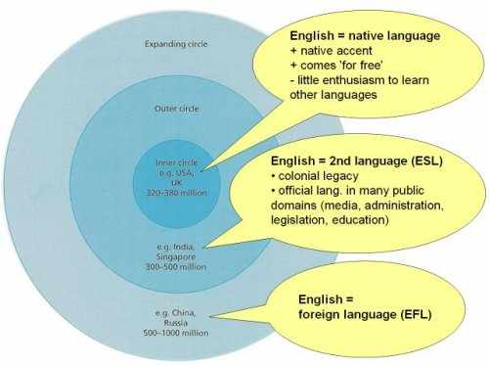

Slide 13
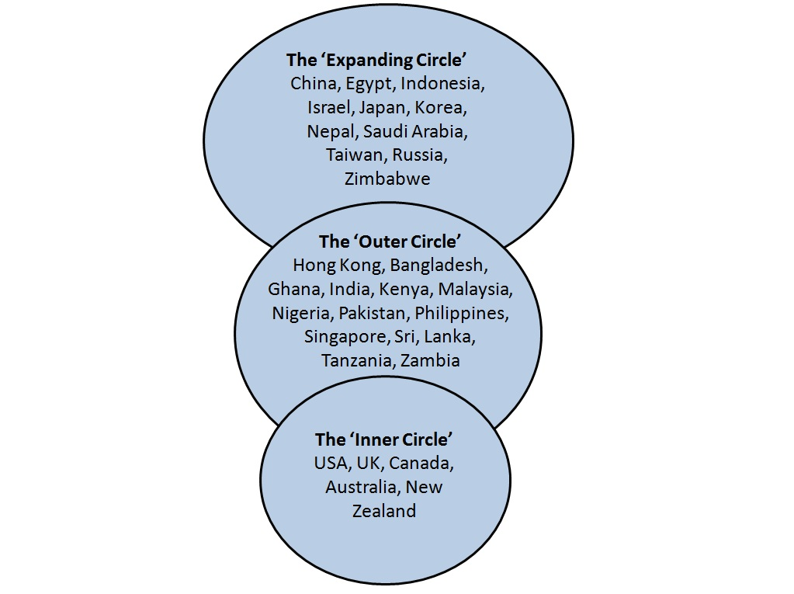

Slide 14
The Spread of English Around the World -- The New Englishes
The term "New Englishes" is used for the varieties which have developed in the Outer Circle, and can also be called "diaspora varieties". They are called "new" because it is only recently that they have been linguistically recognized, although they have a long history in geographical, cultural and linguistic contexts different from the English of the Inner Circle.

Slide 15
Definitions of other kinds of Language Varieties:
Pidgin: A pidgin is a new language which develops in situations where speakers of different languages don't share a common language. The vocabulary of a pidgin comes mainly from one particular language called the lexifier. An early "pre-pidgin" is quite restricted in use and variable in structure. But the later "stable pidgin" develops its own grammatical rules which are quite different from those of the lexifier. Later on, it is learned as a second language and used for communication among people who speak different languages, e.g. Nigerian Pidgin or Guinean Pidgin.

Slide 16
Definitions of other kinds of Language Varieties:
Creole: When children start learning a pidgin as their first language and it becomes the mother tongue of a community, it is called a creole. Like a pidgin, a creole is a distinct language which has taken most of its vocabulary from another language, the lexifier, but has its own unique grammatical rules. Unlike a pidgin, however, a creole is not restricted in use, and performs a full range of functions. Examples are Jamaican Creole and Hawaii Creole English.

Slide 17
Definitions of other kinds of Language Varieties:
Minority dialect: Sometimes members of a particular minority ethnic group have their own variety which they use as a marker of identity, usually along with a standard variety. This is called a minority dialect. Examples are African American Vernacular English in the USA and Aboriginal English in Australia.

Slide 18
Definitions of other kinds of Language Varieties:
Indigenized variety: Indigenized varieties are spoken mainly as second languages in ex-colonies with multilingual populations. The differences from the standard variety may be linked to English proficiency, or may be part of a range of varieties used to express identity. For example, Singaporean English or "Singlish" is a variety very different from Standard English, and there are many other varieties of English used in India and other countries.

